Slide 1
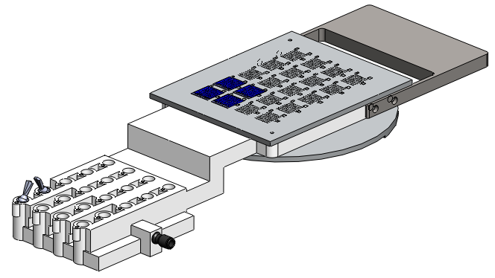
Vacuum chuck for probe station
contacts:
Howard Wieman
hhwieman@lbl.gov
work: 510 495-2473
cell: 631 431-8236
Eric Anderssen
ECAnderssen@lbl.gov
510 495-2821
5/4/12

Slide 2
This vacuum chuck will be used to hold and accurately locate 2 mil thick silicon chips in a probe station. It consists of two aluminum plates bonded to a SLA manufactured vacuum manifold.
This is a request for the machined aluminum part, water jet steel counter weight, and for machining the 3D printer part that we will get from another vendor
The parts are modeled with SolidWorks 2011
Top Assembly: “vc probe assembly u.SLDASM”

Slide 3
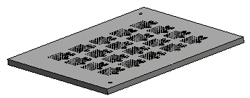
machining tasks
quant. | file | material | image | part description
1 | “vc probe top u.SLDPRT” | mic 6 |  | Vacuum chuck surface with stops for thinned silicon chips
quant. | file | material | image | part description
1 | “vcProbeManifoldV2 u.SLDPRT” configuration: new sla post machine | 3D print, ABS |  | Manifold
1 | “vcCounterWeightV2.SLDPRT” | Steel

Slide 4
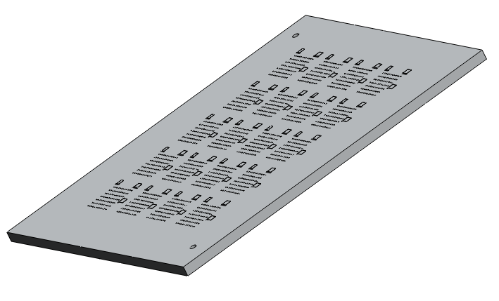
“vc probe top u.SLDPRT”
material:
MIC 6
tolerance:
top and bottom surface flat and parallel to 2 mil
deburr or etch such that silicon chips can slide and pull down on the vacuum surface
Finish 62μin
tolerance:
locating edges for the silicon chips – relative location with respect to each other good to 1 mil

Slide 5
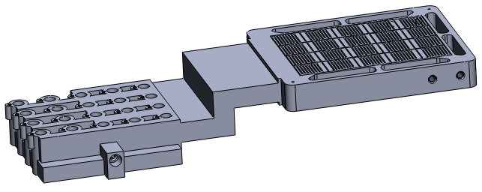
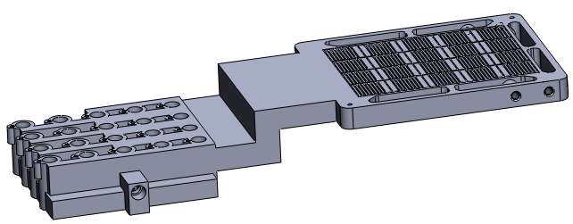
vcProbeManifoldV2 u.SLDPRT
material:
ABS like
configuration: “new SLA”
part as received from SLA house
mill top and bottom surface
configuration: “new SLA post machine”
mill 20 valve pockets
part after machining

Slide 6
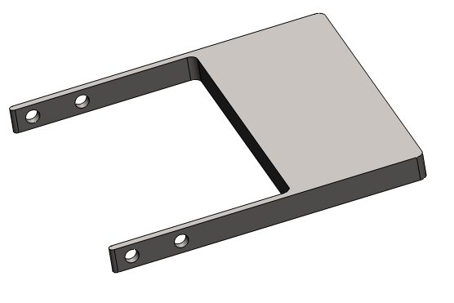
water jet out line
material steel
vcCounterWeightV2.SLDPRT

