Slide 1
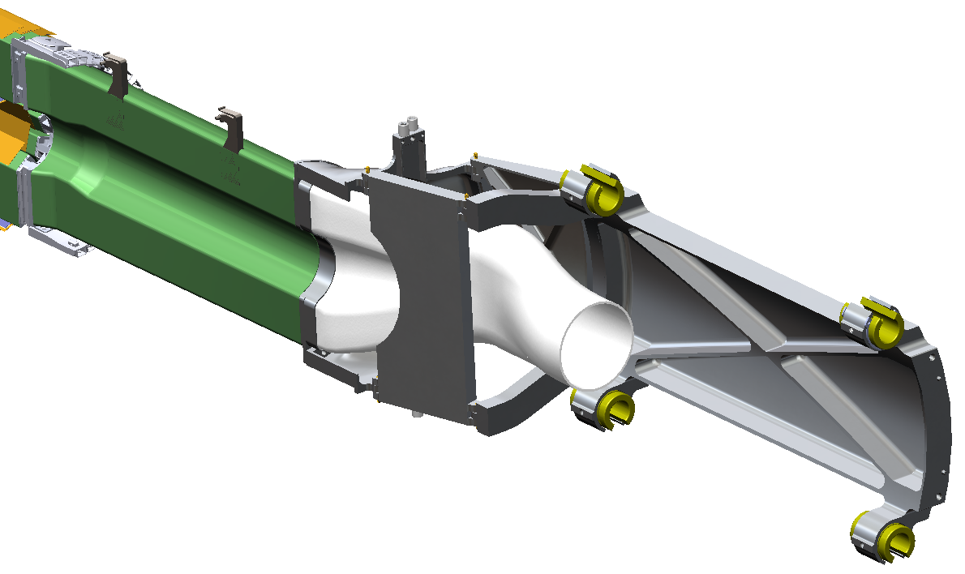
PXL insertion parts
PXLAndDuct_carriagev2.SLDASM
In: http://www-rnc.lbl.gov/~wieman/container_uta_7_8_10.zip
+ additional fixturing assemblies: tt_mandrel_blank.SLDASM, tt_fixture.SLDASM
this document: http://www-rnc.lbl.gov/~wieman/PXL_insertion_system.pptx
2/16/2011

Slide 2
partial parts list for assembly: PXLAndDuct_carriagev2.SLDASM
 | part/file | cnfg | material | source | total # | p. ref | grph
1 | dove plate cyl.SLDPRT |  | 6061 | exist at LBNL | ? | 4
2 | transition_tube_cyl_v3.SLDPRT |  | CF | LBNL | 2 | 5
3 | tt_mandrel.SLDPRT | extended/with trim guides | 6061 | UTA/LBNL prep | 1 each | 6
4 | hinge_D_end_v2.SLDPRT |  | 6061 | UTA | 2 | 7
5 | D_termination_extend_to_hinge_v2.SLDPRT |  | 6061 | LBNL | 2 | 9
6 | hinge_bushing.SLDPRT |  | PEEK BRASS | UTA LBNL | 8 | 10
7 | h_cam_sleeve.SLDPRT |  | PEEK | UTA | 8 | 11
8 | hinge_leaf_out_blistered_v2.SLDPRT |  | 6061 | LBNL | 1 ev 2 | 12
9 | hinge_leaf_in.SLDPRT |  | 6061 | UTA | 1 ev 2 | 13
10 | hinge_east_release_blk.SLDPRT |  | 6061 | UTA | 1 | 15
11 | carriage_base.SLDPRT |  | 6061 | LBNL | 1 ev 2 | 16
12 | hinge_pin_rod_MC_1606T21.SLDPRT | hinge pin | MC 1606T21 prec. al rod | UTA | 4 ev 8 | 17
13 | Retain_ext_modified_MC98541A139.SLDPRT |  |  | MC | *
14 | set_screw_dog_MC92505A191.SLDPRT |  |  | MC | *
* part count included in job: Rail_test_system.pptx

Slide 3
partial parts list for assembly: PXLAndDuct_carriagev2.SLDASM
 | part/file | cnfg | material | source | total # | p. ref | grph
15 | linear bearing liner Pacific Bearing FMN20 |  |  | PB | *
15 | Linear_bearing_liner_FMN20_pacific_bearing.SLDPRT |  | PEEK ** | UA/LBNL | 8
16 | 2-56 x 3/16 in |  | aluminum | FE | 4
17 | duct_D_to_circle_v2.SLDPRT |  | SLS Nylon 11 | FC | 2 | 18
18 | tt_fixture_base.SLDPRT |  | 3/4in MIC6 | UTA | 1 | 19,20
19 | tt_fixture_E.SLDPRT |  | 2 in MIC6 | UTA | 1 | 19,21
20 | tt_fixture_W.SLDPRT |  | 2 in MIC6 | UTA | 1 | 19,22
 | Following new as of Feb 2011
21 | release_hinge.SLDPRT |  | al |  | 1 | 24
22 | release_base.SLDPRT |  | al |  | 1 | 24
23 | bellows_piston_asm.SLDASM |  | brass &cu | servometer | 10 | 24
24 | release_post.SLDPRT | cone | al |  | 2 | 25
25 | release_post | flat | al |  | 2 | 25
26 | Legris 1/8 tube 1/16 NPT |  |  |  | 4
* part count included in job: Rail_test_system.pptx
** eventually fabricate this model in PEEK

Slide 4
partial parts list for assembly: PXLAndDuct_carriagev2.SLDASM
 | part/file | cnfg | material | source | total # | p. ref | grph
27 | 10-24 x .5 aluminum cap screws |  |  | FE | 20
28 | 8-32 aluminum locking |  |  | FE | 20
* part count included in job: Rail_test_system.pptx
** eventually fabricate this model in PEEK

Slide 5
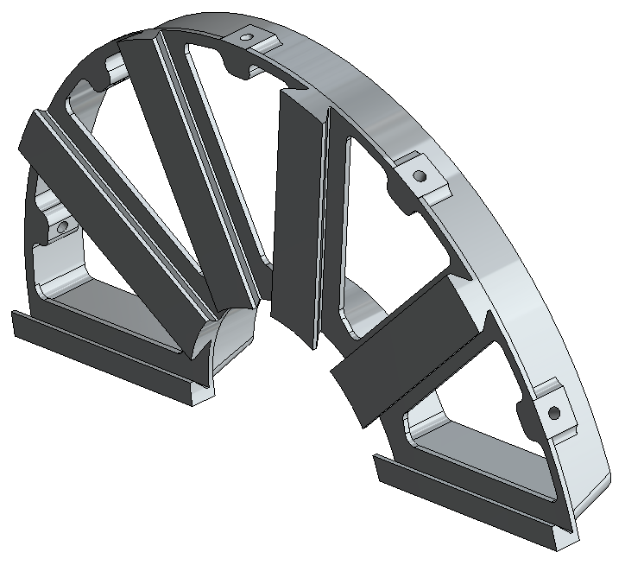
this already built, check if need more and check why hole tool was not used to specify the threaded hole.
dove plate cyl.SLDPRT

Slide 6
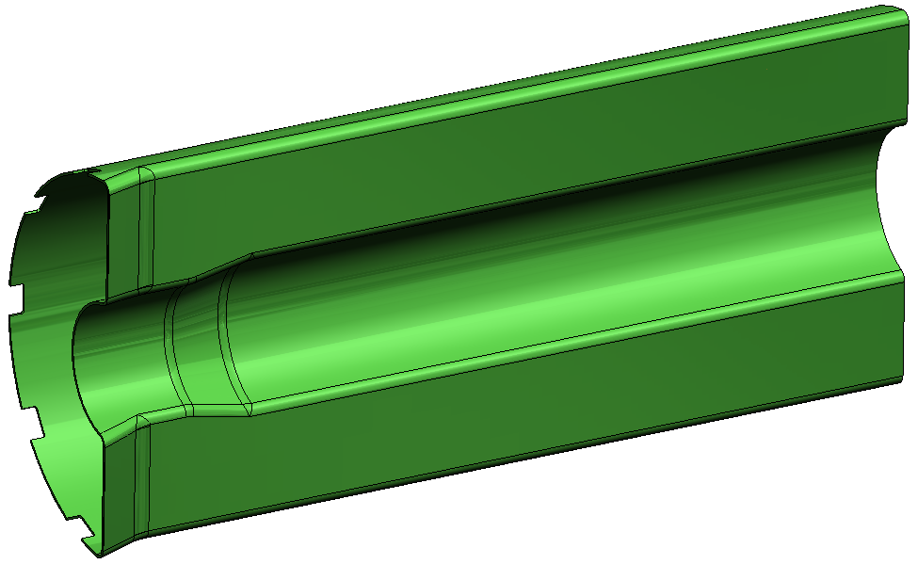
transition_tube_cyl_v3.SLDPRT

Slide 7
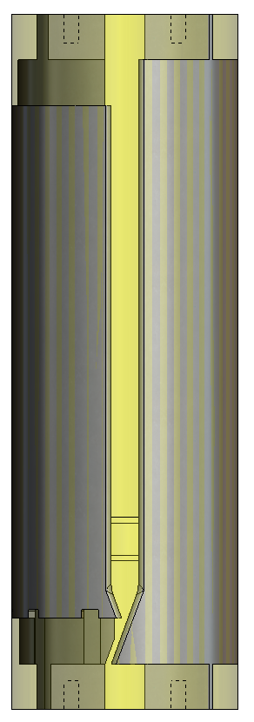
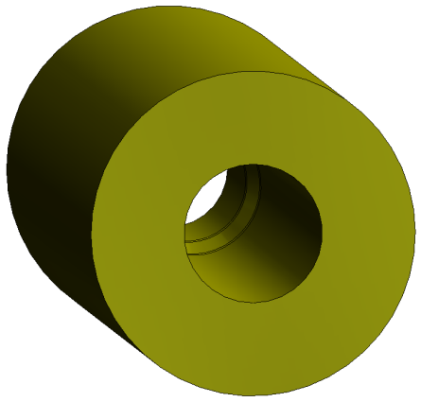
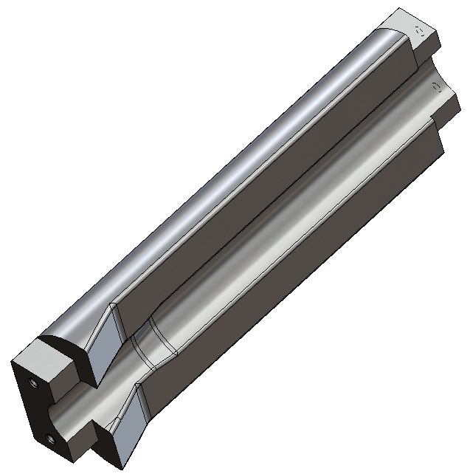
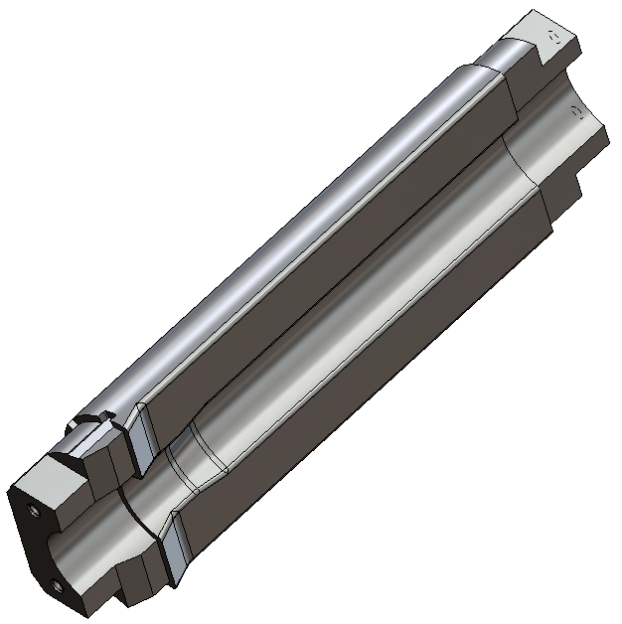
tt_mandrel_blank.SLDASM
tt_mandrel_blank.SLDPRT
suggest forming from single turned piece
64 millionth of inch surface for carbon mold
tt_mandrel.SLDPRT (extended)
tt_mandrel.SLDPRT (with trim guides)

Slide 8
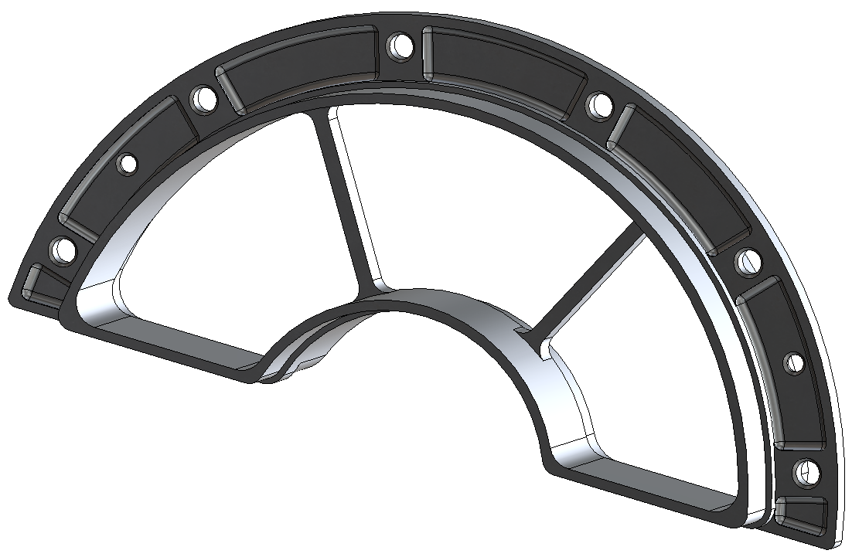
tolerance inner surface
±0.0500 mm (controls glue bond
thickness to plastic air duct)
tolerance outer surface
± 0.050 mm ( controls glue bond thickness to D tube)
RFQ for 8”
round to turn for making 2
pin position tolerance
± 0.25 mm
hole diameter tolerance
+0.1 -0 mm
mm (slip fit 1/8 in nubben)
file | config | material | quant. | image
hinge_D_end_v2.SLDPRT |  | 6061 | 2

Slide 9
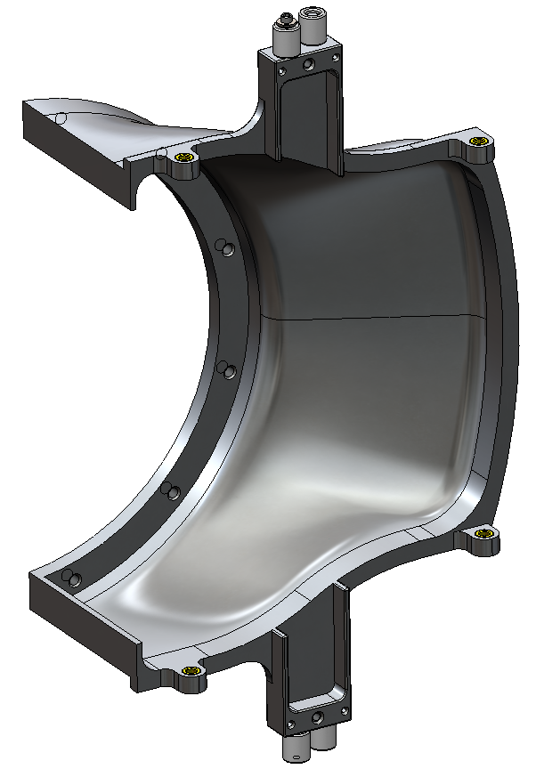
2-56 x 3/16 in aluminum
and aluminum washer
1 of 2
hinge_bushing.SLDPRT 1 of 4
D_termination_extend_to_hinge_v2.SLDPRT
h_cam_sleeve.SLDPRT 1 of 4
HDT.SLDASM

Slide 10
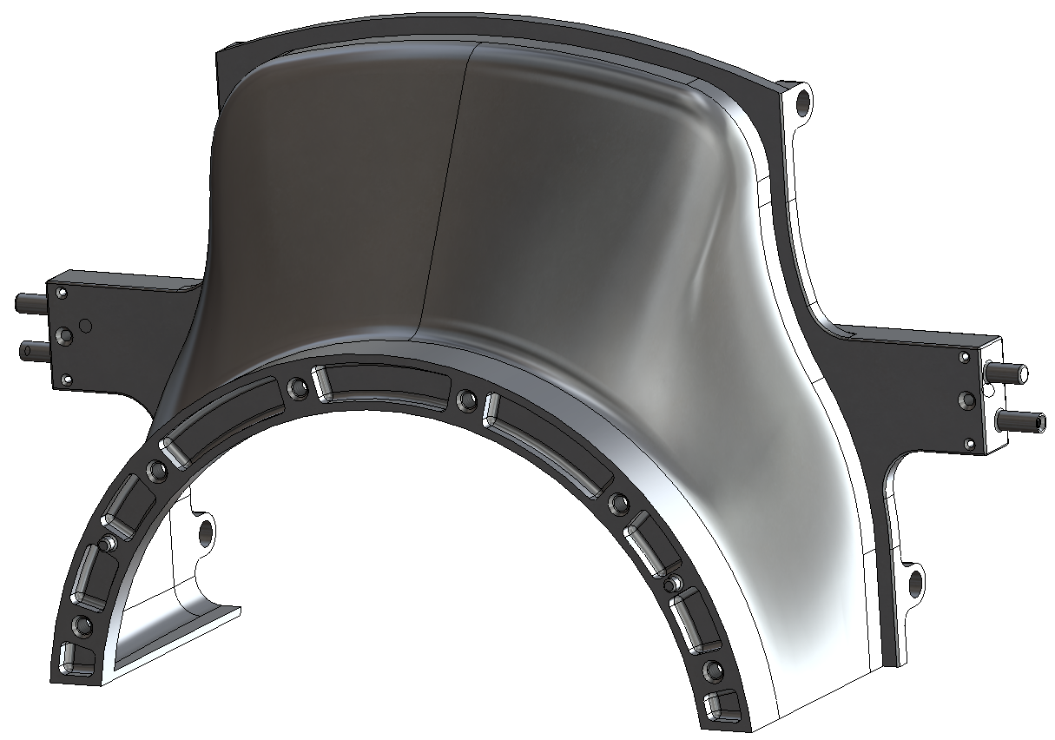
hinge pivot holes (total of 4)
position tolerance relative to each other and relative to mount plane ±0.075 mm
diameter tolerance
+.005 - .00 mm (press fit for peek BRASS bushings)
diameter tolerance
+0 – 0.1 mm
slip fit for peek bushings
DO NOT USE PEEK BUSHINGS. USE BRASS.
D_termination_extend_to_hinge_v2.SLDPRT

Slide 11
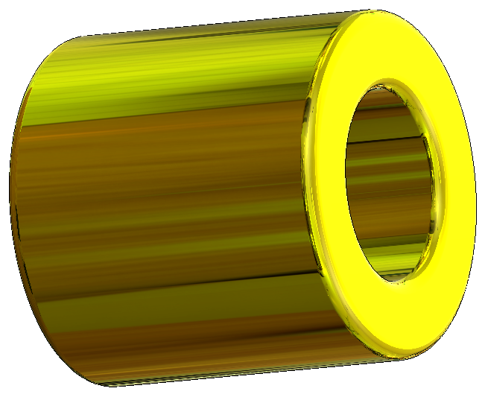
outside diameter tolerance:
+.010 - .0025 mm
press fit into hinge
uses basic hole tolerancing
see design journal for this part
and simulation of
this part
inside diameter tolerance:
+0.025 - .00 mm
DO NOT USE PEEK.
USE BRASS
hinge_bushing.SLDPRT

Slide 12
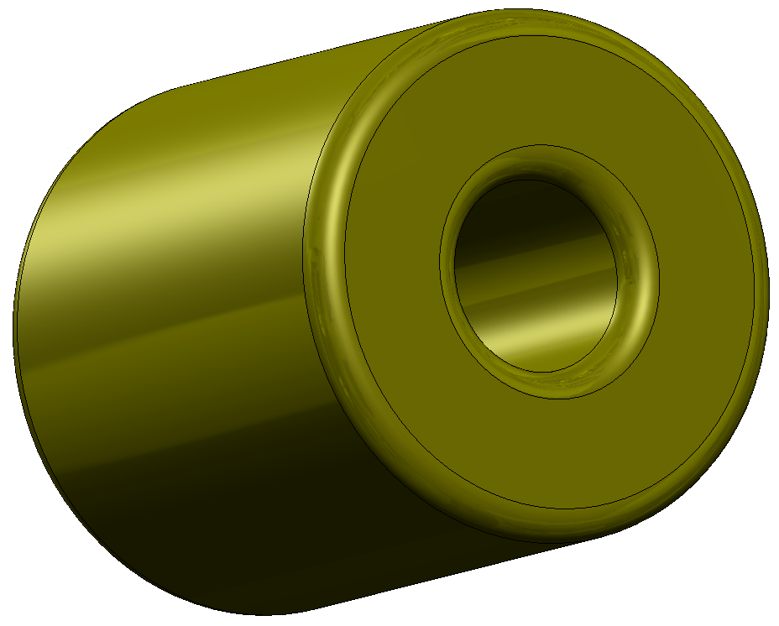
inside diameter tolerance:
+.10 - 0 mm for slip fit
h_cam_sleeve.SLDPRT

Slide 13
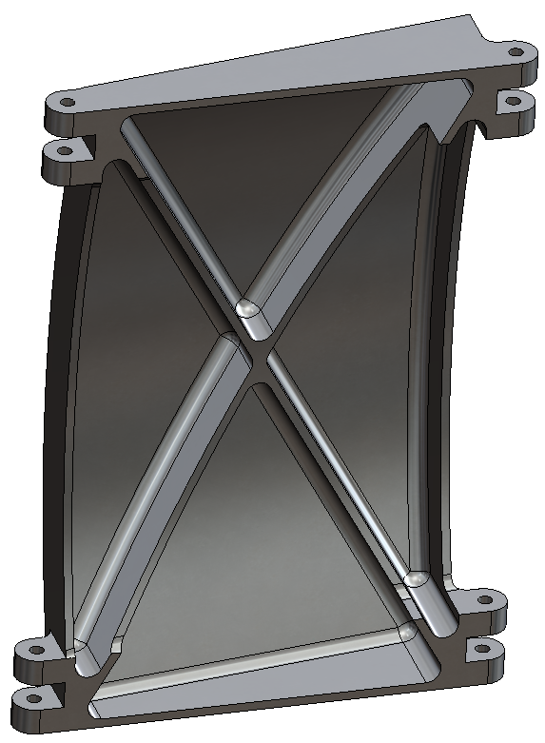
drill hole #31
later during assembly will ream to get clearance on top and interference on bottom
see:
hinge_leaf_out_blistered.SLDPRT (assembly )for reaming dimensions
hole center tolerance
0.075 mm
set by hinge run out
hinge_leaf_out_blistered_v2.SLDPRT

Slide 14
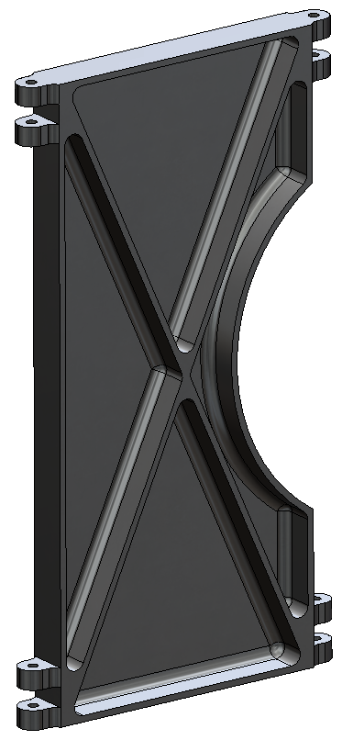
1 0f 4
drill hole #31
later during assembly will ream to get clearance on top and interference on bottom
see:
hinge_leaf_in.SLDPRT (assembly )for reaming dimensions
hole center tolerance
0.075 mm
set by hinge run out
hinge_leaf_in.SLDPRT (machine)

Slide 15
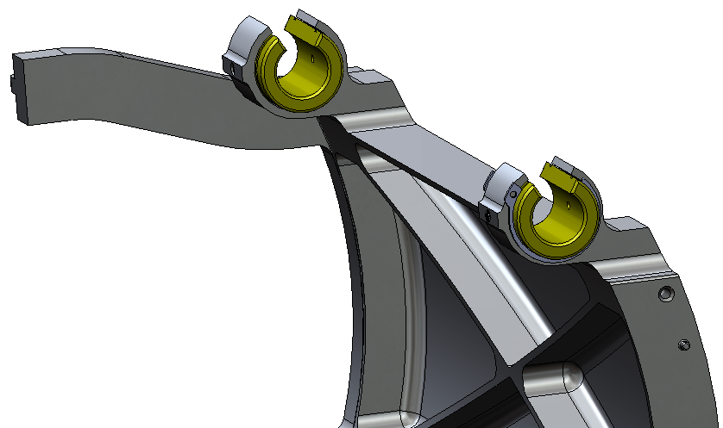
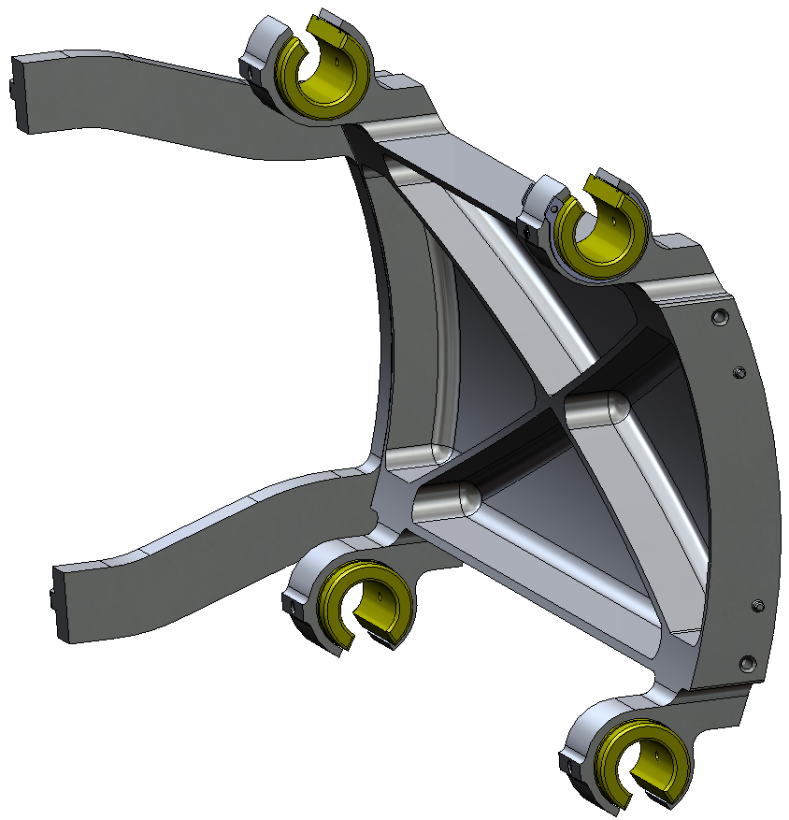
Retain_ext_modified_MC98541A139.SLDPRT
1 of 8
for final replace with non magnetic
hot glue ends of snap ring to bushing to keep from rotating
set_screw_dog_MC92505A191.SLDPRT
1 of 4
for final replace with non magnetic
hinge_east_release_blk.SLDPRT
Linear_bearing_liner_FMN20_pacific_bearing.SLDPRT
for testing use commercial part, replace later with fabricated PEEK part
carriage_base.SLDPRT
carriage_v2.SLDASM (rail test mode)

Slide 16
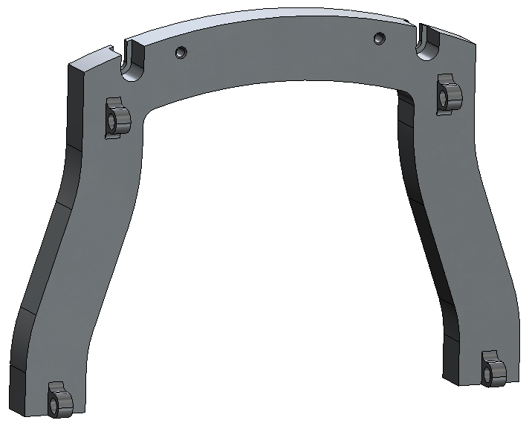
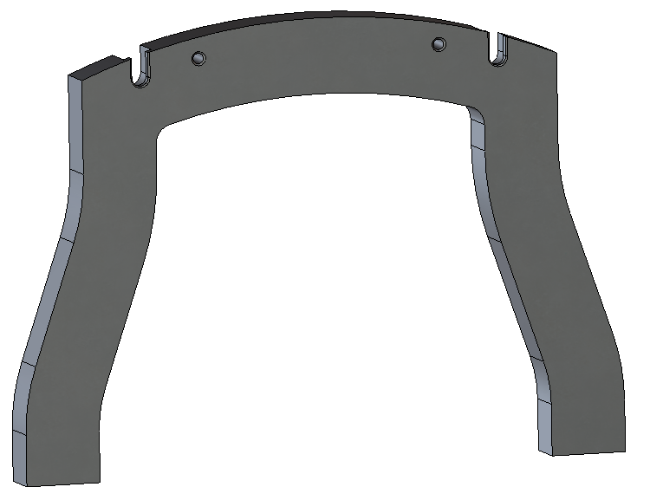
hinge pivot holes (total of 4)
position tolerance relative to each other and relative to mount plane ±0.075 mm
diameter tolerance
+.005 - .00 mm (press fit for peek BRASS bushings)
DO NOT USE PEEK BUSHINGS. USE BRASS.
temporary part used for testing only
hinge_east_release_blk.SLDPRT

Slide 17
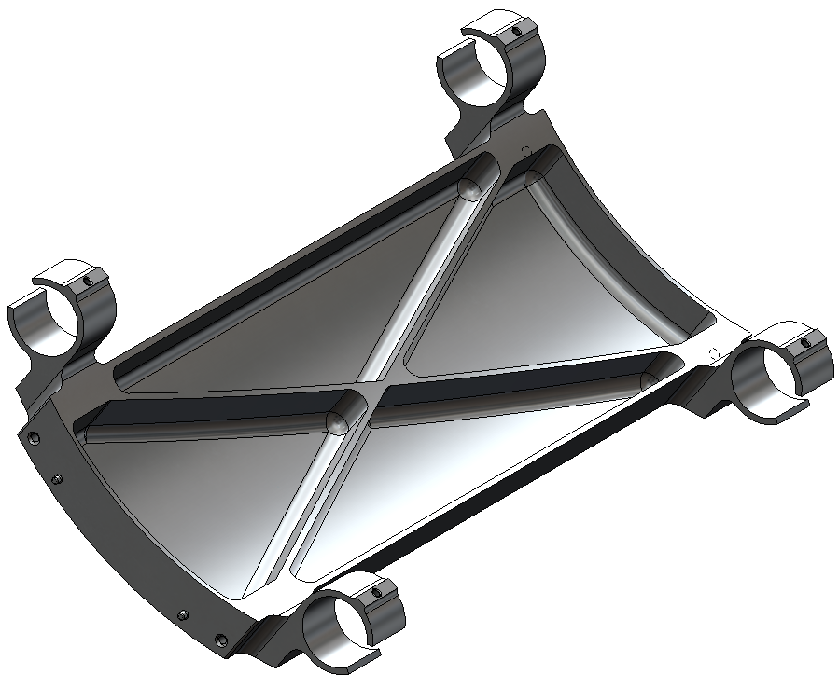
carriage_base.SLDPRT

Slide 18
5-40 thread
5 mm
make from precision
aluminum rod
hinge_pin_rod_MC_1606T21.SLDPRT

Slide 19
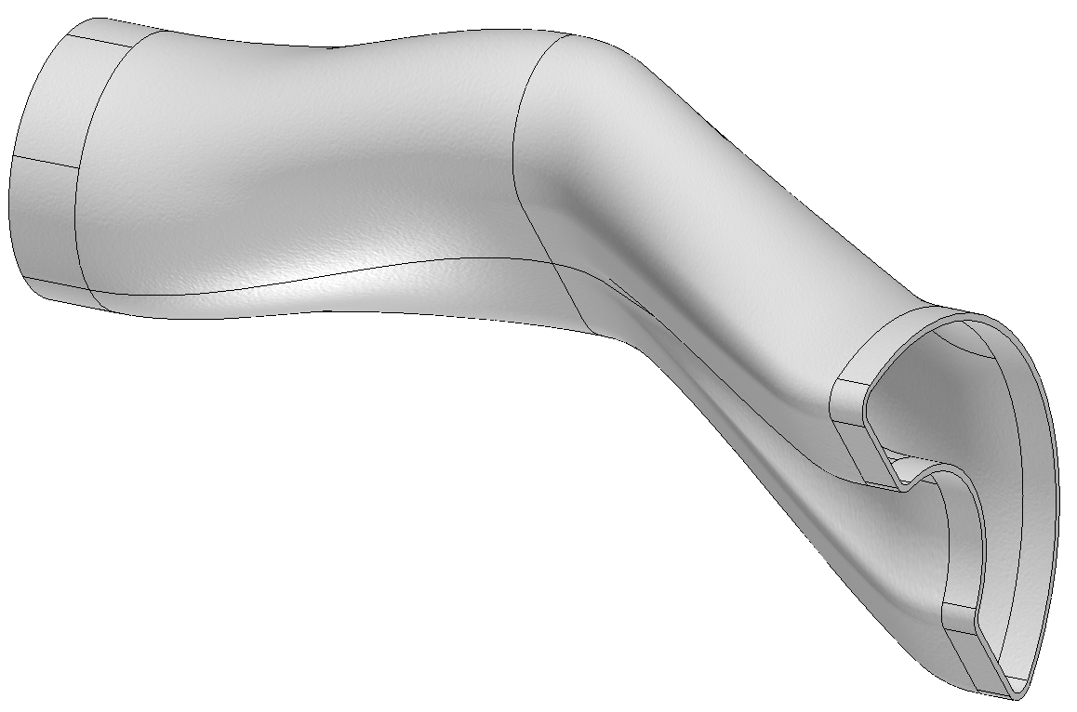
duct_D_to_circle_v2.SLDPRT

Slide 20
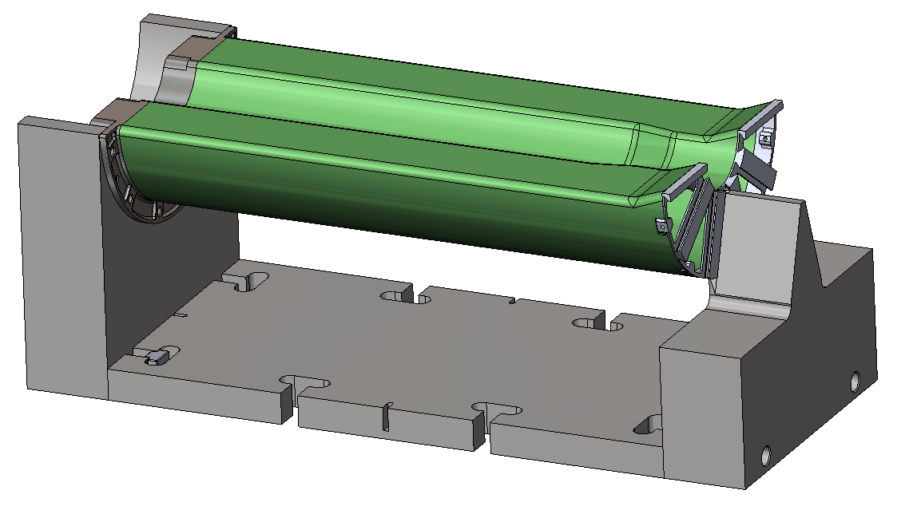
tee_nut_custom_half_in_slot.SLDPRT
see Rail_test_system.pptx
tt_fixture.SLDASM

Slide 21
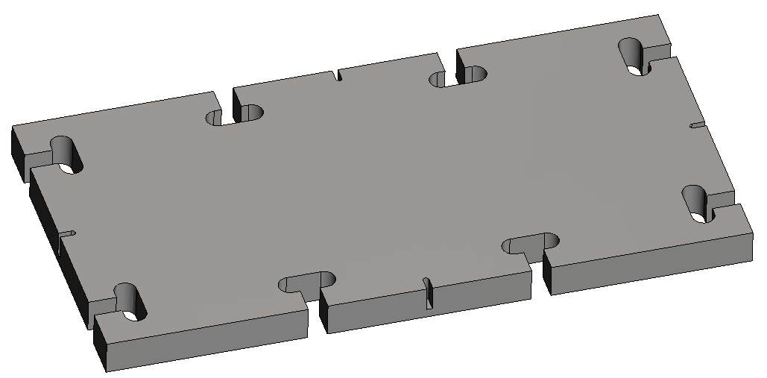
tt_fixture_base.SLDPRT

Slide 22
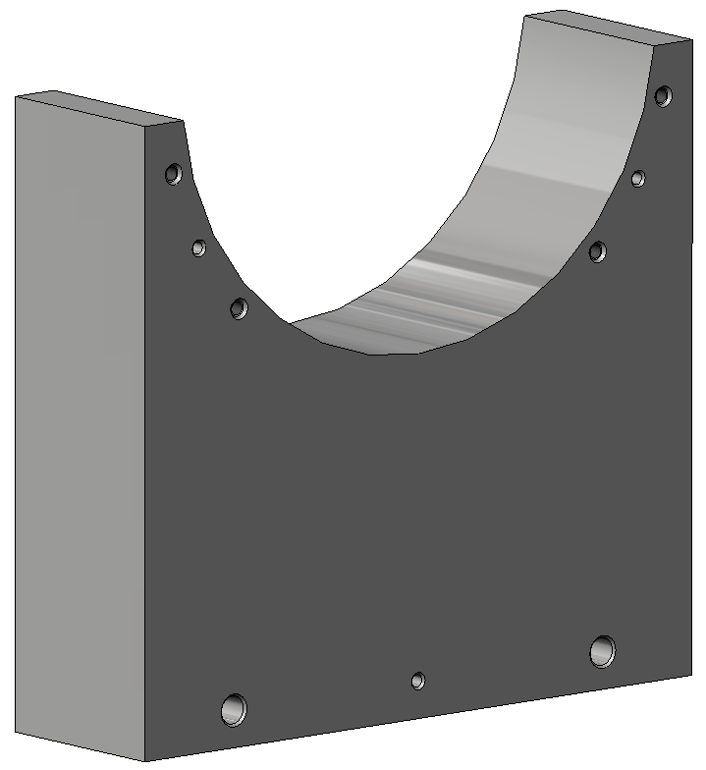
press fit dowel pin 0.125 X .375 in, MC 98381A470
tt_fixture_E.SLDPRT

Slide 23
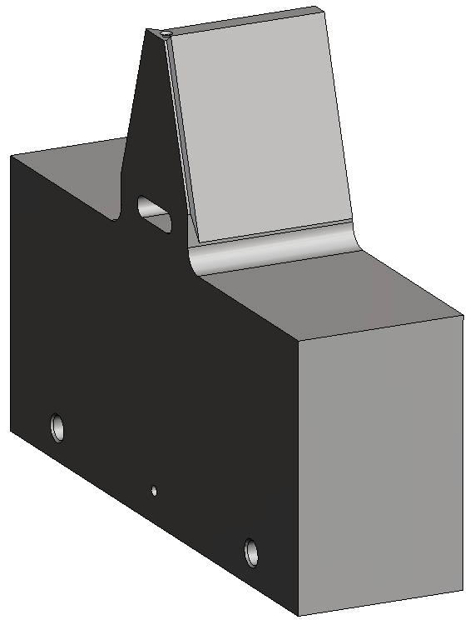
press fit dowel pin 0.125 X .375 in, MC 98381A470
tt_fixture_W.SLDPRT

Slide 24
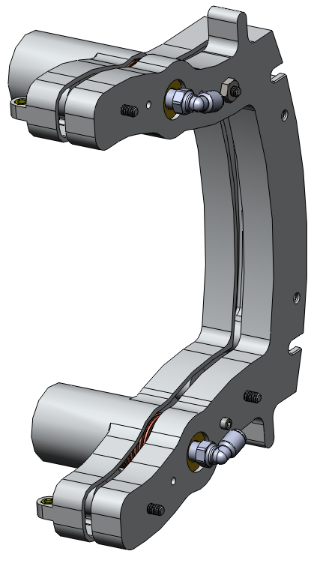
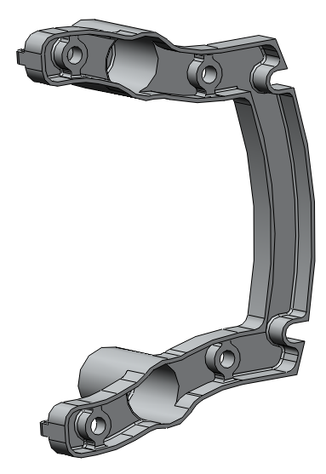
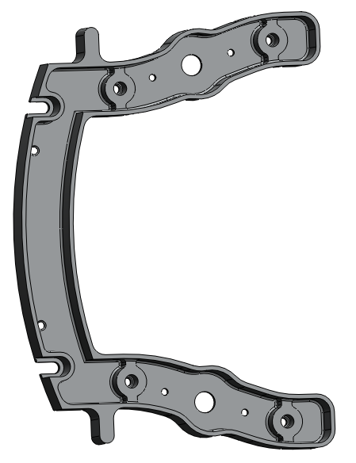
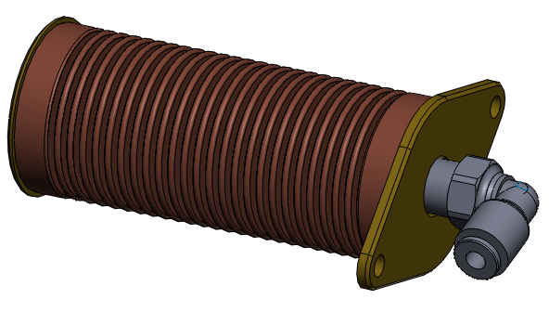
release_hinge.SLDPRT
release_base.SLDPRT
release.SLDASM
bellows_piston_asm_v3.SLDASM

Slide 25
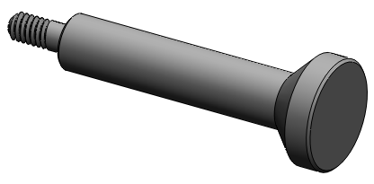
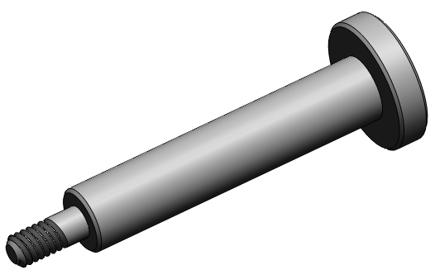
release_cone.SLDPRT
congfiguration: cone
8-32 threads
release_cone.SLDPRT
congfiguration: flat

Slide 26
References:
MC http://www.mcmaster.com/
FE http://www.fastener-express.com/
PB http://www.pacific-bearing.com/
FC http://www.forecast3d.com/

