Slide 1
PXL Machined Parts Order
UTA batch 2

Slide 2
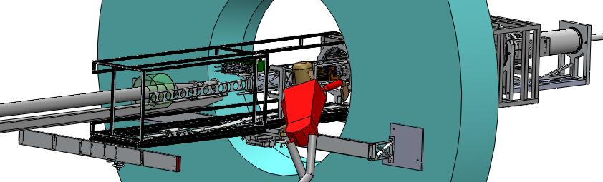
Models for parts and assemblies shown can be found in:
http://www-rnc.lbl.gov/~wieman/container_UTA_5_25_2011.zip
updated: 3 June 2011
For now the models detailed here and in UTA batch 2.xlsx are for reference only.
Will release for fabrication after models have been reviewed.
Unless otherwise specified material is aluminum and tolerances are
± 0.010 inch

Slide 3
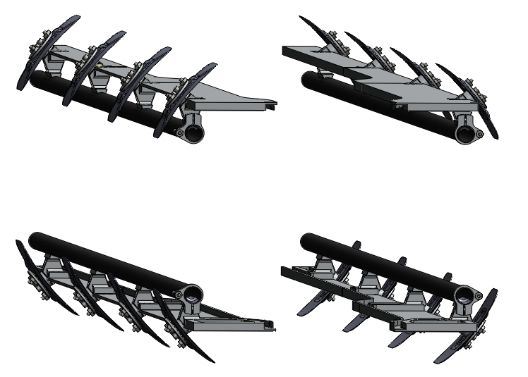
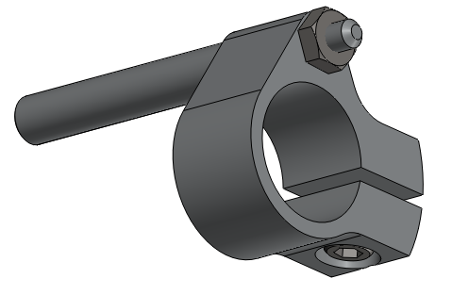
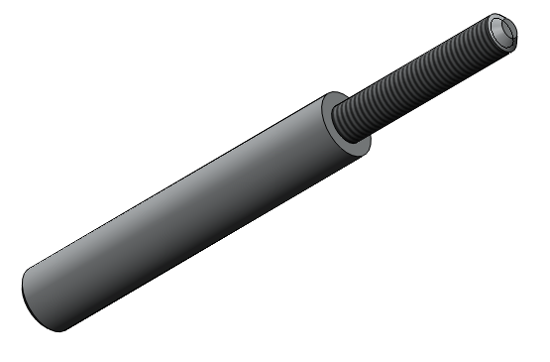
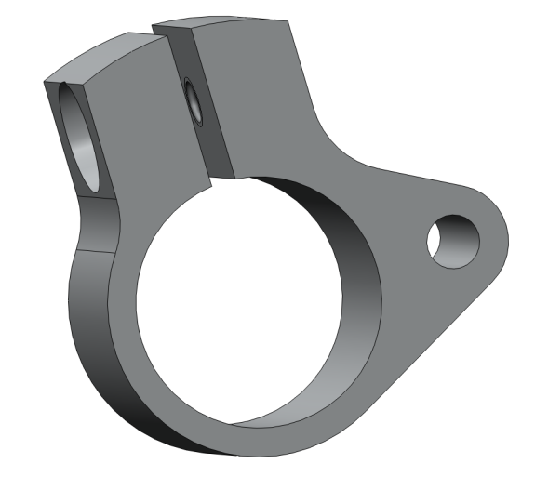
rc_carriage_stop.SLDASM
PIT_rail_20mm_assembly_no_fix.SLDASM
1st ream to 20 mm and then cut slot 2nd
stop_post.SLDPRT
stop_clamp.SLDPRT

Slide 4
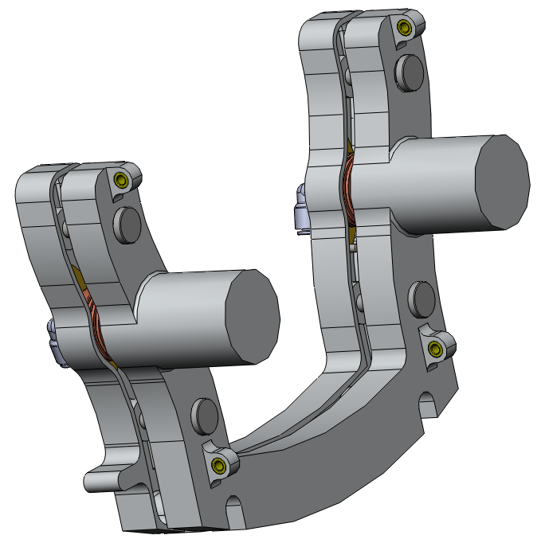
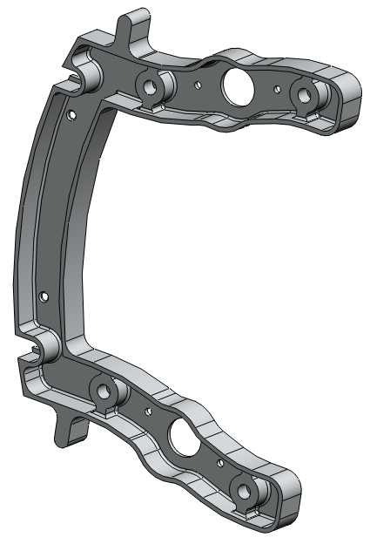
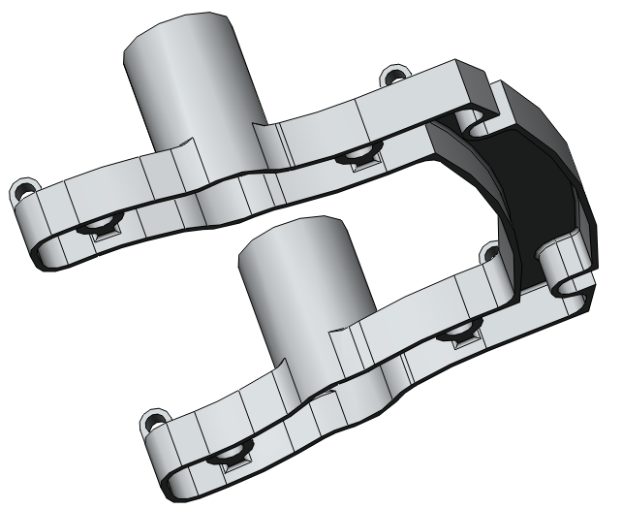
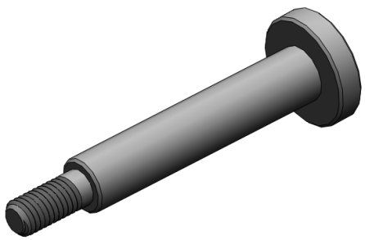
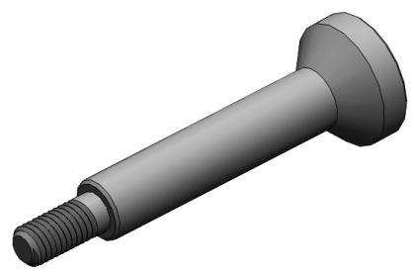
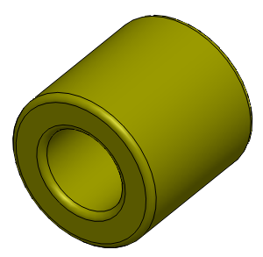
release.SLDASM
release_base.SLDPRT
release_hinge.SLDPRT
release_post.SLDPRT (flat)
release_post.SLDPRT (cone)
hinge_bushing.SLDPRT

Slide 5
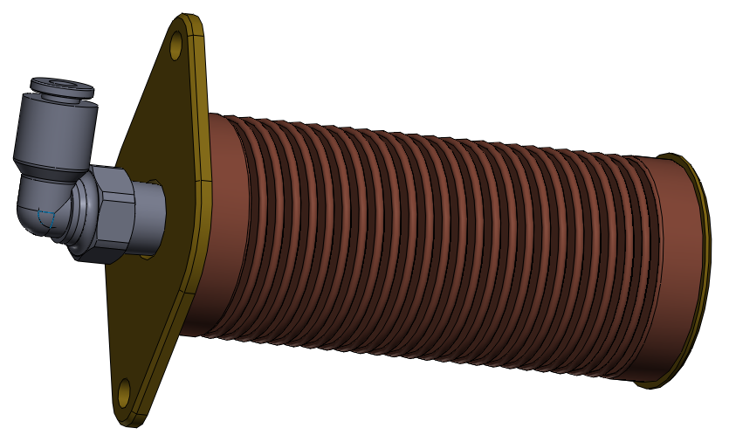
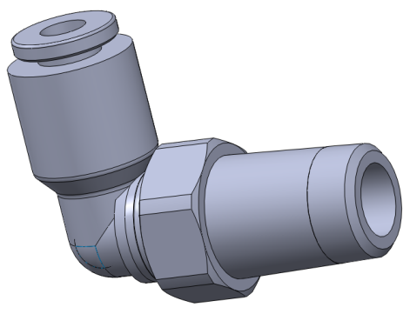
bellows_piston_asm_v3.SLDASM
Legris_elbow_3109_53_08.SLDPRT

Slide 6
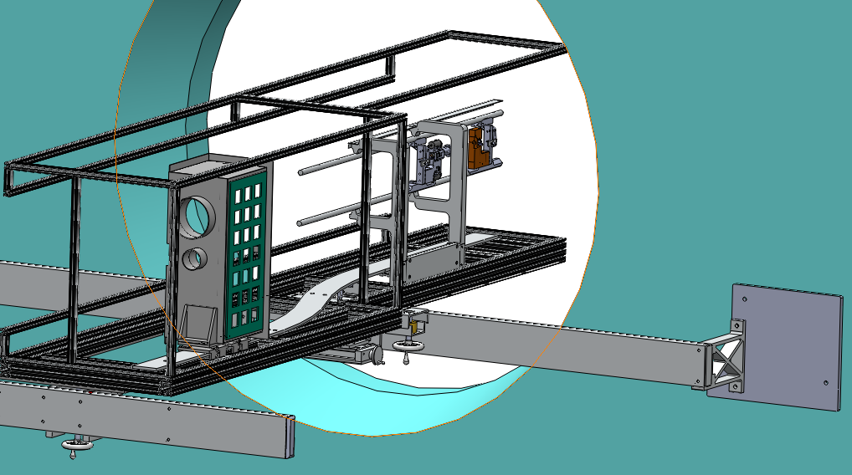
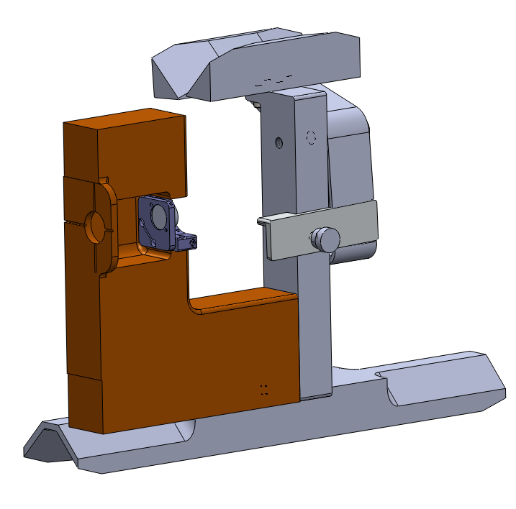
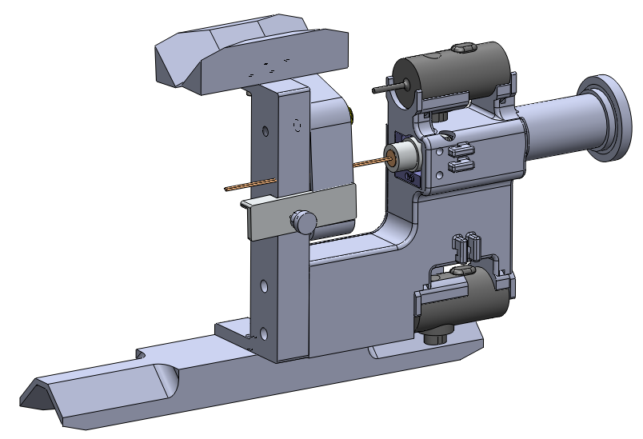
BxFit.SLDASM
align_LACE.SLDASM
align_LACW.SLDASM

Slide 7
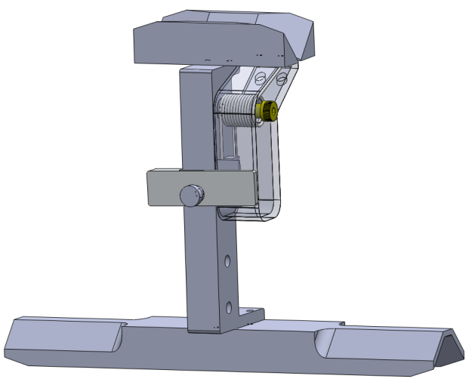

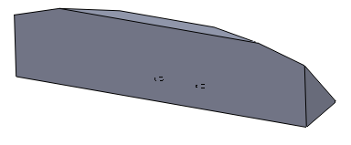
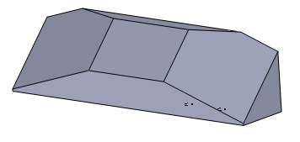
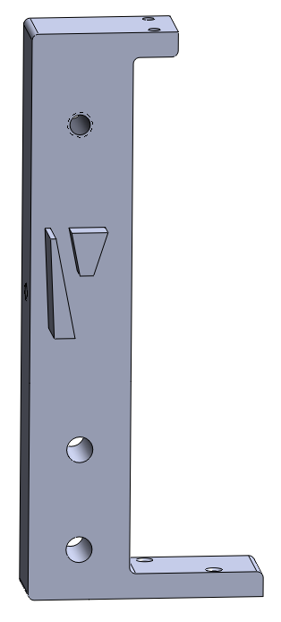
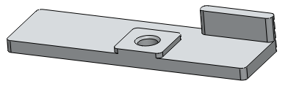
align_b_guide.SLDPRT (Default)
align_b_guide.SLDPRT (t guide fixed)
align_platform.SLDASM
align_b_guide.SLDPRT (t guide mobile)
align_lock.SLDPRT
align_c.SLDPRT

Slide 8
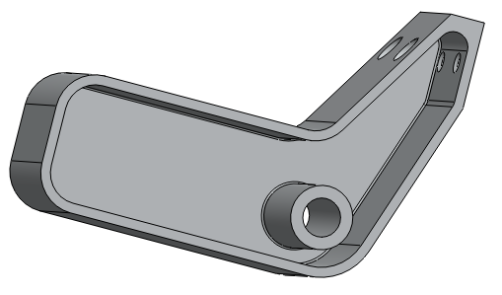
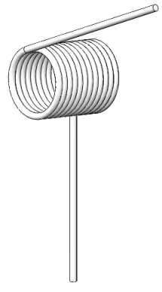
align_spring_arm.SLDPRT
Tspring_360_LH_MC9287K143.SLDPRT

Slide 9
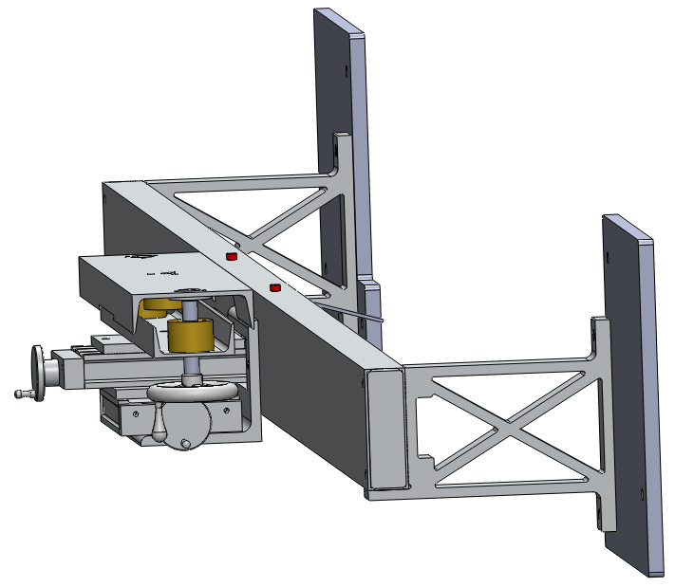
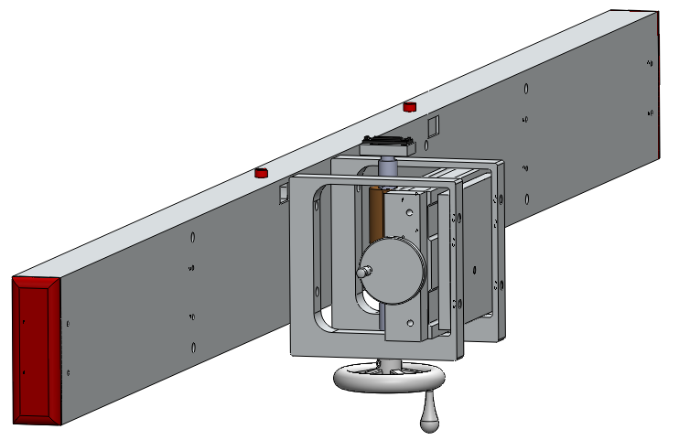
BxS.SLDASM
BxS_rail_e.SLDASM
BxS_rail_w.SLDASM

Slide 10
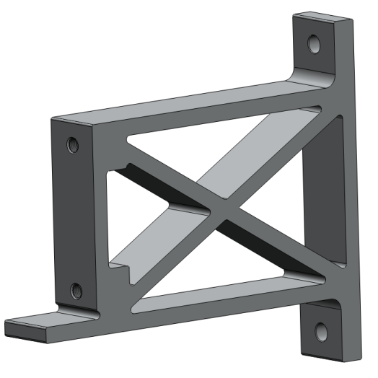
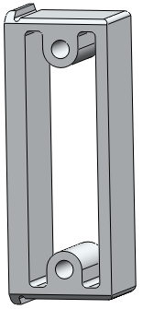
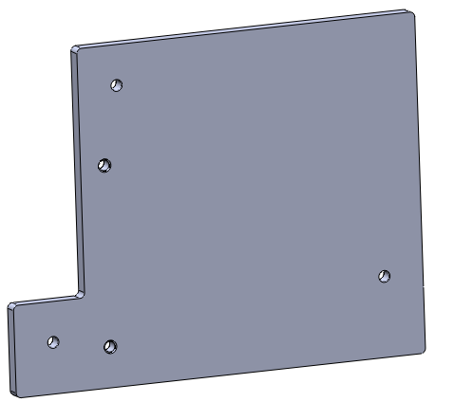
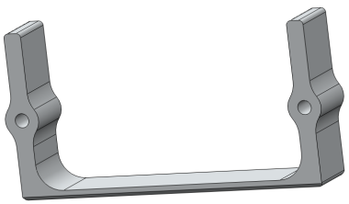
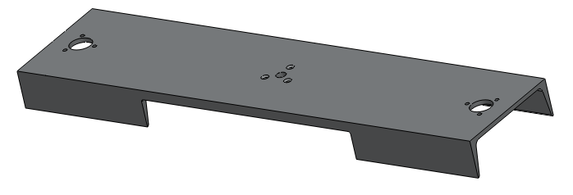

Bx_PoleTip_butch.SLDPRT
BxS_anchor_W.SLDPRT
BxS_rail_insert.SLDPRT
water jet and sander
BxS_rail_w_liner.SLDPRT
water jet and sander
XYYZ_lev_6_channel.SLDPRT
BxS_guide_button.SLDPRT

Slide 11
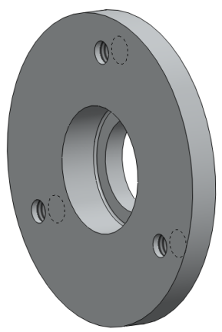
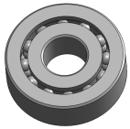
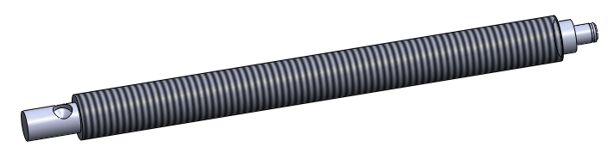
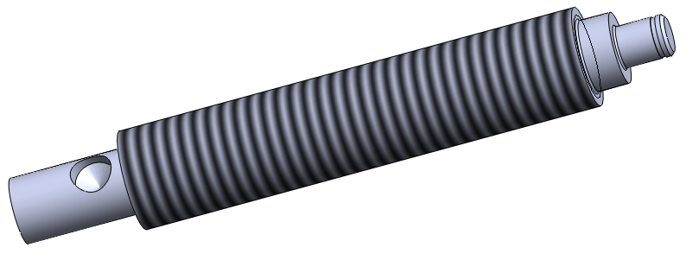
∅ ± .001 inch
bearing slip fit
shoulder depth ± .001 in
bearing_self_align_mc6660K110.SLDPRT
BxS_bearing_housing_w.SLDPRT
∅ ± .001 inch
bearing slip fit
screw_lev_e_mc9880A595.SLDPRT (east)
screw_lev_e_mc9880A595.SLDPRT (west)

Slide 12
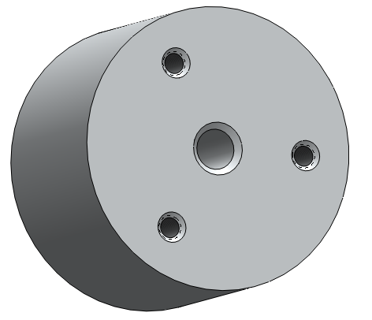
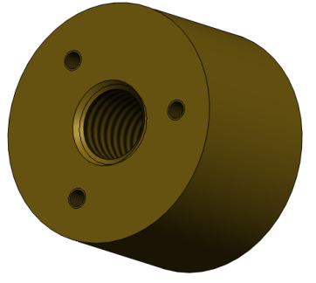
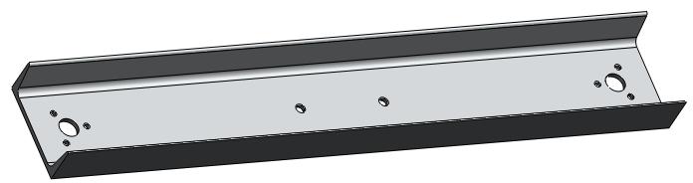
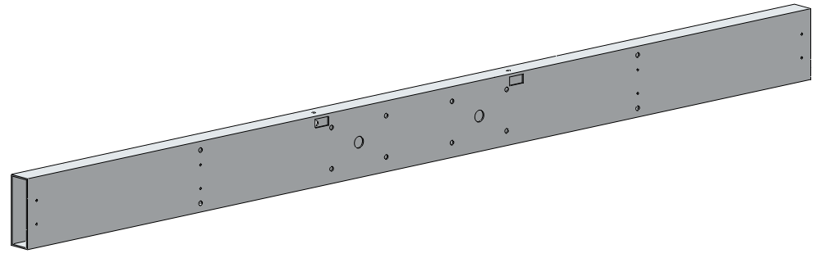
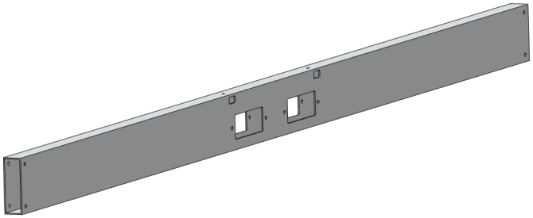
XYYZ_bearing.SLDPRT
nut_lev_mc1343K36.SLDPRT
Use ACME ¾-10 nut blank McMaster Carr 1343K36
Bronze 660
Just drill and tap the 3 #10 holes
XYYZ_channel_foot_3_4.SLDPRT
http://www.onlinemetals.com/merchant.cfm?pid=1067&step=4&showunits=inches&id=298&top_cat=0
BxS_rail_w.SLDPRT
BxS_rail_e.SLDPRT
http://www.onlinemetals.com/merchant.cfm?pid=7042&step=4&showunits=inches&id=1269&top_cat=60
http://www.onlinemetals.com/merchant.cfm?pid=7042&step=4&showunits=inches&id=1269&top_cat=60

Slide 13
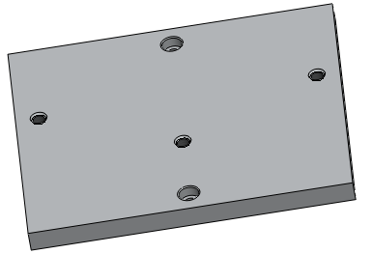
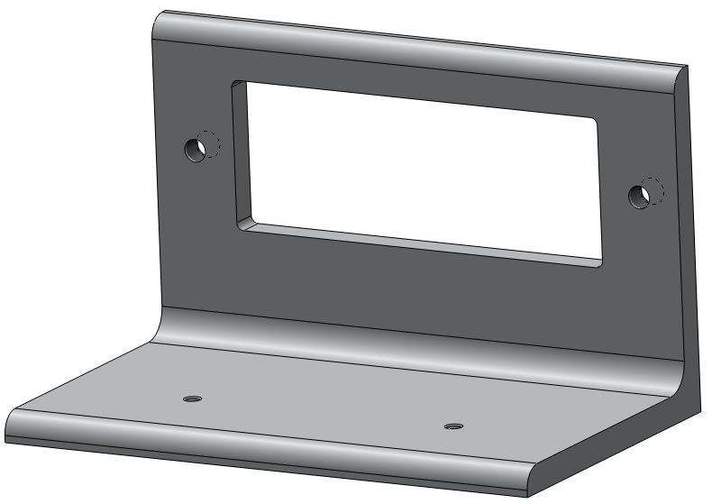
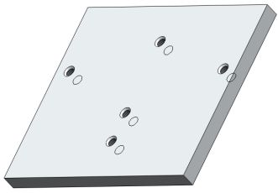
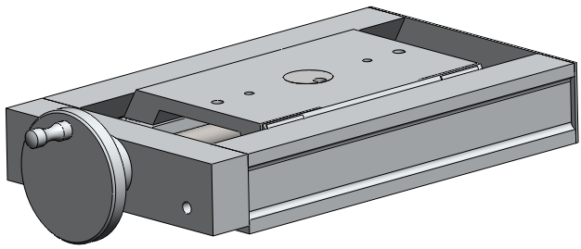
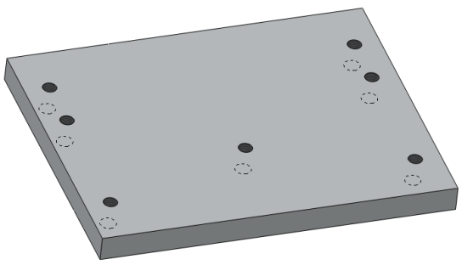
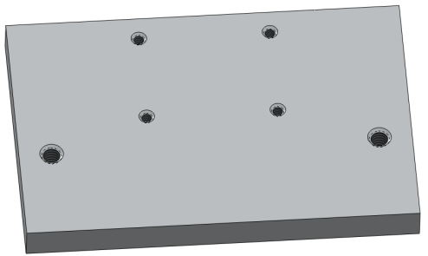
AXY_adapt_plate.SLDPRT
AXY_center_join.SLDPRT
XYYZ_shelf.SLDPRT
http://www.onlinemetals.com/merchant.cfm?pid=14483&step=4&showunits=inches&id=62&top_cat=60
A60.SLDASM
http://www.velmex.com/
½ inch al plate, no need to machine surface
½ inch al plate, no need to machine surface
XY_base_to_hanger.SLDPRT
platform_nut_backer.SLDPRT

Slide 14
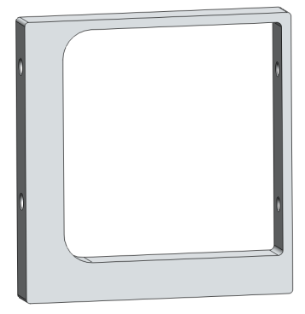
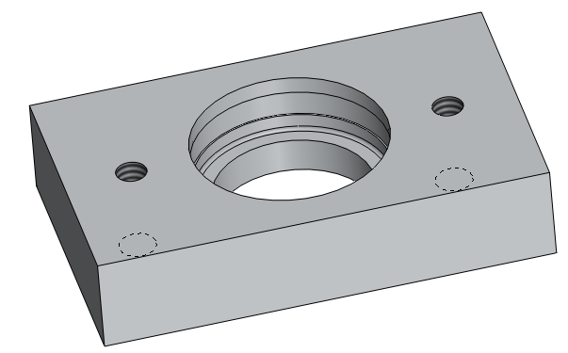
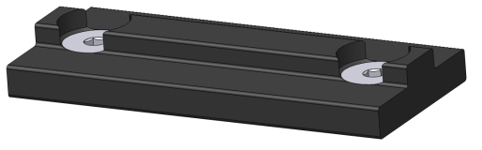
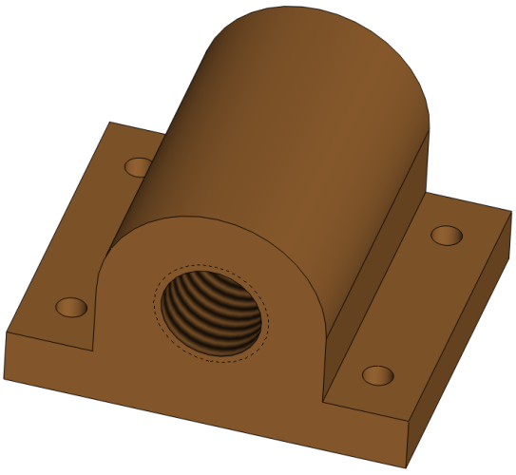
± .001 inch
slip fit on bearing,
bond with Loctite 906
XY_hanger.SLDPRT
machine from 1 inch plate, no need to finish surface
BxS_bearing_housing_e.SLDPRT
8020-6705-custom.SLDASM
platform_nut_mc1710K11.SLDPRT
drill 4 holes in part from McMaster-Carr

Slide 15
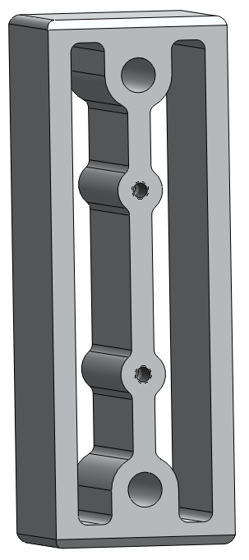


water jet and sand from 1.75 inch al plate such that will slide into box beam
water jet and sand from 1.75 inch al plate such that will slide into box beam
And, tap two holes
BxS_rail_e_liner.SLDPRT
BxS_rail_insert_inner.SLDPRT
3D printer,
tap two holes
BxS_rail_plug.SLDPRT

Slide 16

Box_Insertion_N.SLDASM

Slide 17




skid_poly_MC8657K615_pair.SLDPRT (west)
bulkhead_track_stand_off.SLDPRT
skid_poly_MC8657K615_pair.SLDPRT (east)
water jet 3/8 inch poly
box_bulkhead_rail.SLDPRT
water jet aluminum

Slide 18





bearings slip fit on inner and outer radius
bulkhead carrage.SLDASM
∅ ± 0.001 inch
for slip fit to bearings
post height ± 0.002 inch
bearing_MC3760T50.SLDPRT
bulkhead_carriage_bearing_cap.SLDPRT
bulkhead_foot.SLDPRT

Slide 19

∅ ± 0.001 inch
slip fit bearings and bond with Loctite 609
step height ± 0.002 inch
bulkhead_carriage.SLDPRT

Slide 20



cam_follower_MC3659K11.SLDPRT
bearing capture disk.SLDPRT
box_trailer_hitch.SLDPRT

Slide 21


PXL_GIZMO.SLDASM
carriage_v2.SLDASM

Slide 22



cc_tray.SLDPRT
cc_wrench_guide.SLDPRT
3D print
cc_board_bracket.SLDPRT

Slide 23




hinge_pin_from_MC5911K11.SLDPRT
hinge pins made from precision aluminum shaft from
McMaster-Carr 5911K11
+ .002 -.000 inch
slip fit on carriage pins
machine for press fit with hinge pin:
hinge_pin_from_MC5911K11.SLDPRT
sa_hinge_tab.SLDPRT
cc_tray_bracket.SLDPRT
bushing_peek_MC6627K14.SLDPRT
purchased part from McMaster - Carr

