Slide 1
Notes on beam pipe collars and support brackets for MSC
2012-07-05
Silber

Slide 2
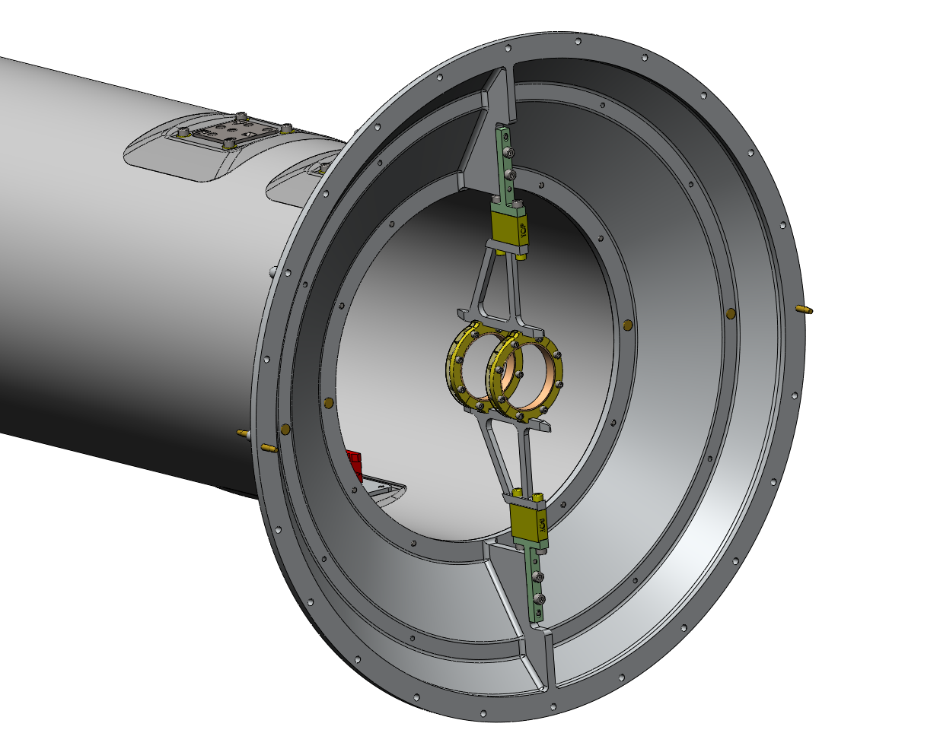
East side
PST_trans_no_fixture.SLDASM

Slide 3
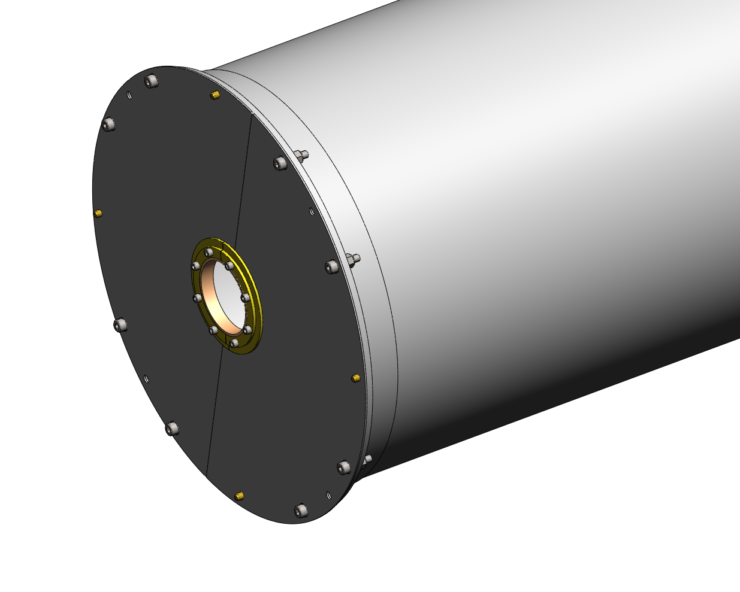
West side
PST_trans_no_fixture.SLDASM

Slide 4
MSC Transition BP Collar Support.SLDASM
Upper bracket can be 6061
Only difference in the two configurations is the size of the vespel thermal break piece
4x M4, 12mm length
(aluminum ok)
“bottom” vespel piece slightly taller than “top”
Thermal break is Vespel
2x Titanium M4, 12mm length
(shown in yellow)
Lower bracket is 2219 (high temp) aluminum alloy

Slide 5
Small Beam Pipe Flange.SLDASM
(inner ring has 1.670” ID)
Small Sliding Beam Pipe Collar.SLDASM
(inner ring has 1.710” ID)
8x helicoils
(4-40, titanium, MSC 70547815)
8x helicoils
(4-40, titanium, MSC 70547815)
Quantities:
1x Small Beam Pipe Flange.SLDASM, vespel – for the west side
1x Small Beam Pipe Flange.SLDASM, aluminum alternative – for the west side
2x Small Beam Pipe Flange.SLDASM, aluminum – for the east side

