Slide 1
Co-Cure Cable Lay-up
Thomas Johnson
11-04-2010

Slide 2
Cable Inspection
Inspect Cable for Damage prior to curing.
Broken traces
Wrinkles
Laminated dirt
Discoloration

Slide 3
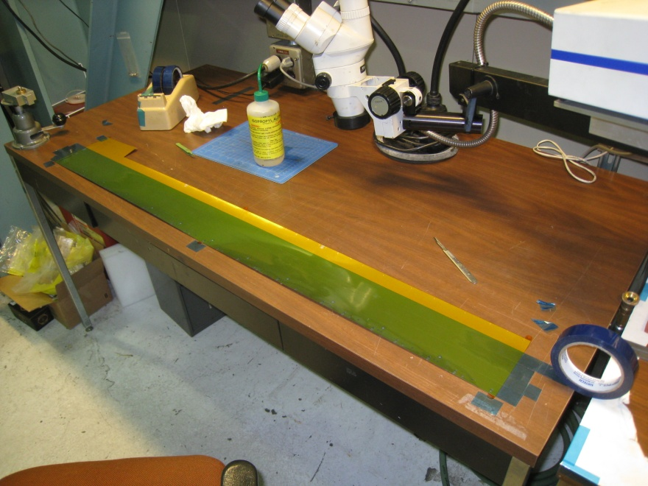
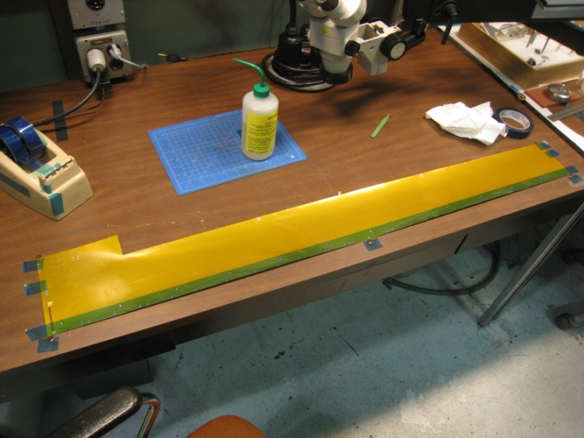
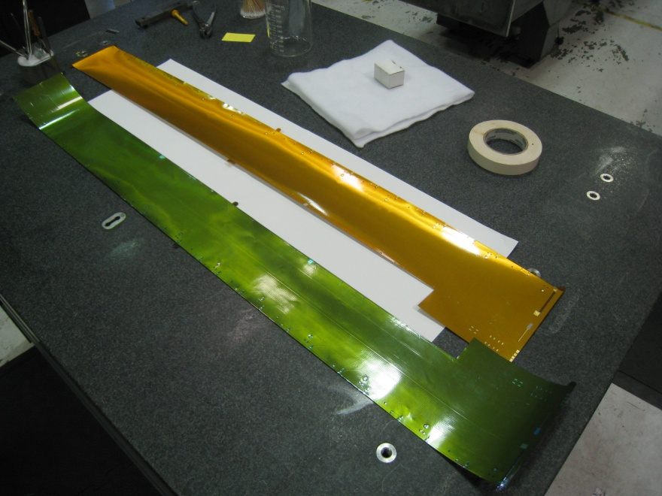
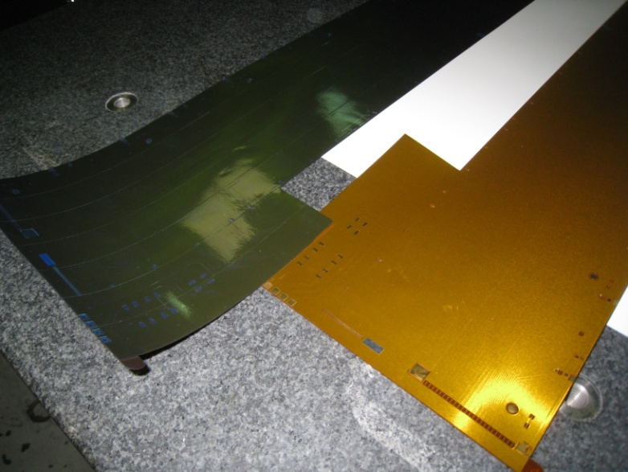
Clean Top Surface and Apply 1 mil Flashbreaker Tape

Slide 4
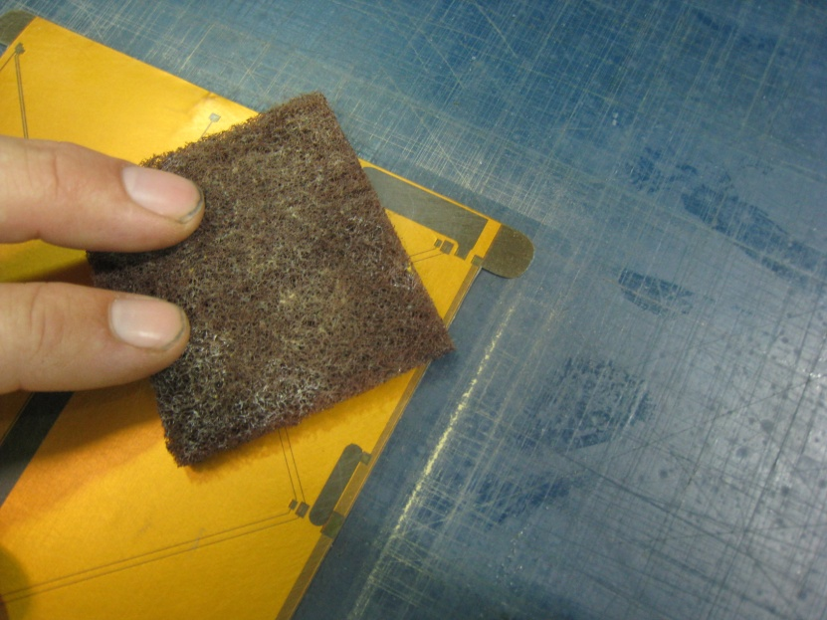
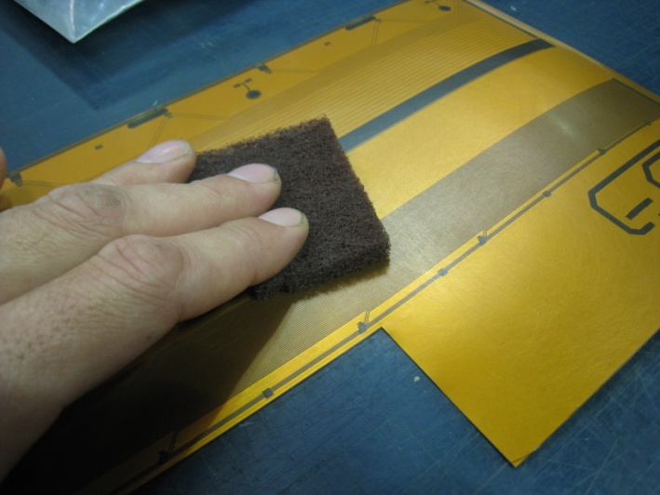
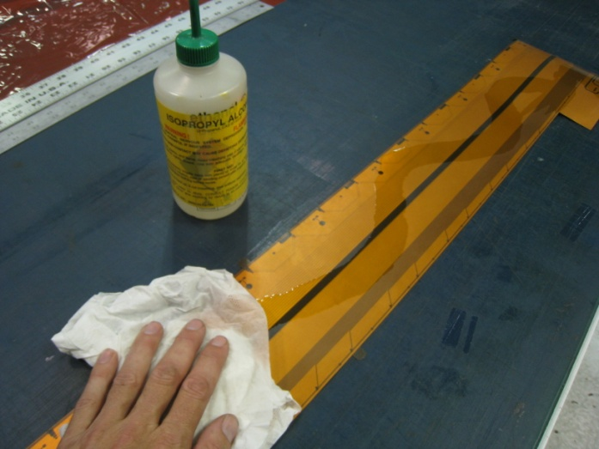
Surface Prep of Backside Prior to Bonding
- Use ScotchBrite pad to Abrade Backside of Cable.
- Clean with Alcohol

Slide 5
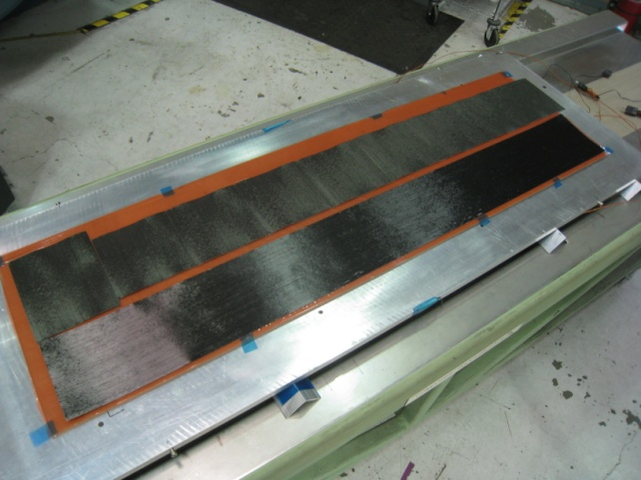
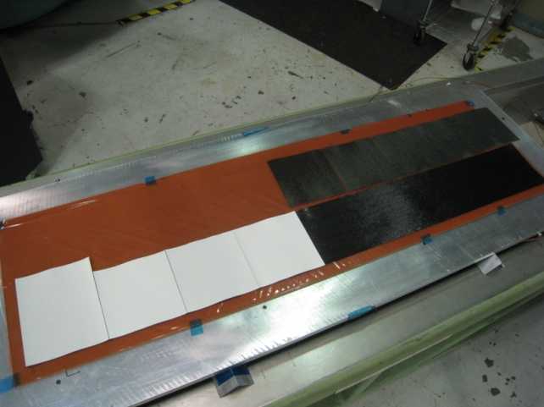
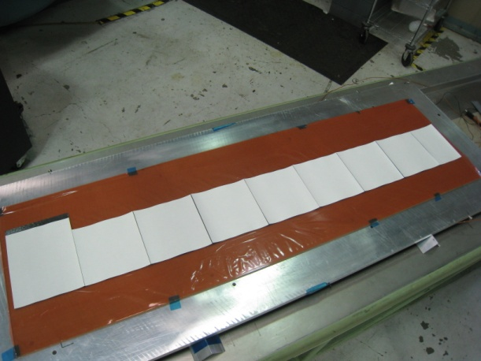
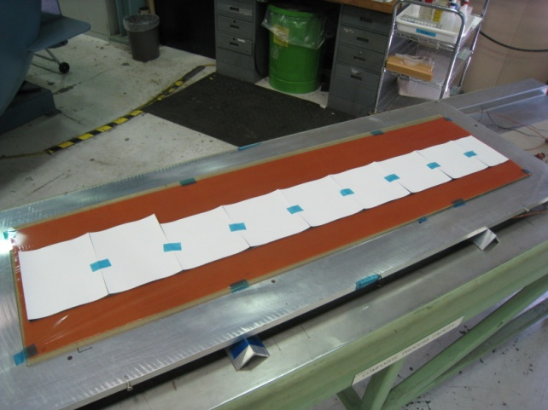
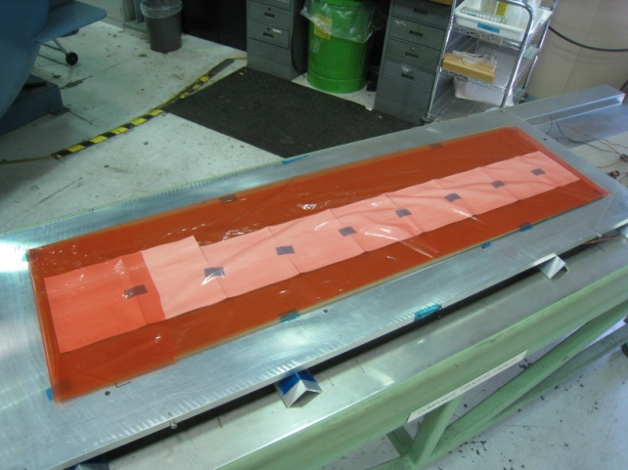
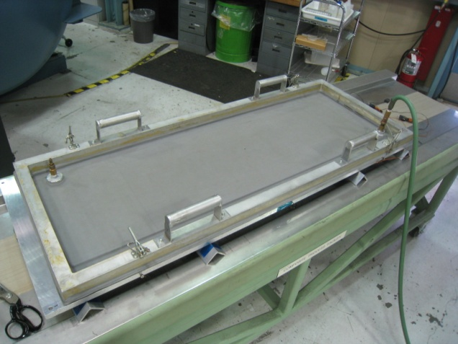
-Part is layed up on a glass plate covered with A4000 release plastic.
-0 deg ply on bottom and 90 deg ply on top.
-The white is the paper backing of the prepreg.
-Once layed out they are taped together to hold in place and covered with another layer of A4000. (4,5)
-Plys are then compacted under vacuum to stick the plys together. (6)
1
2
3
4
5
6

Slide 6
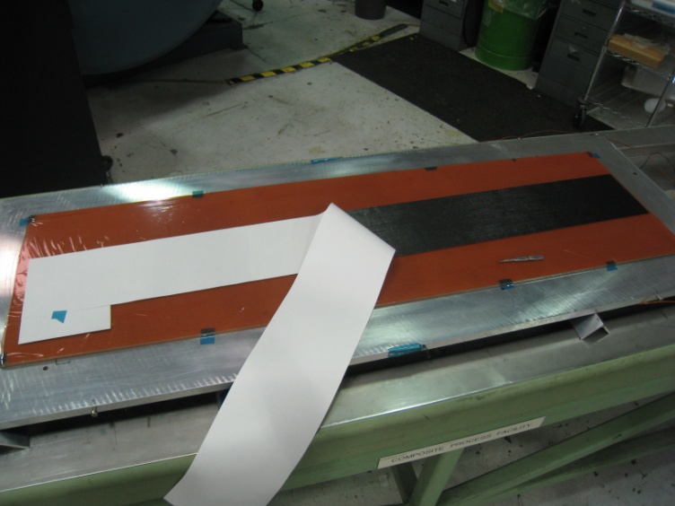
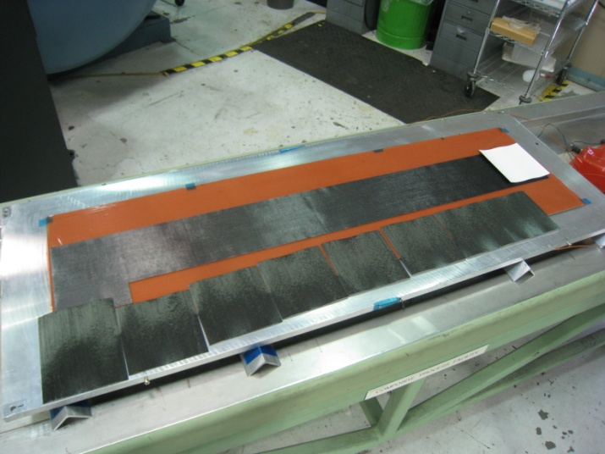
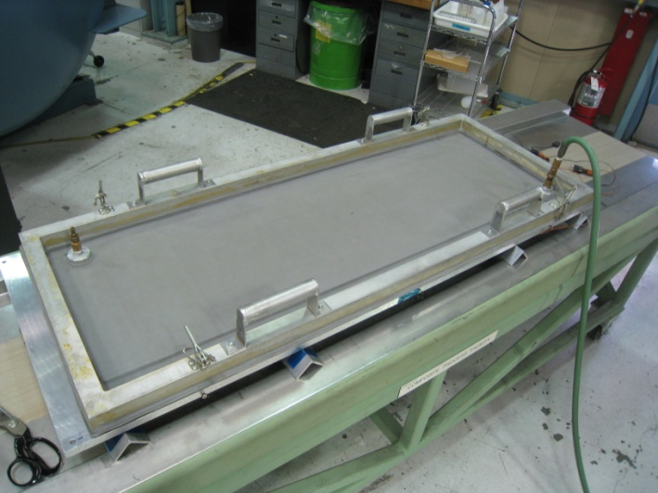
- After compaction, flip part so the 90’s are down against the glass.
- Remove the paper backing from the 0 ply. (1)
- Stack the next 90 deg ply the same as the previous 90 ply. (2)
- Tape together, A4000 release plastic and compact (3,4)
1
2
3
4

Slide 7
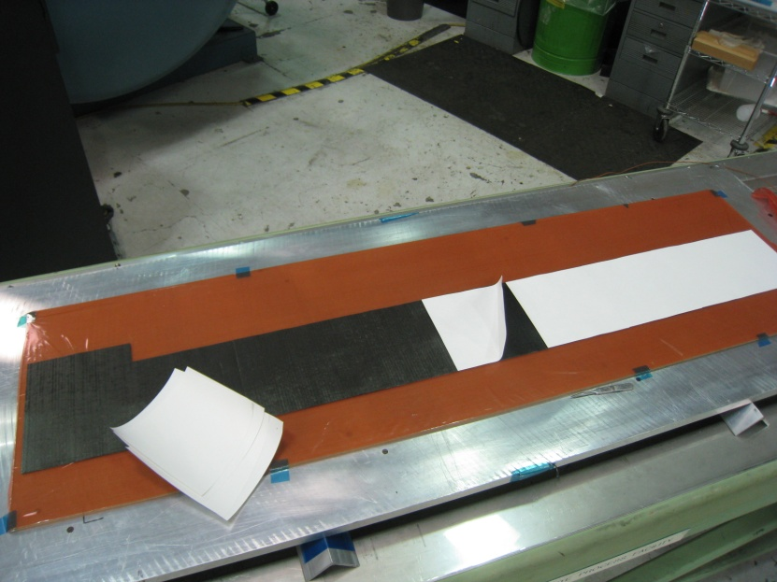
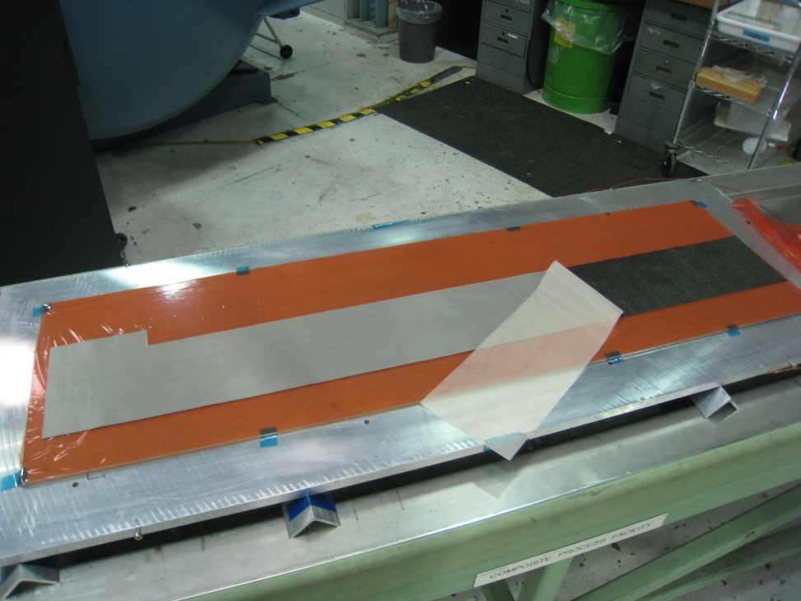
- After compaction remove the exposed paper backing.
- Apply a single layer of pealply to this side.

Slide 8
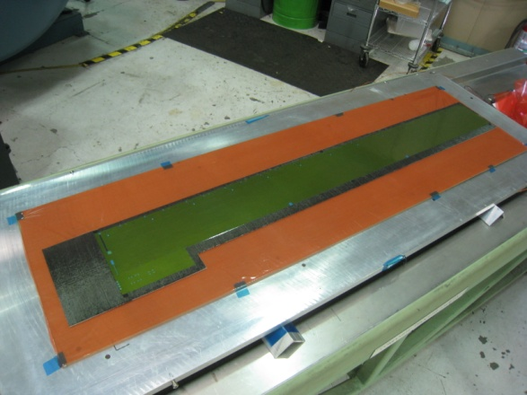
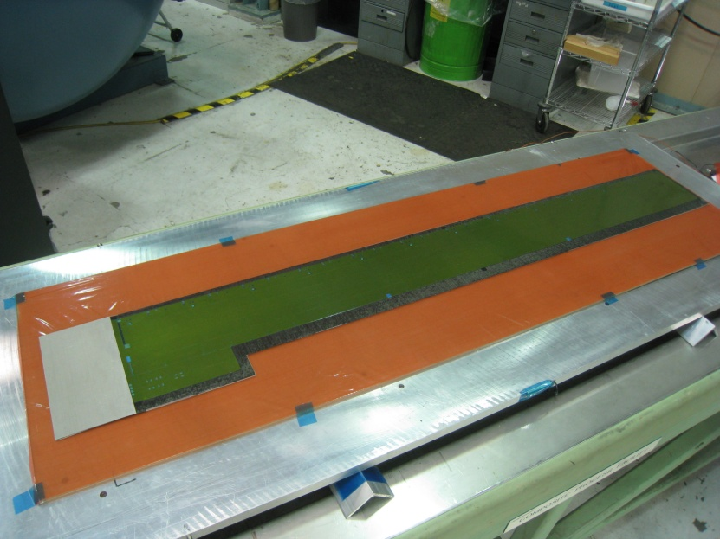
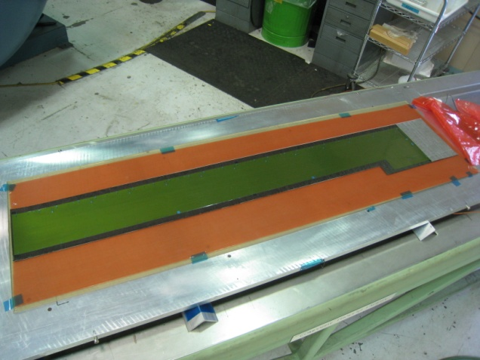
- Flip part again so the pealply is now against the glass and remove the paper backing. (1)
Position cable and apply it to the stack. (2)
Add a small piece of pealply to the remaining exposed carbon on the end. (3)
Cover stack with A4000 release sheet. (4)
Compact. (5)
1
2
3
4
5

Slide 9
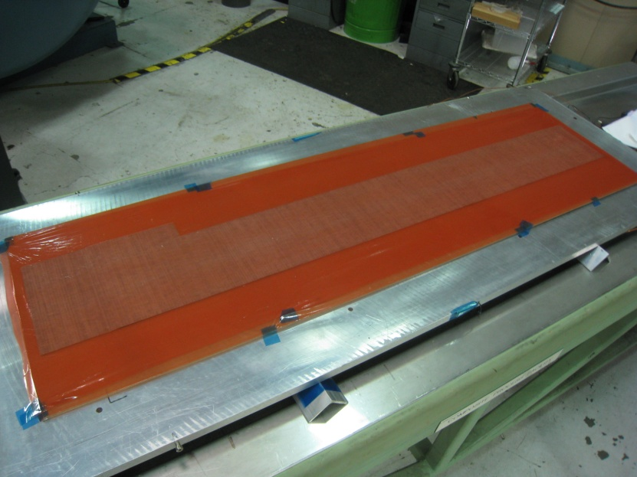
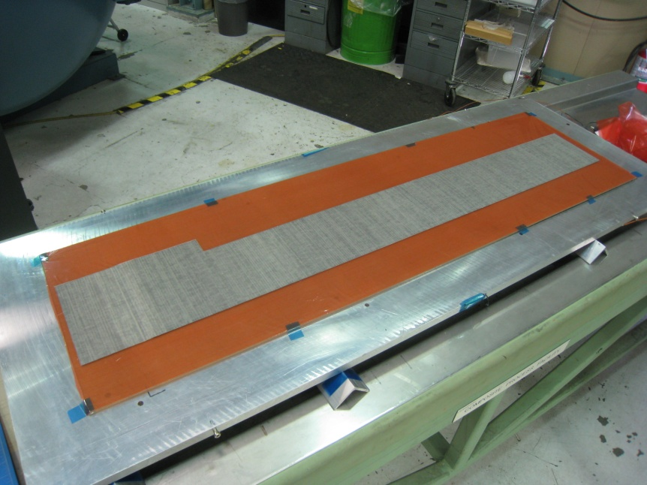
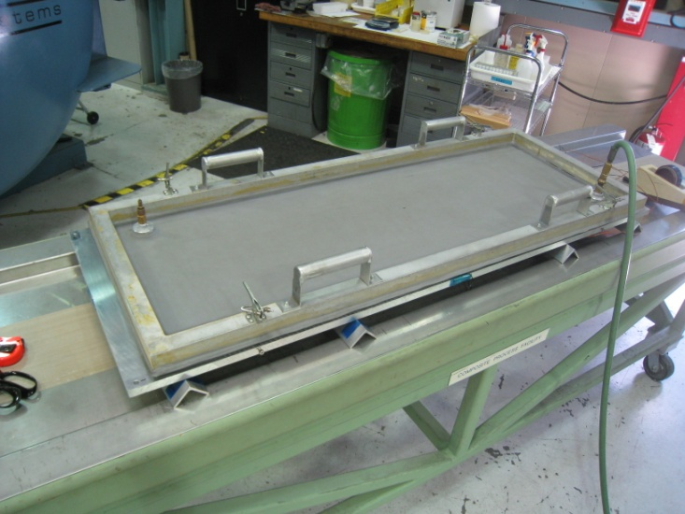
- After compaction, Flip the entire stack so the cable is now against the flat glass surface. (1)
Cover with a fresh piece of A4000 making sure to have no wrinkles. (2)
Add layer of breather (no wrinkles) and put under final vacuum bag for cooking. (3)
2
1
3

