Slide 1
Bonding of Flex Cable to Stave
11/10/2010
Thomas Johnson

Slide 2
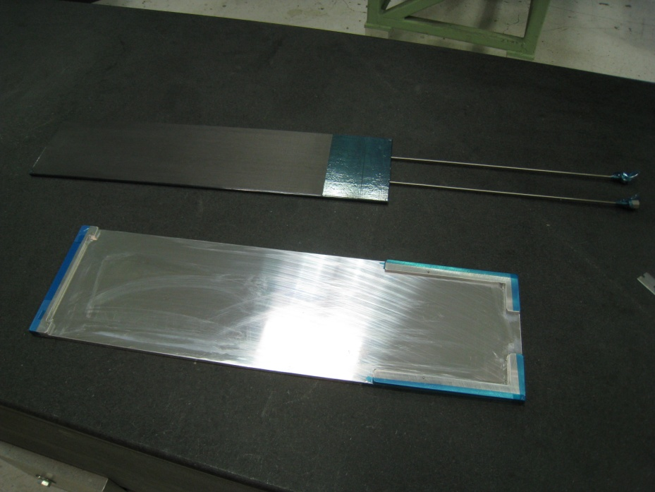
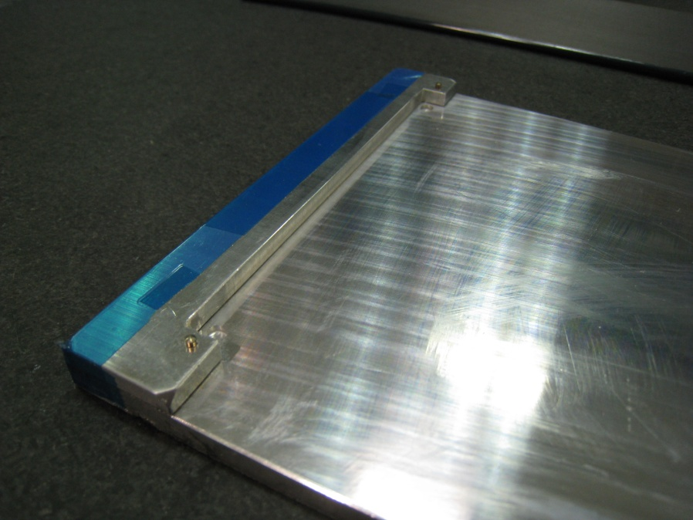
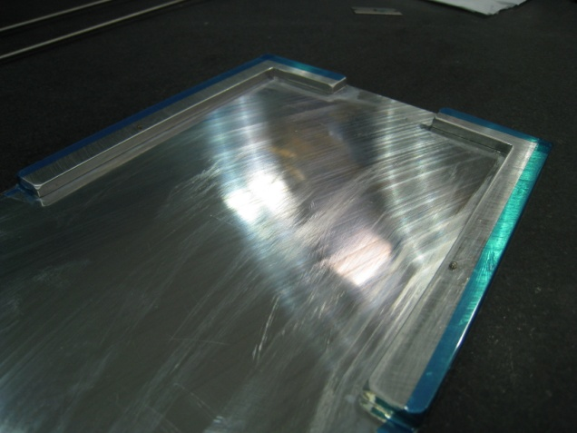
Mic6 Aluminum Bonding Fixture. Pins for cable alignment.

Slide 3
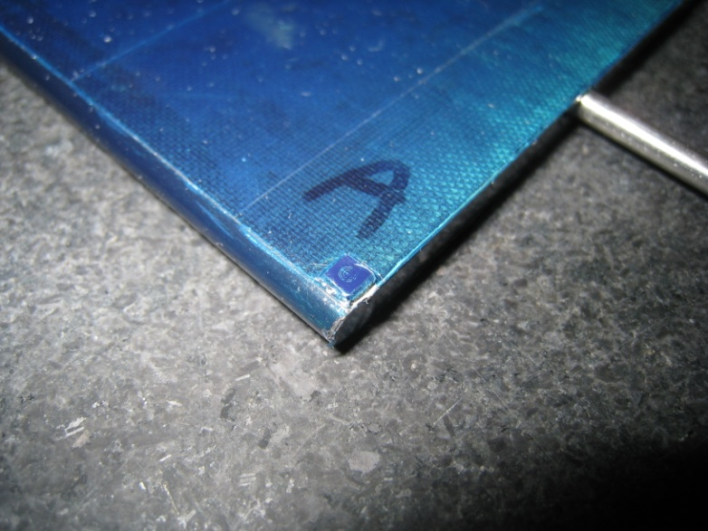
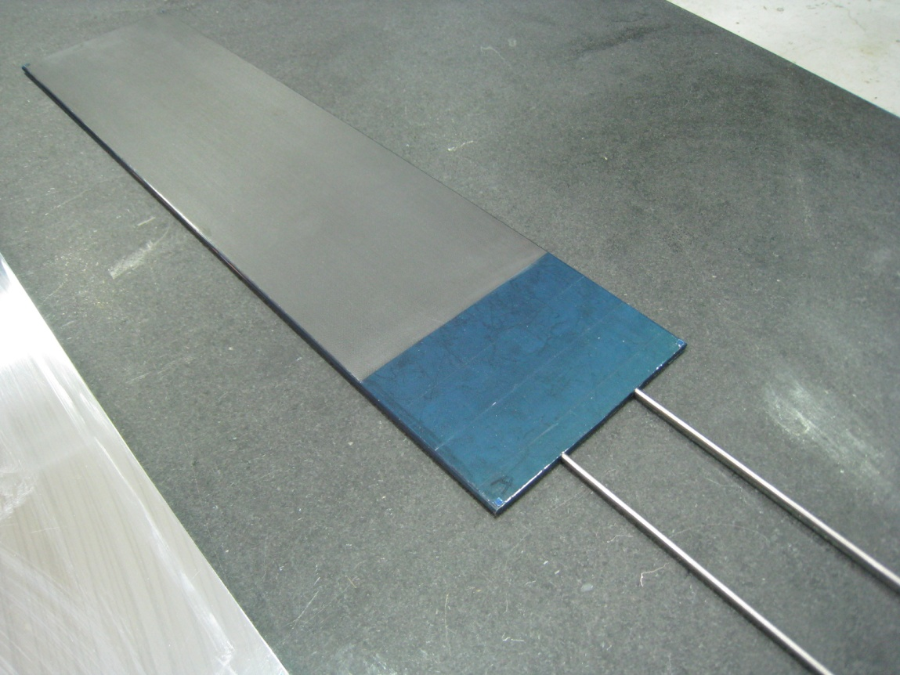
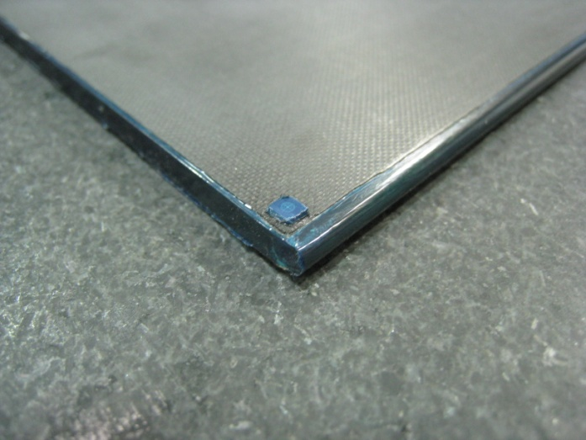
Mask ALL parts of the cable you do not want epoxy on.
Including the backside, edges, targets, etc……..

Slide 4
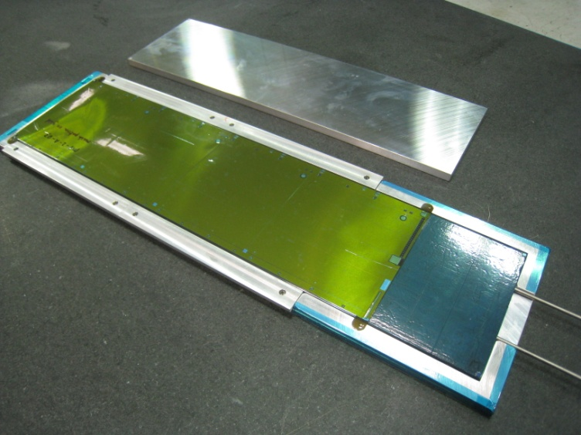
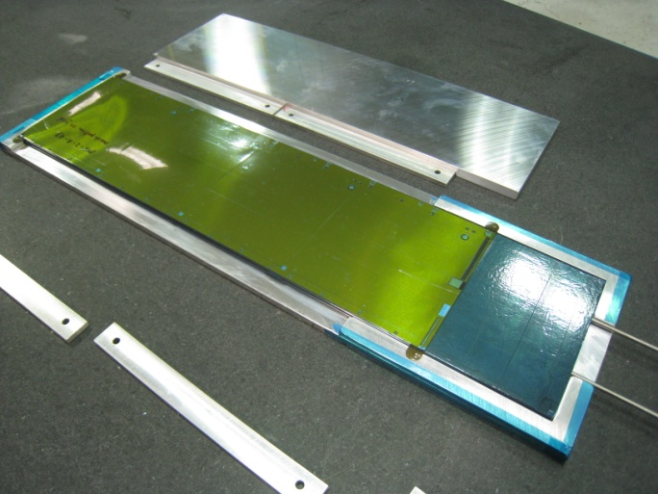
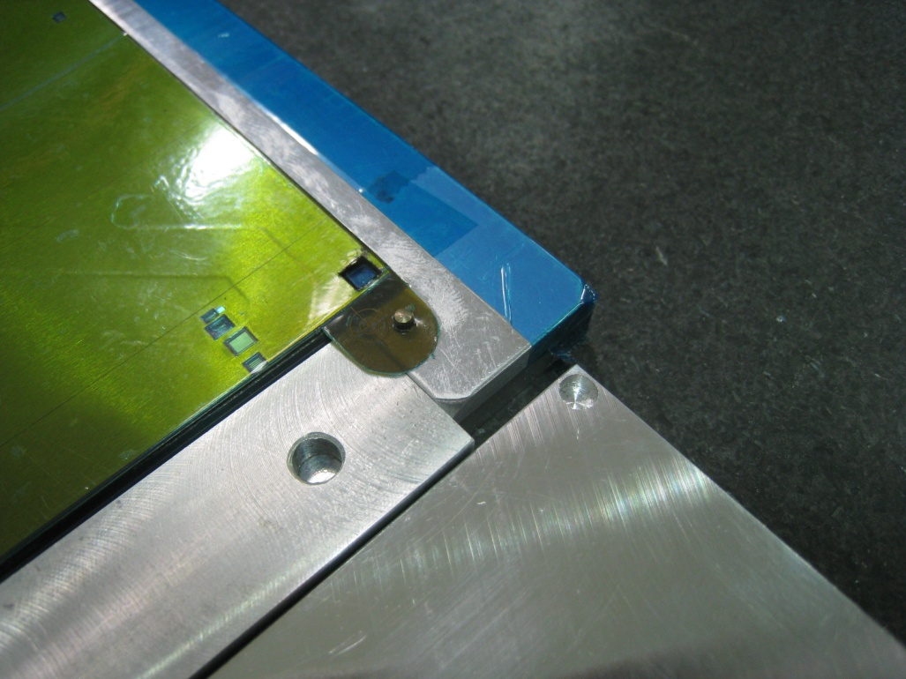
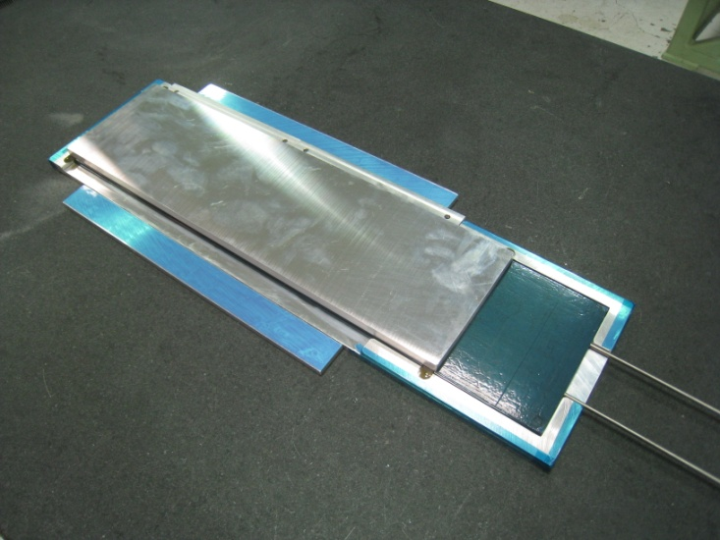
Cable and Stave in Fixture.
Aluminum supports along all edges to prevent squish of stave under vacuum.
Top Vacuum plate with target cutouts.
Locating pins and target cutout.

Slide 5
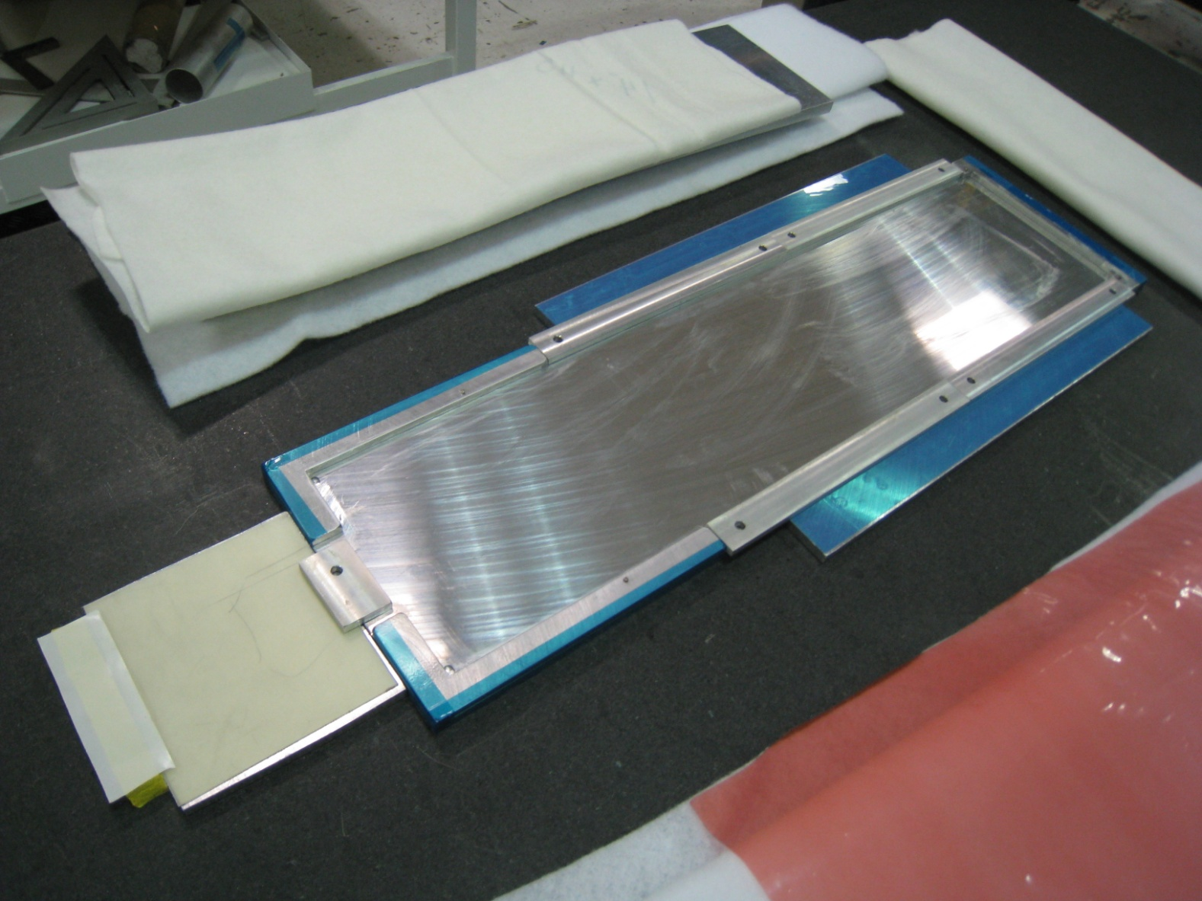
Bonding plate with all outside support pieces.
Extra plate on the end to support the tubes.

Slide 6
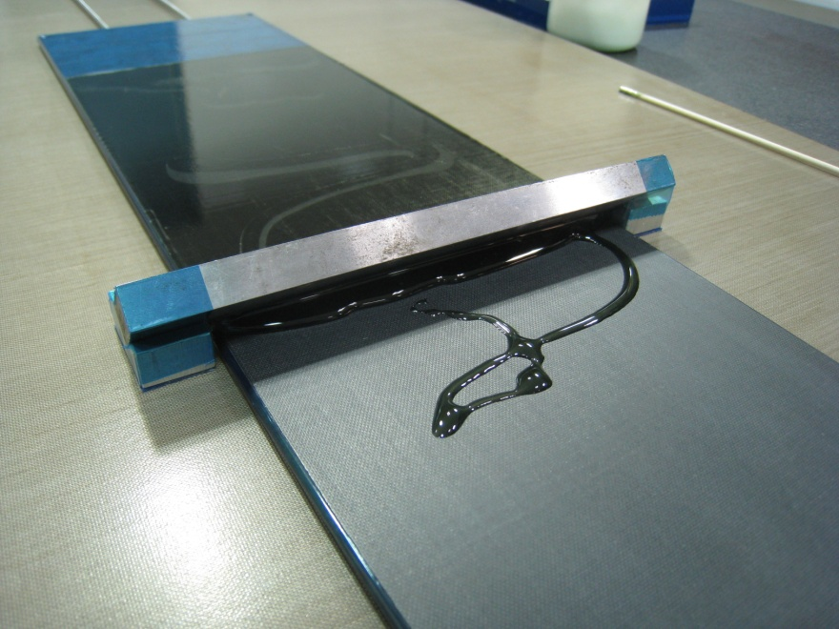
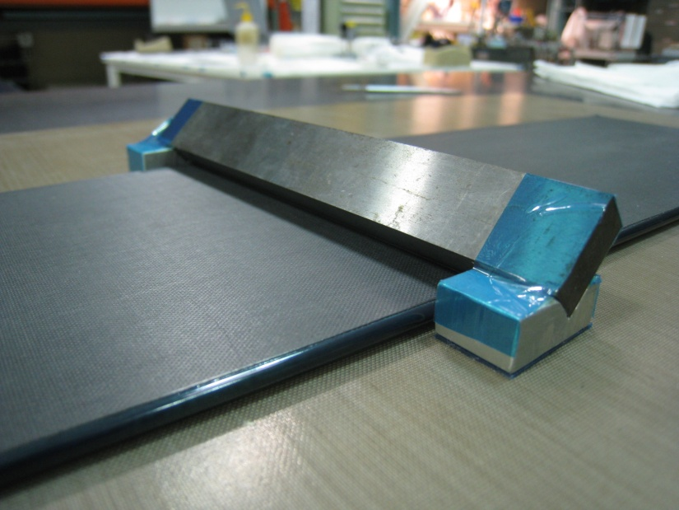
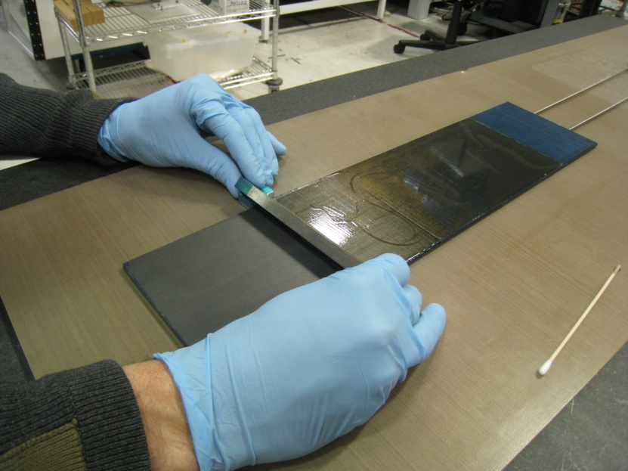
Screen epoxy onto stave. Straight edge is set on blocks providing desired thickness.

Slide 7
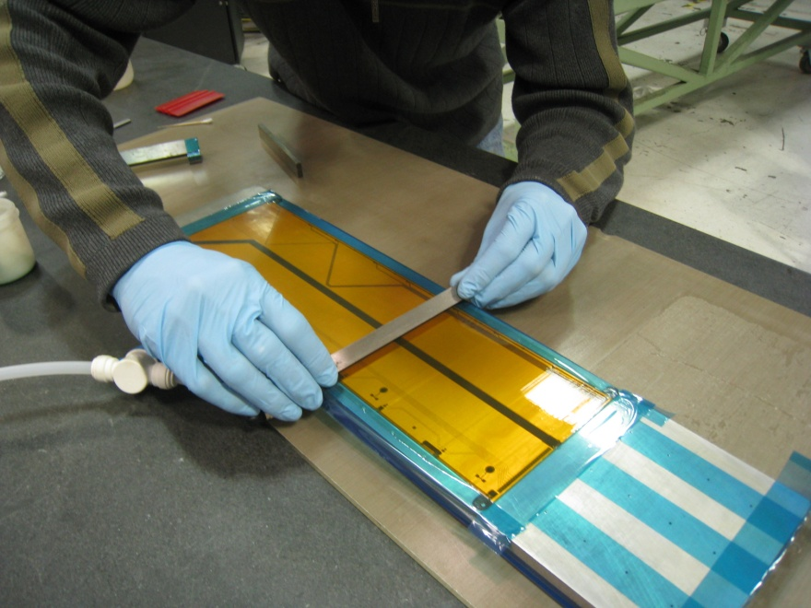
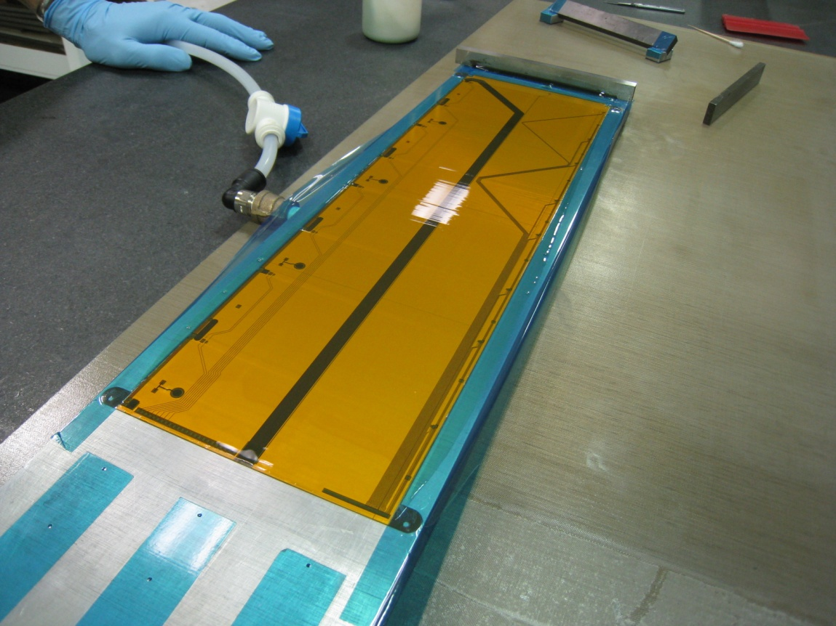
Flex cable on vacuum fixture.
Screening epoxy using straight edge and 2mil blue tape as a thickness gage.
Tape is placed just on the edge of the cable and the straight edge rides on this.

Slide 8
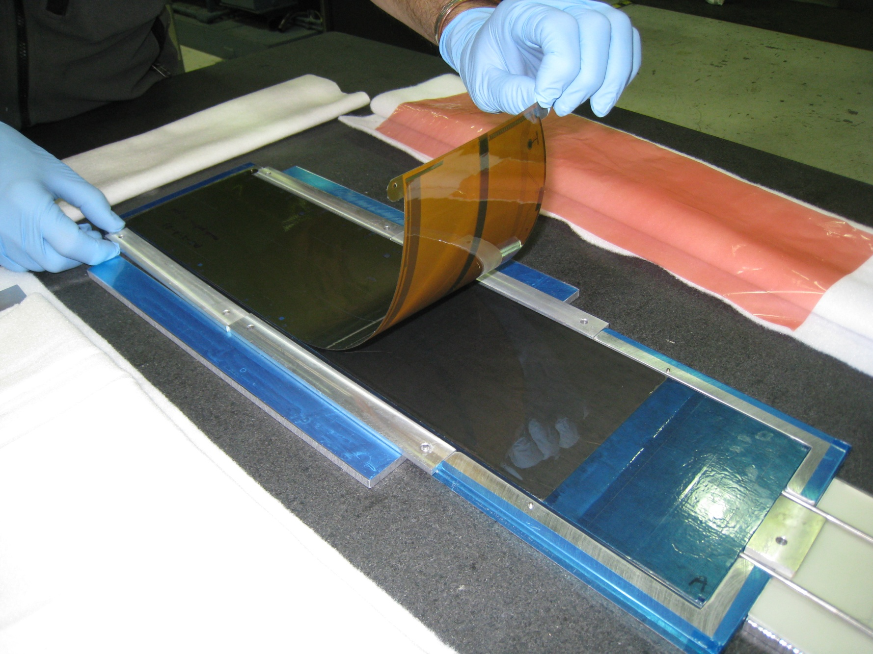
Lay cable onto stave with a rolling motion to help prevent trapped air under cable.

Slide 9
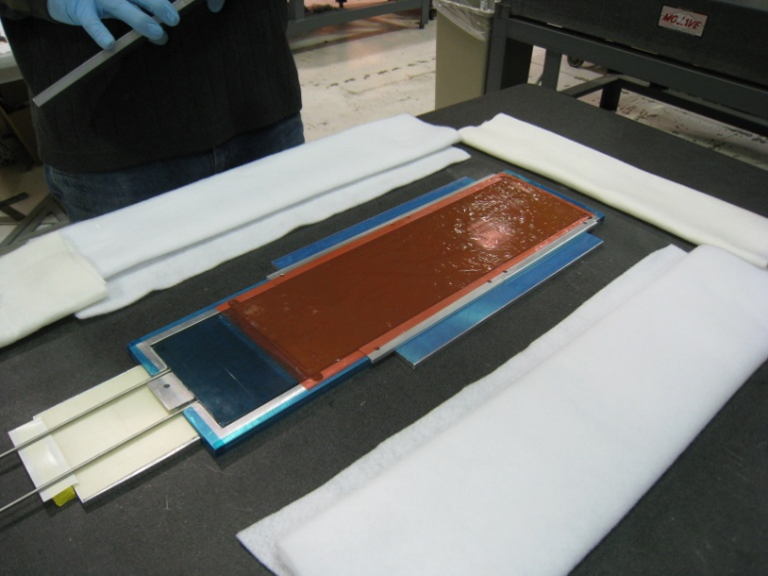
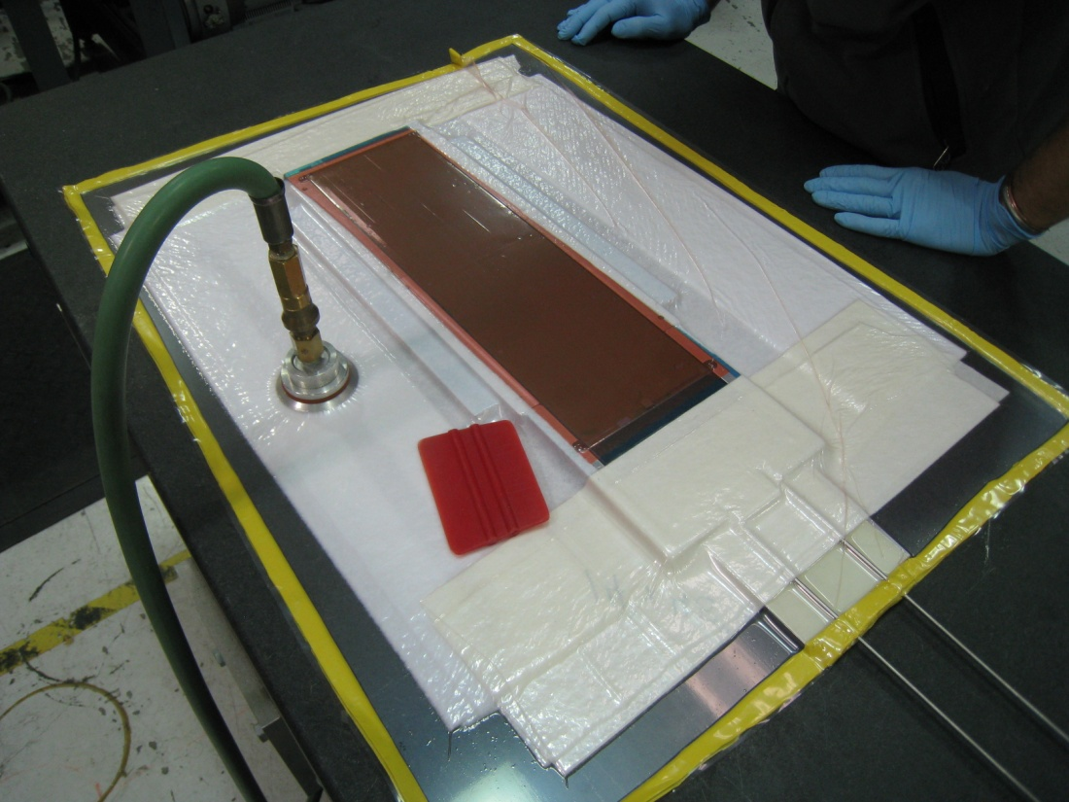
Place sheet of release plastic over cable.
Build a vacuum bag over the entire part and compress.

Slide 10
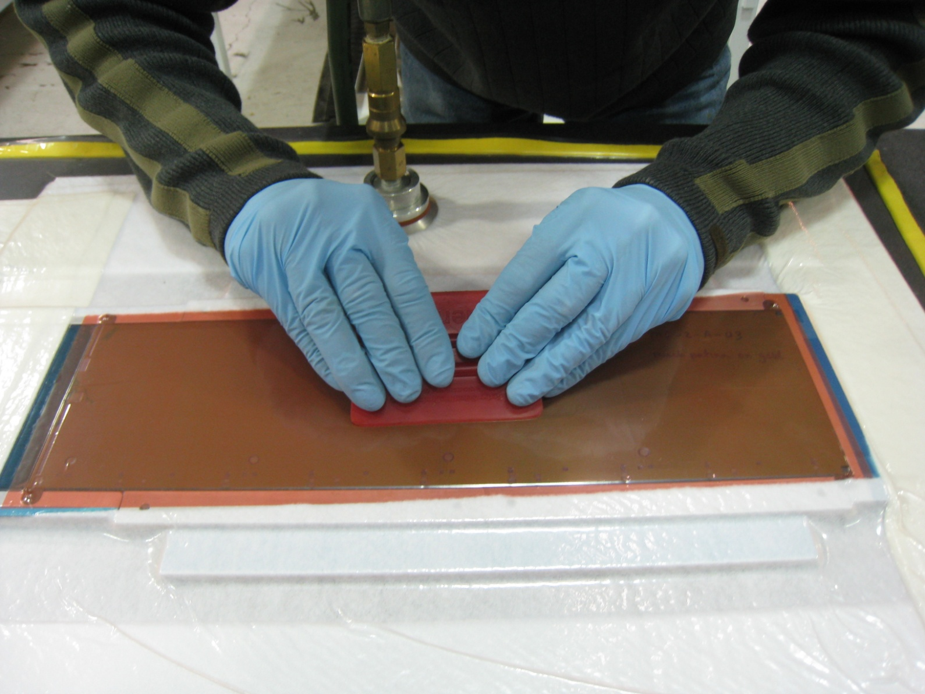
Use soft plastic to squeegee the excess epoxy out.
From the middle of cable work the epoxy to the edge where the vac will draw it away.
Do this until you see no more excess epoxy/no bubbles.
Careful not to puncture your vacuum bag.

Slide 11
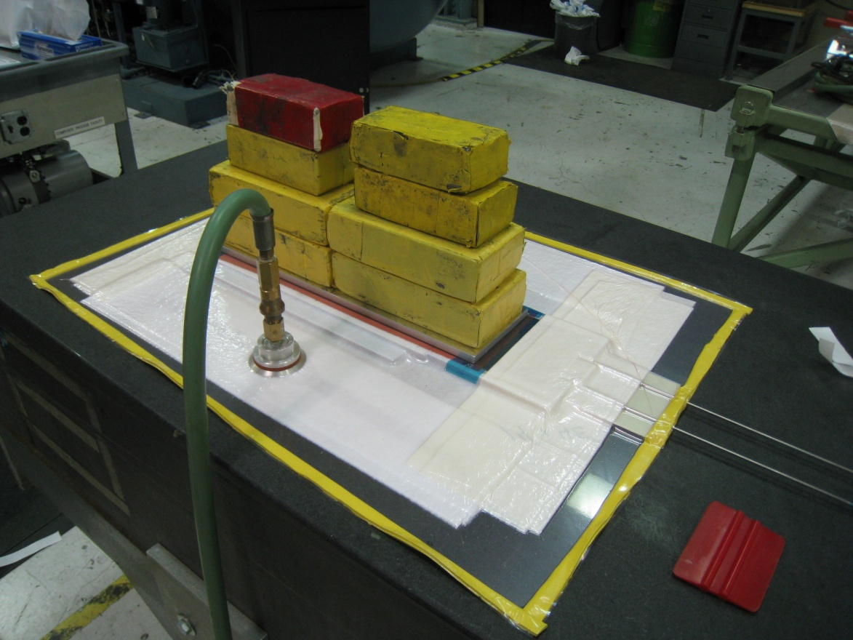
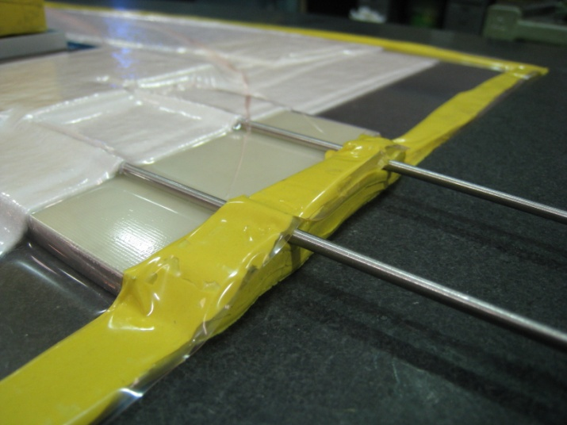
Place aluminum Mic6 plate on TOP of vacuum bag with additional weight during cure.
Additional support for tubes
out of vacuum bag.

