Slide 1
Spectrometer solenoid quench protection
MICE Spectrometer Solenoid Workshop
Berkeley, California
May 10-11, 2011
Soren Prestemon^, Heng Pan^, Vladimir Kashikhin*
^Lawrence Berkeley National Laboratory
*Fermi National Accelerator Laboratory

Slide 2
Outline
Review of protection circuitry
Review of protection scheme concerns
Major recommendations from reviewers
Key protection issues
Protection resistors: value and design
Voltages seen by coils during quenches
HTS leads
3D analysis
Results and discussion
Proposed plan

Slide 3
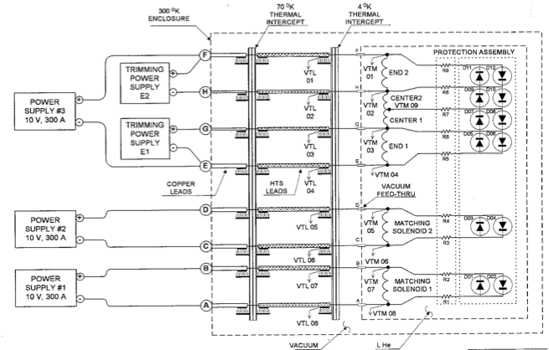
Review of Spectrometer protection circuit

Slide 4
Review of Spectrometer protection circuit
Comments:
System is passive
No “need” to trigger any circuitry
No direct ability to initiate quenches
Bypass resistors allow each coil / coil section to decay at their own speed
Reduces hot –spot temperatures, peak voltages
What we want:
A system that protects coils well during quenches (e.g. training)
A system that avoids damage to the cold mass during serious faults

Slide 5
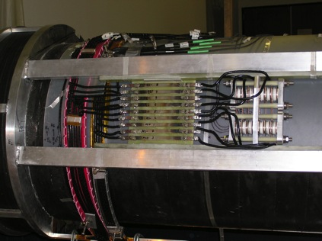
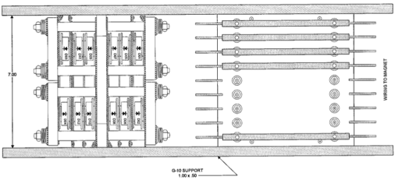
Protection circuit: diodes+resistors
3-5V forward voltage drop (needs to be measured cold)
Forward voltage drop decreases as temperature of diodes increases
Resistor: strip of Stainless Steel
Designed to comfortably support bypass current during “normal” quench decay (~6s)
Temperature rise during ~6s decay is <~300K

Slide 6
Review
The review committee recommends:
to continue the analysis of the quench protection system, including Coupled transient magnetic and thermal calculations, eddy currents in the Aluminium mandrel, external circuits with shunt resistors.
Investigation of different quench scenarios and definition of the hotspot temperatures of coils, leads and shunts.
Definition of peak voltages: to ground, and layer to layer.
Definition of the optimal shunt resistor values for all coils to reduce risk.
Definition of the allowable peak operating current to eliminate the risk of coil damage.
Measurement of the leakage current to ground for each coil, to check the status of electrical insulation.
Limitation of the test current to 200 A until all points above are verified and understood.
Design of the magnet test procedure ensuring a minimal risk of cold mass damage.

Slide 7
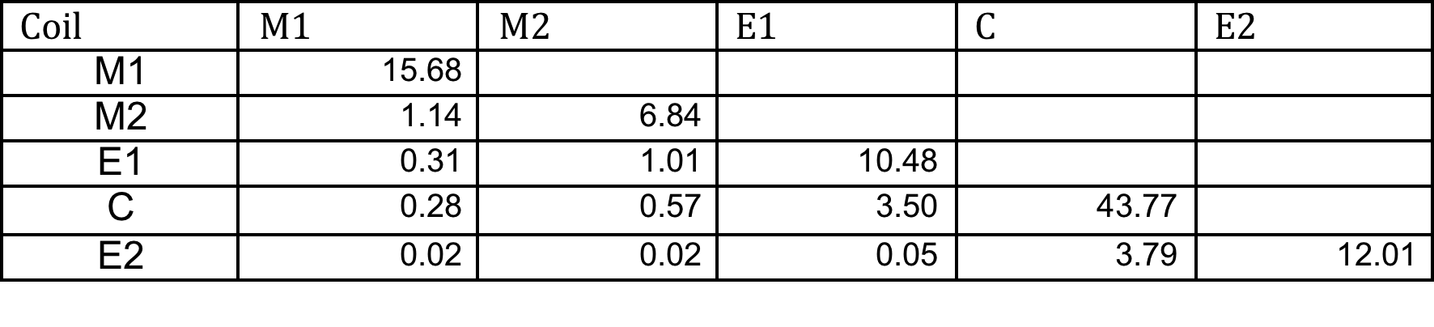
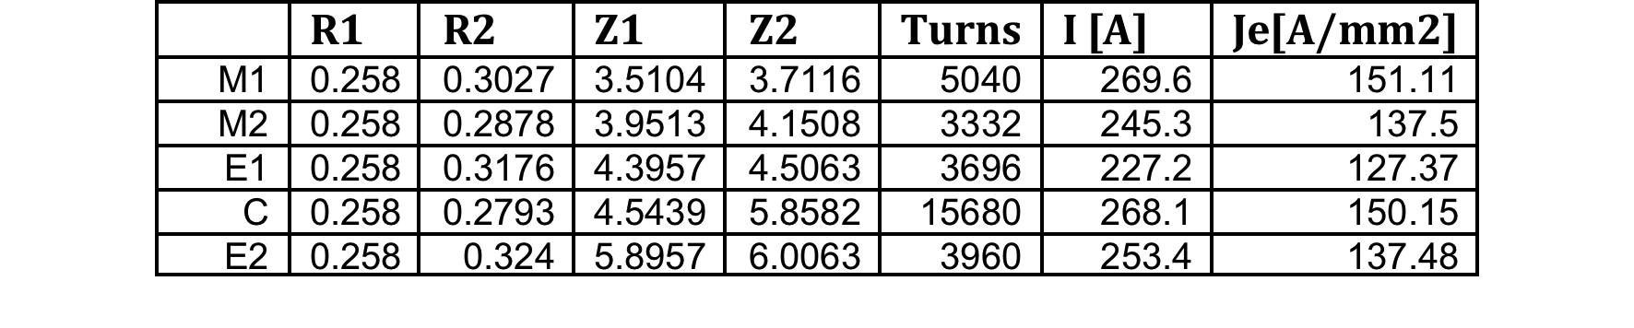
Simple Wilson-code calculations
Basic input parameters:
Cu:SC=3.9
Fractional areas: Copper: 69%; SC: 17.7%; insulation: 13%
Area of unit cell (1 turn): 0.0178 cm²
Relative transverse propagation velocities: 1%
Turn and geometry info
Inductance matrix

Slide 8
Wilson code results
Note: transverse propagation was “tweaked” to ~match 5s decay time for case “C alone”
Sensitivity of derived values, e.g. Tmax and Vmax, is not strong
Peak dI/dt~40A/s

Slide 9
Hot-spot temperature and Peak internal voltage
Code limitations:
No quench back
Transverse propagation “fit”
“Lumped” stored energy; real quench events more complicated
Actual hot spot temp significantly lower, due to bypass current
No detailed information on size of resistive zone, voltage gradients

Slide 10
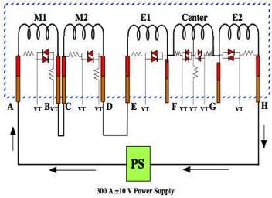
Protection circuit: test condition example
Circuit with most stored energy
If a quench occurs in E1:
Current shunts via diode+resistor across E1
Coil current in E1 decays
Coil currents in neighboring coils increase
Due to mutual inductance
Generate bypass currents
Other coils either…
Quench - very likely, due to quenchback
Remain superconducting
Unlikely except for very low-current quench, when
significant margin is available
Energy in quenched coil is insufficient to boil off stored helium
Current continues to decay due to bypass resistance, but with very long time constant

Slide 11
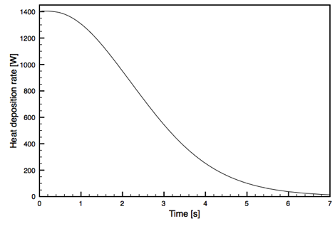
Protection resistors: temperature rise
Characteristic quench decay time ~5s
M. Green, from experiment
Assume all current in bypass:
=> Tmax<300K
Possible concerns:
Anomalous quench scenarios
Is 0.02Ω optimal (define)
Power supply not shut-off

Slide 12
HTS leads
Protection concept:
First: avoid quench by providing margin!
No energizing until high-end temp. sufficiently low
Second: trigger spin-down if issue arises
Interlock PS to high-end temperature
Interlock PS to voltage drop
Third: make access to HTS leads “reasonable”
And design protection to avoid damage to cold-mass in case of such faults

Slide 13
3D simulations
Limitations of “Wilson code” simulation:
Does not consider mutual coupling and full electric circuit
Does not take into account quenchback from mandrel heating
Does not provide means of determining turn-to-turn or layer-to-layer voltages
Vector Field Quench module:
Provides for mutual coupling and full electric circuit
Provides for quenchback from mandrel heating
Can use “Wilson-code” for validation on simple system (e.g. single coil with no quenchback)

Slide 14
3D simulations
Material properties are defined
Specific heat:
Cu, NbTi, Al6061
Thermal conductivity:
Cu, Al6061
Coil effective bulk - longitudinal and transverse
Jc(B,T) of NbTi conductor
Electric circuit for series test configured
Allows diodes + resistors
Various models have been tried
Independent analysis from:
Heng Pan (LBNL)
Vladimir Kashikhin (FNAL)
Some cross checks highlighted:
Importance of mesh (space and time) refinement
Some insight into sensitivity (or lack thereof) with respect to properties

Slide 15
Electric circuit definition
From Kashikhin

Slide 16
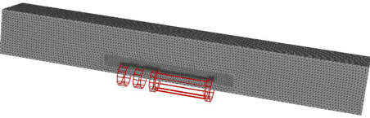
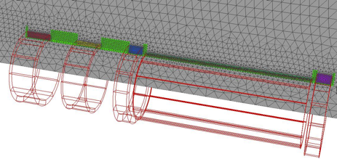
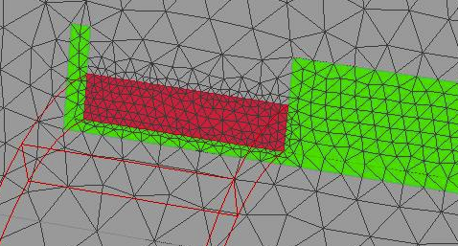
Model mesh (LBNL)

Slide 17
Simulations: validation
Code validation:
Comparison with Wilson code yield reasonable agreement of coil normal zone growth
Wilson code
LBNL VF model

Slide 18
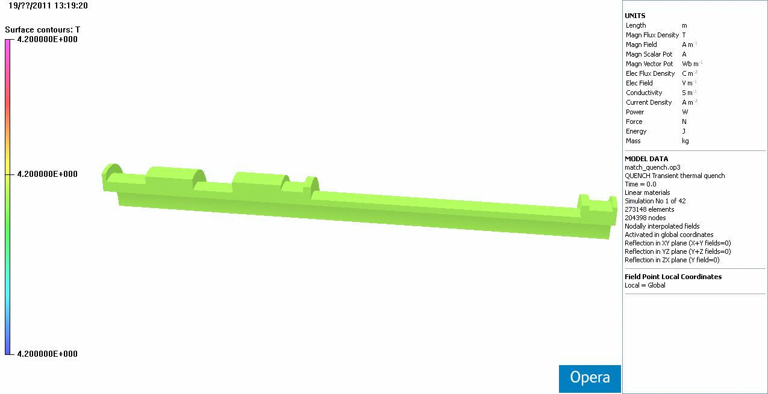

Simulations
Evaluate current fluctuations, decay, voltages, hot-spot temperature throughout circuit:
Dependence on quench current
Evaluate role of quench-back from mandrel:
Temperature rise and distribution in mandrel during a coil quench

Slide 19
Simulations
Current evolution for a central solenoid quench
265A initial current

Slide 20
Simulations
Current evolution for an M1 solenoid quench
265A initial current

Slide 21
Quench Scenarios at Different Currents LBNL model

Slide 22
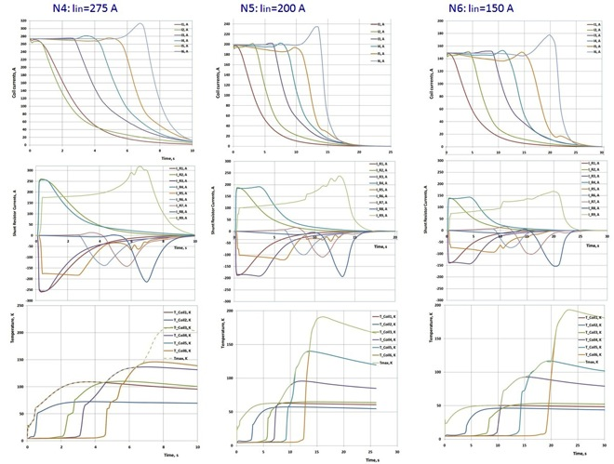
Quench Scenarios at Different Currents FNAL model
N4: The initial current is 275 A. All currents drop to 10 A levels after 10 s. Coil 6 which far away from the quenched Coil 1 will be heated in 7 s to the peak temperature of 140 K. The R9 shunt resistor will carry current ~ 275 A during 8s.
N5: The initial current is 200 A. The current in the Coil 6 drops to zero after 18 s. The Coil 6 hot spot temperature is 180 K. The R9 shunt resistor will carry current ~ 200 A during 15 s.
N6: The initial current is 150 A. The current in the Coil 6 drops to zero after 25 s. The Coil 6 is on the opposite side of solenoid and sees the largest “quench back” delay time. The Coil 6 hot spot temperature is 190 K. The R9 shunt resistor will carry current ~ 150 A during 22 s.

Slide 23
Quench Scenarios at Different Currents Model differences
Main differences:
FNAL model yields longer delay between quenchback of coils further away
FNAL model yields higher hotspot temperatures
Expected sources of differences:
FNAL model needs further time-step reduction
FNAL model includes insulation layer

Slide 24
Simulations: Issues and Caveats
General model differences:
LBNL model: quarter model, heater “surface”
Effectively 2D axisymetric propagation
FNAL model: full 3D model, localized heater
Direct comparison of results using the two models on a quench scenario show differences do not significantly affect later temporal evolution or the hot-spot temperature

Slide 25
Simulations: model comparison
Expect difference to stem from timestep size (0.01 (2D) vs 0.05 (3D)

Slide 26
Simulations: Issues and Caveats
General model differences:
LBNL model:
No separate baseplane insulation layer is modeled
No separate modeling of the aluminum banding is provided
FNAL model:
1mm baseplane G10 is meshed
Aluminum banding is modeled/meshed
Expect some difference in quenchback time
Other: central coil split in z (FNAL), in r (LBNL)

Slide 27
Simulations: Issues and Caveats
Material properties:
Some strange VF code issues were discovered independently by FNAL and LBNL
Problem with interpolation of Jc(B,T) table
Some differences (~10-20%) in material properties used by LBNL and FNAL were found to have similar affects on key parameters (e.g. hot-spot temperatures) when run on the same model
No highly sensitive parameter has been found

Slide 28
Simulations: Issues and Caveats
Model resolution:
Model mesh refinement has been performed:
Results show mesh is sufficiently refined
Temporal resolution:
Significant differences have been found if time-step is not sufficiently small
Tests are ongoing to verify that time-step used in current results are sufficent

Slide 29
Simulations: temporal resolution
Model resolution (LBNL):
Time steps of 0.01 vs 0.005 => sufficiently time resolved

Slide 30
Goals of simulations
Main questions to be answered by 3D simulations:
What are the maximum turn-to-turn and coil-to-ground voltages seen during a quench?
Are there scenarios where a subset of coils quench, but others remain superconducting, resulting in slow decay through bypass diodes and resistors?
What modifications to the existing system should be incorporated to minimize/eliminate risk to the system in case of quench

Slide 31
Goals of simulations: Voltages
Turn-to-turn voltages:
Remains negligibly small throughout quenches (<1 volt)
Layer-to-Layer voltages:
Maximum in Central solenoid
Reaches ~450V - occur in outer layers!
Coil-to-ground voltages:
Maximum in Central solenoid
Reaches ~1.3kV (~2kV resistive)
Values are lower than Wilson code
Segmentation and Quenchback help
Note: Coil hi-potted to 5kV

Slide 32
Protection methodologies
Two approaches under consideration:
Improved passive protection
Add thermal link to sink heat from bypass resistors
Add interlocks on temperature and voltage on HTS leads
Add interlock to shut off power supplies in case of faults
Active protection
Add heaters (e.g. cartridge heaters) to initiate quenches
Requires capacitor bank, fast quench detection
Should protect against serious faults, and reduce hot-spot temp. and internal voltages during typical quenches

Slide 33
Protection methodologies: Issues
Improved passive protection: general rationale
System has survived many quenches
HTS burn-out and lead burn out resulted in very high bypass-resistor temperatures (see burns in G10)
No problem has been observed at joint area
Proposed cooling of bypass resistors will:
Lower temperature at bypass resistors (lower driving force)
Speed up heating of mandrel => produce earlier “quenchback”
Issues:
Must demonstrate that no shorts / new faults will be introduced

Slide 34
Protection methodologies: Issues
Active protection: general rational
Allows user-induced quenches
Protects against fault scenarios
Protects leads (HTS and LTS)
Issues:
Requires more sophisticated detection circuitry
Requires capacitor bank and high-voltage feedthrus
Must not induce shorts under numerous cycles
Must be installed in mandrel (coil already in place)

Slide 35
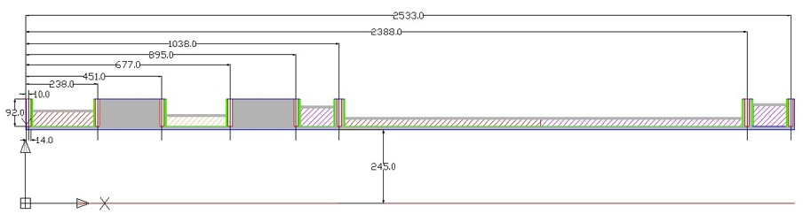
Active Quench Protection System
It is possible to reduce the risk of solenoid damage by implementing an active quench protection system. It was investigated the variant of active quench protection system with heaters incorporated in the Al mandrel body. The key issue for such system is to initiate quenches simultaneously in all coils at a reasonable period of time, and dissipated power. For the quench simulation was used scheme parameters of the quench scenario N6. The initial current was 150 A which is well below the nominal operating current 275 A. At this current more power needed to initiate coil quenches which will be much lower at larger currents. All spot heaters are mounted in the 14 mm diameter holes drilled at distances shown in Figure above. Each spot heater generates 400 W during 1 s or 400 J of thermal energy.

Slide 36
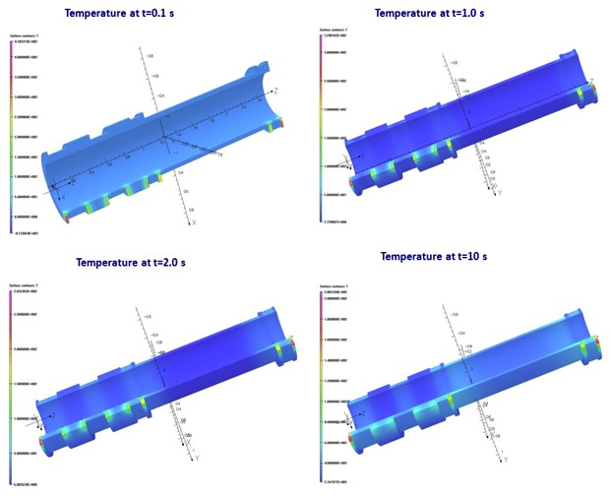
Heaters Energized
When the heaters energized all coils about simultaneously will be quenched in the adjusting to the heater areas. The quench delay time is only 0.1 s. The heater power should be optimized and reduced to the optimal value.

Slide 37
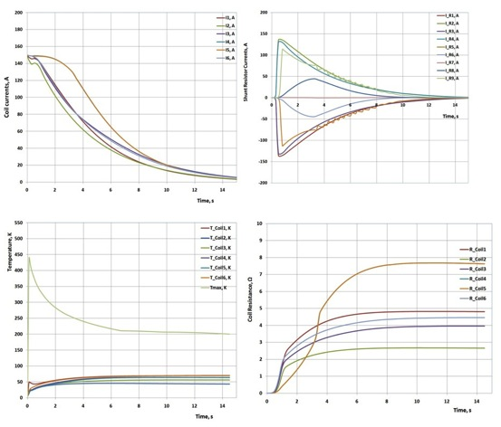
Quench by Heaters
The peak temperature during quench will be in the aluminum around spot heaters. The maximum temperature observed on both sides of the mandrel having only 20 mm thick side Al walls. The proper optimization of heating power will equalize the temperatures around heaters, and the quench time of all coils.
Nevertheless, even for this not optimized scenario, the currents in all coils simultaneously decay to zero in 15 s. Because of more homogeneous dissipated power distribution between coils, the hot spot temperature in coils is in the range of 45K- 70K

Slide 38
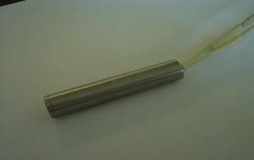
Cartridge Heaters
There is sense for the redundancy to have two groups of heaters (2x8), placed across the mandrel diameter, and powered from independent power sources. This will also further decrease the coil current decay time, and coil hot spot temperature.
The implementation of the proposed active protection system strongly correlates with the probability of quenches at relatively low coil currents. These quenches may be initiated during the solenoid charge/discharge, unexpected temperature rise, magnet training. It is also supposed during the experiment to investigate a muon cooling at different energies with a corresponding field, and the solenoid current variations.
Quench parameters confirm the efficiency of proposed active quench protection system. Usually the cartridge heaters used for soldering, parts preheating during superconducting magnet fabrication. Figure above shows the standard spot heater of 12.7 mm diameter, and 66 mm length. The peak power at DC current is 500 W which more than enough for this application.

Slide 39
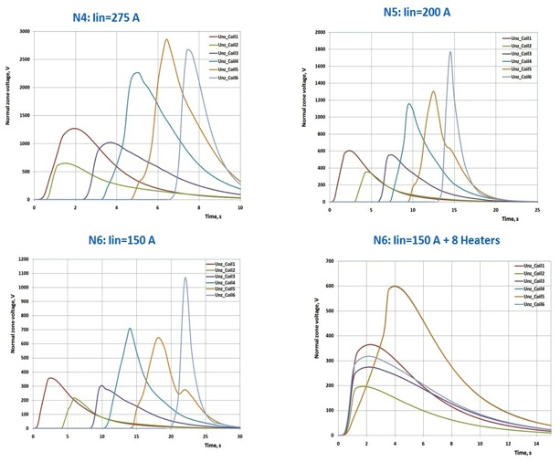
Normal Zone Voltage
The peak Coil5 voltage is 2.8 kV at the 275 A initial current . This coil has 20 layers. In this case the voltage between layers will be ~ 140 V. This is relatively high voltage especially combined with the temperature rise, and He gas low electrical properties.
With heaters at 150A the peak voltage is two times lower.

Slide 40
Some Findings
The lower quench current is, the longer delay time in the “quench back”.
The coil current decay time for the solenoid final configuration is in the range of 10 - 25 s, and depends on the material properties.
The coil hot spot temperature at the low quench current may reach 200K.
The coil leads attached to the heavily stabilized by copper leads (inside the cold mass) may be overheated or even melted.
The active quench protection system with cartridge heaters into Al mandrel can reduce the risk of the cold mass failure. The spot heater mockup test may be useful.
The low current quenches possible during the magnet system operation.
The presented simulation results should be verified by using: the more fine mesh, measured superconductor critical current density at varies temperatures and flux densities, measured nonlinear cold diode V-A characteristics.

Slide 41
Remaining concerns
General consensus:
Bypass resistors will get warm during…
low-current quenches
Serious fault scenarios (e.g. burn-out of HTS leads, or lead feed-thru)
Need to “clamp” bypass resistor temperature
Will/can warm bypass resistor result in lead-quench?
Lead quench (initiated at joint) will propagate into coil
Coil quench will result in current decay
Leads are adiabatic => ~4-6 seconds at full current before burn-out
Does this concern justify active protection circuit?
Review pros and cons of implementing active protection?

Slide 42
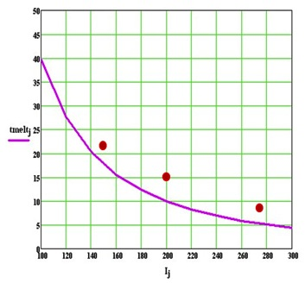
Strand Critical Adiabatic Heating
So, the adiabatic estimation shows the possibility of the bare strand melting in the lead of a far away coil at any quench current, if the quench propagates along the whole solenoid length from the Coil 1 to the Coil 6. This estimation does not take into an account the normal zone grows and the corresponding current decrease around overheated strand, which initially heated from the nearby shunt resistor.
The copper strand melting time vs. current. Strand carrying the I_R9 currents (275A/8s, 200A/15s, 150A/22s) shown as the red dots

Slide 43

View of protection circuitry

Slide 44
Temperature rise of bypass resistors: radiation cooling vs convective transfer 200A constant current, “Adiabatic ends”
Assume ε=1

Slide 45
Heat transfer to Helium

Slide 46
More realistic thermal accounting
Heat transferred along resistor
Heat transferred to LHe (film coefficient)
Heat transferred via radiation

Slide 47
Effect of conduction from ends case of 6s time constant
End conduction competes poorly
Film boiling is best, but need LHe
Long t0 scenarios require distributed cooling
Note: current is decaying (6s time constant)
With Lhe cooling
T [K]
Adiabatic (but end-cooled)
Time [s]
Conductor length [m]
Clamped temperature

Slide 48

Summary
Protecting resistors from
Open circuit
Low-current quench
=> need to sink resistors
Preferably to mandrel nearby:
large heat capacity,
access all helium,
induce coil quenches

Slide 49
Proposal
Provide a path for thermal transport from resistors to cold mass:
Simple design that minimizes risk to resistors
Avoid shorts
Avoid significant deformations
Allow resistors to flex
Capable of transferring ~1.5kW DC with “reasonable” dT
Example: dT=300K, Cu plate, 15cm long =>A=15cm²

Slide 50
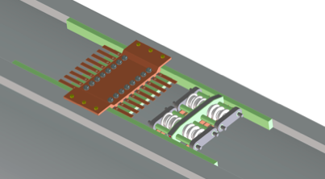
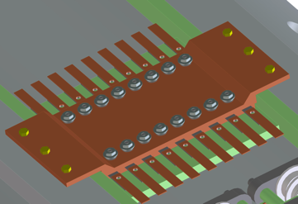
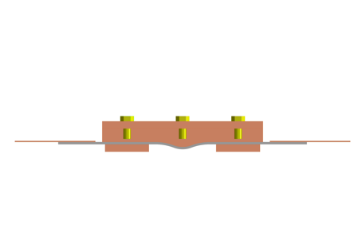
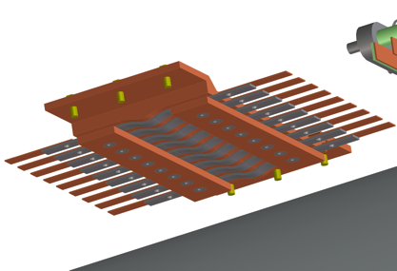
Example of thermal link Thanks to Allan Demello
Capable of >2kW with dT=300K

Slide 51
Proposed plan
Finish test of bypass resistor cooling scheme
Demonstrate reduction in peak temperature
Demonstrate no electrical shorts under cycling
Implement bypass resistor cooling scheme on spectrometer solenoids
Finalize, with detailed engineering note, all 3D simulations
Find sources of the few remaining discrepancies between the two models
Implement strict controls:
Temperature limits on HTS leads
Automate PS shut-off based on quench voltage signals
Give serious consideration to adding active protection
Weigh pros and cons – evaluate risks

