Slide 1
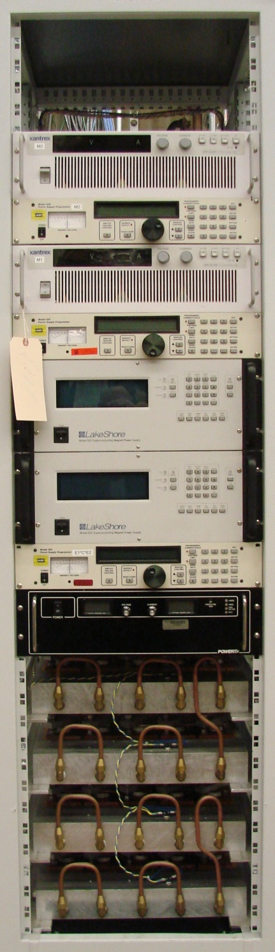
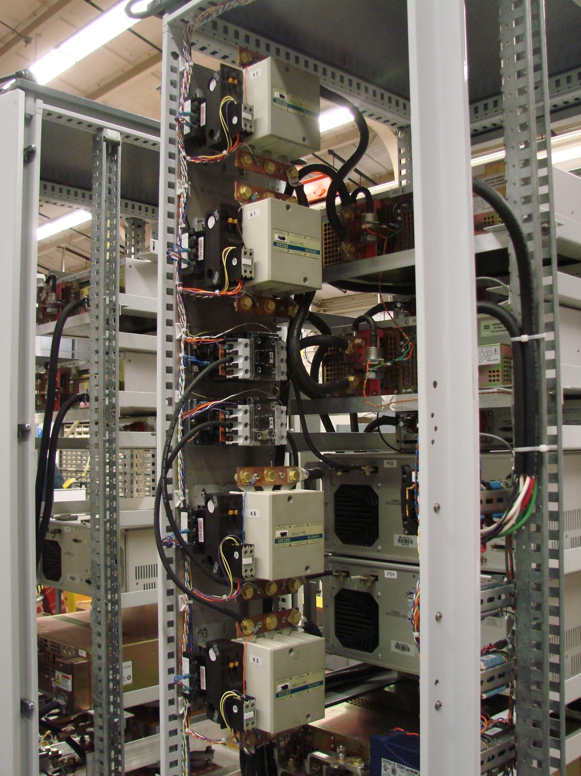
Power Supply System
Spectrometer Solenoid
Test Plan Review
Feb 17th 2012
John Joseph
LBNL

Slide 2
Simplified PS System Block Diagram
Slow Control Functions
  Ramp Rates
  Contactor switching for ramp cycles
  Status Monitoring
    Voltage
    Current
    Temperature
  Direct control of all PS Units
QDS Functions
  Real time Quench Detection
  Contactor switching for fast discharge
  Real time system status monitoring
Power Supply Slow Control System
Magnet Coil Power Supply
Rack
Power Supplies
for the
Center Coil &
Matching Coils
Quench Detect System

Slide 3
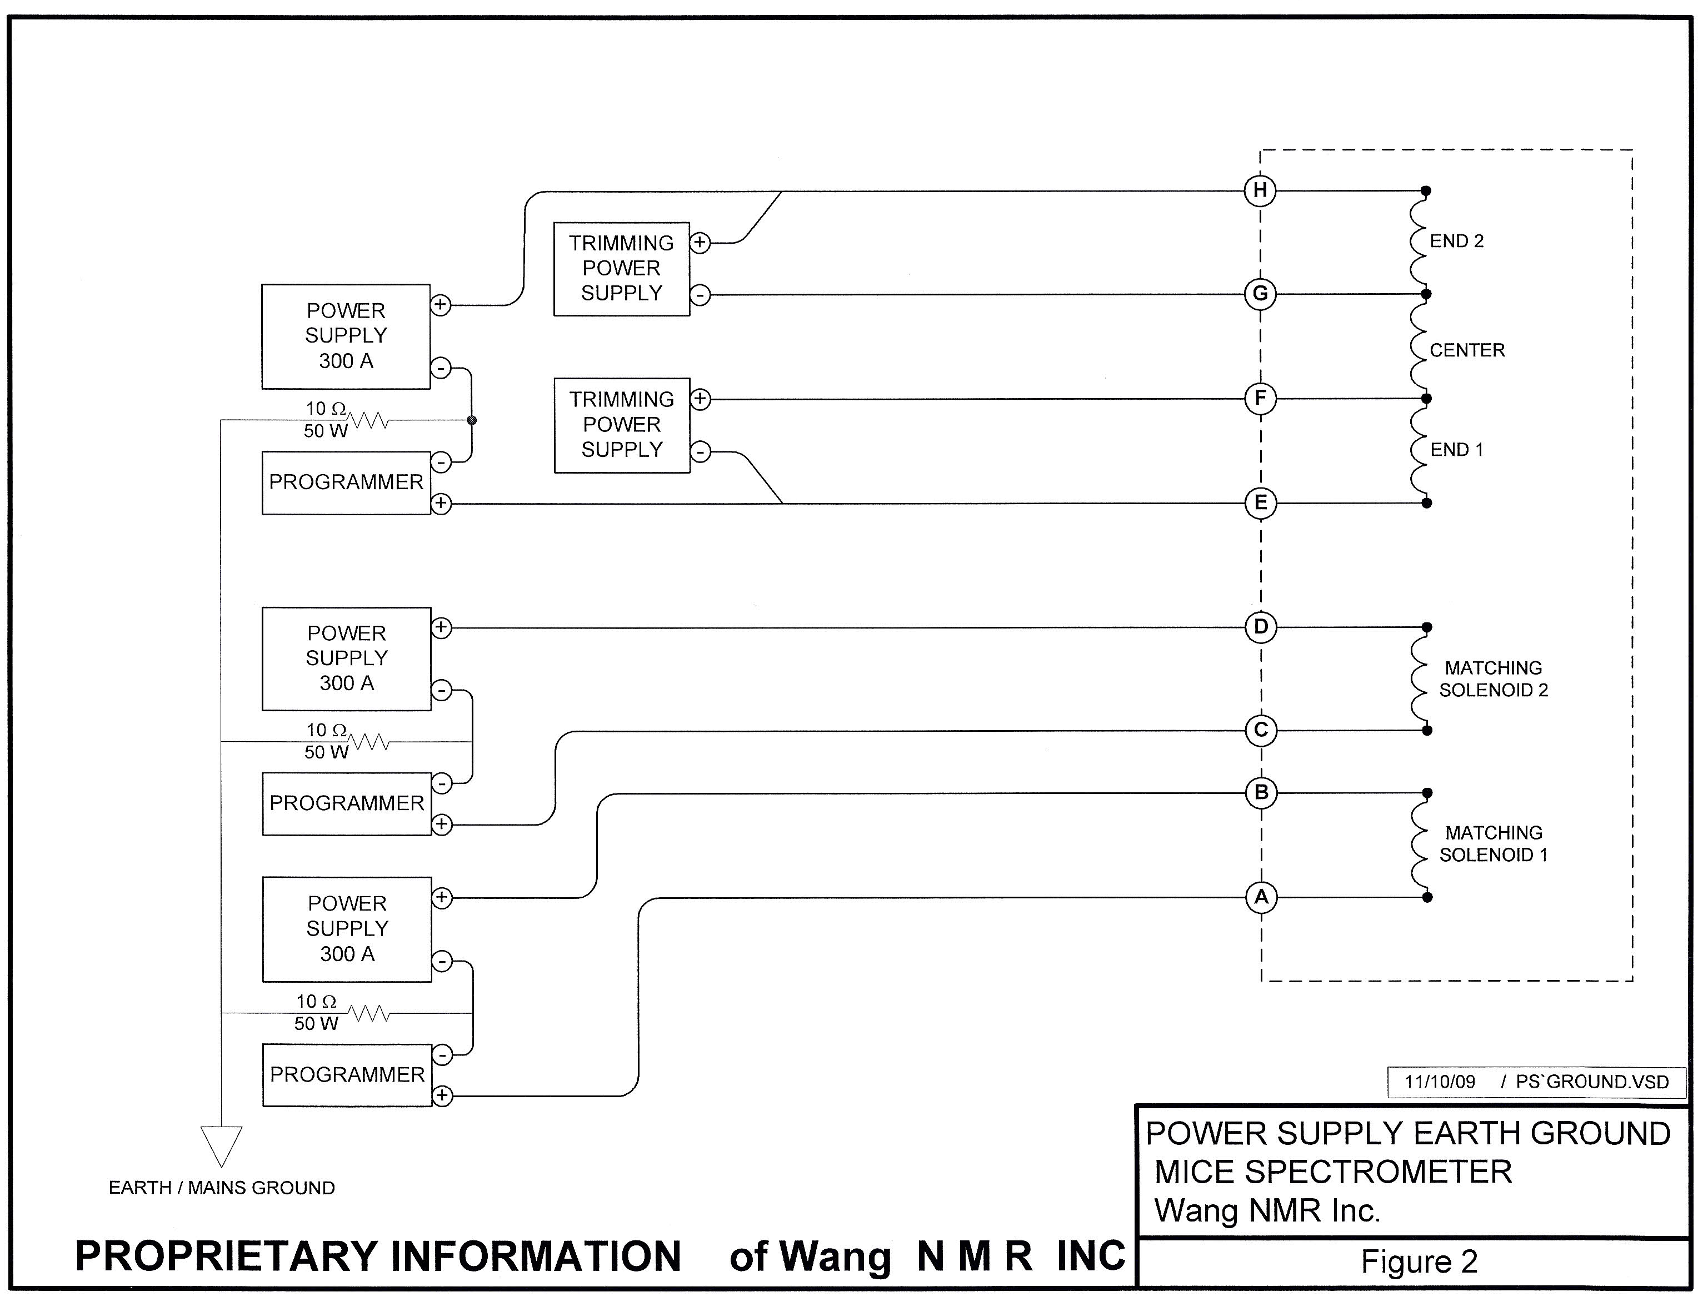
Primary PS Rack Components and Loads

Slide 4
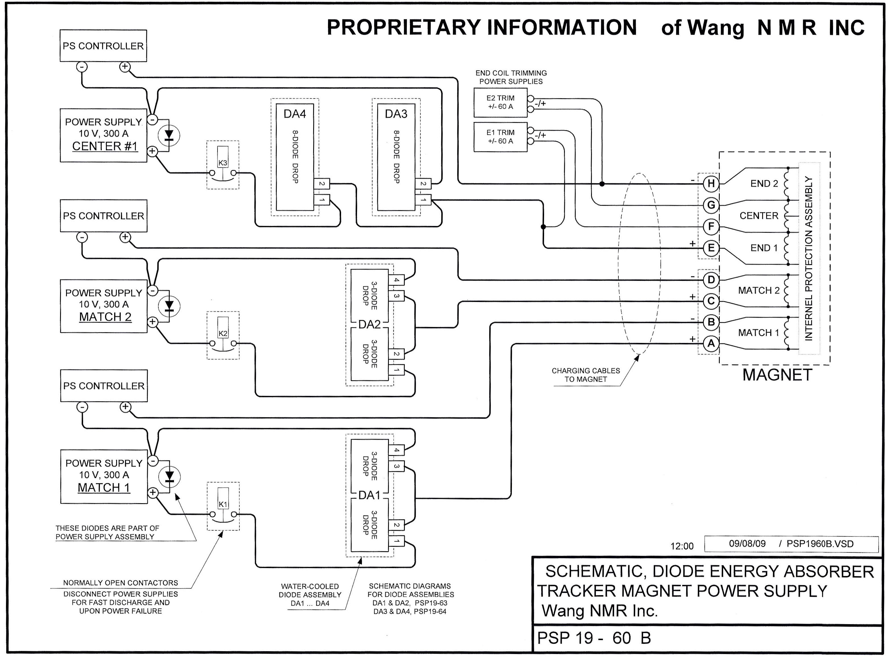
Wang NMR System: DC SIGNAL PATH & Control

Slide 5
LBNL/MICE: DC PATH [As Built]
Added 5 contactors to system
  HTS Lead protection during fast discharge

Slide 6
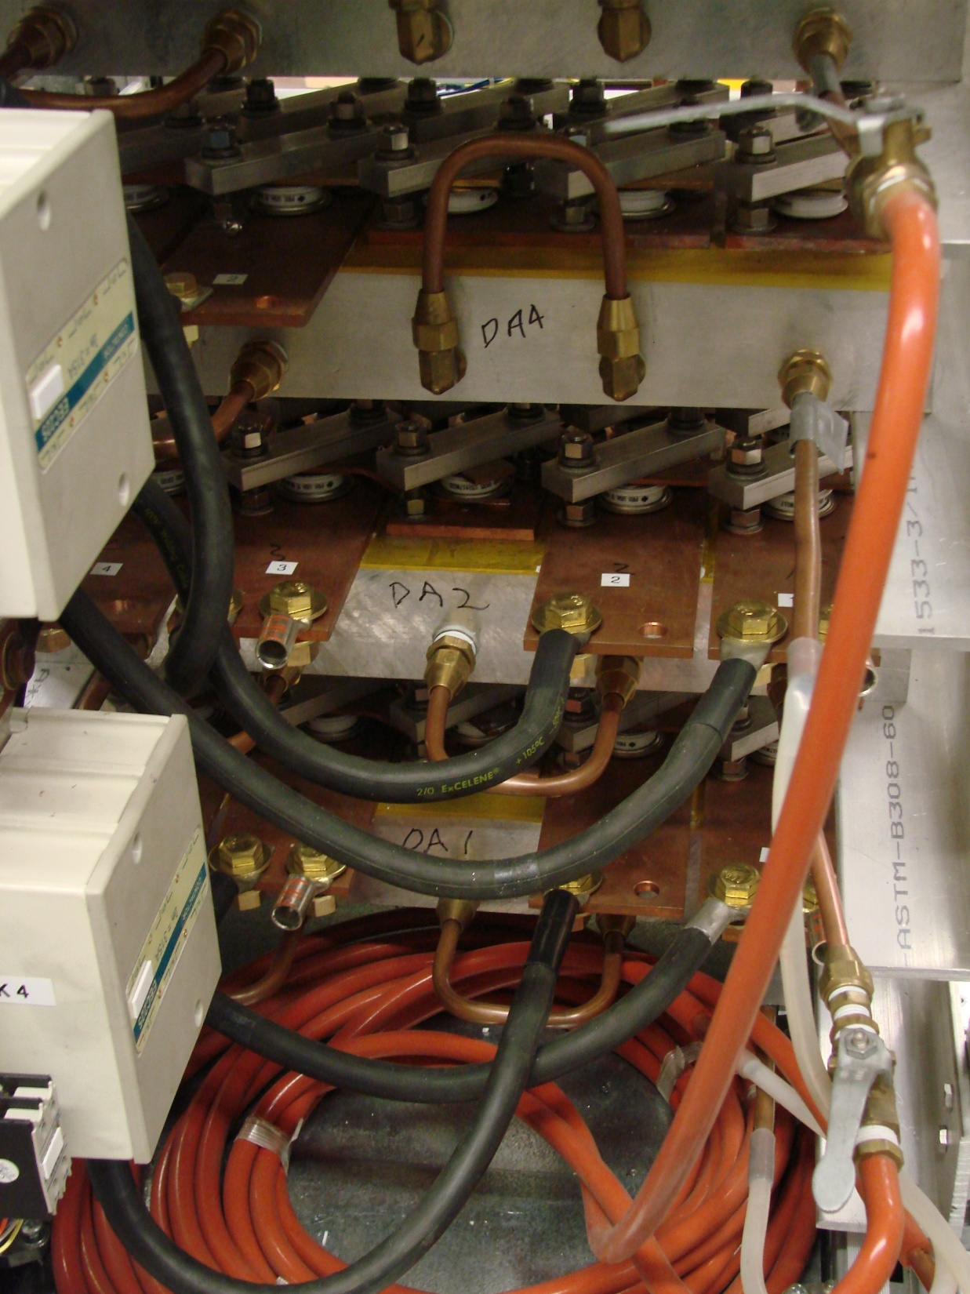
Energy Absorber Assemblies
Plumbing for Water Cooling of Energy Absorbers
4 Energy Absorbers
  Required for slow ramp down of coils
  2 diode assemblies per absorber circuit
    1 DA always dissipating power into air & water
  2 water circuits available for cooling

Slide 7
POWER SUPPLY RACK CONFIGURATION
FRONT VIEW
K2
MS2 300A PS
MS1 300A PS
K1
EC1 60A PS
K7
EC2 60A PS
K8
CS 60A PS
K3
EA - DA3
EA - DA4
EA - DA2
K6
EA - DA1

Slide 8
Summary of Changes Implemented @ LBL
Redesigned system to improve HTS Lead protection
  Additional contactors to isolate coils from power supplies during fast ramp down and enable in-cryo coil protection
  Adding 2nd Solid State Relay to handle increased Contactor pickup current
Reconfigured rack to optimize DC cabling
  Improved physical separation of AC and DC wires
  All Contactors physically close to associated supplies
Moved all AC wiring above water cooling circuits
Replacing 15 VDC PS with 24 VDC PS for interlock circuits
Replaced all control and monitoring wiring
  Bundled twisted pair

Slide 9
Requires 2nd Solid State Relay
  ~35A of in-rush when coils energized to close contactors
Replacing 15 VDC PS with 24 VDC PS
  Standard for Interlock systems
  Requested by RAL
Potential to stagger Contactor on signal to reduce instantaneous power peak

Slide 10
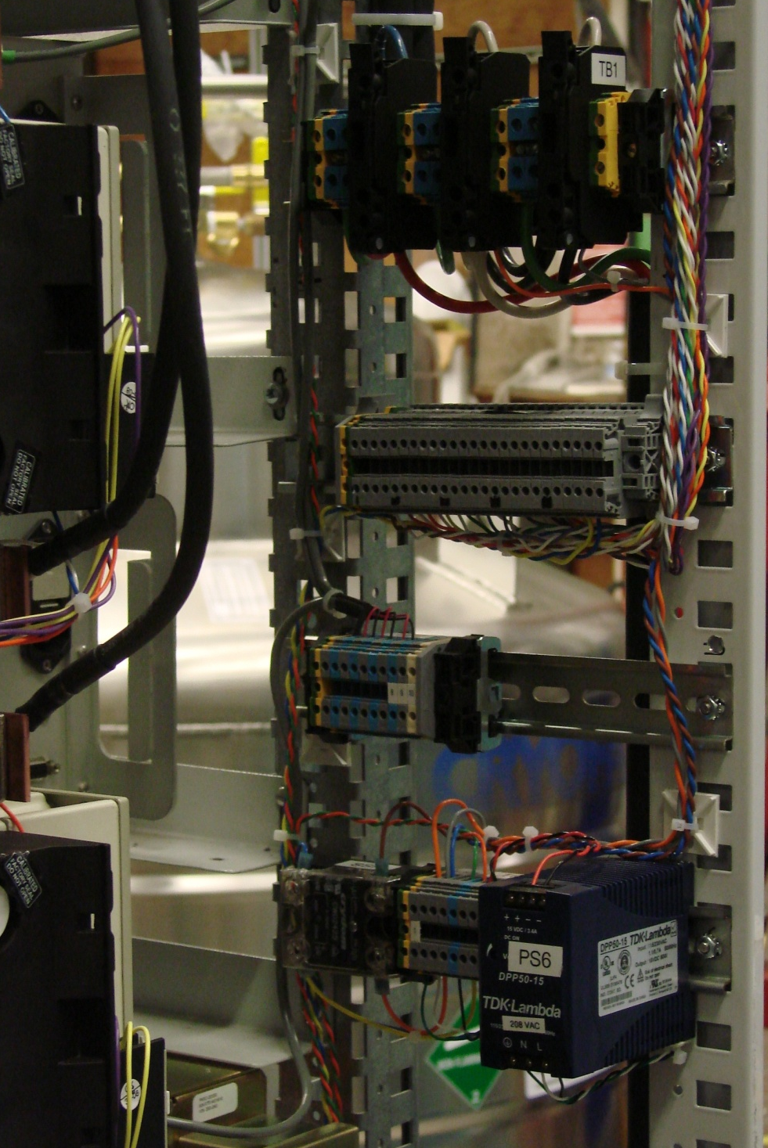
Power Entry, Control, and Monitoring
TB1
208 VAC 3-PHASE
Power Entry
TB4
Status Monitoring
K1 - V_{DROP}
K2 – V_{DROP}
K3 – V_{DROP}
K4 - V_{DROP}
K5 - V_{DROP}
K6 - V_{DROP}
K7 - V_{DROP}
K8 – V_{DROP}
CONTACT STATUS
PS TEMP SENSORS
TB4
Status Monitoring
TB2
PS Voltage Monitoring
SSR, TB3, PS6
Interlock & Contactor Control

Slide 11
Additional Changes per Collaboration Discussion
Rewire Temp Sensors to move over-temp reaction control to Slow or Fast DAQ
  Overheating of Energy Absorbers should be slow ramp down not fast discharge
Add Emergency Off switch to front and back of racks
Contactor Aux Contacts indicate
  All Contactors closed
  One or more Contactors open
    Currently only indicates if all are open

Slide 12
Power Requirements for Test
Loads on 3 Phase 208 VAC
  300A Power Supply for the Center Coil (15A @ 3.3kW)
  300A Power Supply for Matching Coil 1 (80% efficiency min)
  300A Power Supply for Matching Coil 2 (80% efficiency min)
Loads on Single Phase 208 VAC
  6 Contactor Coils requiring 970VA for Pickup
  2 Contactor Coils requiring 245VA for Pickup
  24VDC, 60 Watt, Power Supply for system Interlock circuits
Loads on 120 VAC
  60A Trimming Power Supplies for the End Coils (Qty 2)
    850 VA per Unit
  Power Supply Controllers for the 300A Units (Qty 2)
    50 VA per Unit

Slide 13
Tasks to Complete
Complete remaining assembly tasks on the rack to be used at Wang
  Implement RAL recommendations
Complete the final Documentation package
  Final Schematics & Wire Lists
  Configuration Drawing
Low Current Functionality Testing of all System Components
  Avoid connecting water circuits
  Load PS outputs with shorting cables
Decision on Assembly of 2nd Power Supply Rack
  Requested to go directly to RAL
  New rack configuration is under consideration

