Slide 1
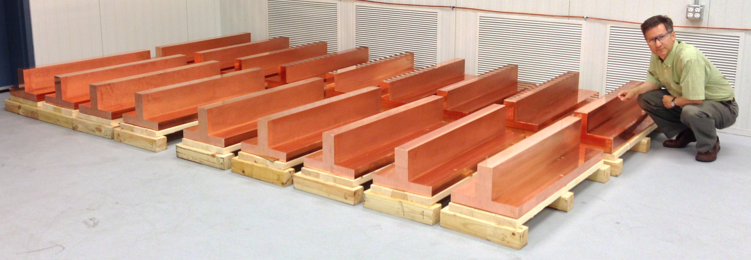
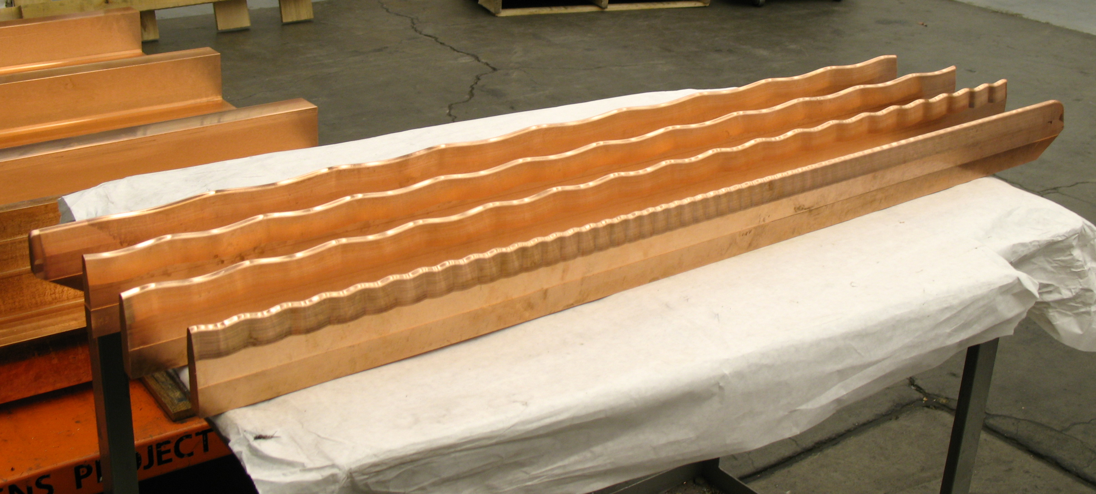
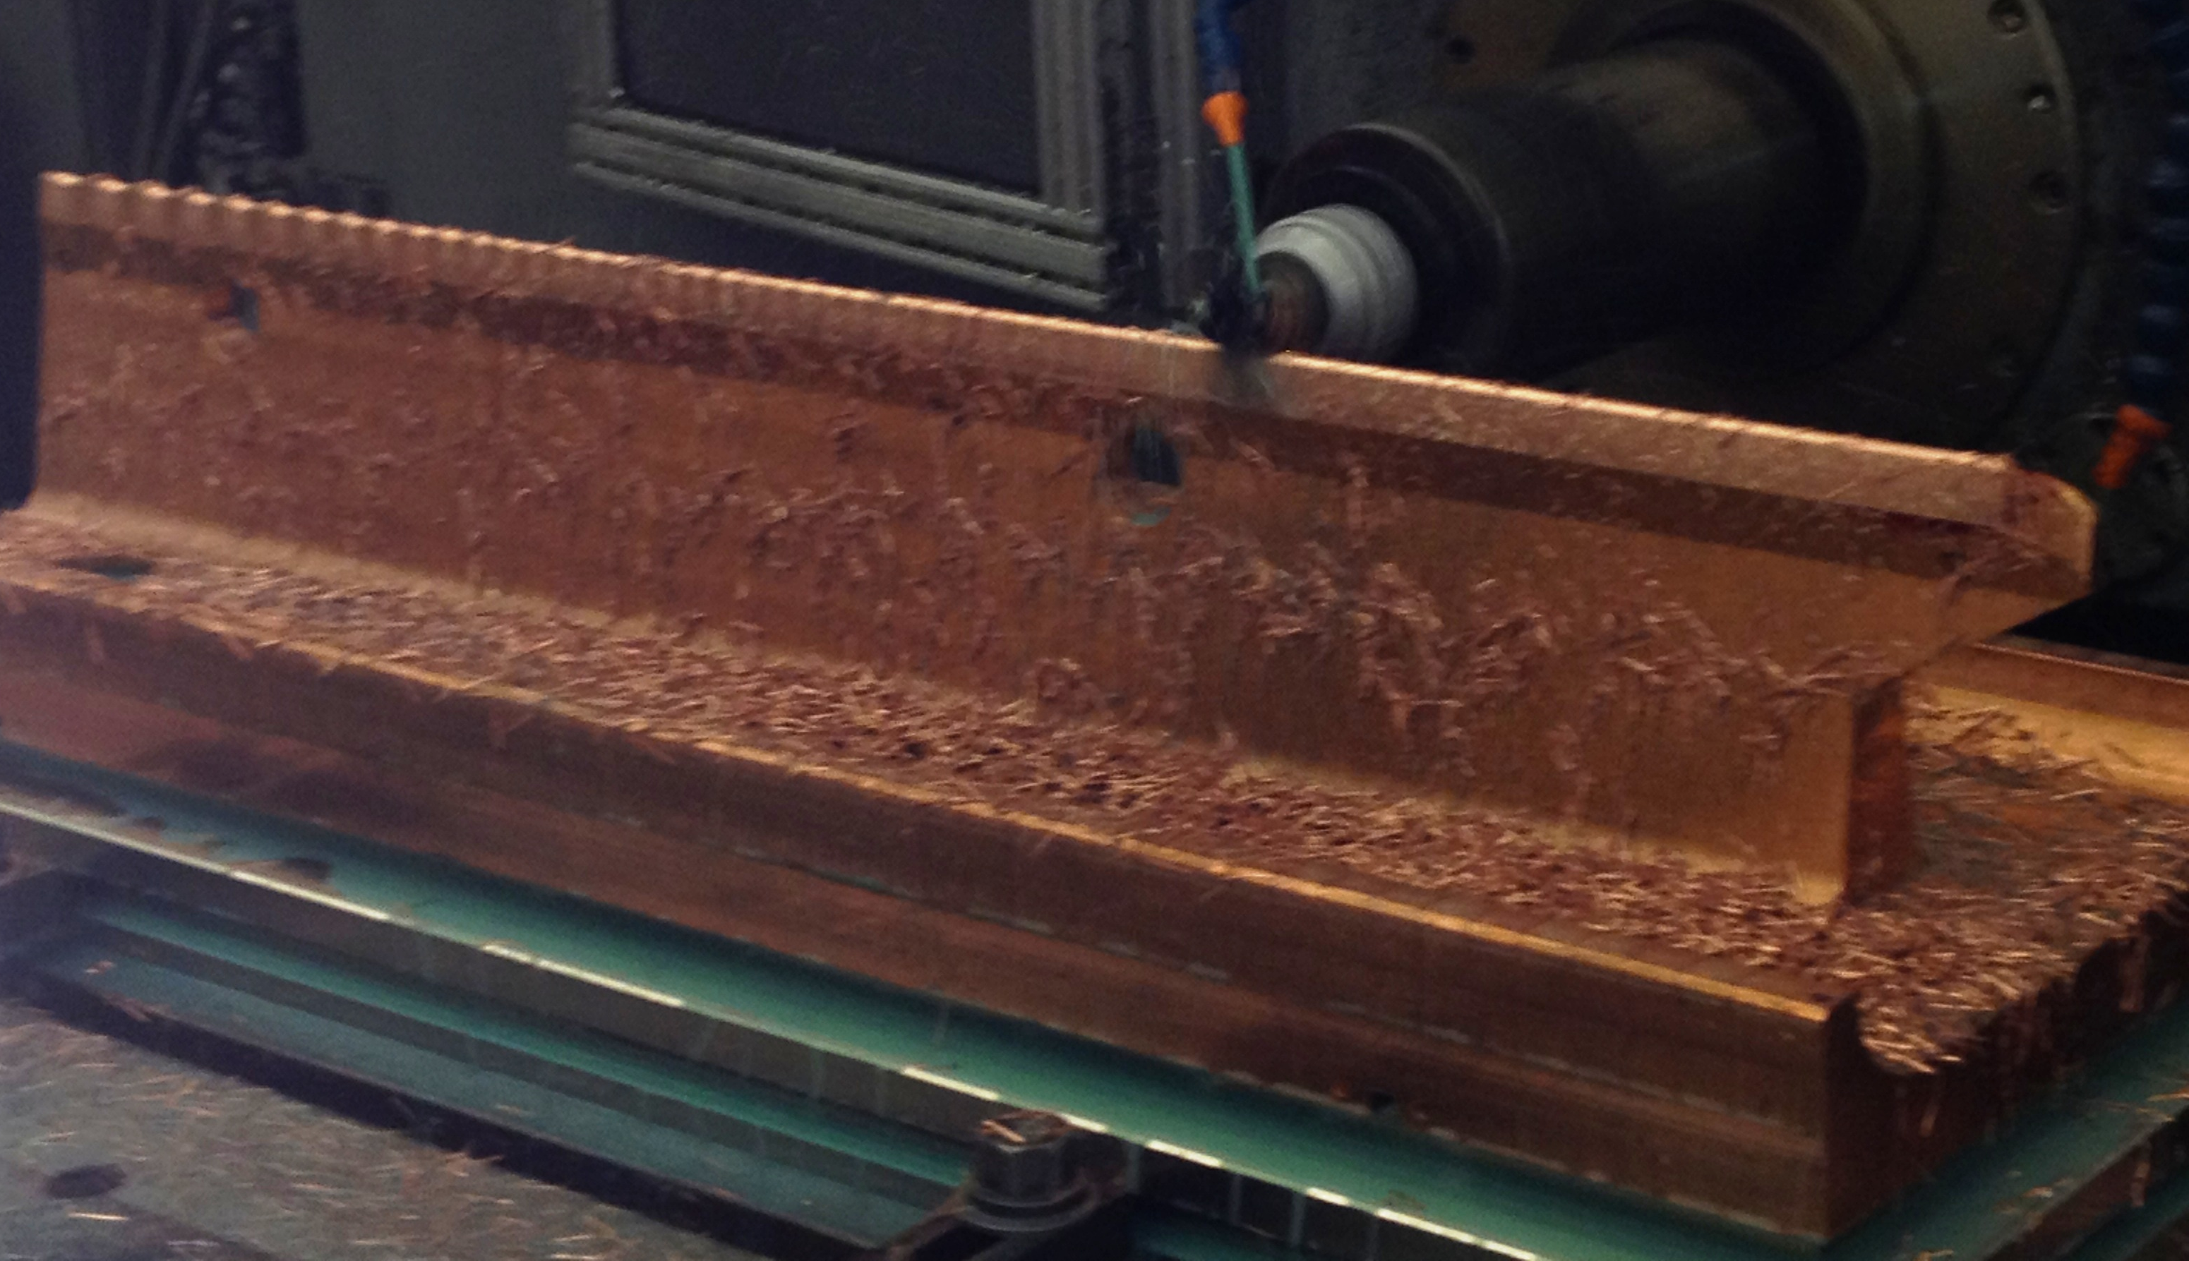
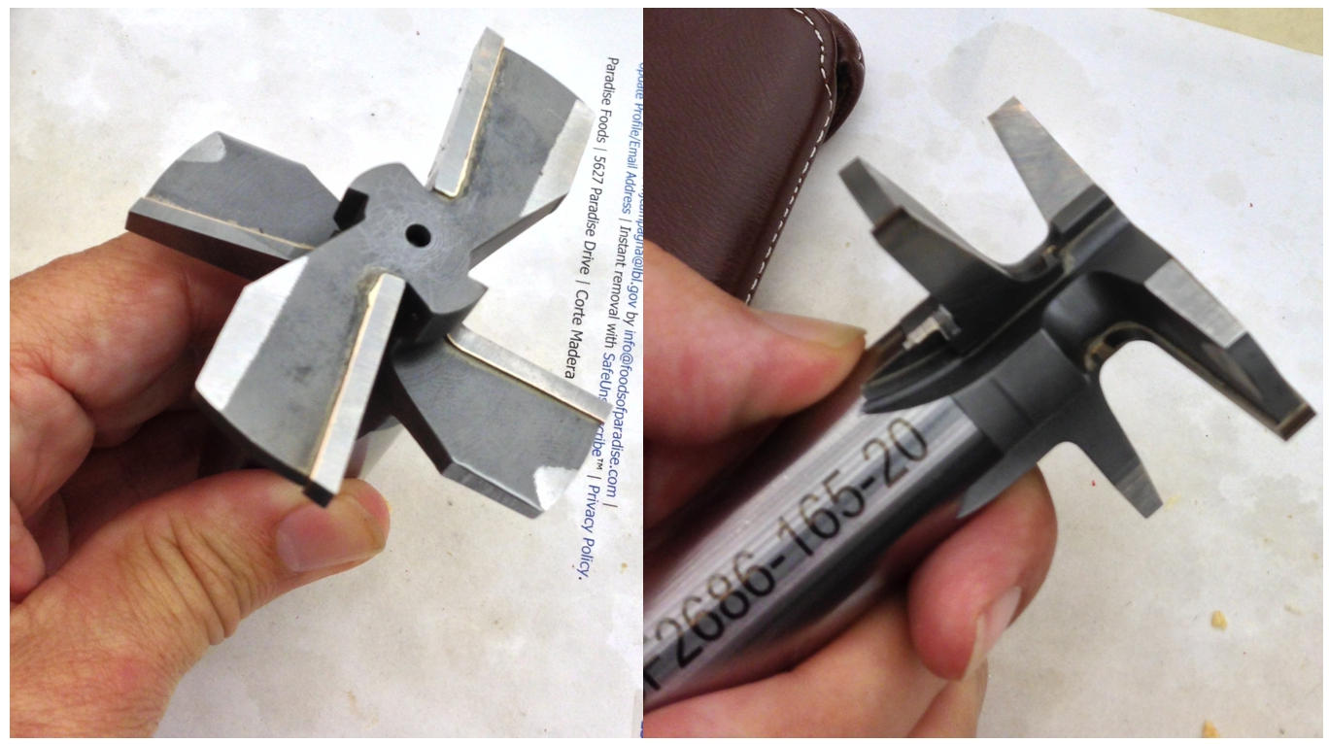
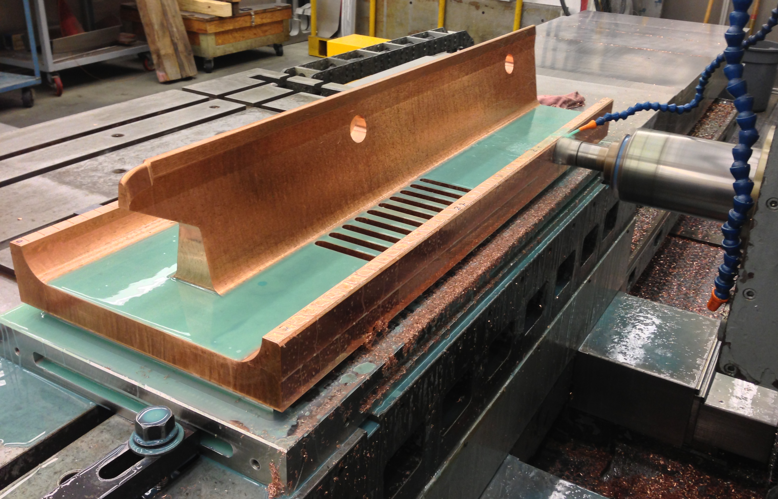
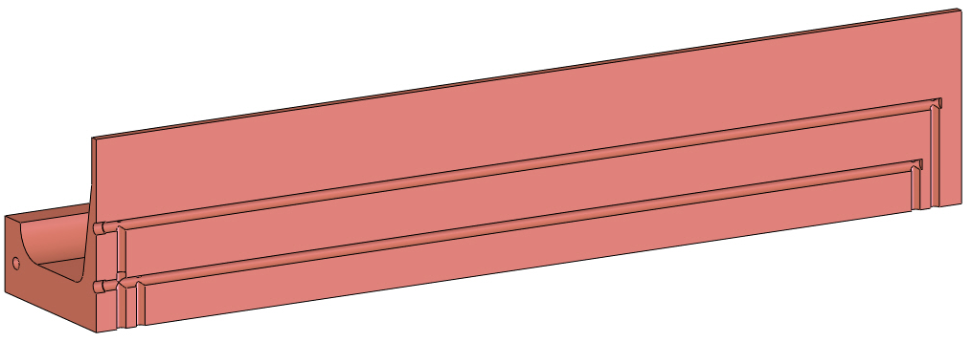
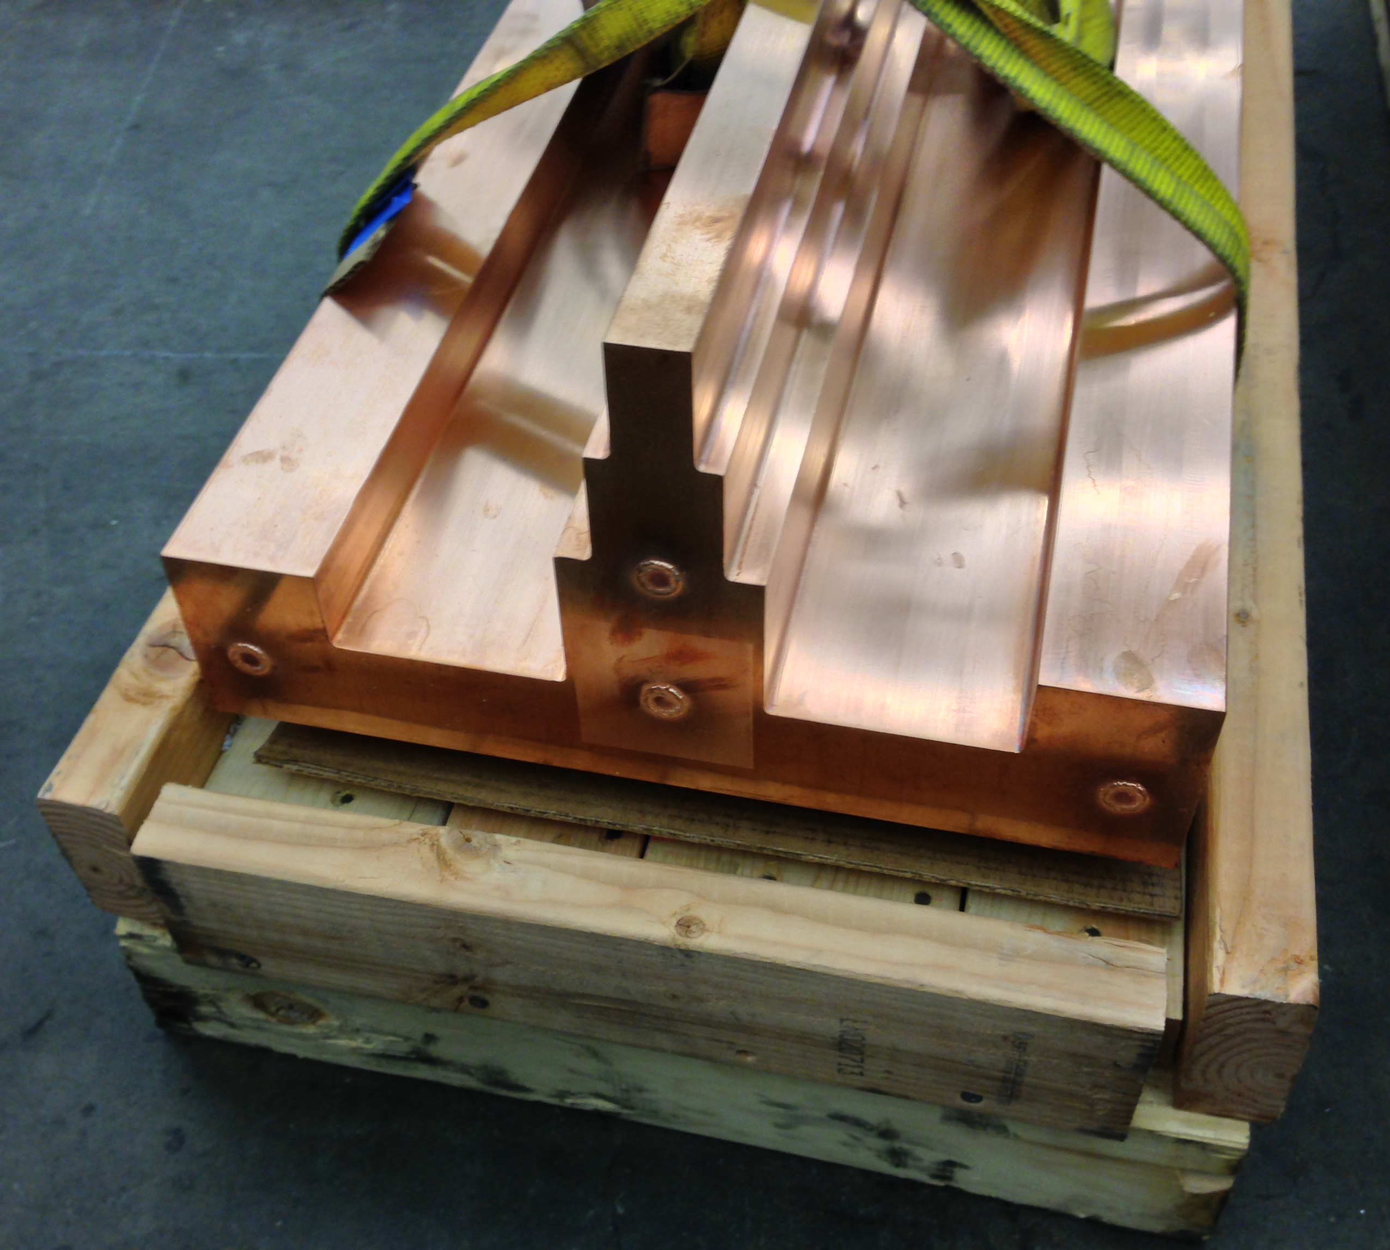
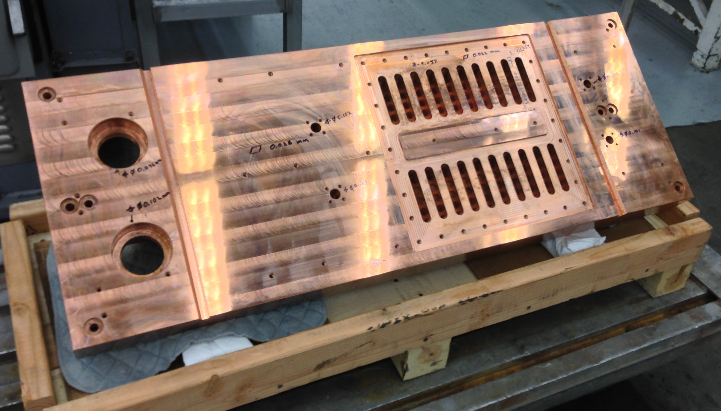
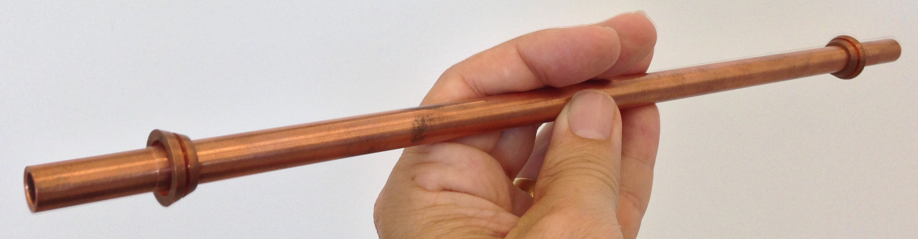
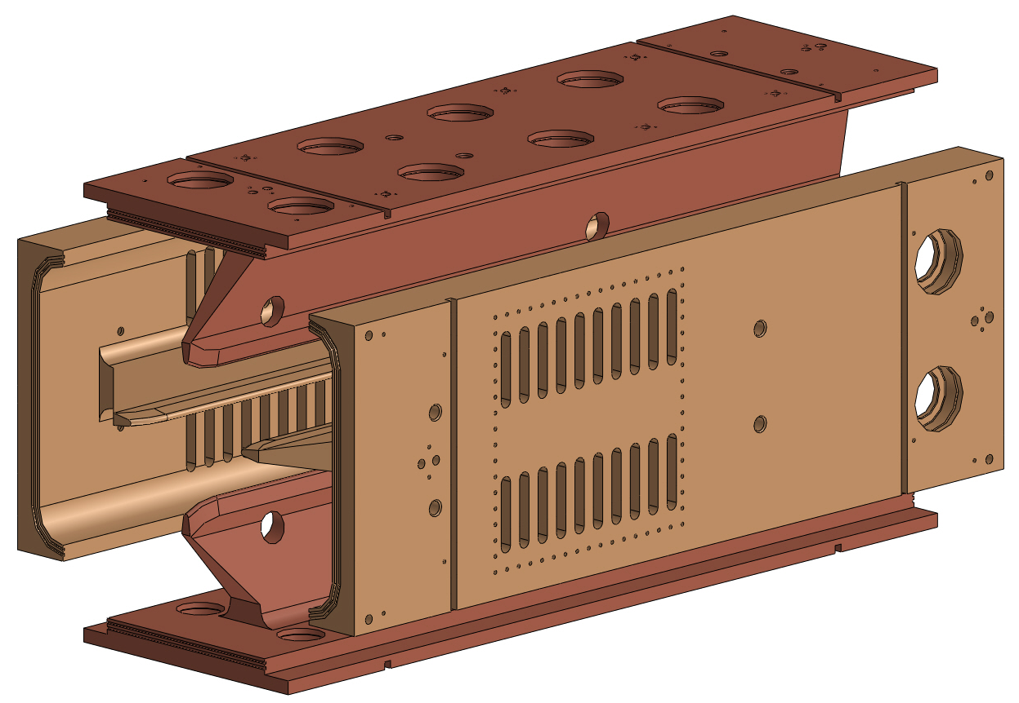
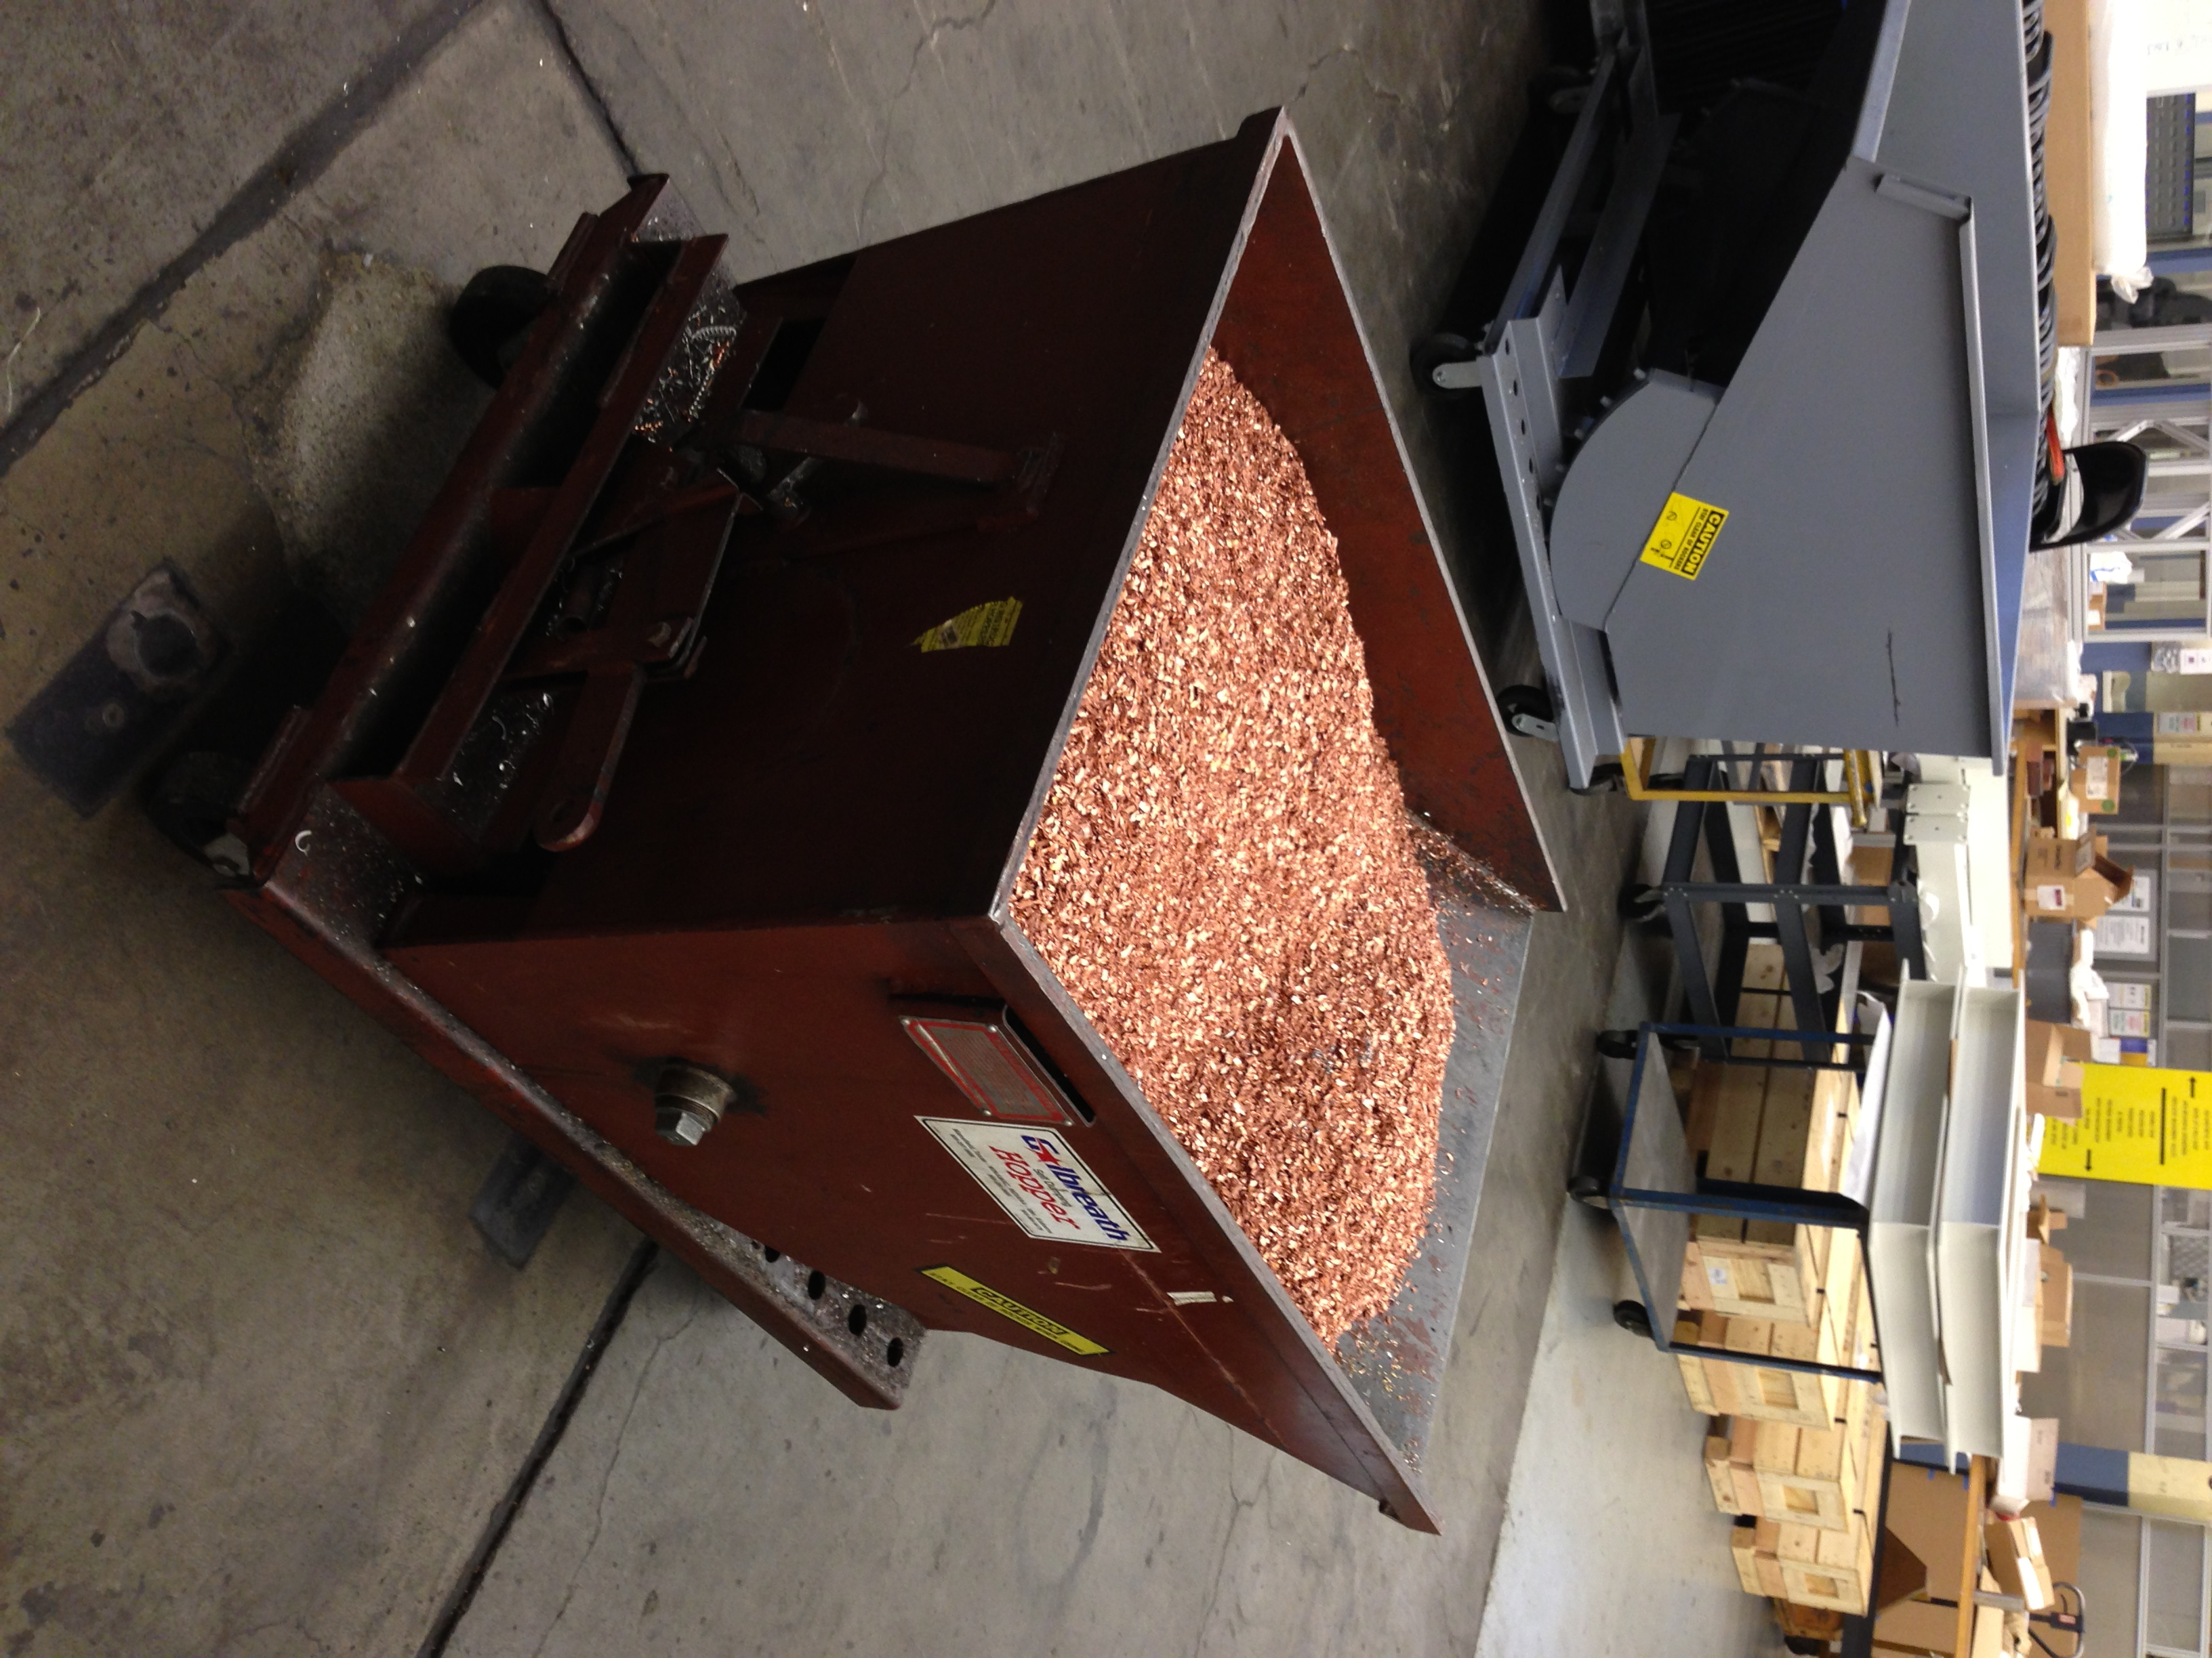
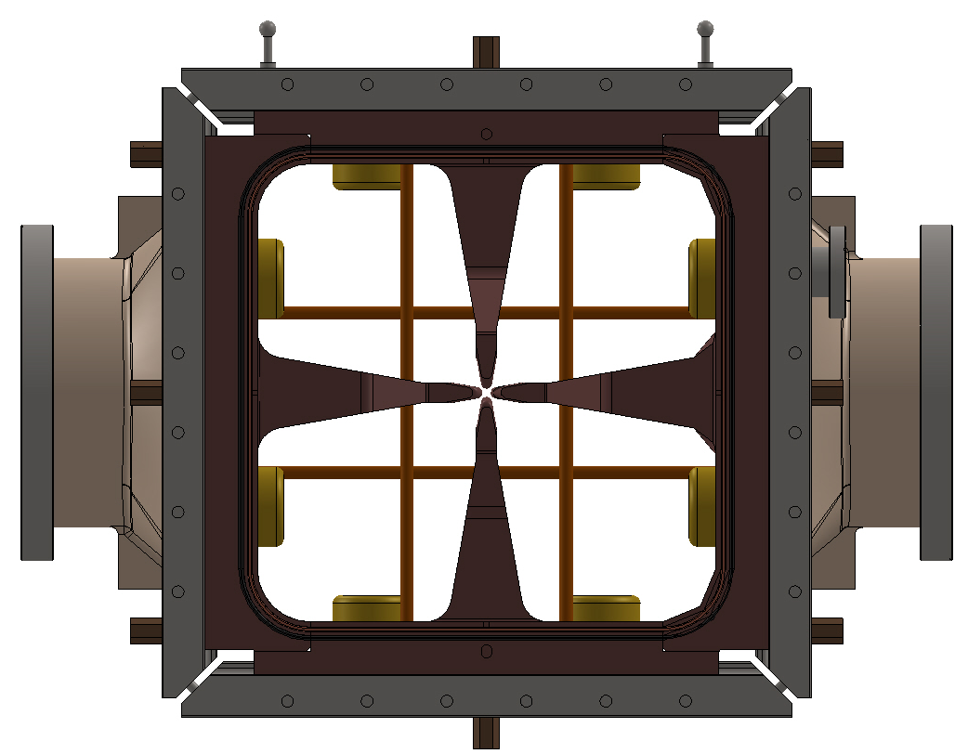
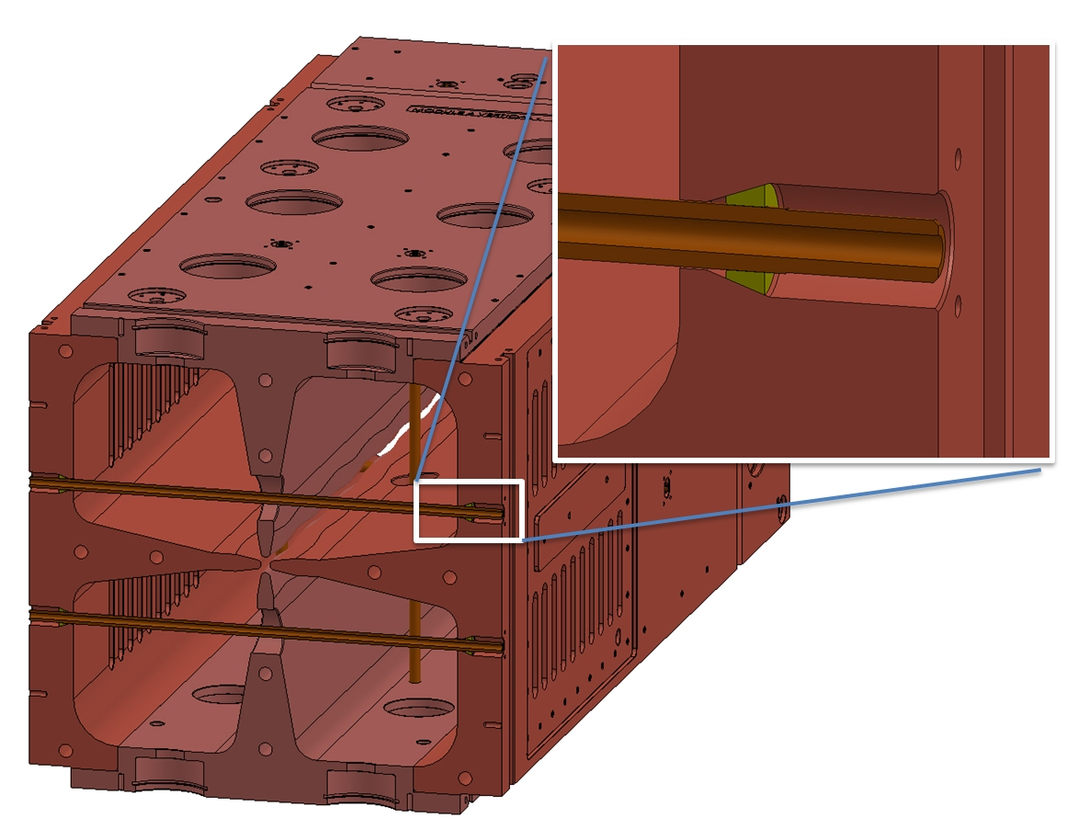
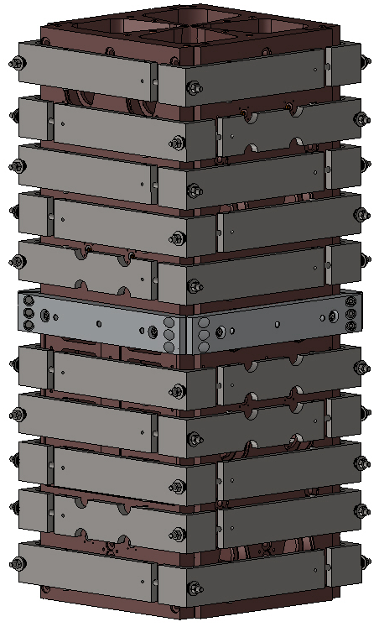
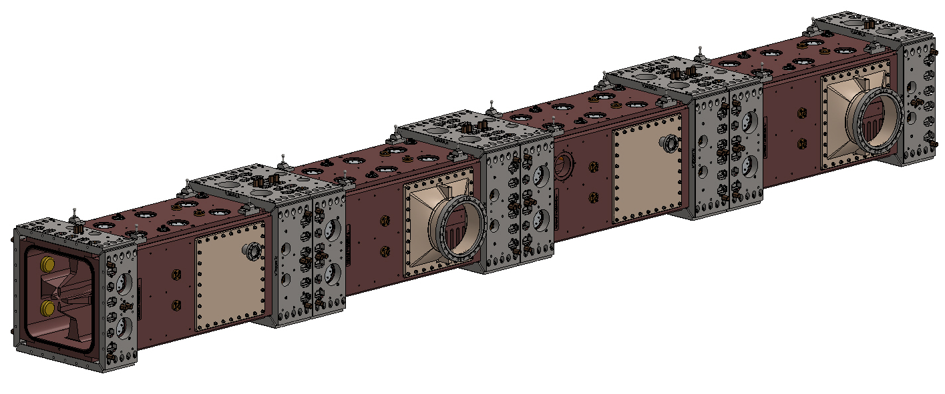

Progress on the Fabrication of a CW Radio-Frequency Quadrupole (RFQ) for the Project X Injector Experiment (PXIE)*
M.D. Hoff, A.J. DeMello, A.R. Lambert, D. Li , J.W. Staples and S.P. Virostek
Lawrence Berkeley National Lab, Berkeley, CA, USA
PROJECT X
Abstract
The Project X Injector Experiment (PXIE), a prototype front end of the Project X accelerator [1] proposed by Fermilab, is currently under construction. The complete PXIE beamline [2] is made up of an H⁻ ion source, a low-energy beam transport (LEBT), a 2.1 MeV, 162.5 MHz radio-frequency quadrupole (RFQ) accelerator, a medium-energy beam transport (MEBT) and a 30 MeV section of superconducting cryomodules. The 4.45 m long CW (continuous wave) RFQ consists of four separate modules that are joined by means of specially designed bolted joints. Each module consists of four solid copper vanes that are brazed together to form a 4-quadrant accelerating cavity. The ~100 kW of total wall power heat is removed by means of gun drilled water cooling passages. Mode stabilization is provided by a series of brazed, water cooled pi-mode rods. Tuning is achieved using a total of 80 fixed slug tuners. Fabrication of the PXIE RFQ is now under way at LBNL.
Test of modulation program and vane tip profile cutter
June 18, 2013
18 tee shaped pieces ready to start fabrication
Tee shaped pieces are machined into vanes
Cutting modulations on a vane
Vane tip profile cutter
Vanes are gun drill from one end for cooling
The gun drill holes are cross drilled to form cooling passages accessible from the outside of the RFQ
Gun drilled entrance holes are plugged and electron beam welded vacuum tight
After machining, 4 vanes are assembled and brazed together to form a module
Pi-mode rods connect quadrants to provide RF mode stabilization
The machinist are making chips
The 4 vanes are brazed together in a hydrogen furnace in the vertical position using clamps featuring Inconel Belleville washers
After brazing, the modules have O-ring grooves machined into the ends . Then the modules are joined together with collars made of 4 stainless steel joint plates. The joint plates contain pockets that accept bolts to fasten modules together
Paper ID
WEPMA19
* This work was supported by the Office of Science, U.S. Department of Energy under DOE contract number DE-AC02-05CH11231.

