Slide 1

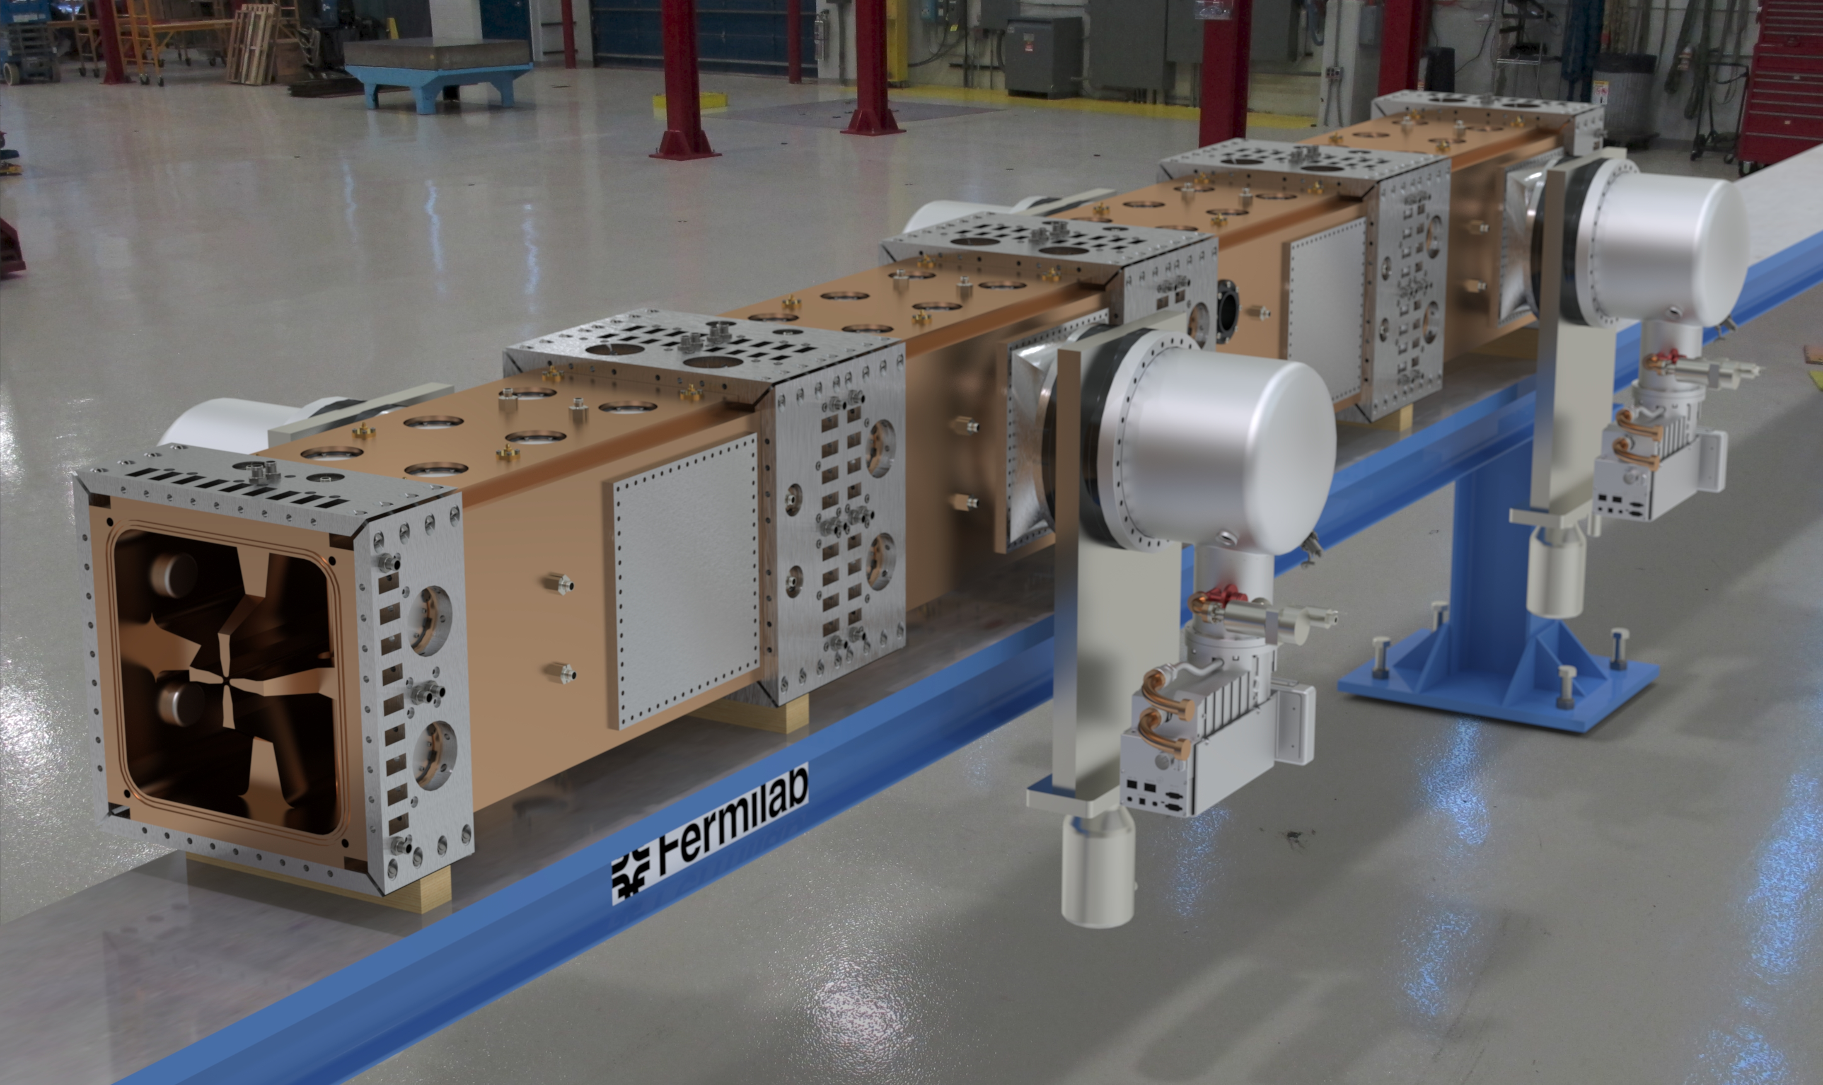
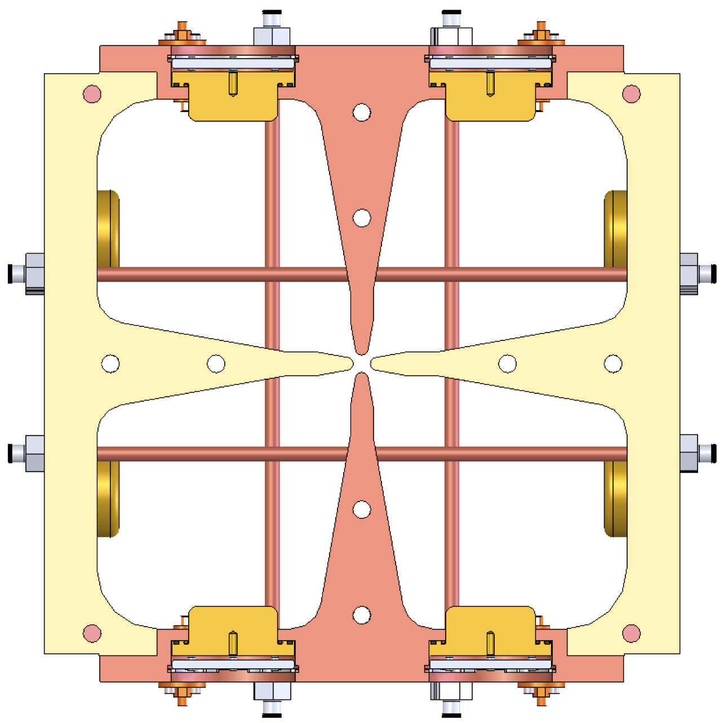
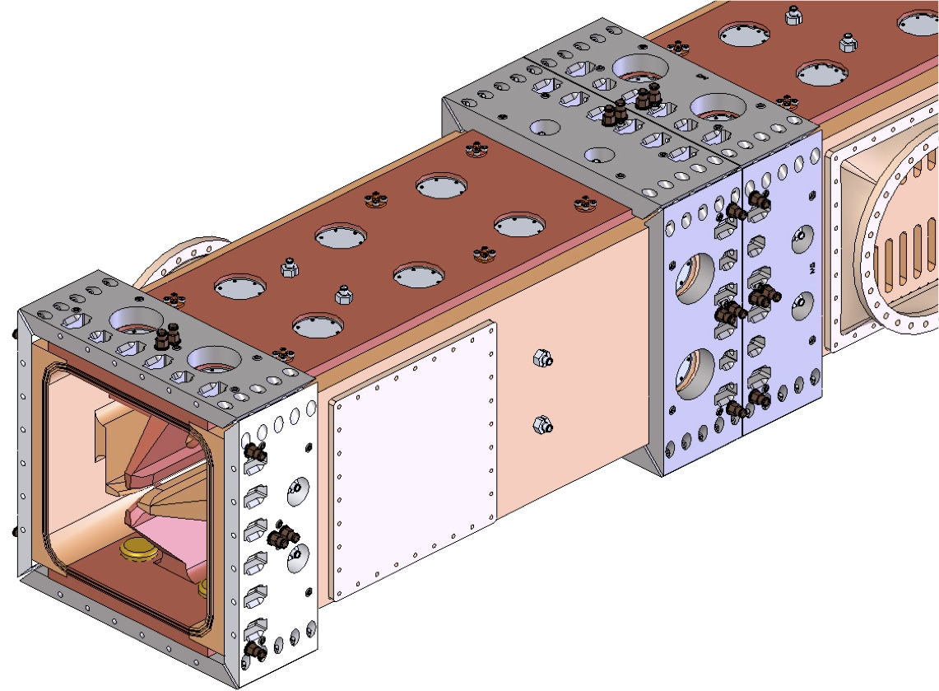
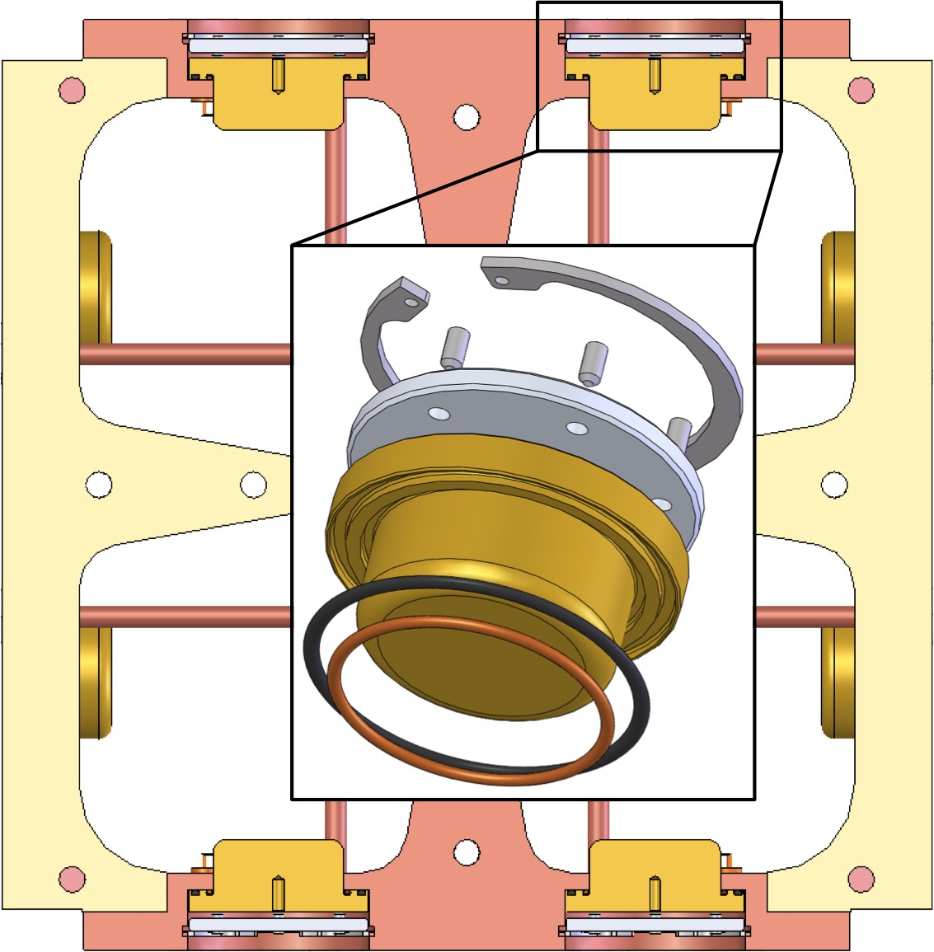
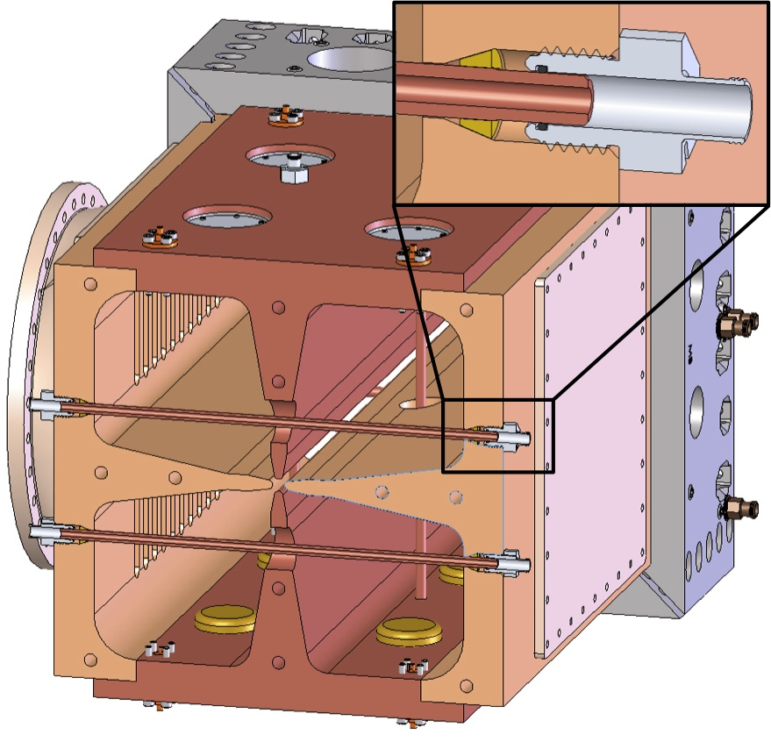

Final Design of a CW Radio-Frequency Quadrupole (RFQ) for the Project X Injector Experiment (PXIE)*
S. Virostek, A. DeMello, M. Hoff, A. Lambert, D. Li and J. Staples
Lawrence Berkeley National Lab, Berkeley, CA, USA
PROJECT X
Abstract: The Project X Injector Experiment (PXIE) now under construction at Fermilab is a prototype front end of the proposed Project X accelerator. PXIE will consist of an H⁻ ion source, a low-energy beam transport (LEBT), a radio-frequency quadrupole (RFQ) accelerator, a medium-energy beam transport (MEBT) and a section of superconducting cryomodules. The PXIE system will accelerate the beam from 30 keV to 30 MeV. The four-vane, brazed, solid copper design is a 4.45 m long CW RF accelerator with a resonant frequency of 162.5 MHz. The RFQ will provide bunching and acceleration of a nominal 5 mA H- beam to an energy of 2.1 MeV. The average power density on the RFQ cavity walls is <0.7 W/cm2 such that the total wall power losses are ~80 kW. LBNL has completed the final design of the PXIE RFQ, and fabrication is now under way. The completed PXIE RFQ will be assembled at LBNL and tested with low-level RF prior to shipping to Fermilab. Various aspects of the final RFQ mechanical design are presented here.
INTRODUCTION
RFQ DESIGN FEATURES
Modules consist of 4 vanes machined from solid billets and brazed together
Vane tips are modulated using a specially designed fly cutter in a horizontal mill
12 mm Ø gun drilled water passages each carry ~4 gpm
Differential vane/wall water temperature control provides maximum active tuning range
Fixed tuning of cavity with solid Cu slug tuners (80 total)
Cooled pi-mode rods for RF mode stabilization (16 pairs)
RFQ Cross Section
Rendering by Don Mitchell (FNAL)
MODULE JOINING
The RFQ design consists of four modules, 4.45 m total length
It will accelerate a nominal 5 mA H⁻ beam to 2.1 MeV
Modules are made of four solid, modulated OFHC copper vanes brazed together
Total wall power losses are approximately 80 kW
Primary inter-module RF joint is a 3 mm wide,
250 μm high raised lip on the module ends
Initial seal backed by a canted coil spring to
protect an outer o-ring vacuum seal
Modules connected using a
‘flangeless’ joint design in
which connecting bolts and
nuts are recessed into the
outer layer of stainless steel
SLUG TUNERS PI-MODE RODS
FABRICATION SCHEDULE
Final design and fabrication drawings were completed earlier this year
Fabrication tests are complete (vane cutter, test braze, vane prototype)
Pre-braze bead pull of first RFQ module to be performed in April 2014
First RFQ module to be completed in May 2014
Final RFQ module to be completed in August 2014
Finished module leak check, flow check and CMM done in Oct. 2014
Bead pull performance verification of fully assembled RFQ in Dec. 2014
Arrival of completed RFQ at Fermilab in February 2015
Machined from solid copper slugs
Canted coil spring and o-ring provide RF and vacuum sealing
Sealing force provided by recessed snap ring and pressure plate with set screws
Passes through holes in vanes
Internal cooling prevents distortion
Brazed into cavity wall at both ends during module vane braze
Preloaded brazing ferrule provides a reliable RF and vacuum seal
Paper ID
WEPMA21
* This work was supported by the Office of Science, U.S. Department of Energy under DOE contract number DE-AC02-05CH11231.

