Slide 1
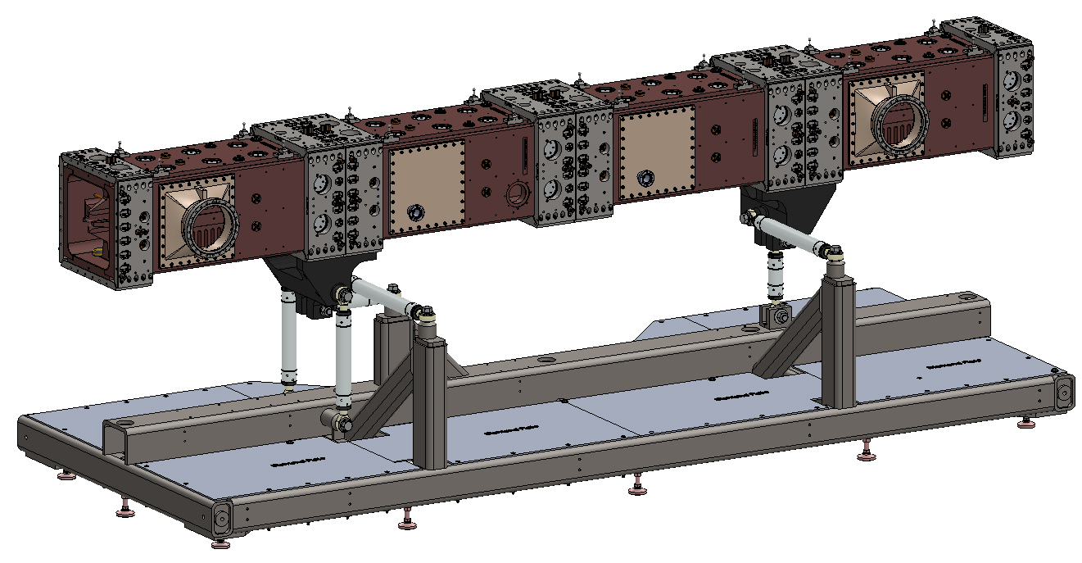
PXIE Support Frame Design Review
Matt Hoff LBNL February 5, 2015

Slide 2
How the support frame works, in mostly chronological order
Main support frame
4 strut temp outrigger
Qty 1
3 strut temp outrigger
Qty 3

Slide 3
First module is attached
Lifting set-up for placing modules
3 strut temp outrigger
4 strut temp outrigger
Some of the temp struts are compliant since the module is over constrained

Slide 4
Assembly sequence
Modules 2 and 3 are attached
Temp outrigger between modules 1 &2 removed
Permanent 4 strut to RFQ mount with 4 precision struts attached.
Module 4 is attached with temp outrigger

Slide 5
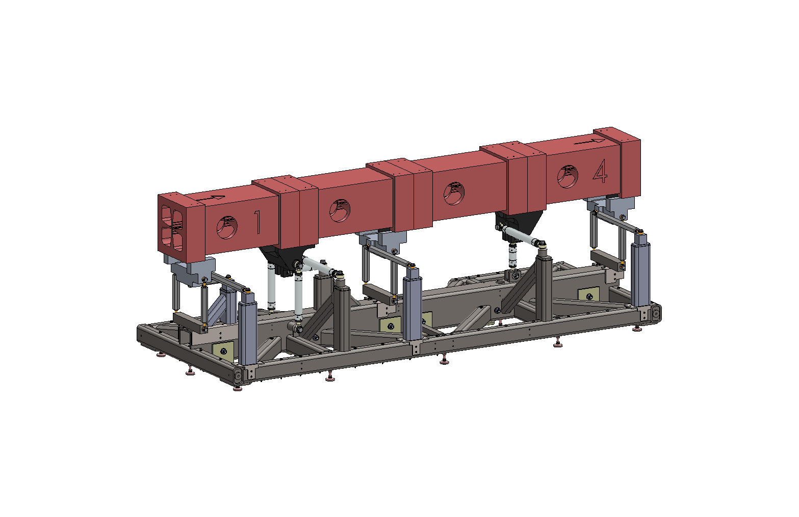
Complete assembly
Temp outrigger between Module 3&4 removed. 2 strut to RFQ permanent mount with 2 precision struts is attached
This assembly configuration is also the shipping configuration. At this point the temp outriggers and struts can be left attached during bead pull and vacuum testing, or they can be removed if they get in the way. If removed, they will need to be reinstalled for shipping.
Precision struts are ridged (x6). All temp struts are mildly compliant (x10).

Slide 6
Neoprene bushing
Struts types
Permanent
Strut
(precision)
Compliant
Strut
(shipping)
Right hand thread
Standard inexpensive left hand thread rod end. McMaster 60645K182
Neoprene tube cut to length –McMaster 8637K211
Durometer 75A
¾ inch HHCS
Special precision rod eyes with no play, swaged extra tight.
Precision lock collars.
Usually incorporate differential threading (fine and course) in rod ends.
Steel tube body. 6 required
Made from 2 inch aluminum hex rod stock with left and right ¾ inch threads in the ends. 13 required.
McMaster 3031T963

Slide 7
PXIE RFQ Shipping Frame
Air ride trailer
Shipping frame in green

Slide 8
A shipping frame like below will be made out of C 10 x 20lb steel channels bolted together at the overlaps. 4 machine mounts are attached. 4 attachment points are on the corners for the truck tie-down chains. Hoist rings are used to attach the support frame / RFQ to the shipping frame. The frame is not painted.
Trucker attach point
Machine mount
This is very similar to how the SNS shipping frame was designed.

Slide 9
This is the catalog page for the machine mounts. The RFQ and support frame weighs about 12,500 lbs. There fore 4 SLM-48A’s rated at 4,800 lbs each should be adequate.

Slide 10
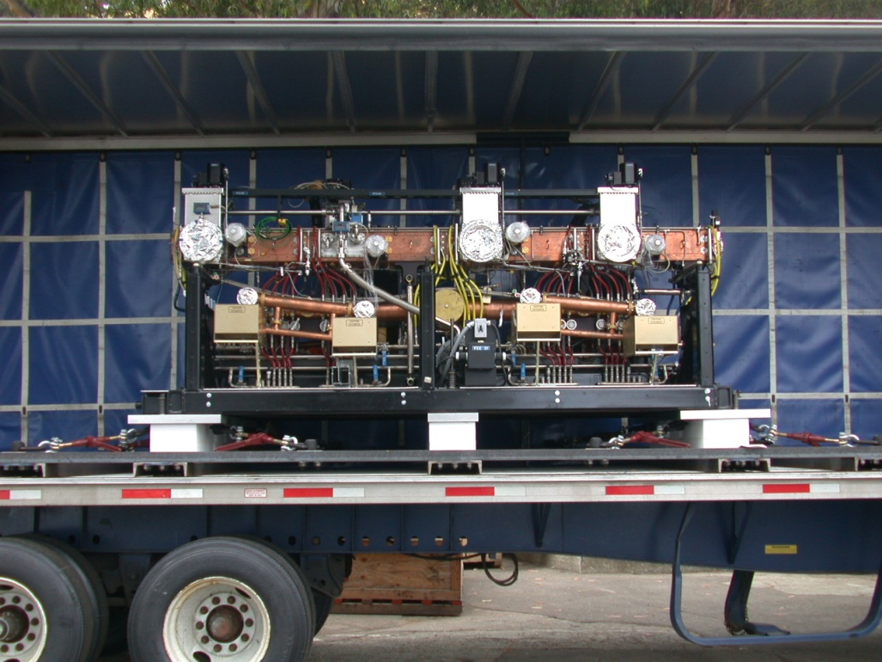
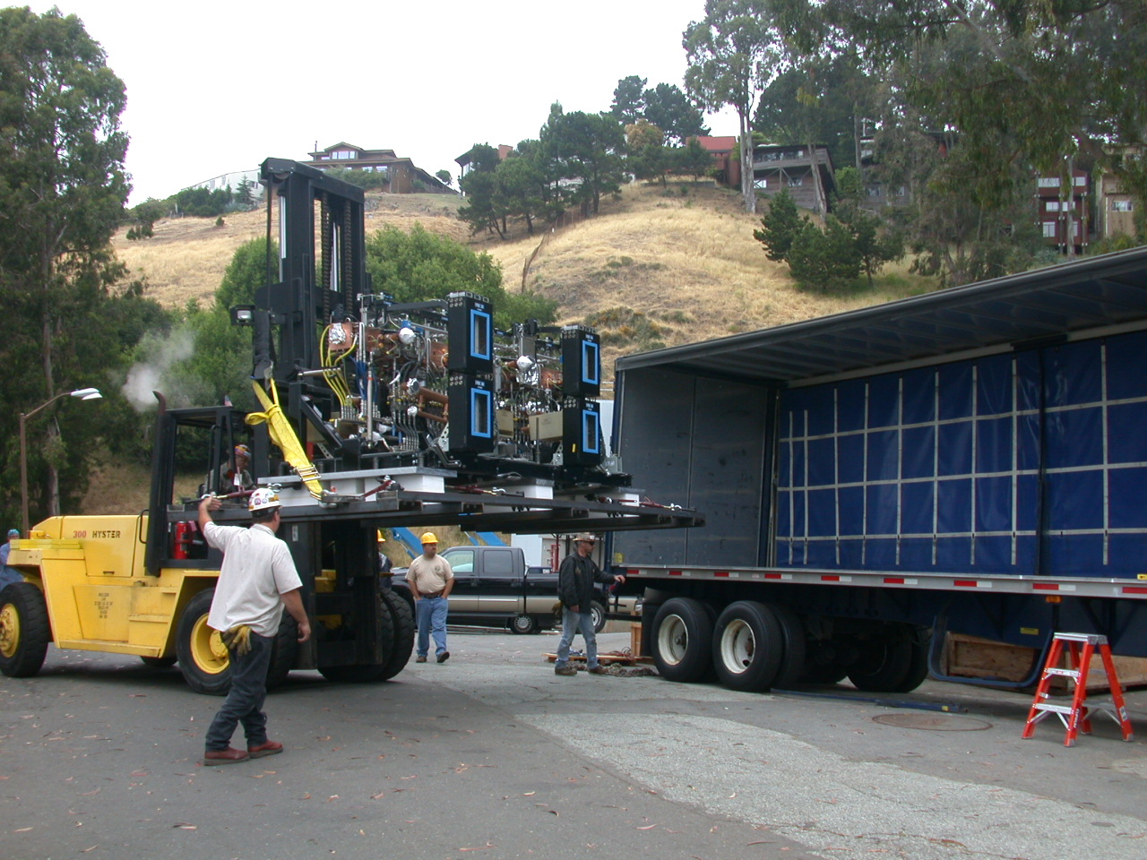
The fork lift loads the package into the side of the LBNL air ride curtain truck. Its fast and easy.
SNS RFQ June 2002

Slide 11
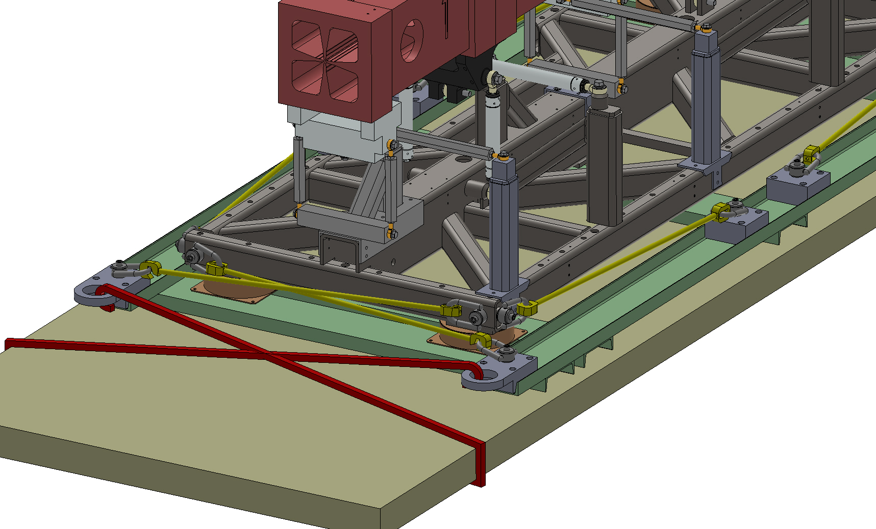
PXIE shipping frame details
Experiment binders, Qty 8 (yellow). Could be either ratchet strap or binder chain. Installed by LBNL. See slide 8.
4 discrete point for the trucking chains
Truck bed
Trucker’s chains (red)
Shipping frame made from channel stock bolted together. Bolts not shown.
Machine mounts, one at each corner. Bolted to support and shipping frame

Slide 12
A top and side view of the PXIE RFQ shipping frame.

Slide 13
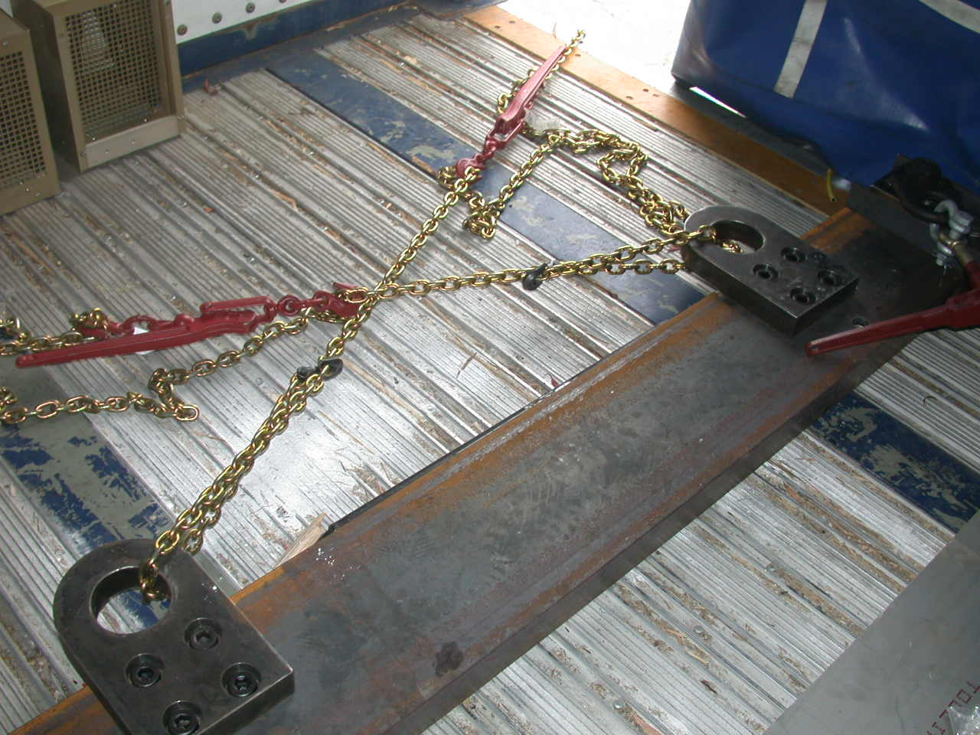
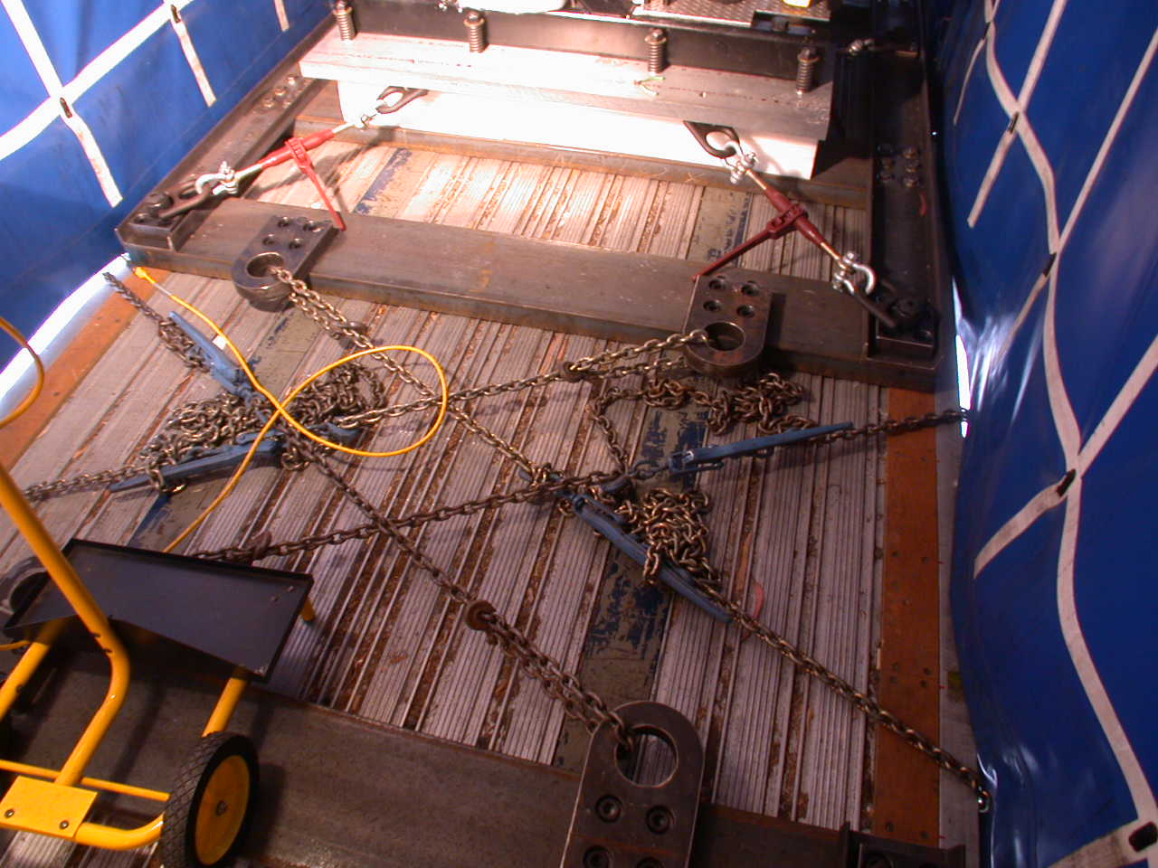
Trucker’s chains
After loading, the truck driver is now allowed to chain the package to the truck bed using the four attachment points provided. The truck load chains never touch the support frame or RFQ.
Pictures are from shipping the SNS RFQ June 2002

Slide 14
Shipping Frame vs Support Frame Integration
Hole for attaching the machine mount (vibration mount)
Swivel hoist rings
Machine mount (vibration mount)
3 hoist rings attachment holes per corner of the support frame.
(3/4-10 UNC supports a 5,000 lb hoist ring.)
Shipping frame

Slide 15
Lifting Points
Each corner of the support frame can accept a 5,000 lb hoist ring
LBNL has not analyzed the frame for lifting at the four corners as shown
These 2 outriggers must be removed for a vertical crane lift
RFQ + 6 struts + Temp struts + Support Frame = 12,500 lbs

Slide 16
Casters
Hamilton Caster S-EDH2-83DT70 rated to 6,500 lbs each
10.5in
5 caster mounts are provided

Slide 17
Leveling Feet
Access hole for a deep socket to tighten lock nut if required
14 locations under the support frame are available. Not all need to be used.
McMaster-Carr 6111K333
¾-10 x 6 inch 7,400 lbs ea
Stainless $61 each

Slide 18
Leveling Feet
Approximately 12,500 lbs
1300 mm
94.5mm
3.7 inches

Slide 19
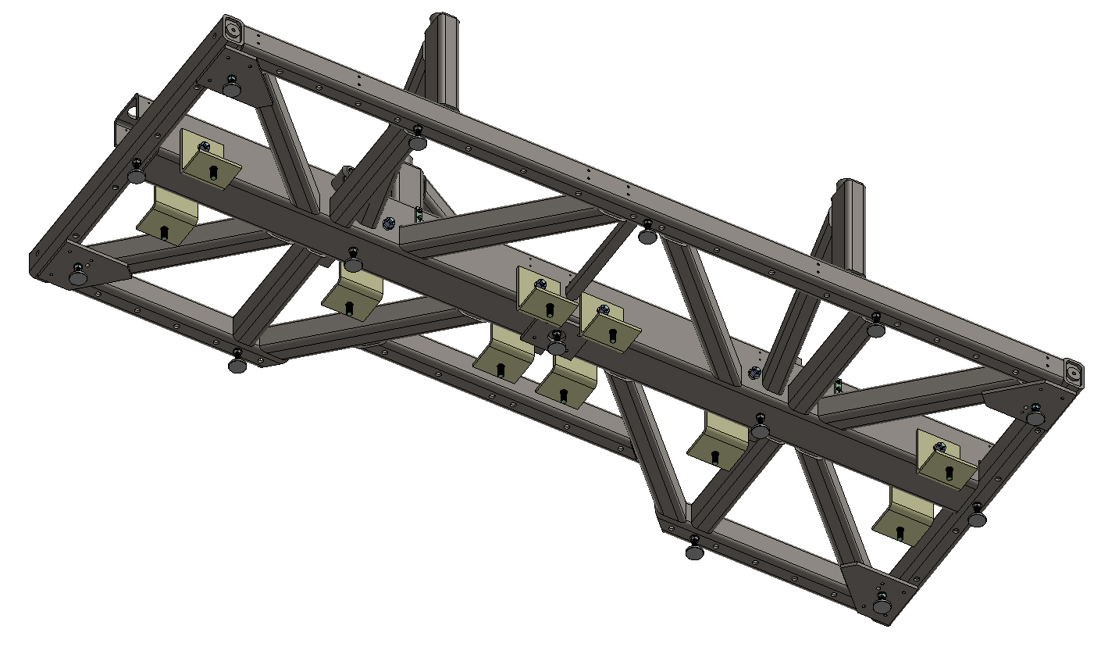
Earthquake Brackets
The easiest earthquake restraints to install are L-brackets bolted to the center frame member and then directly to the floor. The floor anchor shells can be drilled ahead of time with tolerances of +/- 1 inch. The L-brackets will be machined to match after alignment and leveling of the frame.
The Support Frame has 10 earthquake bracket locations available. Using 4 or 5 locations should be adequate.

Slide 20
Earthquake Brackets
The brackets are cut from a 8 x 12 steel tube. The same size tube as used for the center tube of the support frame
The brackets will be sent to FNAL without holes.
After aligning and leveling the support frame, the final hole locations can be determined and drilled. Then the brackets will bolt into place easily and accurately.

Slide 21
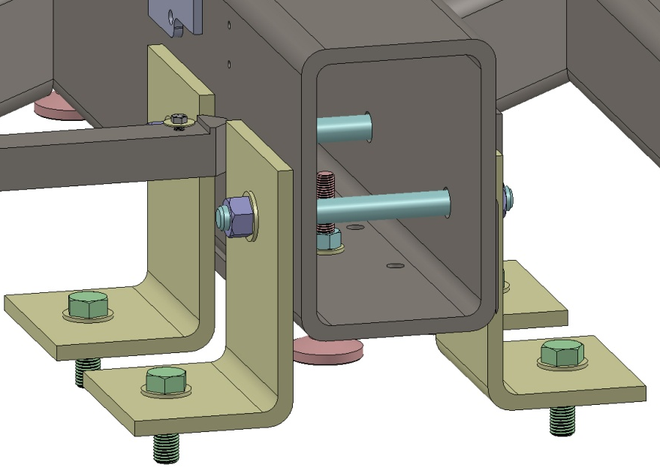
Earthquake Brackets
Brackets are bolted directly to 1 inch anchor shells in the floor and to the 8 x 12 main beam with 1 inch threaded rod.
Not all locations are required.

Slide 22
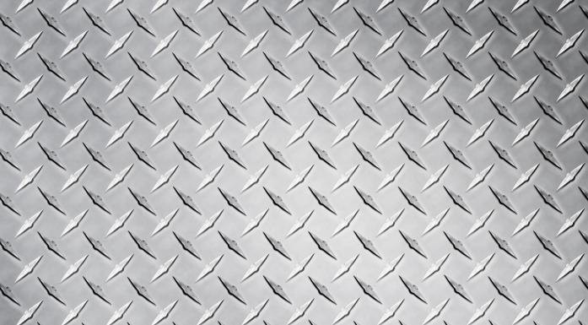
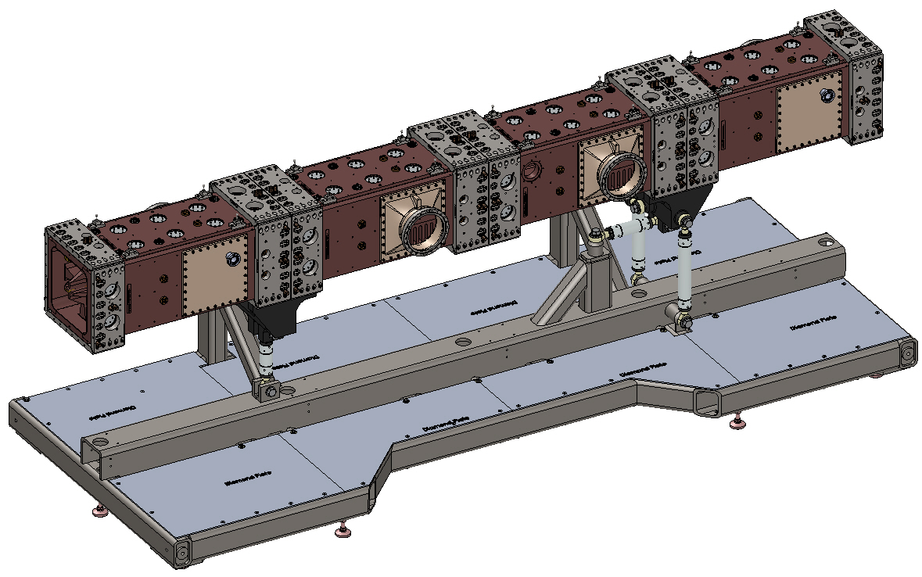
Floor Boards
Floor boards are made from ¼ inch thick aluminum diamond plate. (Sorry, my CAD does not do diamond plate, so its modeled as regular plate.)
The floor boards are segmented into 8 pieces for easy installation and handling. The heaviest floor board is about 22 lbs.
The floor boards are held down around their perimeter with fasteners. Most are flush flat head screws around the outside, then a few hex bolts that are proud. The proud bolt heads are along the center tube in locations that do not cause a tripping hazard. Installation is done without reaching under the frame more then 3 inches.

Slide 23
8 floor boards
12 proud hex screw heads
38 flat head screws on the perimeter
Floor Boards
Floor plates are well supported

Slide 24
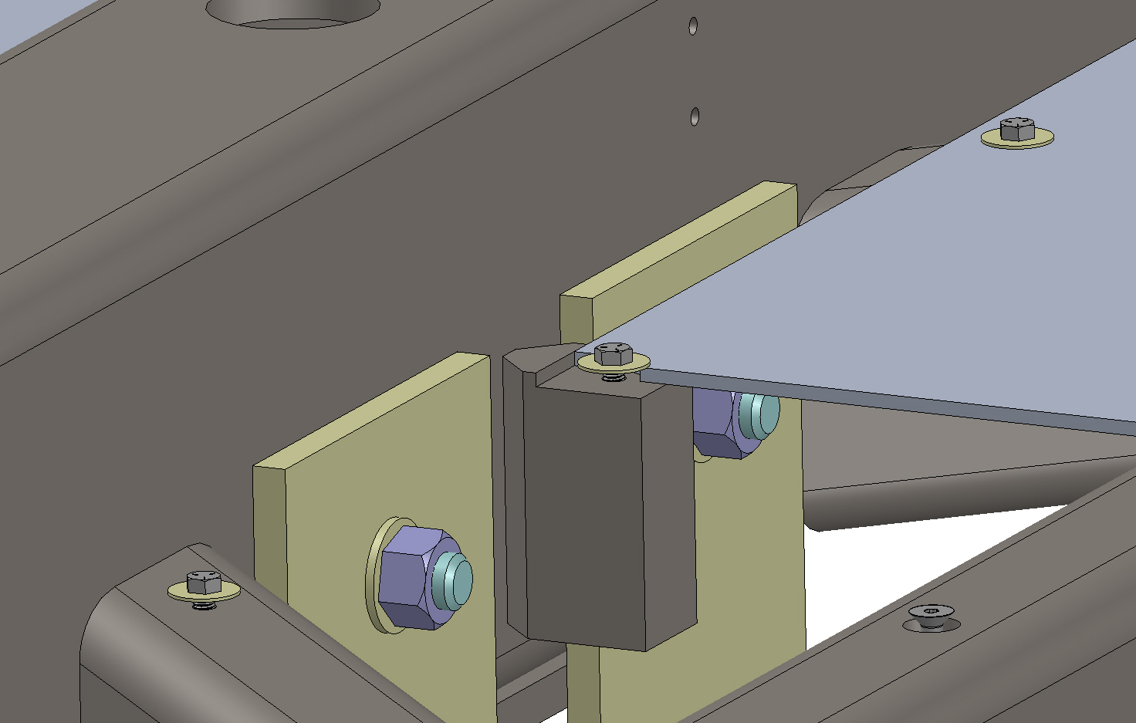
Floor Boards
Proud ½-13 hex head bolts with fender washer
One floor board in fore ground not shown

Slide 25
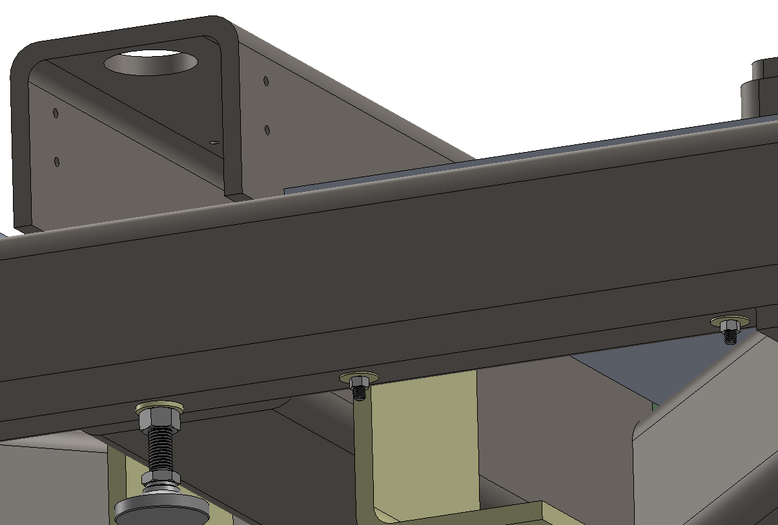
Floor Boards
Flat head screws
Qty 38
McMaster-Carr 91253A941 flat head socket cap screw 3/8-16 x 7 inch long. The bolt passes through 1 inch clearance holes in the frame and is held with a fender washer and standard nut.

Slide 26
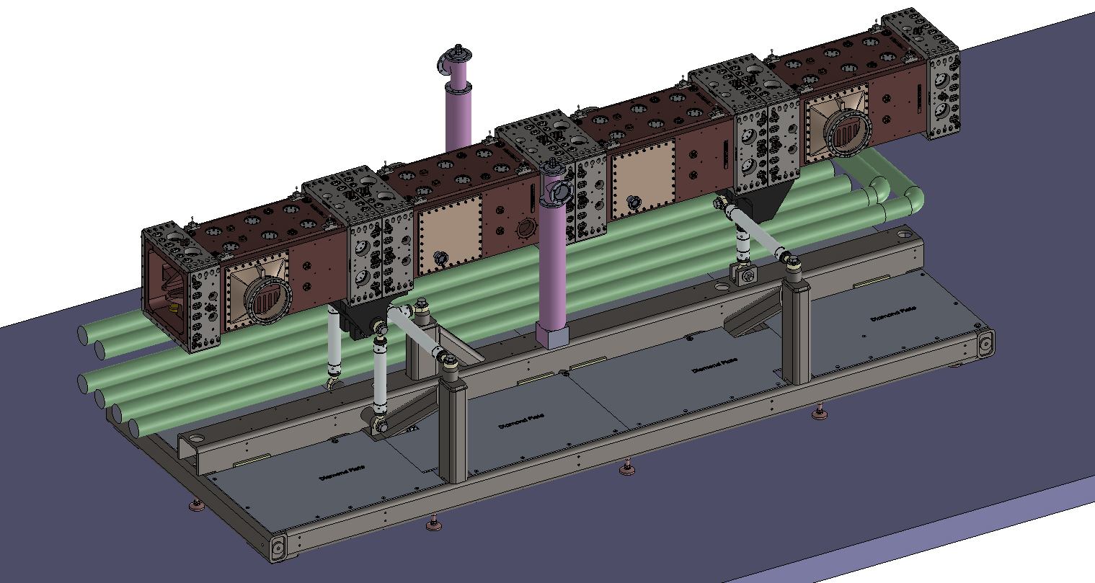
CAD model of the RFQ and support frame in at FNAL

Slide 27
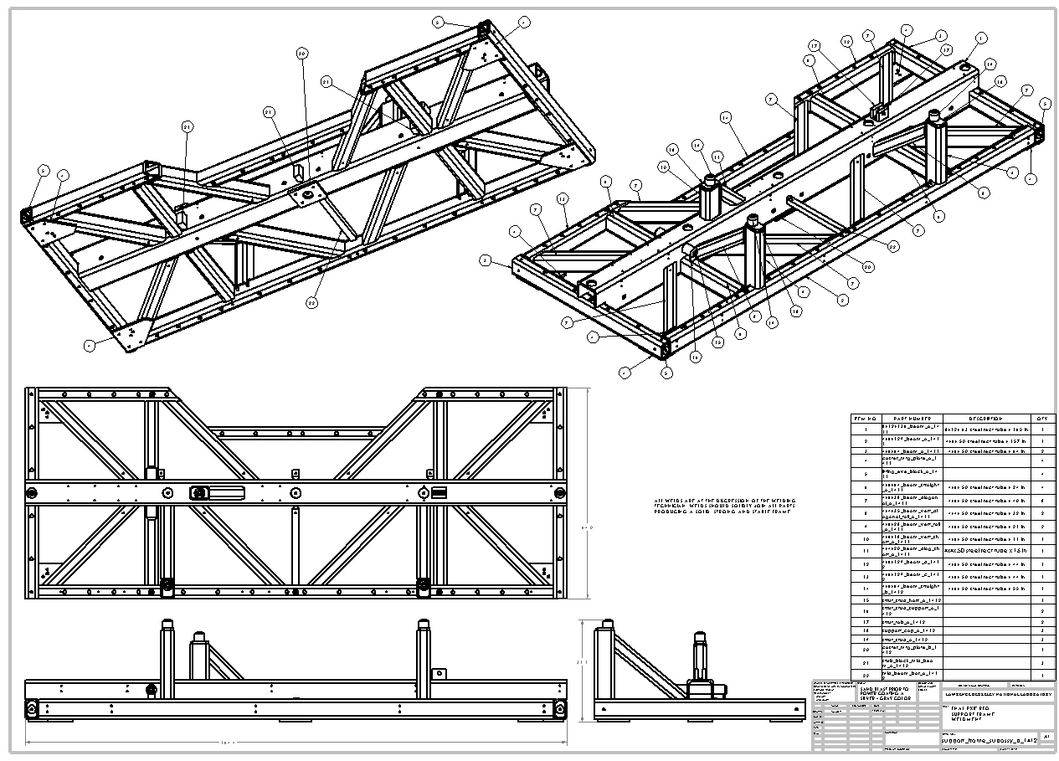
Support frame fabrication drawings
Support frame parts are detailed and ready for fabrication

Slide 28
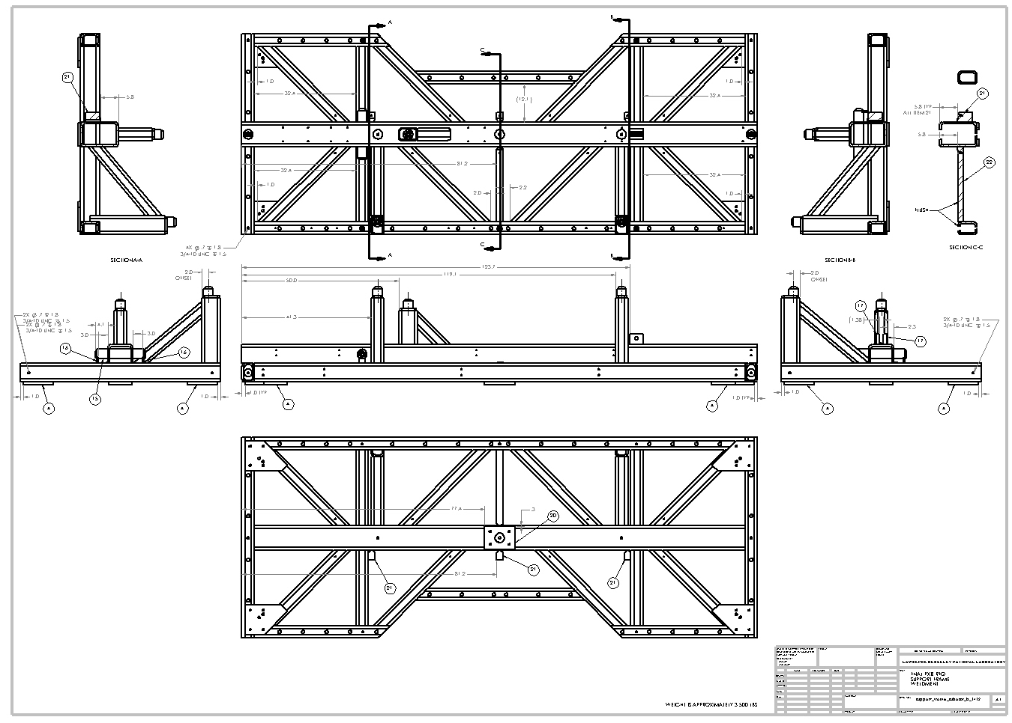
Support frame fabrication drawings

Slide 29
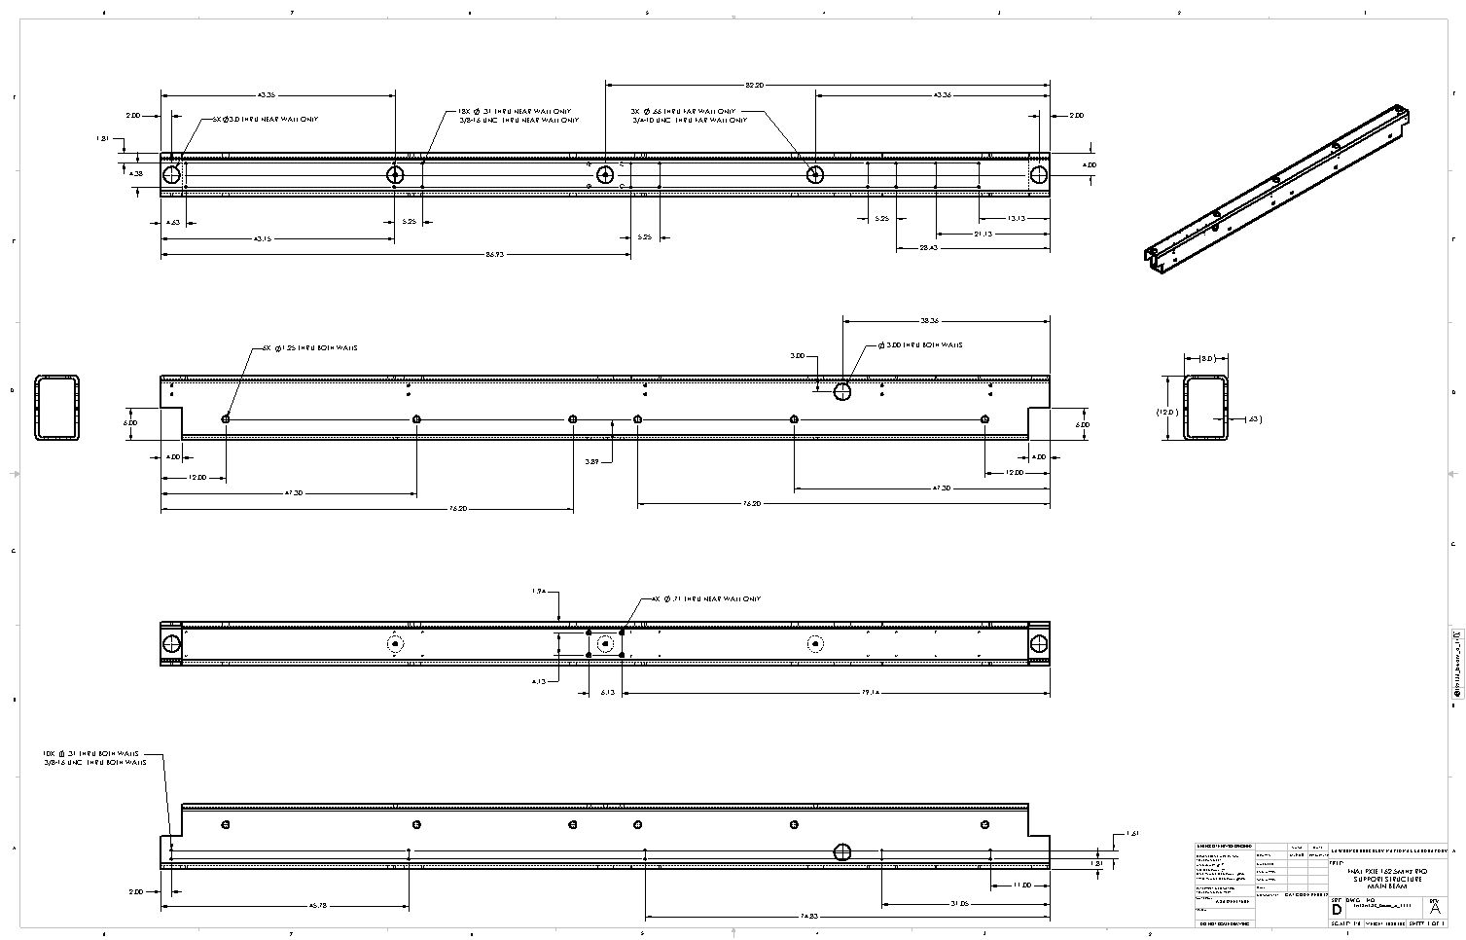
Support frame fabrication drawings

Slide 30
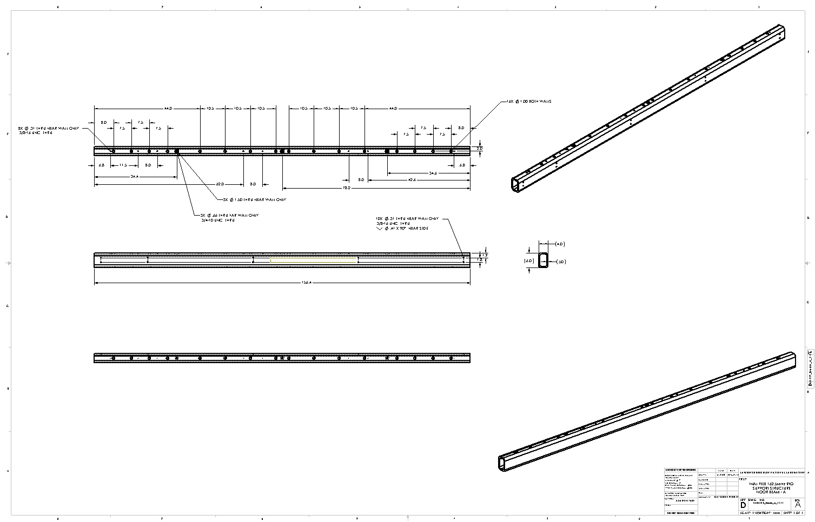
Support frame fabrication drawings

Slide 31
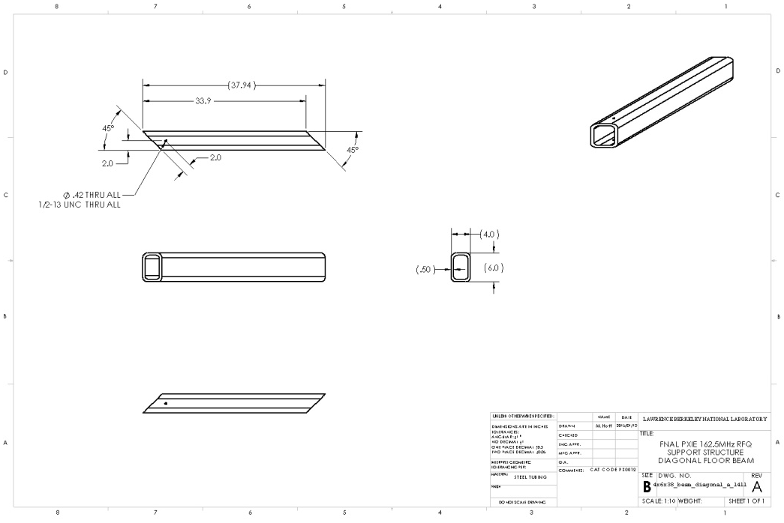
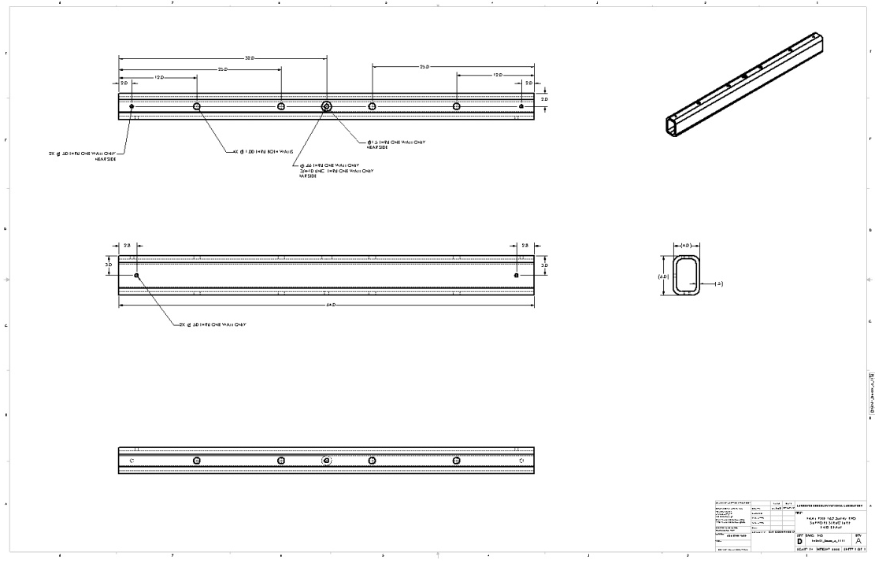
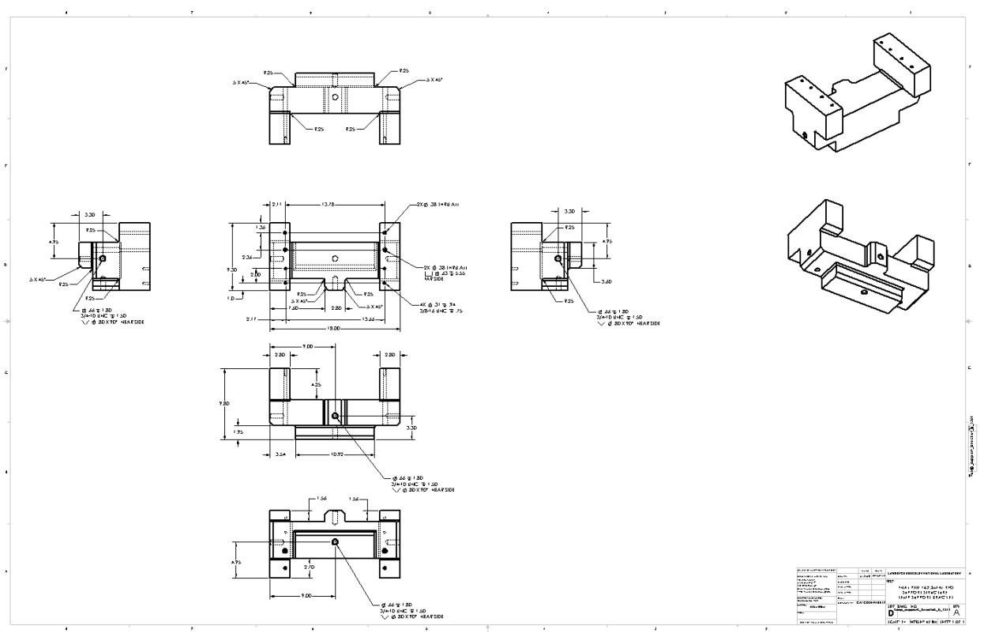
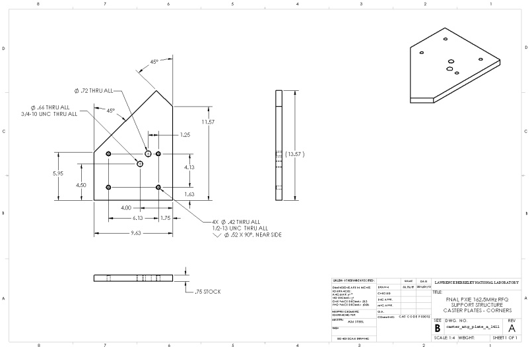
Support frame fabrication drawings
These are some examples of the support frame drawing. All drawings for the main frame are complete and ready for fabrication.

Slide 32
Parts not detailed yet!
Shipping frame
Temp struts x10
Temp outrigger x4
Temp vertical support x1
Temp center support x3
Diamond floor plates x8
Precision struts x6
Strut to RFQ mounts x2

Slide 33
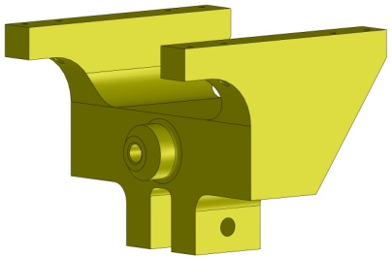
Schedule
The Building 77 shops estimates the frame will take 8 to 12 weeks to fabricate.
Ordering and fabrication can start immediately. The shop is not busy. Needs work.
The remaining parts that need detailed will only take 5 days to detail.
The precision struts are considered a standard part at the ALS and are ordered by length and standard diameter (2.5 inches) though them.
The support frame and outriggers will be painted a silver – gray color.
The shipping frame is not painted or coated. Its is used raw.
The aluminum strut to RFQ mounts can be left raw or painted to add some pizzazz.

