Slide 1
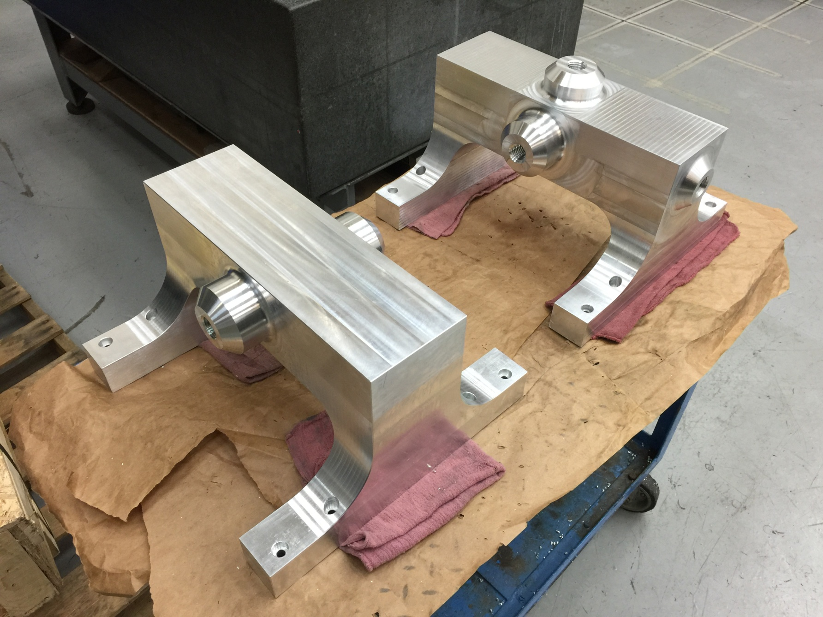
March 19 PXIE Fabrication Update
Matt Hoff LBNL March 19, 2015

Slide 2
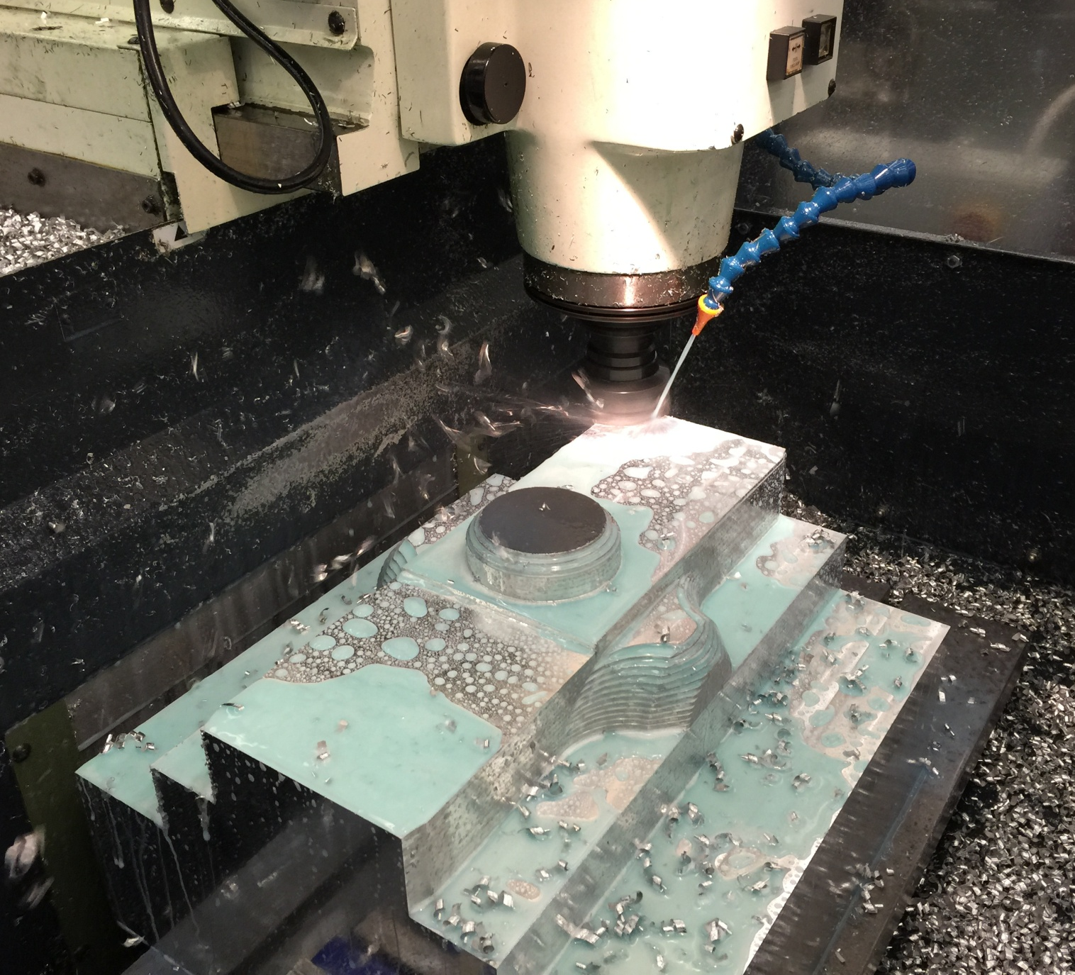
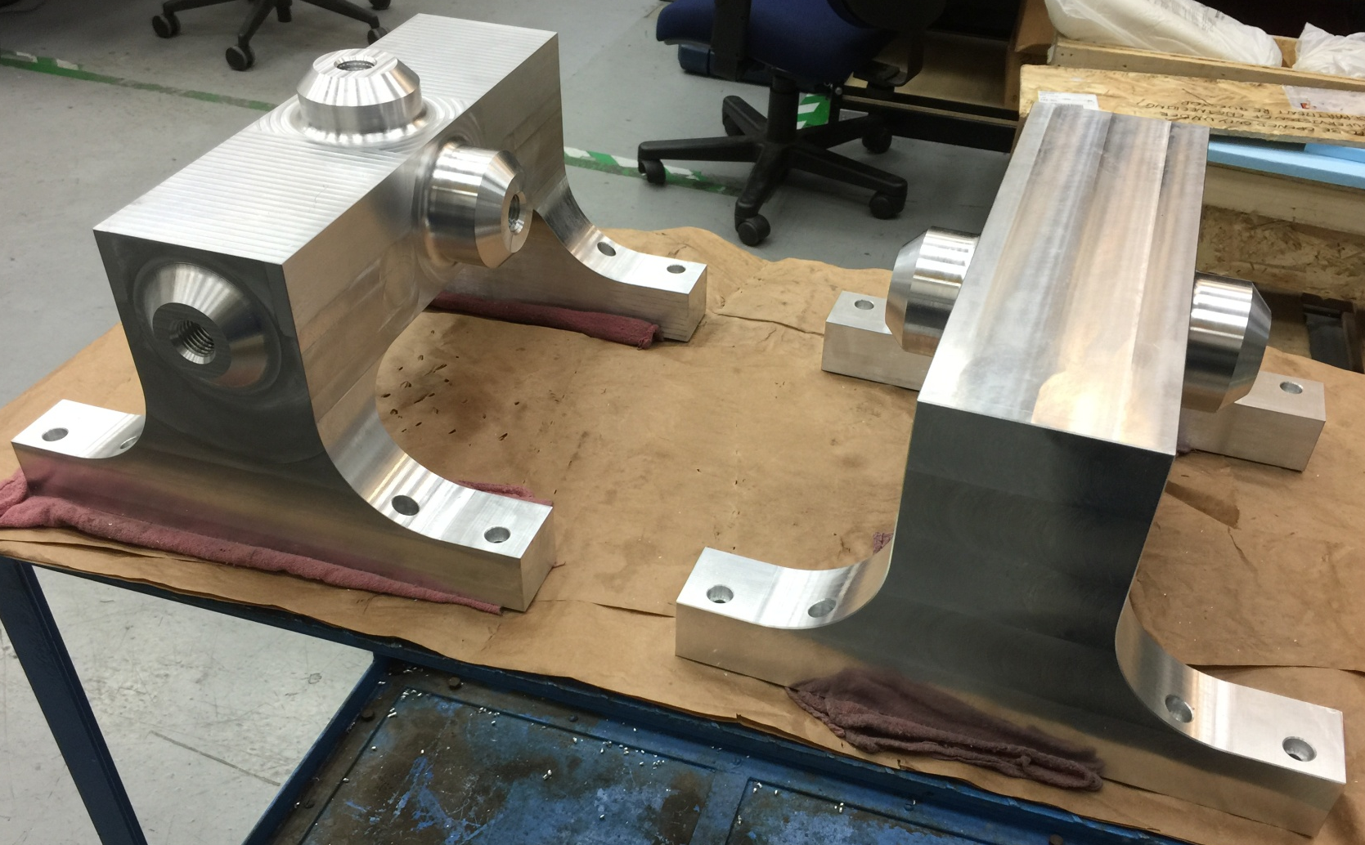
2 weeks ago.
This week. Both strut mount blocks are complete

Slide 3
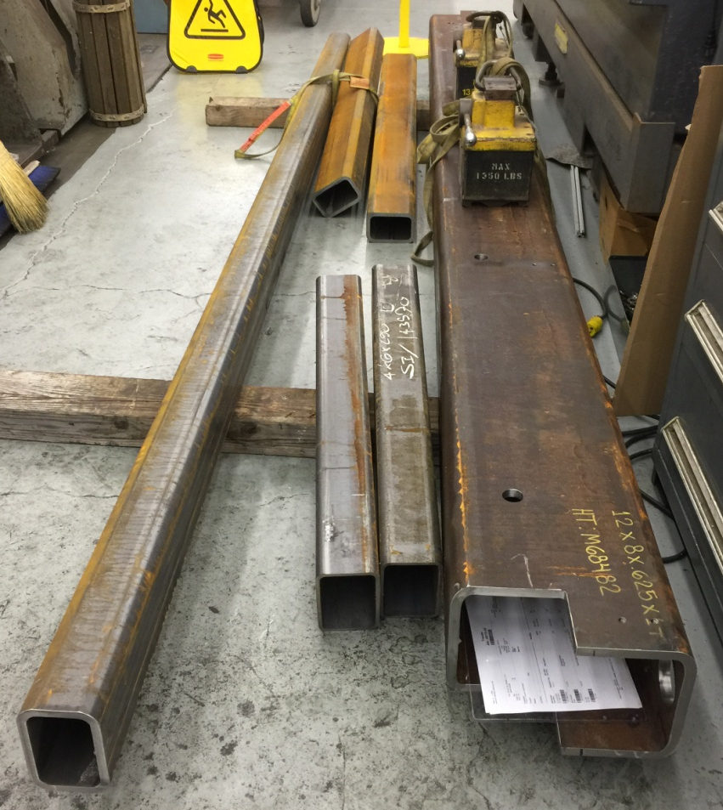
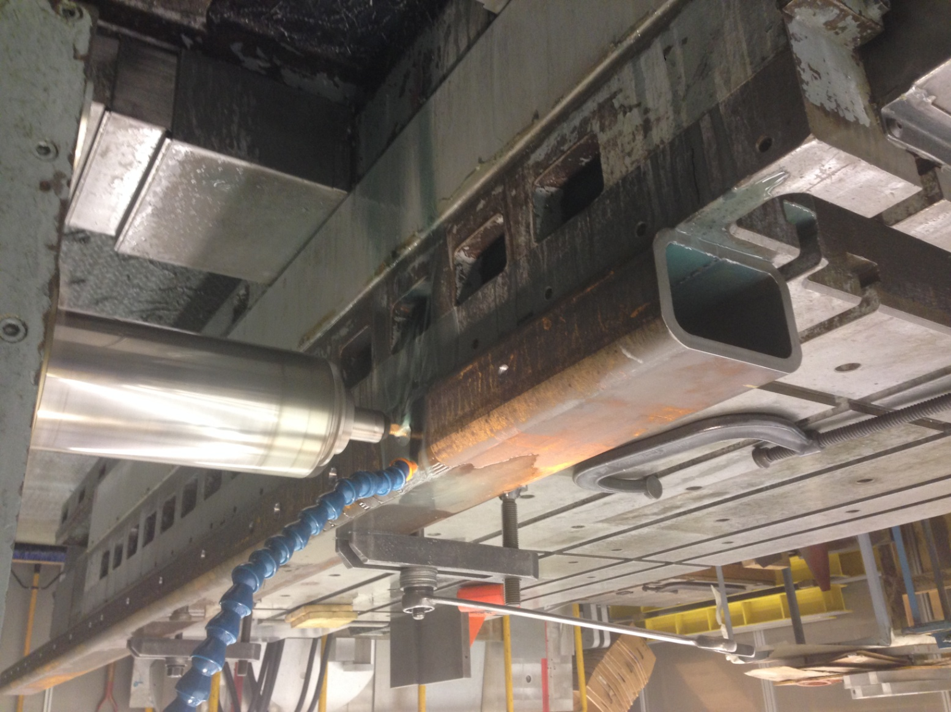
2 weeks ago
This week
Main beam complete
Longest side rail in progress
Rusty tubes at the top of the picture are the end rails. The two clean tubes are not PXIE

Slide 4
The adjustable tuner design is set. Two pair of the tuners are being fabricated first. After evaluation, the remaining 58 will be fabricated.

Slide 5
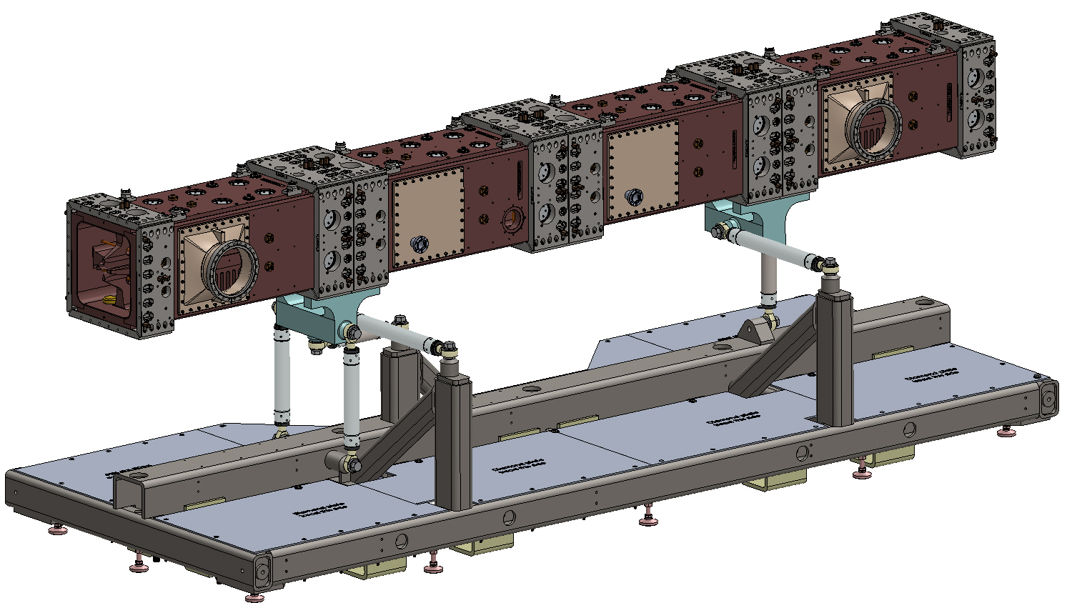
The bloated fastener problem with the CAD model has been fixed and an updated version has been sent to FNAL

Slide 6
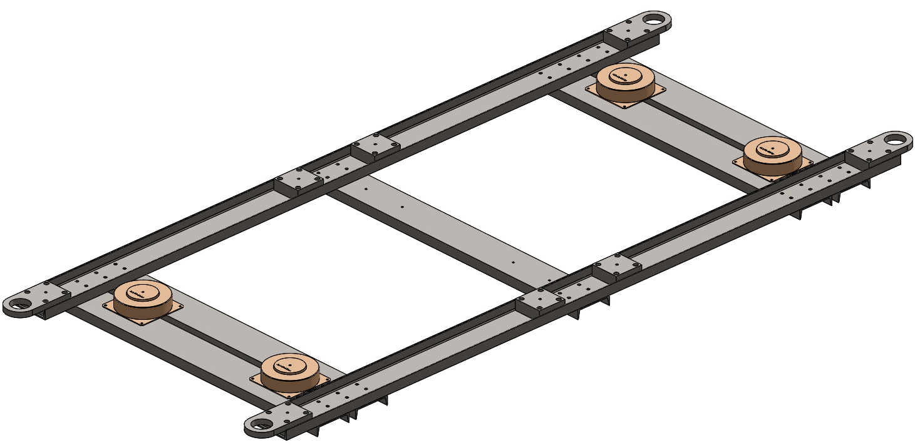
Shipping frame pieces have been drawn and sent to the shop for fabrication

Slide 7
All custom parts have been sent to the shop for fabrication.
Support Stand is on schedule to be completed April 30, 2015
Casters and machine mounts (vibration isolators) have been ordered
A long list of approximately 80 different off the shelf items required for assembly has been created. Procuring the list is next.

