Slide 1
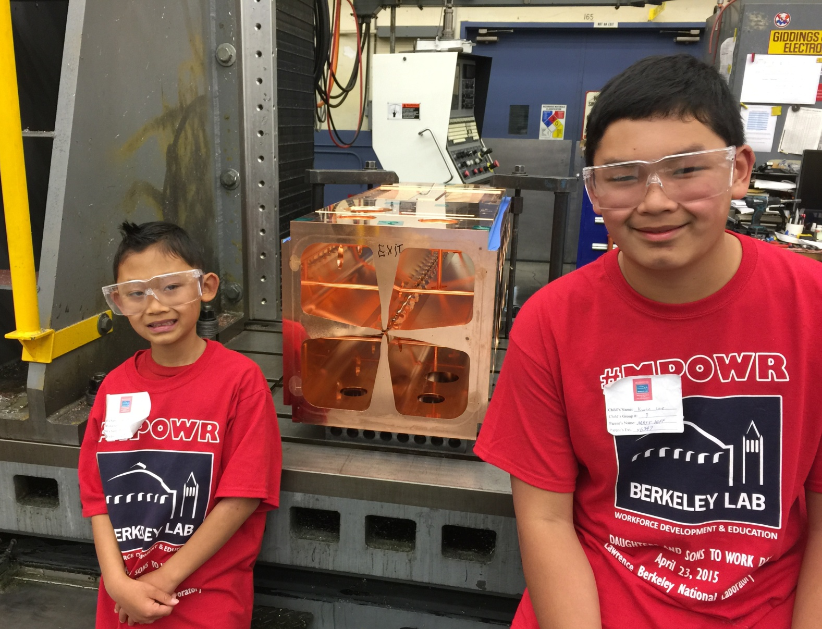
April 30 , 2015 PXIE Fabrication Update
Daughter and Son to Work Day
April 23, 2015
Ari and Kwin, my wife’s cousin’s kids with Module 2
Matt Hoff LBNL April 30, 2015

Slide 2
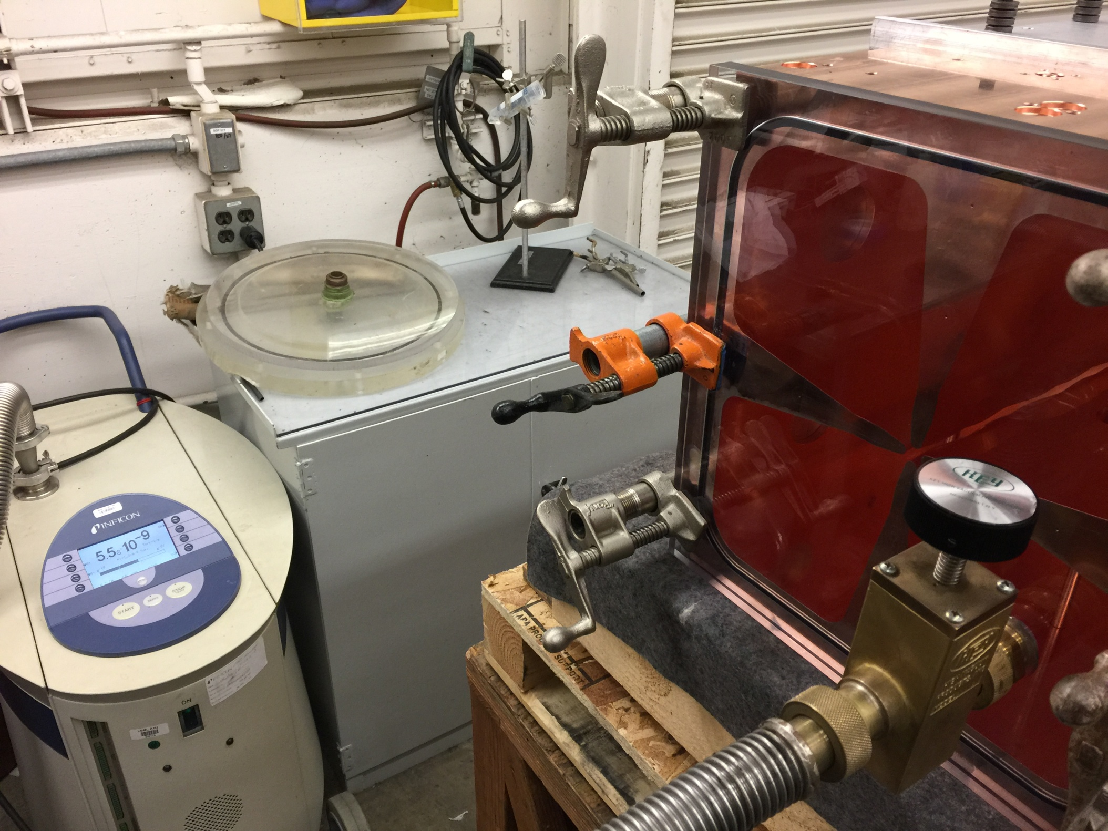
Module 4 is leak tight
April 28, 2015

Slide 3
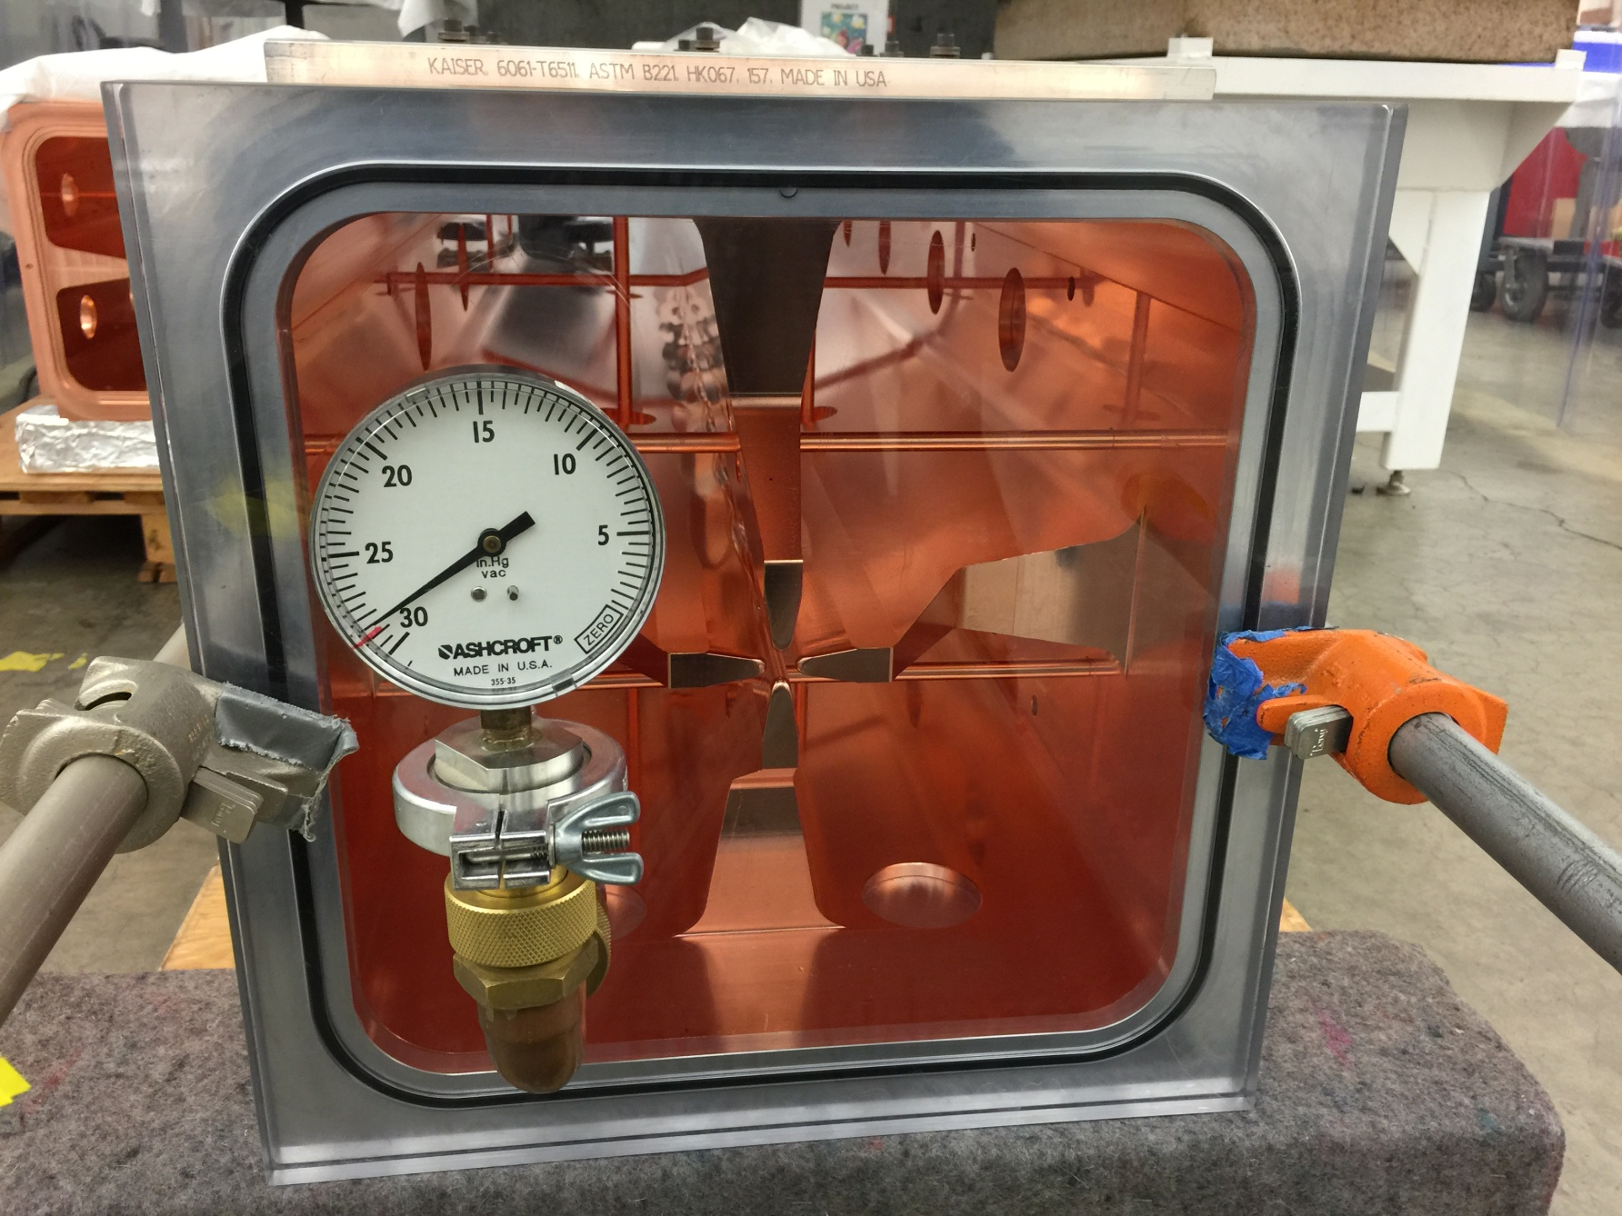
Module 4 April 30, 2015 at 10:30 AM. Their has been no vacuum pumping on this module for over 36 hours and the vacuum gauge still reads a low pressure. Leak tight.

Slide 4
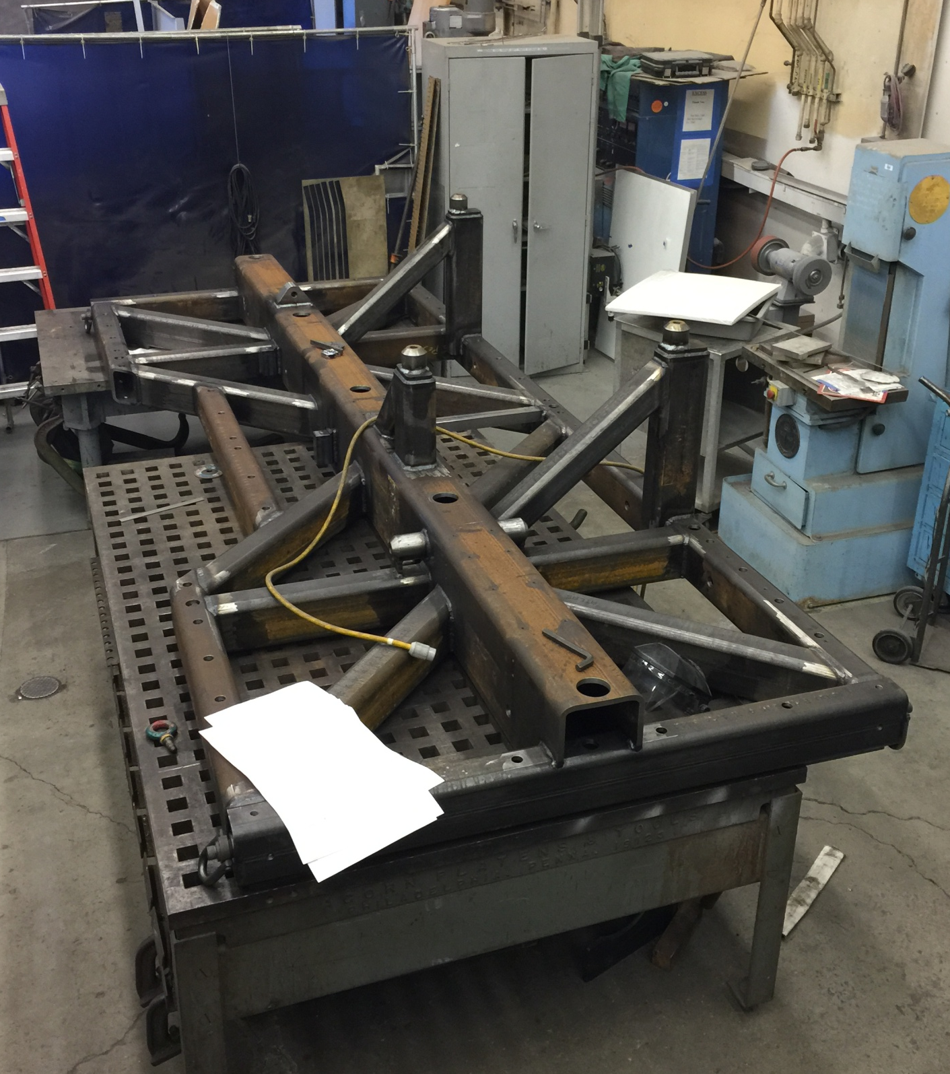
Main Support Frame welding complete. Off to the poweder coat vendor May 1.
Auxiliary supports (outriggers) are still being fabricated / welded. They do not need painting.

Slide 5
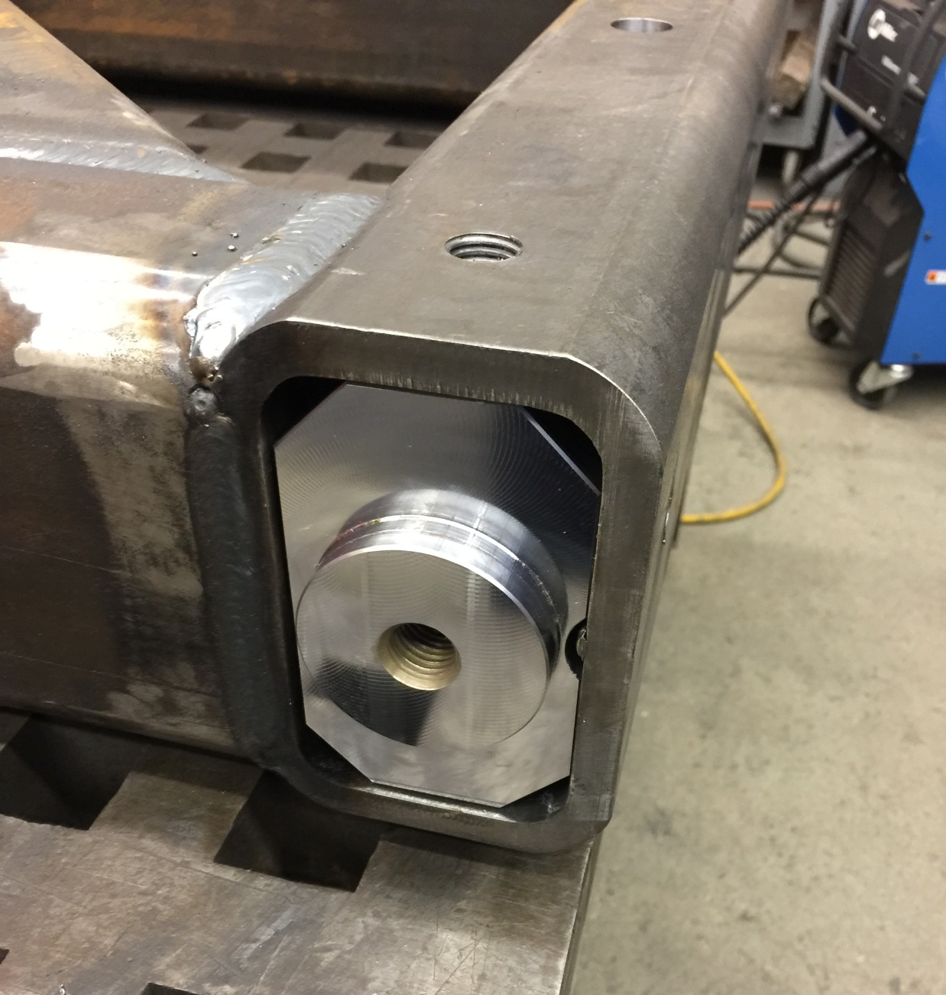
Support Frame Details
After weld
The rectangular steel tubing has a weld seam bump on the inside. The end block machinist hand fitted each end block to fit perfectly inside each tube. Nice craftsmanship from the LBNL shops.

Slide 6
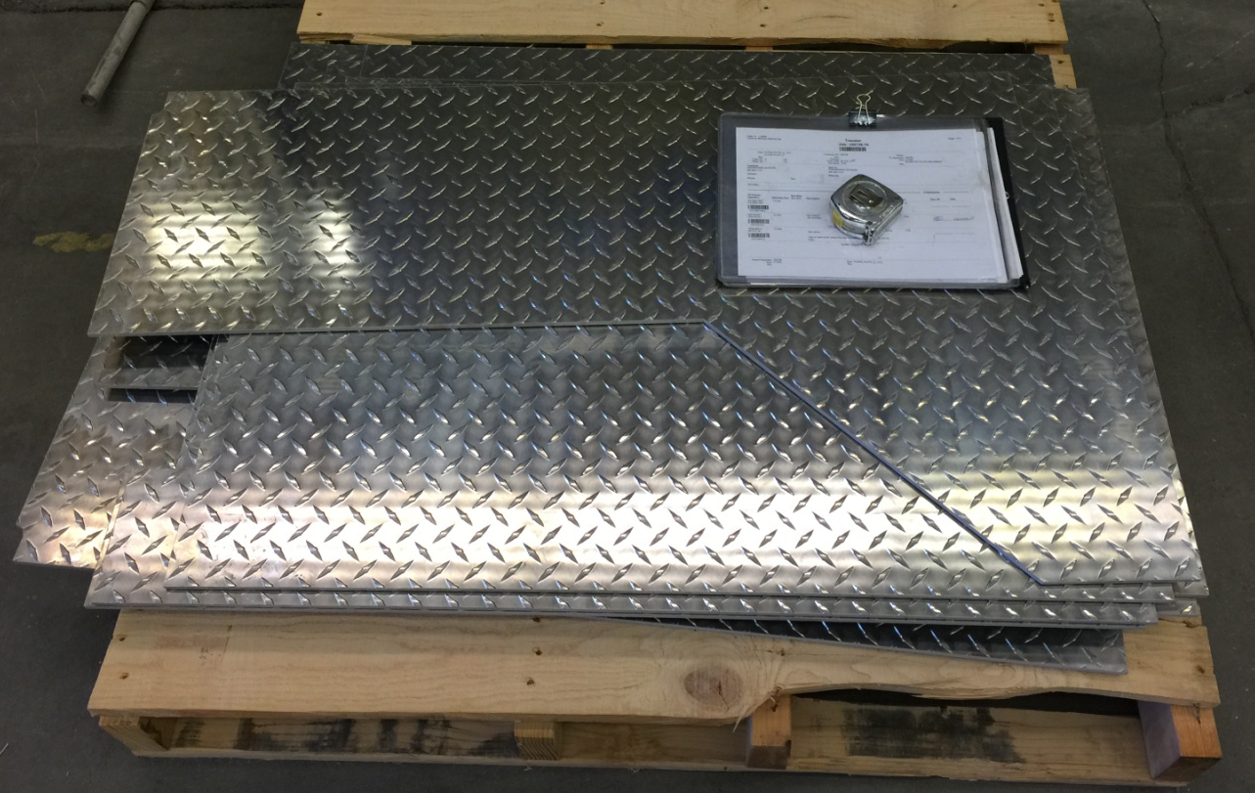
Support Frame Details
Floor plates fabricated

Slide 7
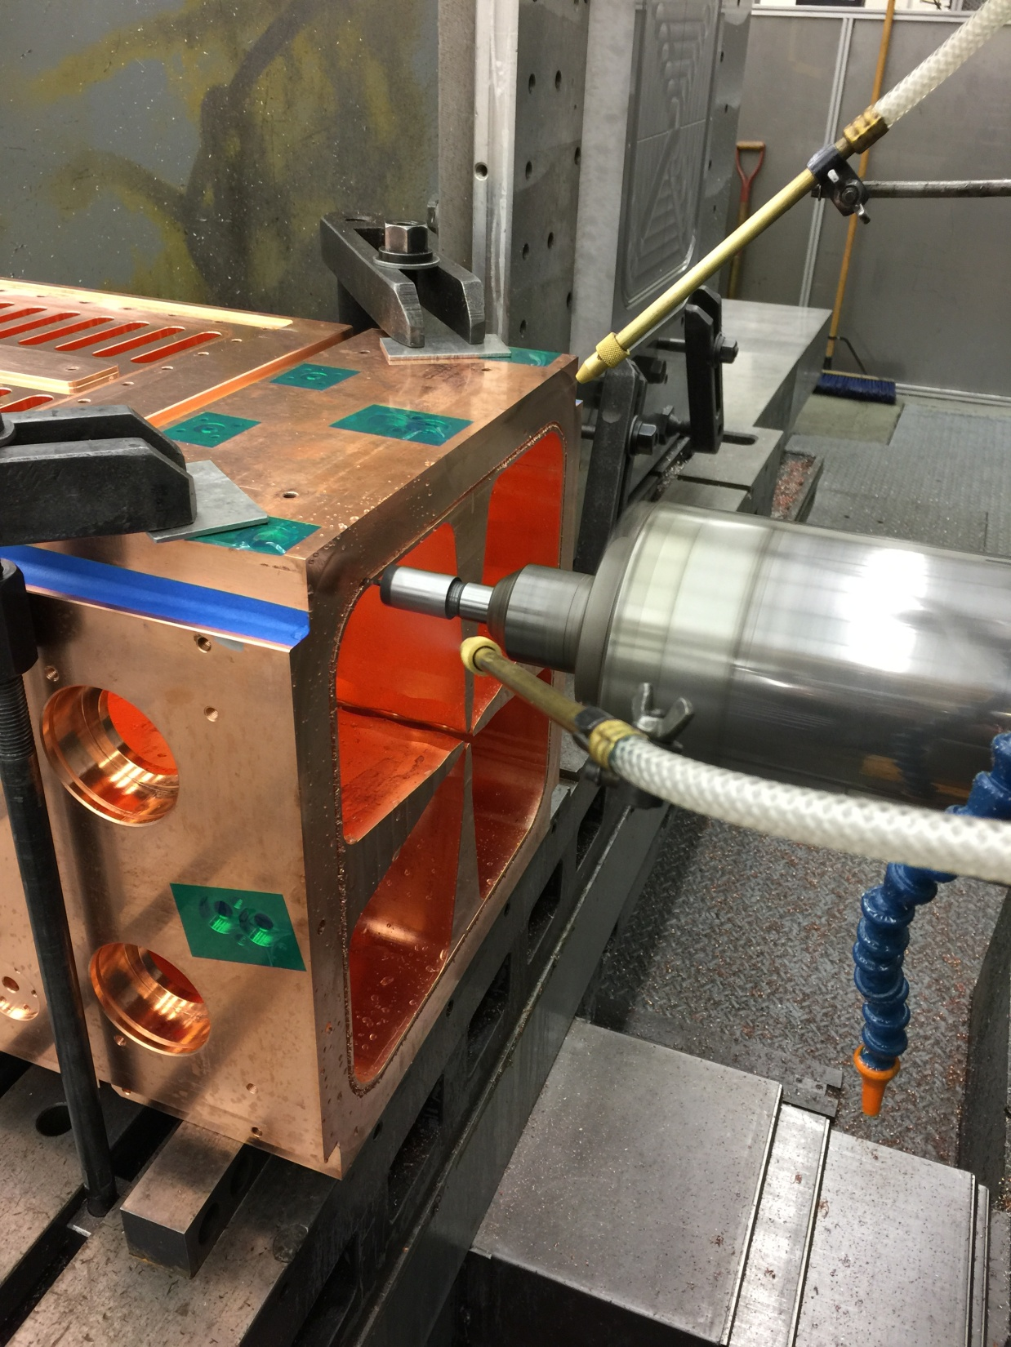
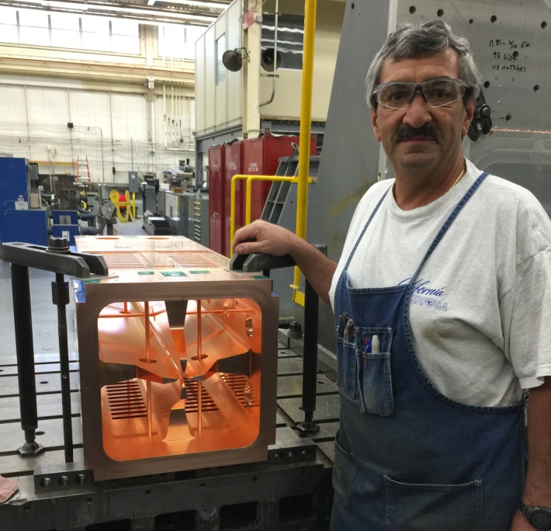
Module End Wall Machining is underway.
Module 1
Lead machinist Mark Campagna
Module 2 April 23, 2015
Modules 1 and 2 are complete. Module 3 will be done either May 1 or May 4th. Module 4 after that.

Slide 8
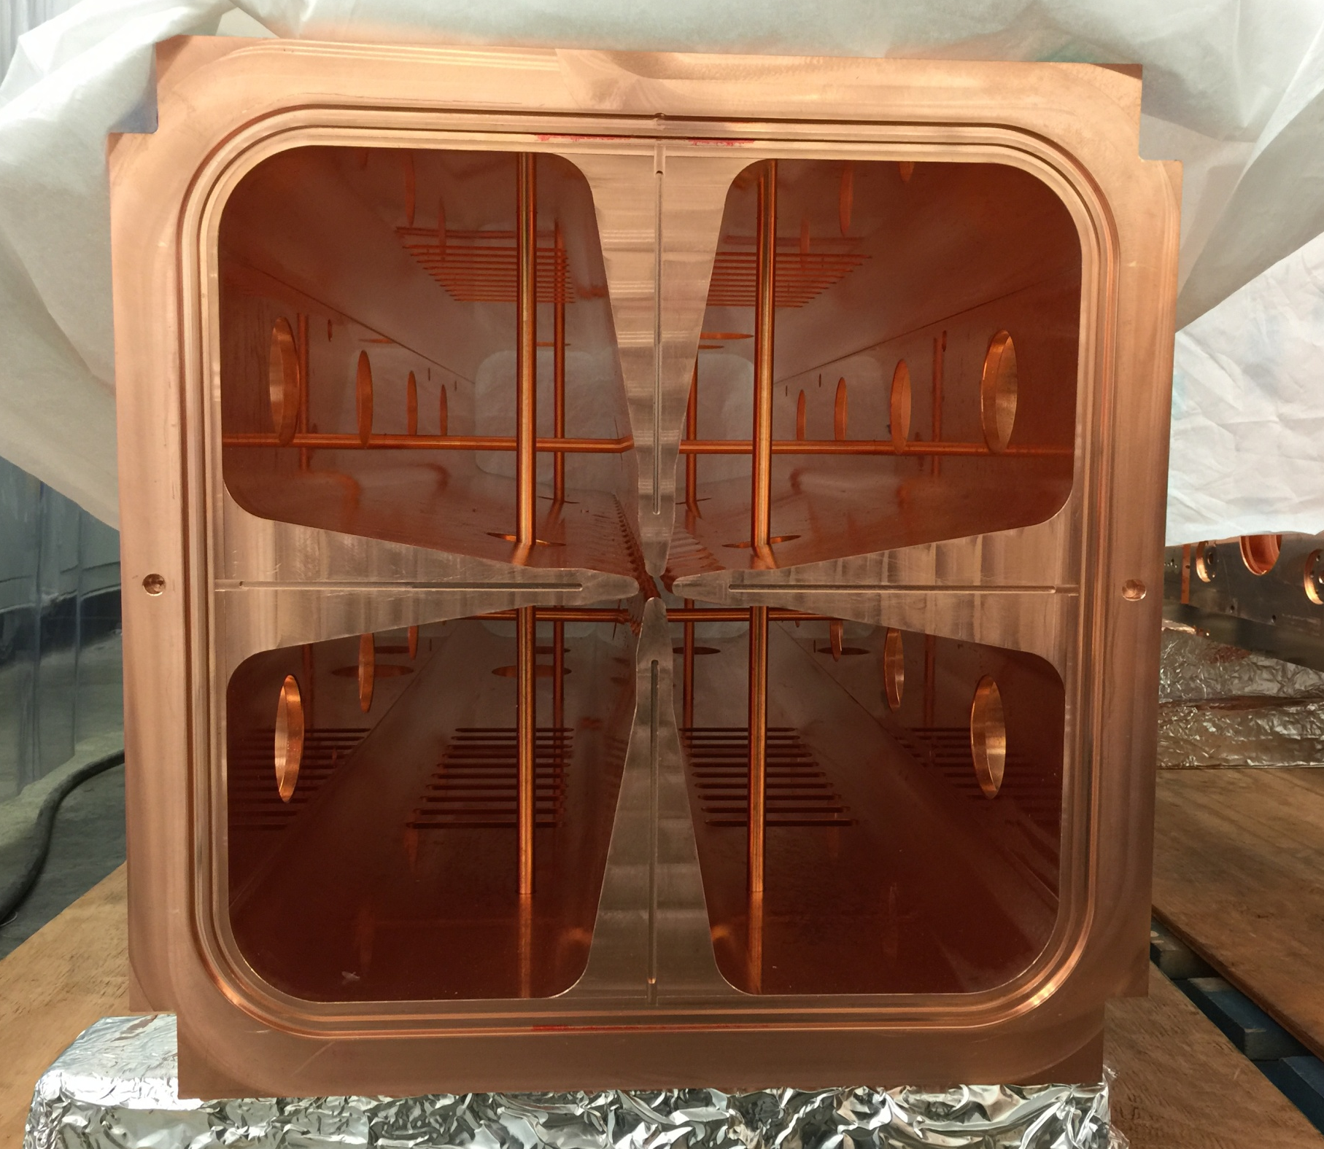
Module 2 Entrance end
Raised lip (barely visible)
Vane tip canted spring grooves
Dowel pin hole
Dowel pin slot
Canted spring groove inside
O-ring groove outside

Slide 9
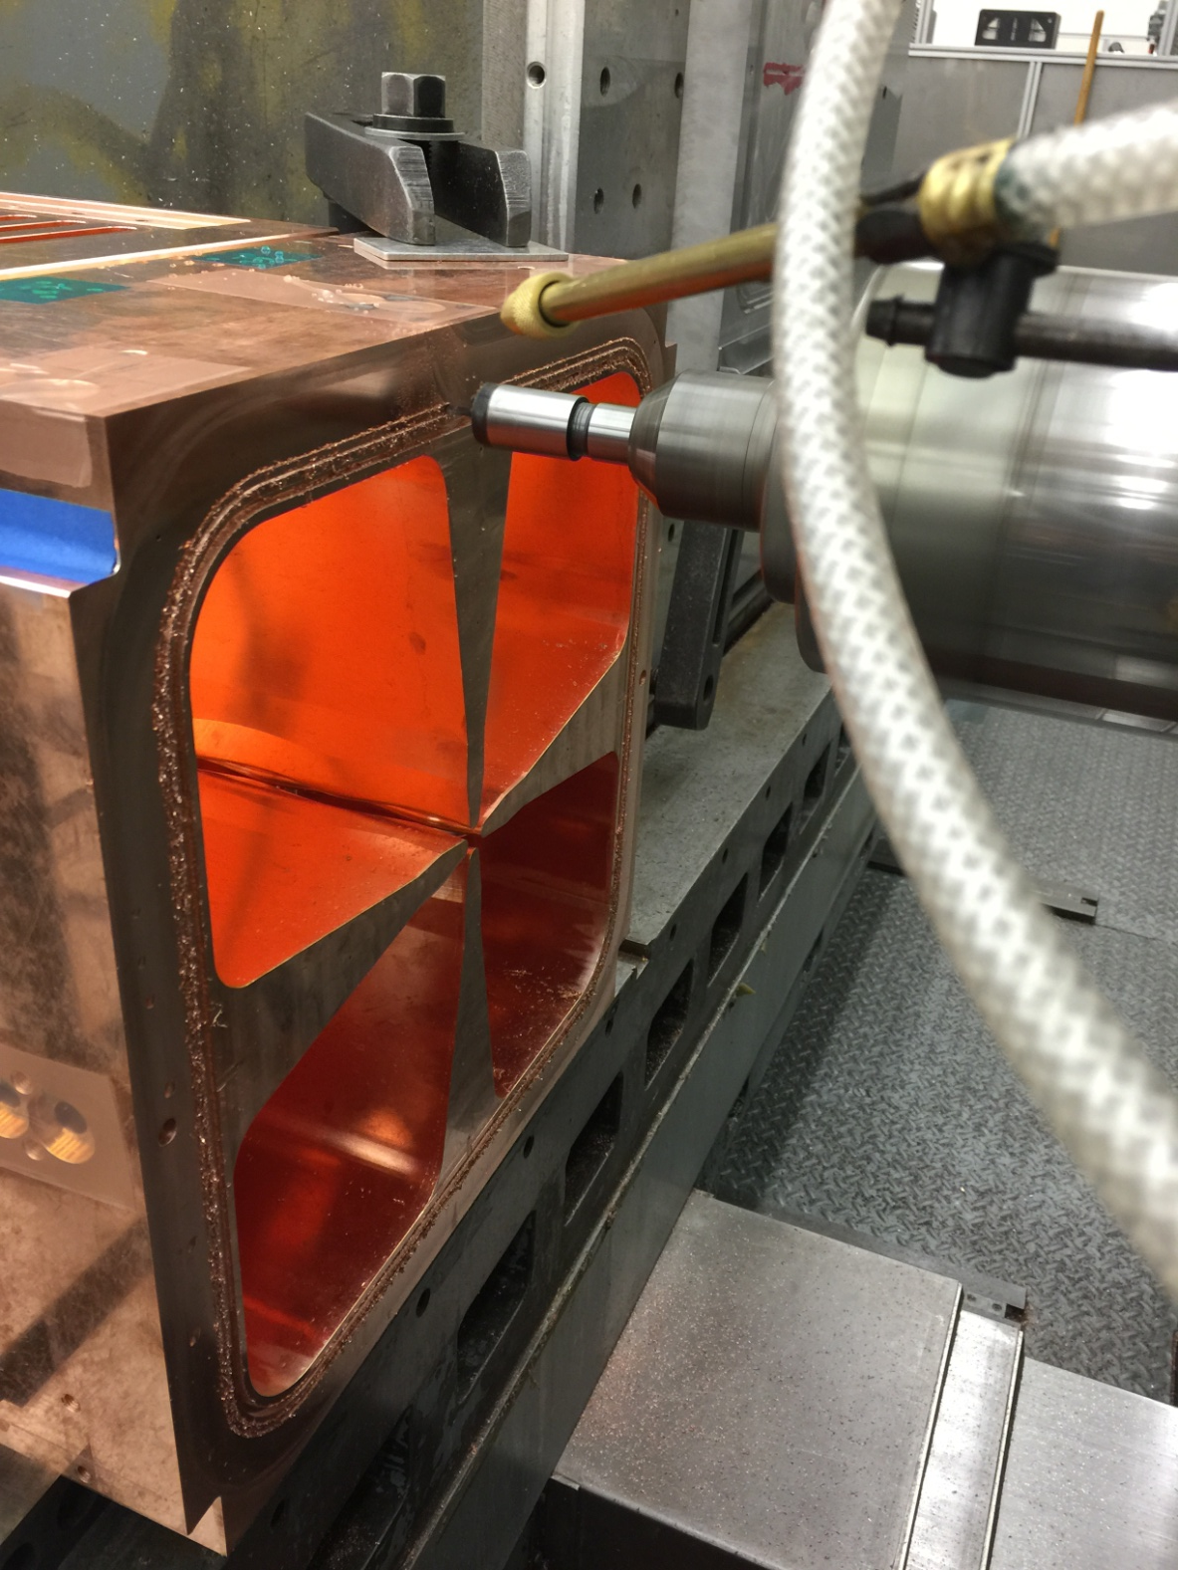
Module 3 end wall machining April 30, 2015 at 10:20 AM.

Slide 10
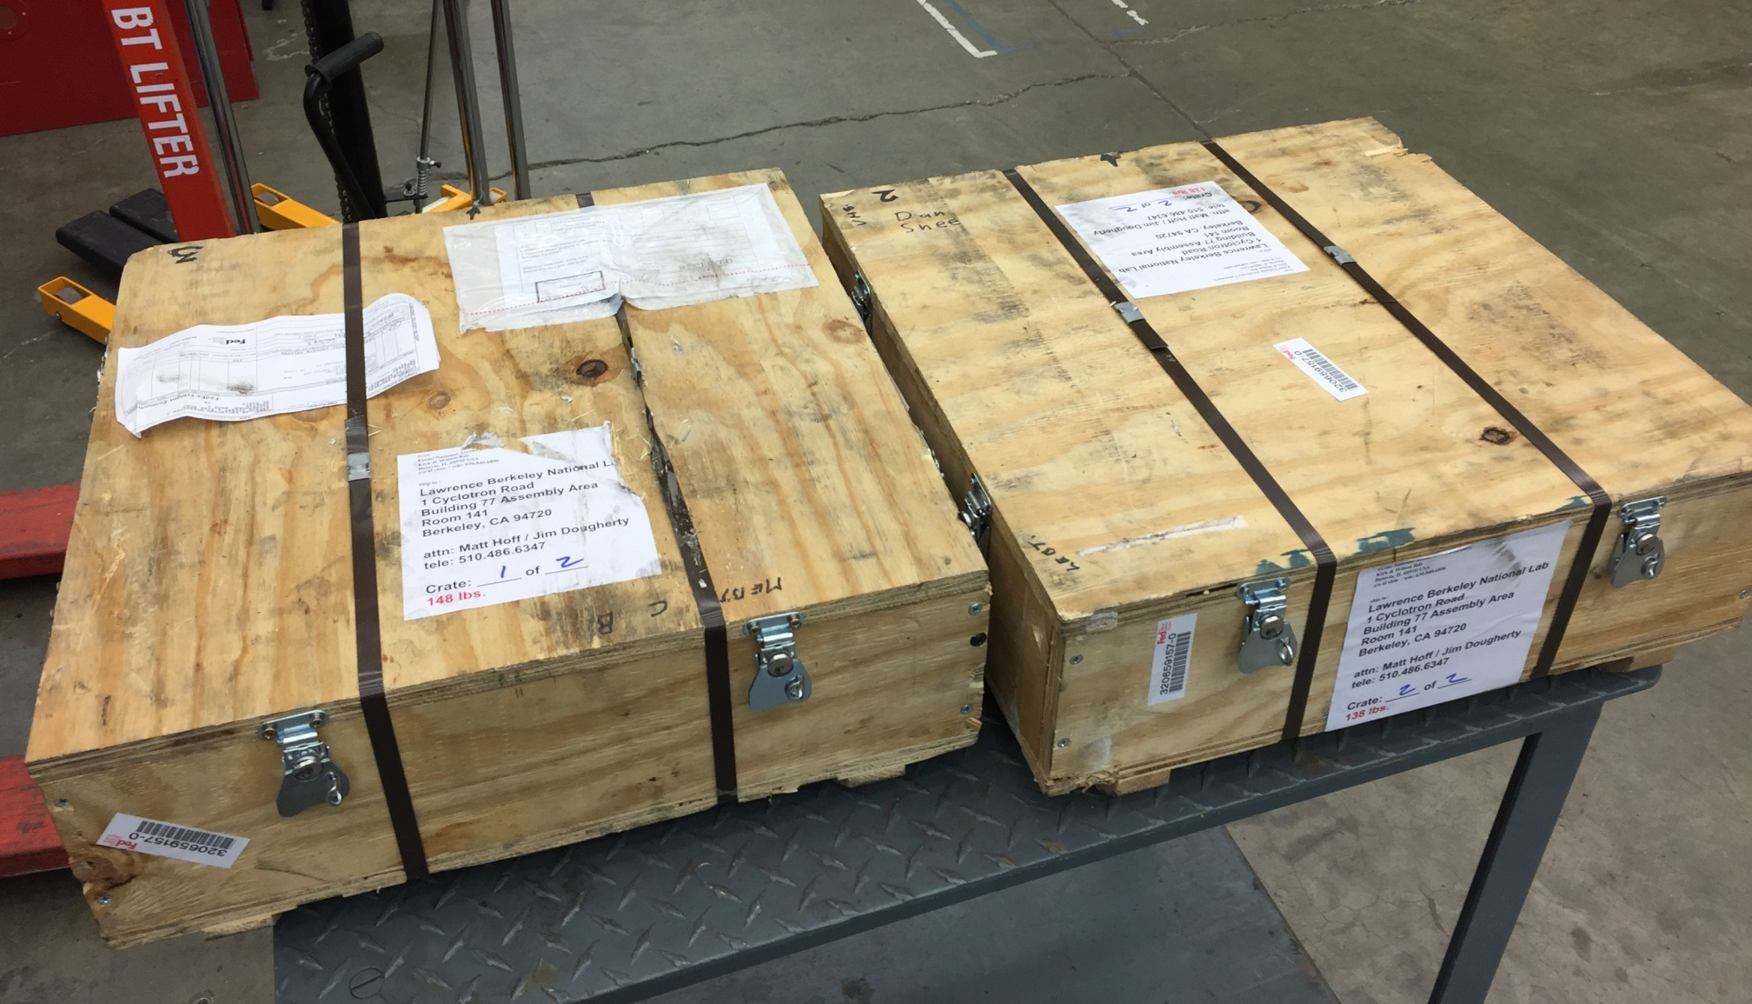
End Cap Plates from FNAL arrived April 28, 2015. The boxes have not been opened yet.

Slide 11
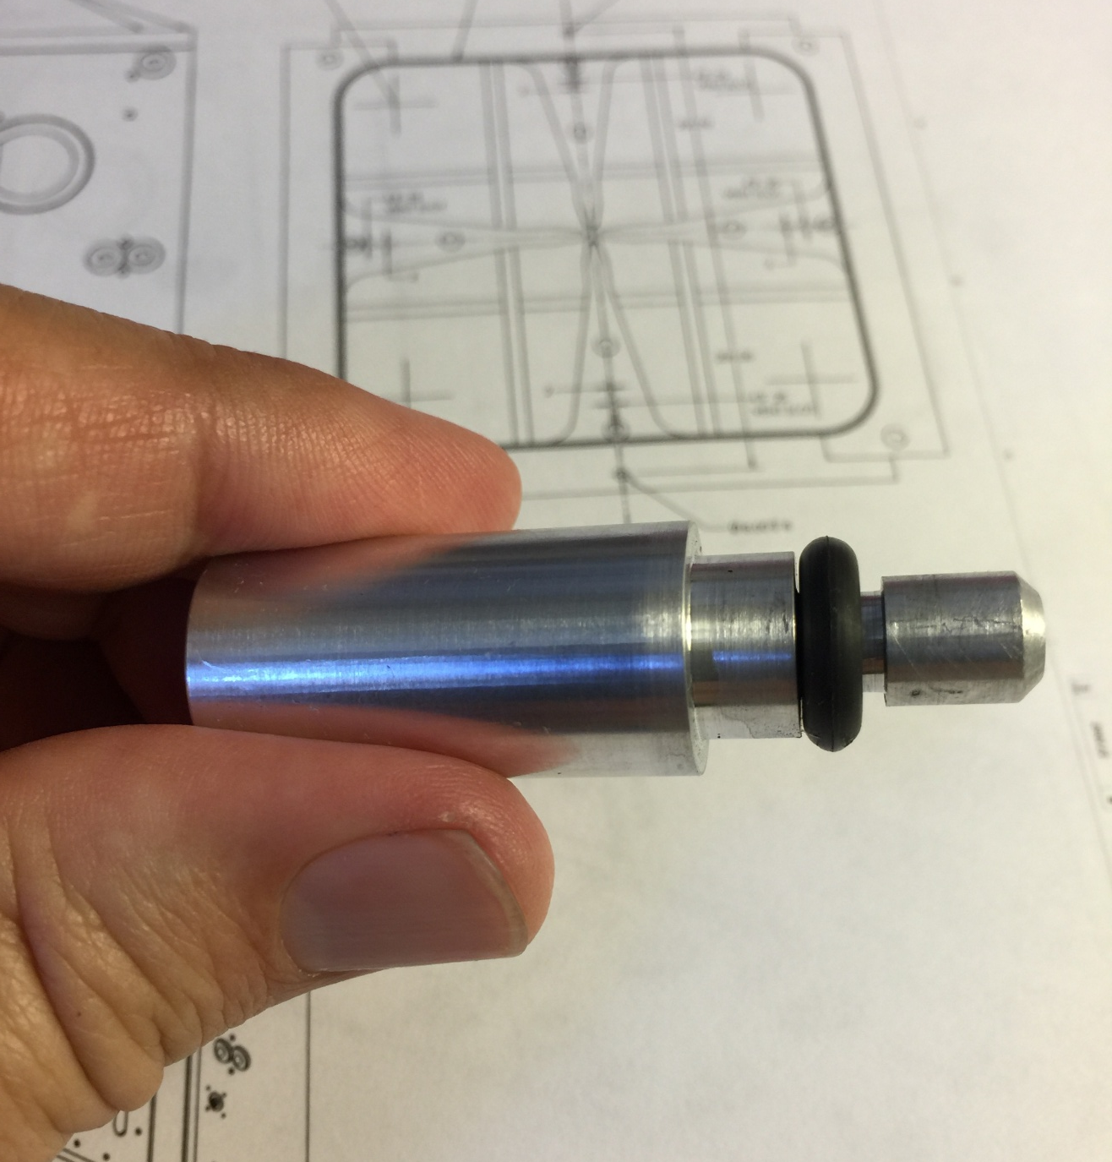
Sensing loop port plugs have been designed and prototyped. 48 more are now in production. These will plug the sensing loop port holes if the sensing loop are late for vacuum testing.

Slide 12
The shipping spread sheet has been started. The list will grow longer and more detailed in the coming weeks.

