Slide 1
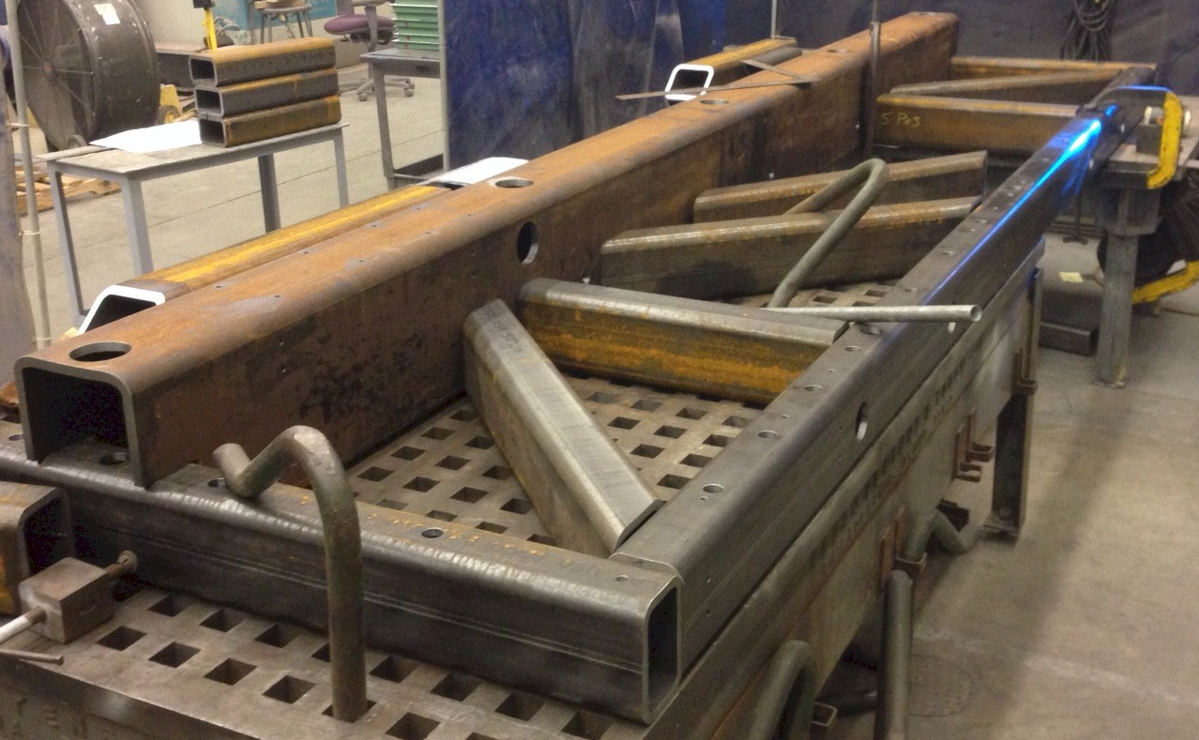
Fabrication Update – The Frame Awakens
Matt Hoff LBNL April 2, 2015

Slide 2
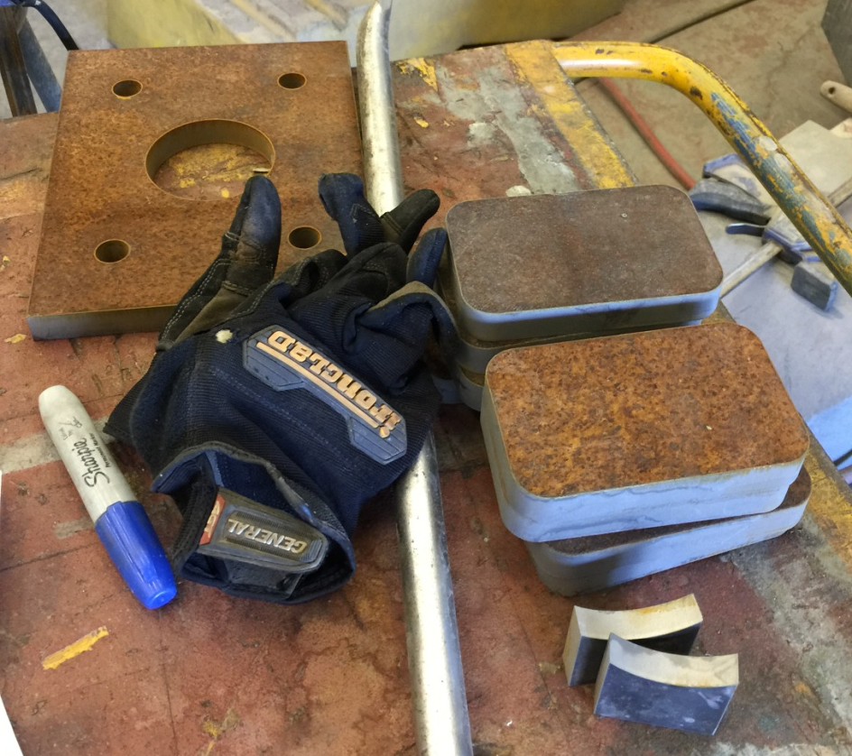
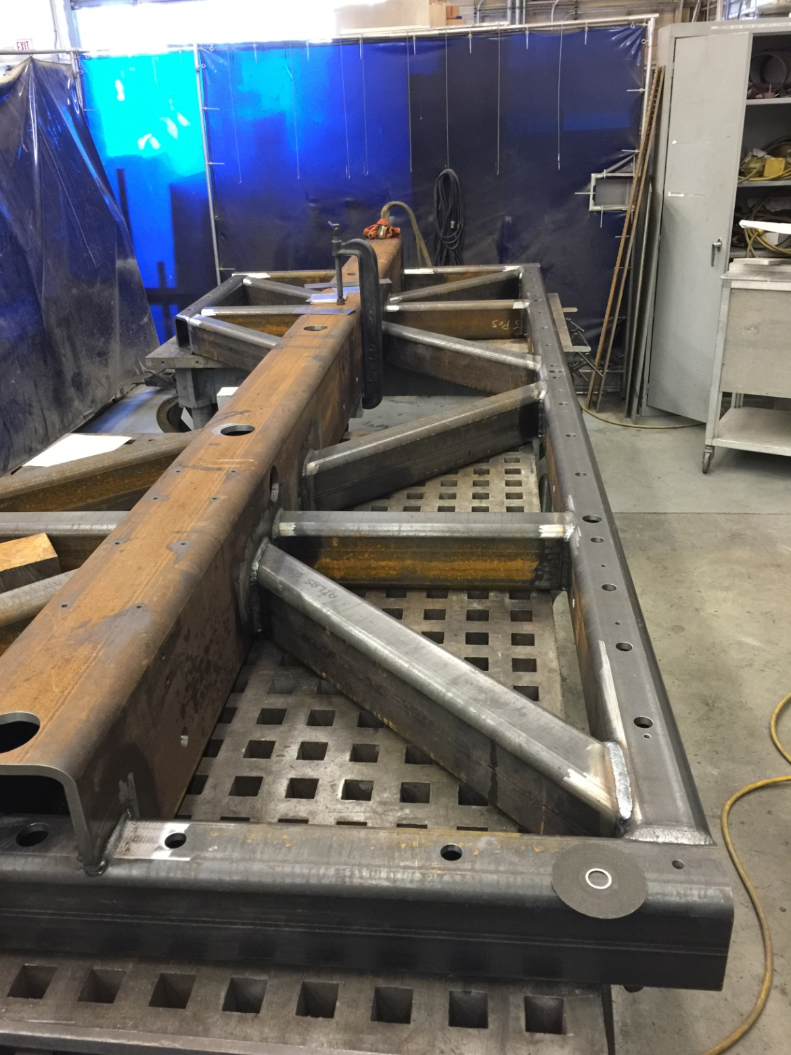
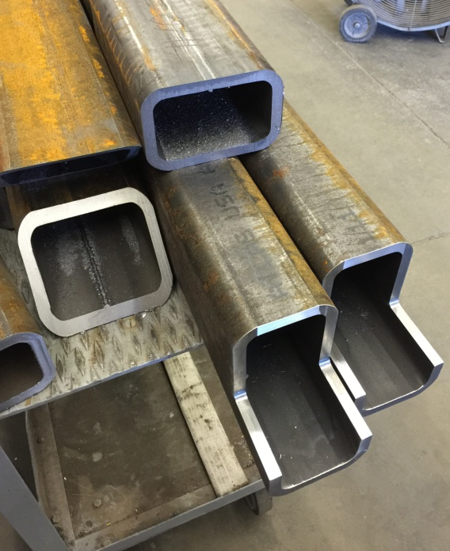
Full welds on this half of the frame
Water jet cut small pieces
No welds this half yet
Machining details
Photo taken 4/1/2015

Slide 3
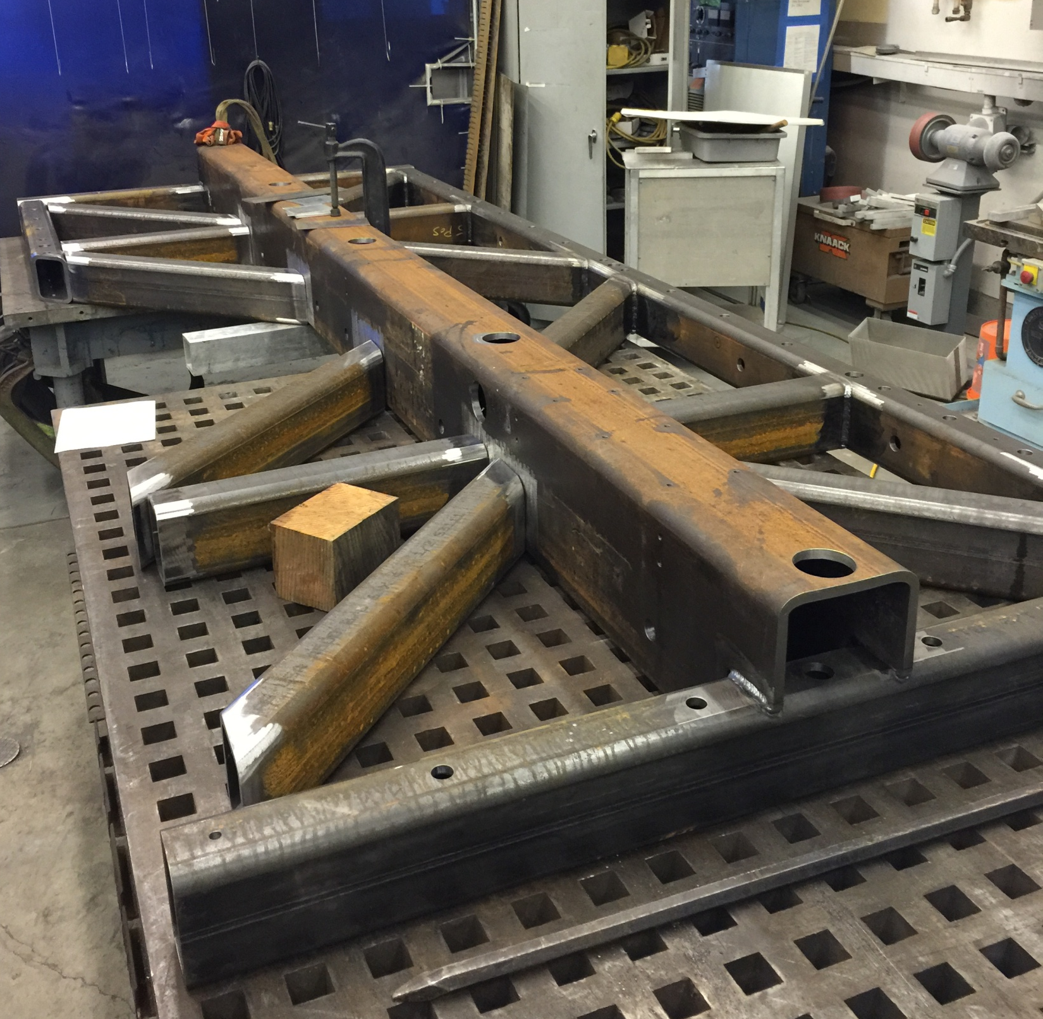
Machining Details
LBNL’s two best welders

Slide 4
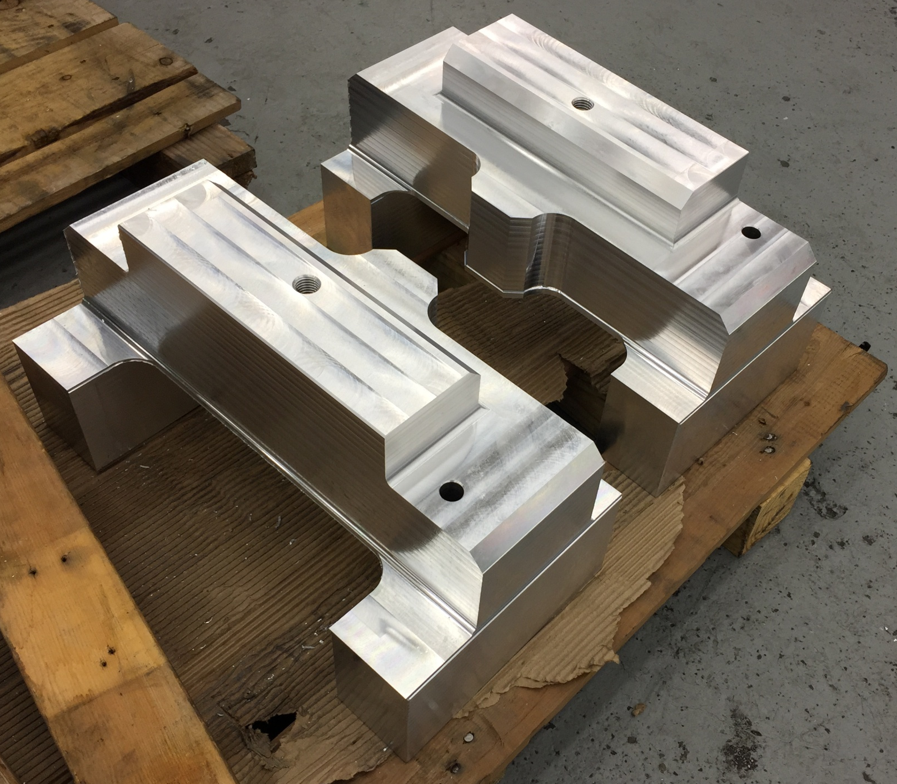
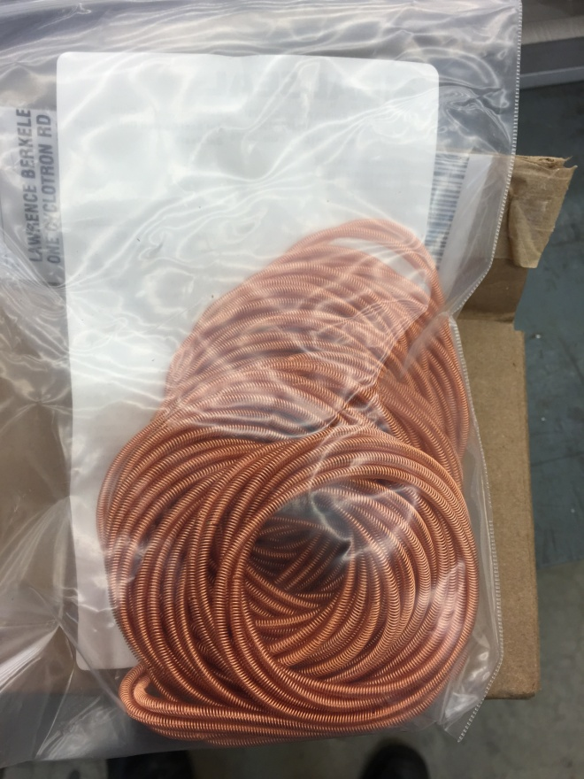
Parts are being fabricated and off the shelf items are arriving
100 Bal Seal canted spring rings for the slug tuners
2 of 4 temporary strut mounting blocks

Slide 5
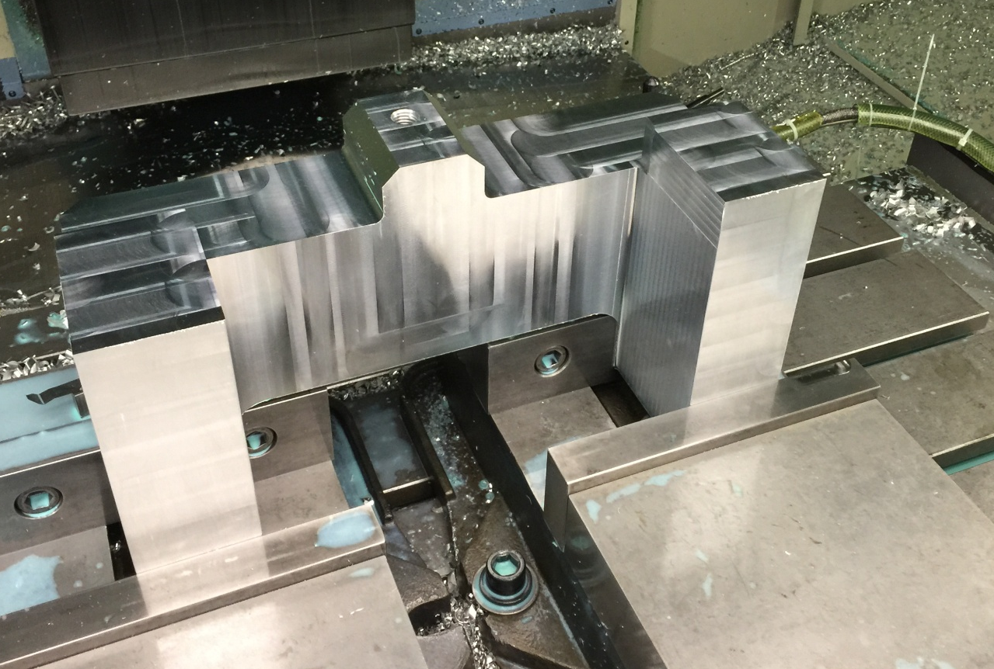
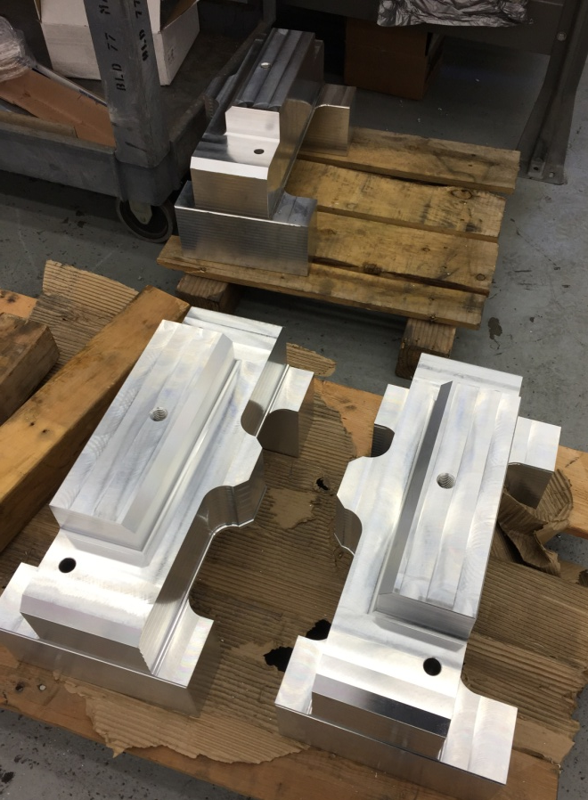
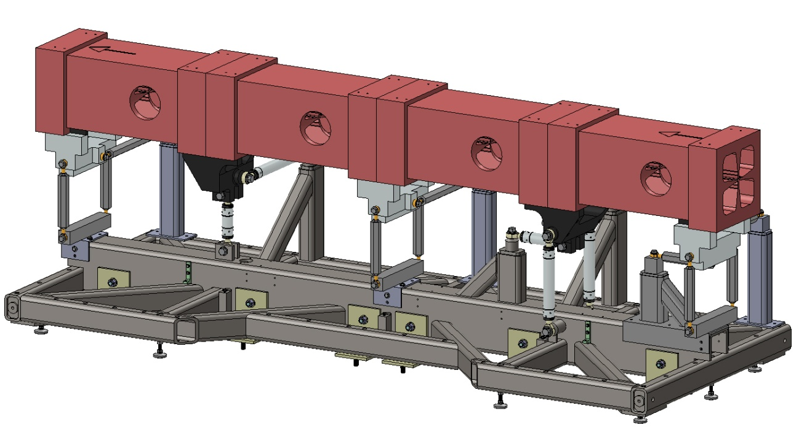
All 4 temporary strut supports
Temp strut mounts in model

Slide 6
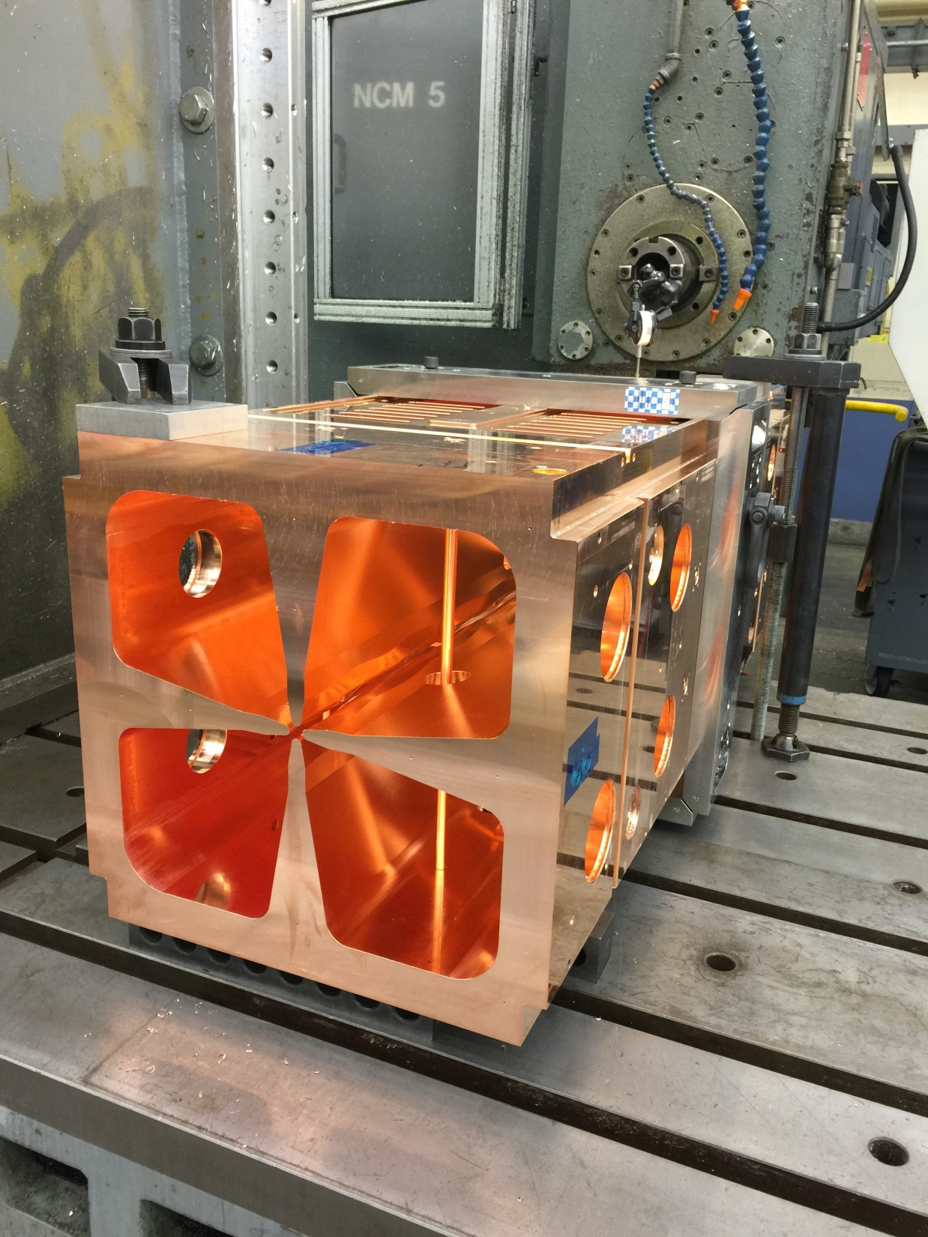
End Machining
Module 1 and 2 are scheduled for final end machining starting Friday April 3, 2015. This should be fast. This is the final machining step in the copper.
Module 3 will follow after Module 4 is leak tight. Then finally Module 4.
This picture is Module 4 getting the ends trimmed for a vacuum check

Slide 7
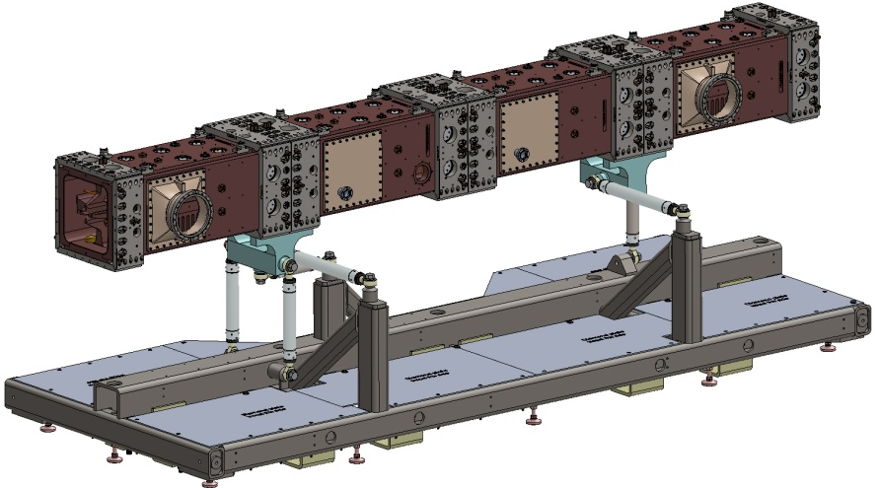
Summary
Support Frame fabrication is progressing at a good rate. On schedule.
Other pieces needed for assembly are in progress.
Some off the shelf items have started to arrive.
Module end machining starts Friday April 3.
FNAL has a copy of LBNL’s CAD model

