Slide 1
SSD Mechanics
E Anderssen, H Matis, J Thomas LBNL
S Bouvier, G Gouilloux Subatech

Slide 2
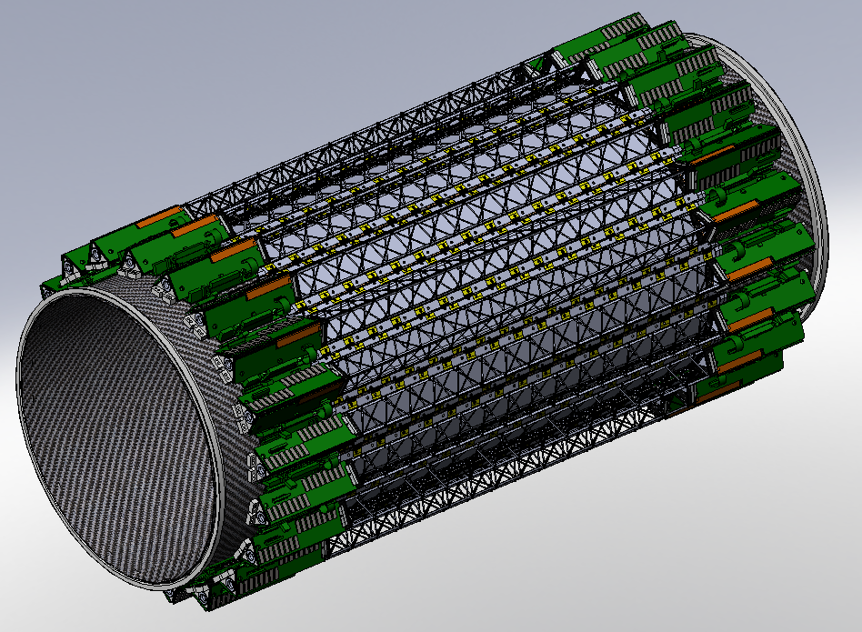
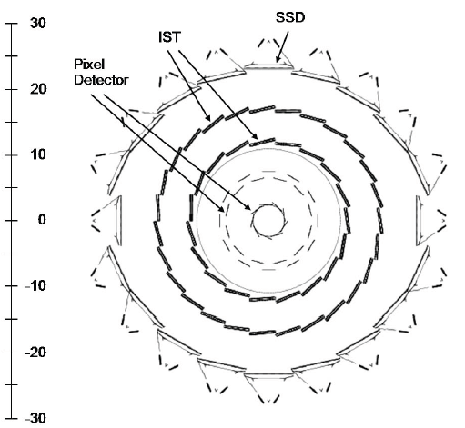
Silicon Strip Detector
SSD is an Existing STAR detector—undergoing retrofit
HFT is responsible for Integration of the SSD into the upgraded tracker volume
Talks on the Electrical Upgrade will follow

Slide 3
SSD Integration Overview
Change of Mechanical Supports
Reduction of material first goal (looked at Be/Albemet)
Simplification of assembly and later survey
Integration of Services with FGT and HFT
Later discussion of changes to internal cable materials
Routed Space within FGT presented elsewhere
Will show Routing space in overview only
Improvement to the SSD Cooling
Problems arose with cooling during previous installation
Cooling system near limit but adequate—main problem kinks in hosing
Change to route all cooling out East Side rather than also thru FGT

Slide 4
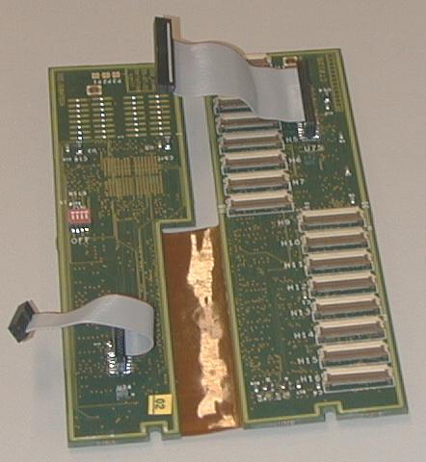
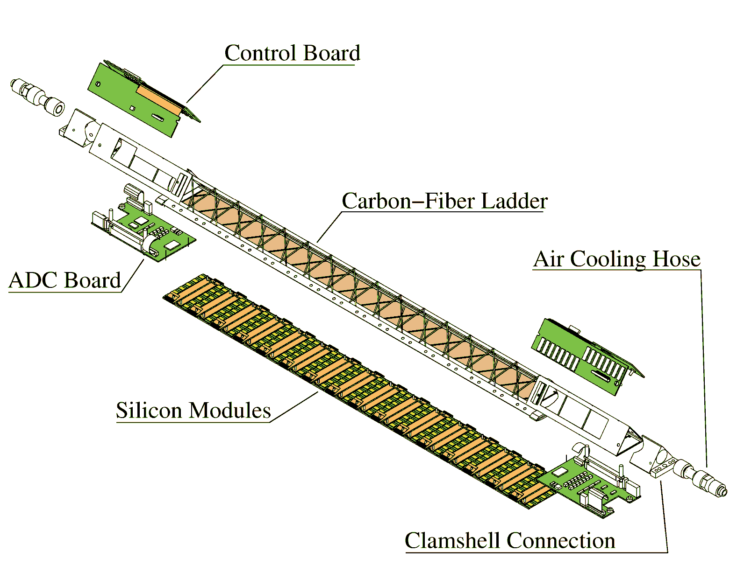
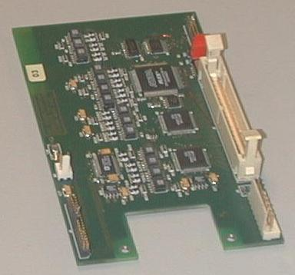
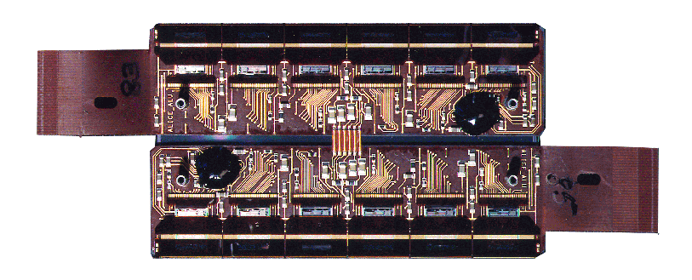
SSD Ladder
Notes:
The main structure of one SSD ladder is a carbon fibre beam with a triangular cross section with a base of 40mm. The length is 1060mm.
It supports :
The 16 detection modules
And on each end, one ADC board and one control board
The control board is fabricated with a flexible layer. So it can sit on the top of the ladder.
This board distributes the power supply and all the signals necessary to control and run the 16 detection modules. It multiplexes also the analogue signal coming from the modules to the ADC board.
In case of a latch-up occurring in the FEE of one module, the control board is able to detect it and switch off the power supply, then the module is bypassed during the next readout until its re-initialisation.
The cooling of the system is done by air.

Slide 5
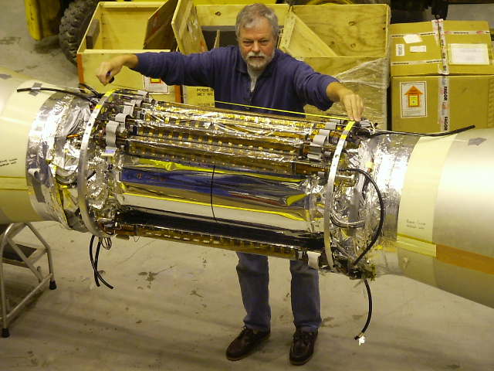
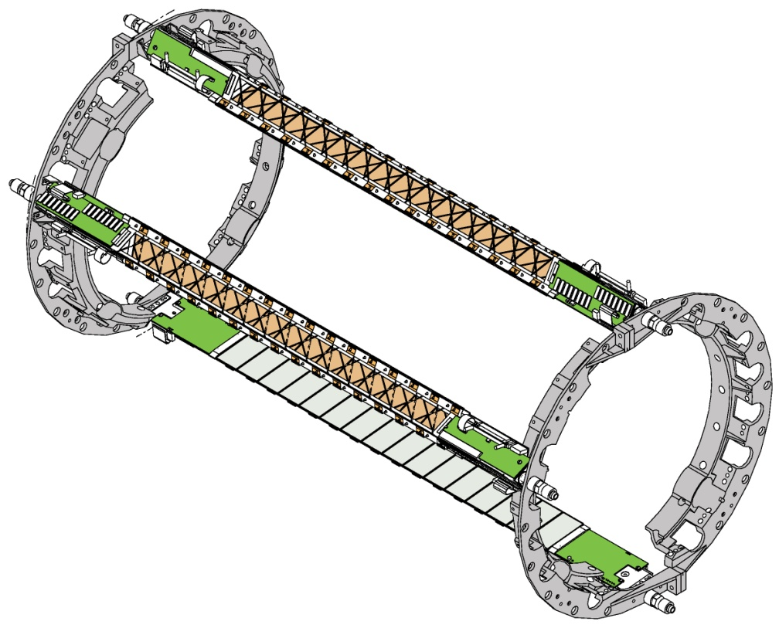
Changes in Mechanical Support of Ladders
Old Supports Shown above, consisting of Aluminum Rings
Ladders Supported by ends on the rings—pinned and bolted
Ladder Mechanical interface maintained—rings go away
Rings required on old cone structure—cones joined by two beams—not cylinder; Rings in acceptance of FGT, looked for ways to reduce mass.
New Cones have cylinder—mount ladders directly to shell

Slide 6
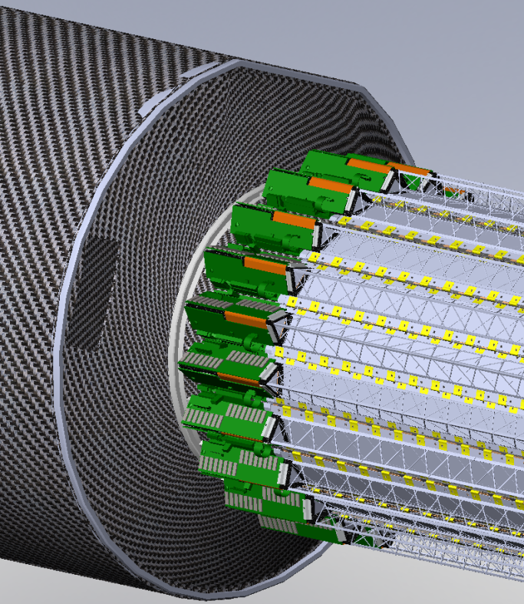
SSD Mounted Directly to OSC
OSC (Outer Support Cylinder) Spans Gap between two ‘cones’ (East/West)
Removal of Rings allows greater ‘cone depth’ for transition plates improving support performance (SSD integration impacts all of HFT/SSD structures)
Most SSD Services exit the ladder radially allowing OSC to be shorter as well
Survey possible after mounting (windows to see sensors from outside are part of ladder design)
SSD Can be mechanically assembled and surveyed directly on OSC prior to integration with the cone structures (see later talk)

Slide 7
SSD Services
EAST
Shrouds
Cables and Fibers go out both sides (See FGT Talk to see cross-section)
Cooling all out East Side—may require more length to accommodate fittings and tubing bends
Length on East end also affects Pixels—length increase in right direction, i.e. not competing against Pixels or IST…
Conductive Shrouds required to meet standoff requirements within Inner Field Cage—covers both ‘sharp’ Cone flanges and SSD Services, also provides support for foil over SSD

Slide 8
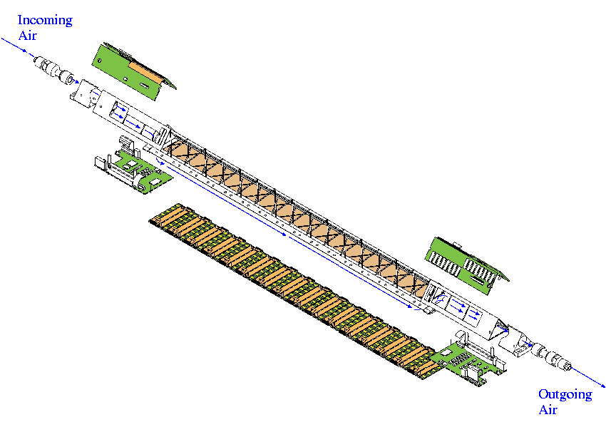
SSD Cooling system : measurement results
Cooling On – vs 19 ºC | SIDE P | SIDE N
ADC Board | 33.1ºC | 33.2ºC
Control Board FPGA | 33.7ºC | 30.7ºC
Control Board Conn | 27.6ºC | 24.5ºC
24.5ºC
19ºC
30.7ºC
End Electronics
To be Replaced
3 W
33.2ºC
27.6ºC
25.1ºC
30.9 ºC
33.7ºC
10 W
3 W
Cooling Off – vs 19 ºC | SIDE P | SIDE N
ADC Board | 42.8 ºC | 46.5ºC
Control Board FPGA | 34.8ºC | 36.5ºC
Control Board Conn | 45.2ºC | 45.4ºC
27.8 ºC
33.1ºC
29ºC
Notes:
These are the results of the air cooling test. The temperature are suitable for the SSD working in good condition.

Slide 9
The performance of the old electronics was perfectly satisfactory when the cooling system was in perfect condition
The new SSD electronics will be designed with ‘next generation’ components
The new electronics is projected to consume less power than the old electronics even though the new electronics is faster
So if we can design a new cooling system that has the same cooling capacity as the old system, but is more reliable, then we should be successful in cooling the new electronics, too.
1 l/sec of air at 0.5 m/sec was extensively tested on the bench, and was shown to work, without vibration or other difficulties

Slide 10
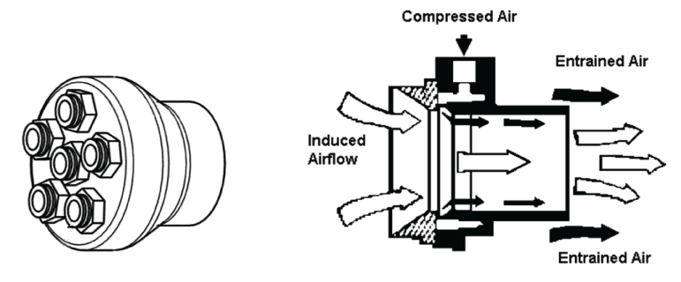
The Previous Solution – a Vortec Transvector
The previous solution was compact, convenient and clever
The left panel (above) shows the vacuum distribution manifold that transfers air from the small diameter tubes to the Transvector. The right panel shows the Transvector airflow amplifier and its principles of operation.
It worked. The Transvector drew air over the ladder by starting with air from the IFC (~1 bar). The system had a measured pressure drop of -12 mbar at the far end of the ladder and -43 mbar after 4.5 m of 8 mm (ID) plastic hose.

Slide 11
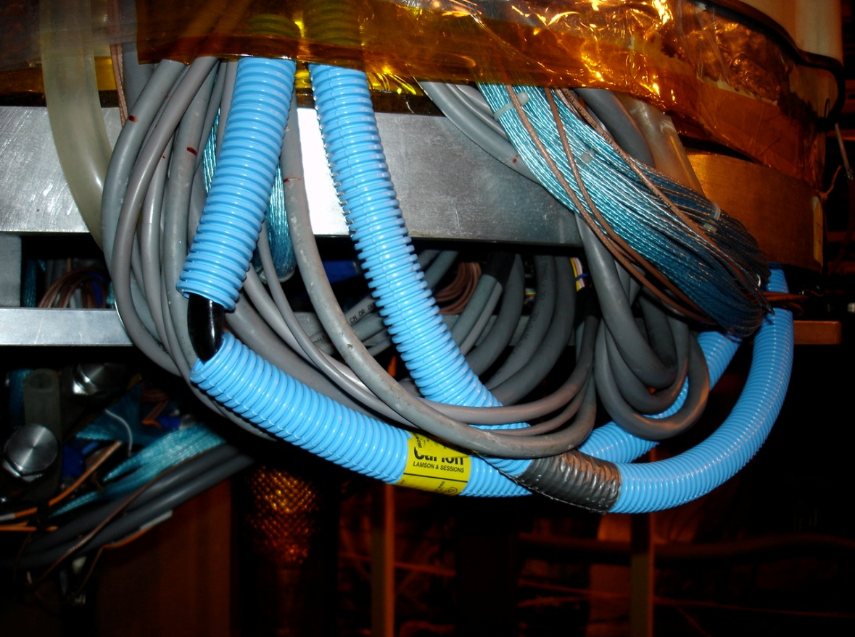
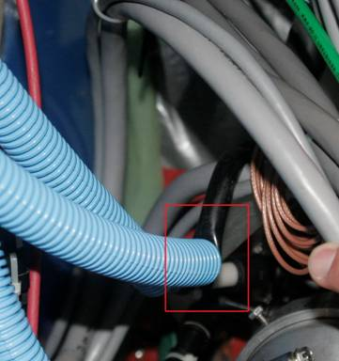
Hose Collapse/Kink
NOT
Good…
GOOD
Hoses under Vacuum, but not great pressure differential
Larger size for better conductance is more susceptible to buckling
‘Protection’ is dangerous/unhealthy when not monitored
Move to rigid pre-bent Aluminum tubing

Slide 12
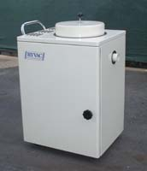
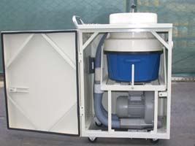
A Different Solution to the Same Problem
The wood products industry needs high volume vacuum sources to clear wood chips from around saws and lathes.
Thus, there is a commercial line of vacuum sources that provide vacuum with more flow and pressure than we need.
These vacuum sources can be purchased, off the shelf, and are designed for continuous operation. They run on 3 phase 240 VAC.
http://www.dustcollectorsource.com/

Slide 13
RP-212-EL and RP-426-QL
A wide variety of option are available. Shown above are the vacuum curves for a 1.2 kW and a 2.6 kW system from a small company in Southern California.
They will build to suit our needs. Cost is about $4K.
Either system is more than sufficient for the needs of the SSD and gives a convenient amount of excess capacity to enable us to keep the motor cool and even increase the airflow, if necessary.

Slide 14
Cooling Summary
Satisfactory cooling can be achieved by using a vacuum source to pull air from the IFC across the ladders of the SSD
Extensive measurements show that it works when everything is working perfectly
In order to achieve excess capacity to compensate for non-ideal conditions, we should go to a new source of vacuum
230 V / 3 Phase Siemens turbine. The motors are brushless and rated for continuous operation, 25 year lifetime, 65 dBA.
We should use larger diameter hoses at each stage of the design
The most sensitive hoses are the ~ 1 cm diameter hoses between the manifold and each ladder. These can be made larger for the majority of the distance between the manifold and the SSD.
The ~ 1 cm hoses should be made stiff (so they won’t kink)

Slide 15
Conclusion
Support of SSD off of OSC seems both feasible and desired
Removal of Support Rings reduces material and frees space to improve integration and structural performance
Later talks will document better, but service routing space seems adequate, but needs to be done in detail
Cooling out of East end seems possible, and reduces service loads on West (FGT) end
Proposed cooling system has increased capacity, and upgraded SSD should dissipate less power
Proper integration of cooling tubes is required to prevent failures of previous type (kinks)

Slide 16
Backup

Slide 17
Losses are a function of distance
The vacuum source will be mounted on the North Platform
Dirty power available
We will need approximately 30 meters (100 feet) of tubing to run between the source and the manifold on the face of the TPC.
Using the old manifold is reasonable and desirable
The vacuum source is manufactured with 2 inch input ports
The pressure lost in a perfectly smooth tube that is 100 feet long is approximately 4 inches of water.
http://www.gates.com/industrial/pressure/airFlow.cfm
However, the pressure lost in a 3 inch tube is only 0.5 inches of H₂O
The only caveat on running a long plastic tube is to provide a conductor inside the tube to dissipate static charge
The pressure lost in a 8 mm (ID) tube that is 4.5 m (15 foot) long is 17 inches of water (43 mbar)
In good agreement with measurements
Note that a 1 cm (ID) tube only looses 13 mbar … very sensitive to ID
We should use large tubes to conduct the vacuum.
We are still limited by the 1 cm orifice on the ladders but we can tolerate this (and other small diameter hardware) by keeping the overall length of these sections very short.

