Slide 1
HFT Middle Support Cylinder
Eric Anderssen, LBNL

Slide 2
Description
IST
Pixel Insertion Tube
MSC Interface Flange
The MSC directly supports the IST and Pixel detectors as well as the Beam Pipe mid-section
The MSC is supported by externally by the Cone Structures (bolted flanges to Cones)
IST and Pixels are Cantilevered from the MSC Interface Flange, along with Far Beam Pipe Support
Breaks (bolted flange joints) necessitated by assembly (discussed later)

Slide 3
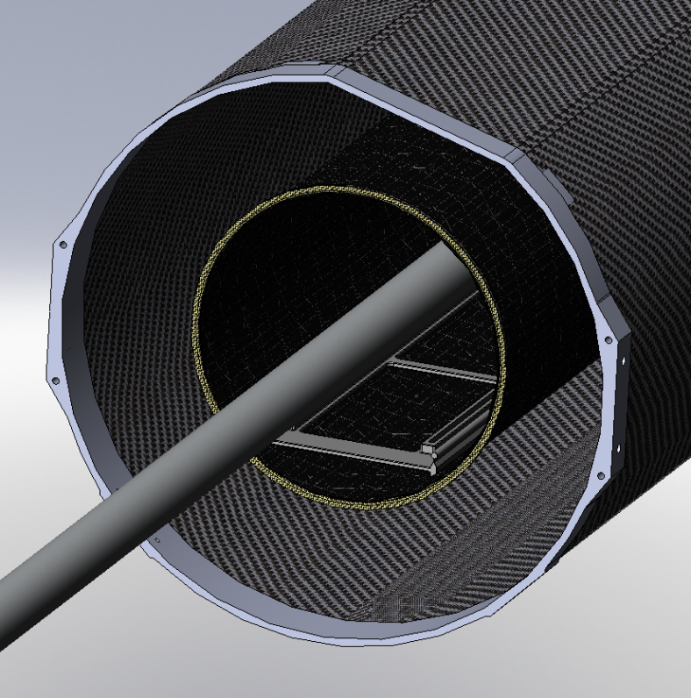
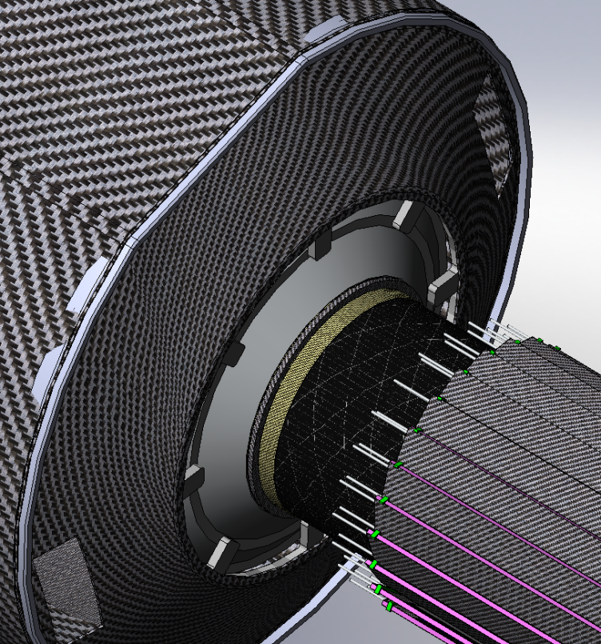
MST Supports
Pixel Insertion Tube Simply supported at both ends
Cantilever section is bolted to inside of ESC (East Support Cylinder/Cone) Fingered interface to allow IST Services to pass thru this interface
Lengths still under iteration with ESC design

Slide 4
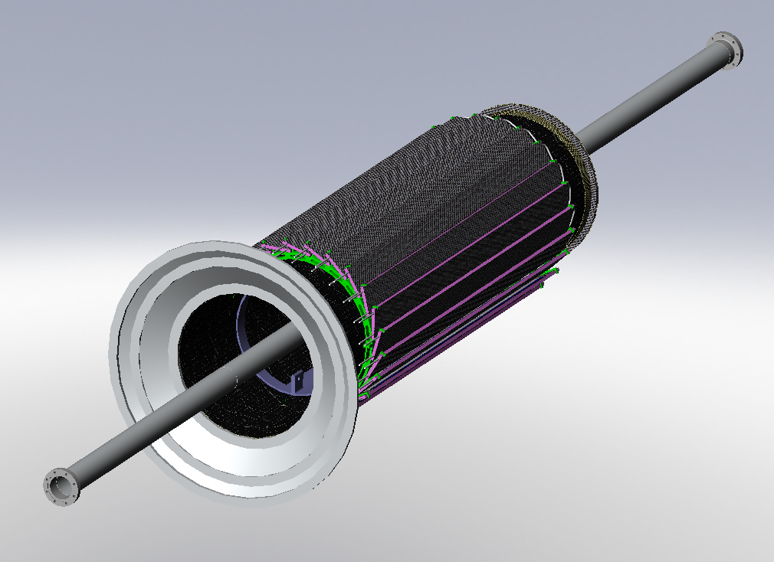
Assembly Sequence Drives MSC Layout
IST is integrated first (and tested) on smaller MSC Cylinder
Interface Flange is present to allow service integration (connector strain relief)
Beam Pipe installed/Supported after IST Integrated onto MSC
Note Pixel Kinematic mounts also part of this structure
Mounts May interfere with IST…
Pixel Kinematic Mounts

Slide 5
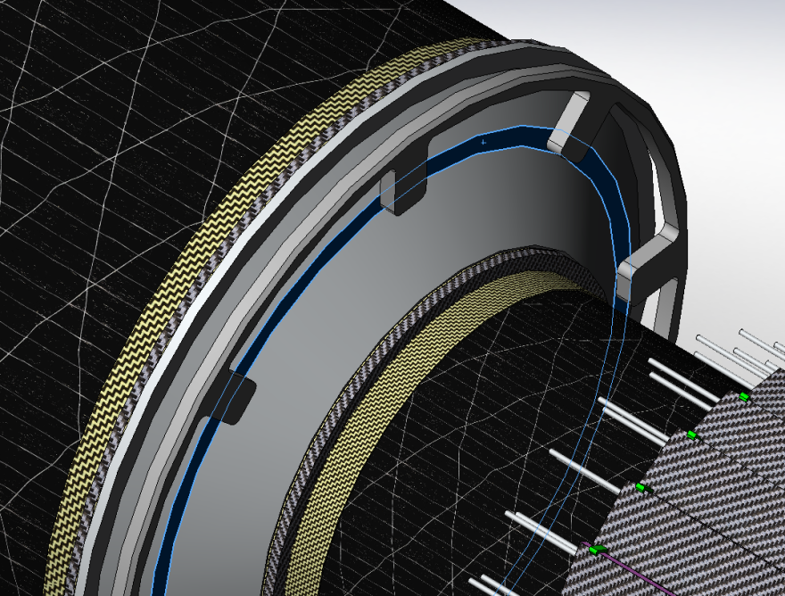
Staged Assembly of Beam Pipe
<Length Between Supports
?
Access to Vacuum Flange during assembly necessitates split in ISC
Note also Beam Pipe support at MSC Interface flange—access needed to make up support
Large overhang, and External Pixel Insertion tooling may lead to longer PIT
Services for IST Now routed over PIT
View to left shows gaps in fingers for IST Services

Slide 6
IST Services on Outside of MSC
12mm
Route is moderately torturous, but gap can be increased with minimal effort
Tubes (~1cm OD Rigid Aluminum) need to be routed thru this gap along with cables of similar size
8 Support Fingers, so 3 Staves per Gap (3-6Tubes/3Cables)

Slide 7
Integration Status
Recent work on Cone structures shifted Pixel Mount locations (potential interference with IST)
IST working on shorter layout—may alleviate
Lengths are easy to change—Mfg limit ~2.8m which we are nowhere near
Beam Pipe supports still need to be designed, but scheme allows access to flanges
Pixel Insertion well understood for internal geometry
External Pixel insertion scheme not yet—may affect length of PIT
External Support on East End of Beam Pipe will affect Pixel Insertion (longer PIT may help by removing this external support)

