Slide 1
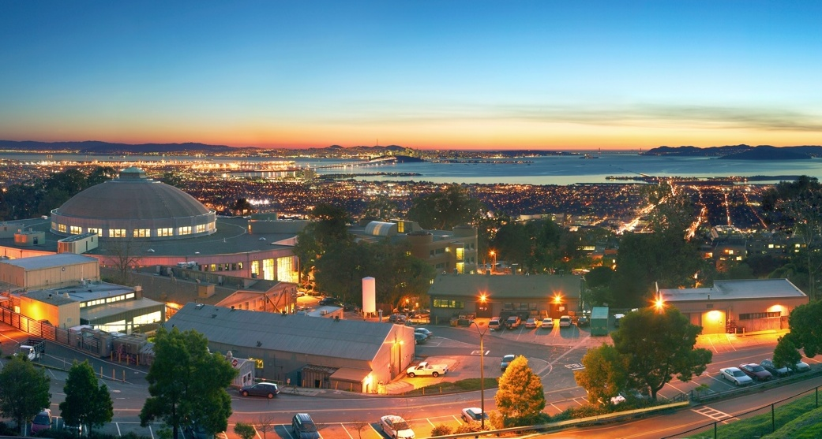
Detector Developments at Lawrence Berkeley National Lab.
Dionisio Doering
ddoering@lbl.gov

Slide 2
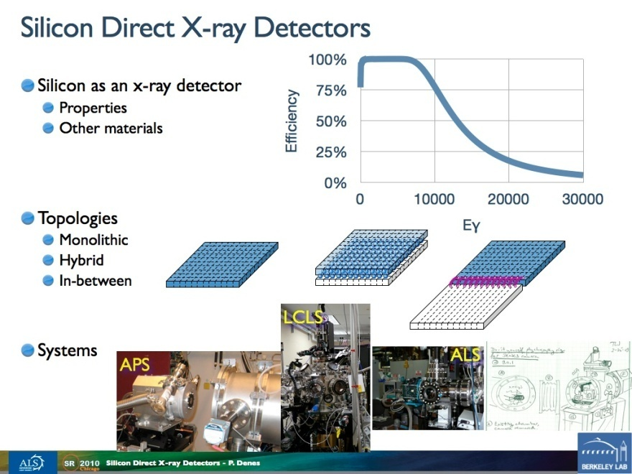
Introduction
Development of a FastCCD (FCCD) camera
  Concept
  Prototype
  Improved mechanical design
  Larger area
Other developments
see P. Denes talk
Thursday

Slide 3
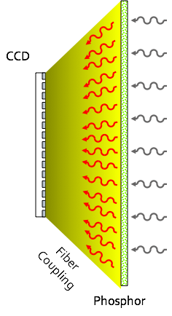
Typical 2D x-ray detector
    X-ray photoconverts in phosphor
    Photoelectron ionizes →scintillation photons
    Some distortion in fiber taper
    Photons photoconvert in CCD
    Collect the photoelectrons
    Signal is digitized
    Picture shows in the user’s monitor
Notes:
Goal: Biggest bang for the buck in terms of improvements of SR facilities. How to make the best improvement for SR research? Our answer for this task is better sensors. “Small” amount of money for big improvements
1 - First explain the canonical X-ray detector elements
2 - Second show how it works, indirect detection
3 – State our internal goal
4 - No comercial available CCD but we can produce dem

Slide 4
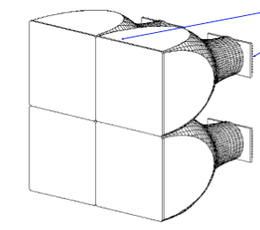
Our original idea
Improve this detector by making it faster
faster readout (factor 100)
faster phosphor
Original specs for X-ray detector:
≥ 100 frames / s
15 bit dynamic range
8 bit resolution
sparse scan
Concept - late 2003
phosphor
CCD
No suitable CCD at the time!
Find multi-port CCD
Concentrate on readout
R&D on faster phosphor
CCD
Custom readout IC
Back end electronics
Notes:
Goal: Biggest bang for the buck in terms of improvements of SR facilities. How to make the best improvement for SR research? Our answer for this task is better sensors. “Small” amount of money for big improvements
1 - First explain the canonical X-ray detector elements
2 - Second show how it works, indirect detection
3 – State our internal goal
4 - No comercial available CCD but we can produce dem

Slide 5
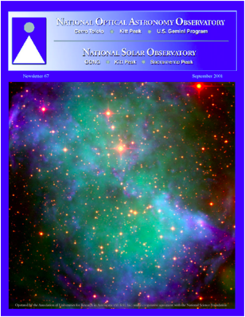
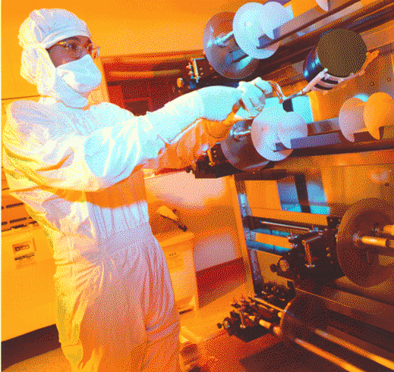
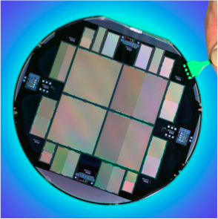
CCDs @ Micro Systems Lab (MSL)
LBNL 2k x 4k CCD:
Blue: H- at 656 nm Green: SIII at 955 nm Red: 1.02 nm
Notes:
Goal: We know how to make CCDs in the lab.
1-show the lab were the LBNL CCD is processed
2-show a wafer
3- show a picture of this CCDs
Details
Show the SNAP CCD and mention it is designed for astronomical applications.
What is SNAP
SNAP - the SuperNova Acceleration Probe - is a proposed space observatory designed to measure the expansion of the Universe and to determine the nature of the mysterious Dark Energy that is accelerating this expansion. SNAP is being proposed as part of the Joint Dark Energy Mission (JDEM), which is a cooperative venture between NASA and the U.S. Department of Energy. If selected it will be launched before 2020.
http://snap.lbl.gov/

Slide 6
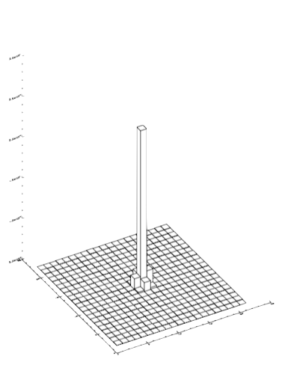
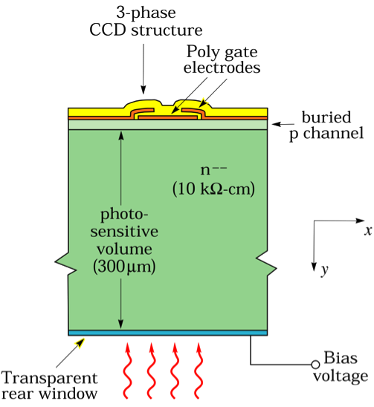
Thick, Fully Depleted LBNL CCD
PSF
E
At VSUB = 115 V,
σD = 3.7 ± 0.2 μm
S. Holland
Notes:
Goal: Show what is the SNAP CCD.
1 – Explain the CCD profile, pointing out front and back
2-Thick, can be as thick as 650 um
3 – fully depleted, no free charges floating around, all the charge is collected by drift, difusion is reduced
4 – good point spread function
Details
First explain the TL pictures showin the 3 phase CCD structur and going towards the bottom. Show the rear window and mentioned that we can apply the bias voltage through the top. Point out that this is a high resistivity silicon wafer (that will be linked with SOI sensor). Talk about thick and fully depleted and what they do for psf. Good stuff already.

Slide 7
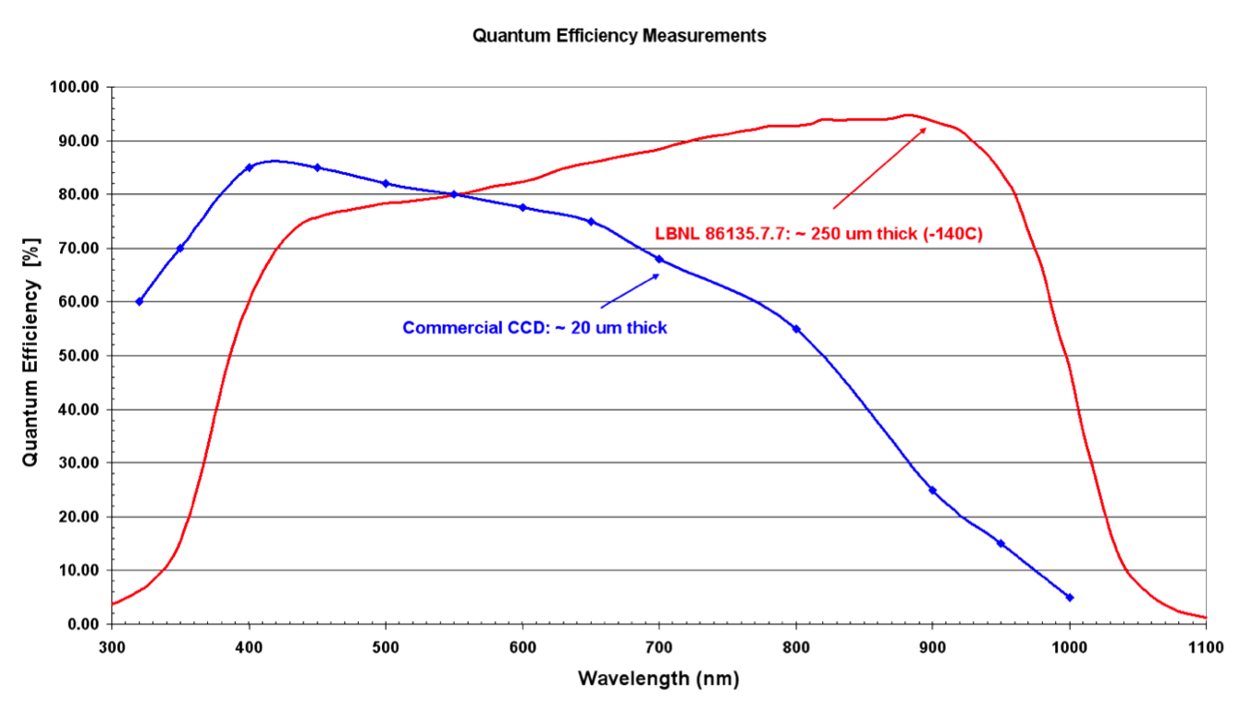
Thick, Fully Depleted CCD good for visible light
Notes:
Goal: Explain the motivation for the astronomical application for building a thick fully depleted CCD (good red response).
Details

Slide 8
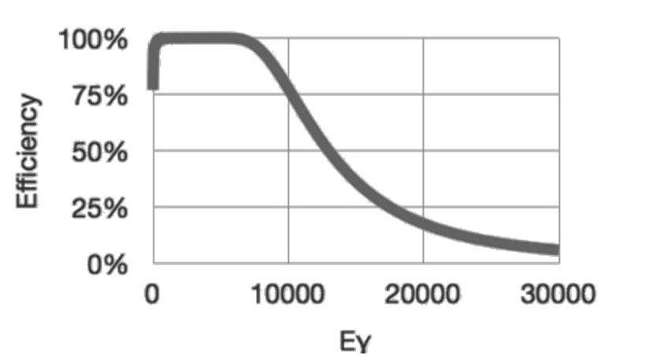

Thick, Fully Depleted CCD good for X-rays
Notes:
Goal: Show that thick, fully depleted are good for ALS because we are a soft X-ray facility!!!
Details

Slide 9
Discrete CCD, ADC & readout solution
CCDs are intrinsically slow
  Single output CCD
  Column parallel CCD
  Almost column parallel CCD
LBNL FCCD
  Multiple outputs (ex.48 per side)
  Faster outputs (ex.1MHz)
  200 fps
Notes:
Goal: Show that convencional/discrete ADC&readout takes a lot of space, are heavy and unpractical for fast CCDs with lots of outputs and that’s why we needed to build an IC for that. No commercial CCD available for the speeds we are targeting (just bring the question, solutuion comes later)
1- Why CCDs are slow, in one end it can be a single port CCD... Too slow
2- on the other end it can be really fast, too fast for the specs, not needed and creates the fanout problem that we can solve but dont need
3- A good compromise: almos column parrallel, show the specs for the LBNL CCD
4- Show that we need to implement 3 blocks to have a complete camera system
Details
First show the discrete version of ADC/RO electronics for a 4 port CCD. Example Leach controller
Second show that CCD are slow because their serial readout. To make fast we need more outputs and faster ones.
Third for a 48 output CCD we need about 10 Leach systems (~ 4 feet tall and 140 lbs)
Forth we have a solution for the FCRIC
Fifth what about the sensor there is no one available at the time... We might have to make them
Comercial CCD -> not available!!
4 port readout
96 port readout -> big
Solution -> very compact single chip ADC and readout

Slide 10
Discrete CCD, ADC & readout solution
CCDs are intrinsically slow
  Single output CCD
  Column parallel CCD
  Almost column parallel CCD
LBNL FCCD
  Multiple outputs (ex.48 per side)
  Faster outputs (ex.1MHz)
  200 fps
Notes:
Goal: Show that convencional/discrete ADC&readout takes a lot of space, are heavy and unpractical for fast CCDs with lots of outputs and that’s why we needed to build an IC for that. No commercial CCD available for the speeds we are targeting (just bring the question, solutuion comes later)
1- Why CCDs are slow, in one end it can be a single port CCD... Too slow
2- on the other end it can be really fast, too fast for the specs, not needed and creates the fanout problem that we can solve but dont need
3- A good compromise: almos column parrallel, show the specs for the LBNL CCD
4- Show that we need to implement 3 blocks to have a complete camera system
Details
First show the discrete version of ADC/RO electronics for a 4 port CCD. Example Leach controller
Second show that CCD are slow because their serial readout. To make fast we need more outputs and faster ones.
Third for a 48 output CCD we need about 10 Leach systems (~ 4 feet tall and 140 lbs)
Forth we have a solution for the FCRIC
Fifth what about the sensor there is no one available at the time... We might have to make them
Comercial CCD -> not available!!
4 port readout
96 port readout -> big
Solution -> very compact single chip ADC and readout

Slide 11
Discrete CCD, ADC & readout solution
CCDs are intrinsically slow
  Single output CCD
  Column parallel CCD
  Almost column parallel CCD
LBNL FCCD
  Multiple outputs (ex.48 per side)
  Faster outputs (ex.1MHz)
  200 fps
Notes:
Goal: Show that convencional/discrete ADC&readout takes a lot of space, are heavy and unpractical for fast CCDs with lots of outputs and that’s why we needed to build an IC for that. No commercial CCD available for the speeds we are targeting (just bring the question, solutuion comes later)
1- Why CCDs are slow, in one end it can be a single port CCD... Too slow
2- on the other end it can be really fast, too fast for the specs, not needed and creates the fanout problem that we can solve but dont need
3- A good compromise: almos column parrallel, show the specs for the LBNL CCD
4- Show that we need to implement 3 blocks to have a complete camera system
Details
First show the discrete version of ADC/RO electronics for a 4 port CCD. Example Leach controller
Second show that CCD are slow because their serial readout. To make fast we need more outputs and faster ones.
Third for a 48 output CCD we need about 10 Leach systems (~ 4 feet tall and 140 lbs)
Forth we have a solution for the FCRIC
Fifth what about the sensor there is no one available at the time... We might have to make them
Comercial CCD -> not available!!
4 port readout
96 port readout -> big
Solution -> very compact single chip ADC and readout

Slide 12
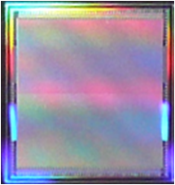
(almost) Column-Parallel Fast CCD (FCCD)
LBNL FCCD
Custom multi-port CCD
480x480 pixel matrix
30um square pixels
Direct detection
Back illuminated
LBNL
CCD
Custom readout IC
Back end electronics
Notes:
Show the solution for the first block
LBNL CCD

Slide 13
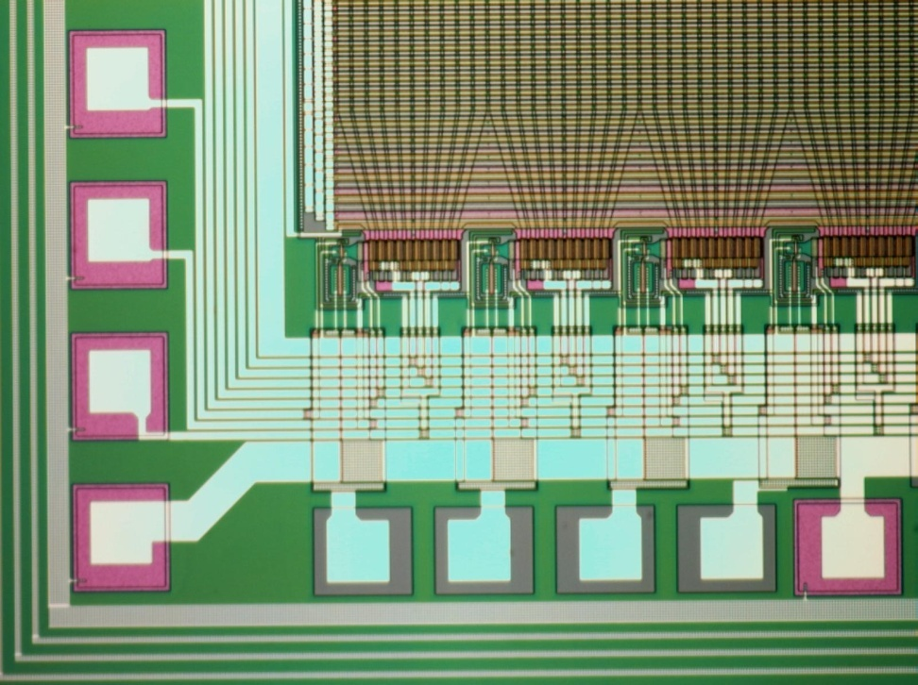
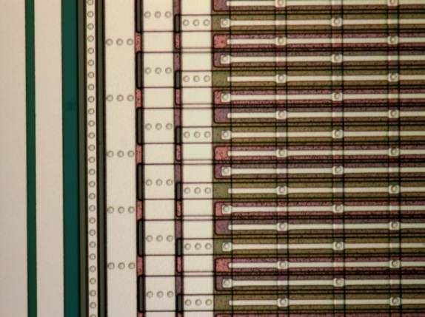
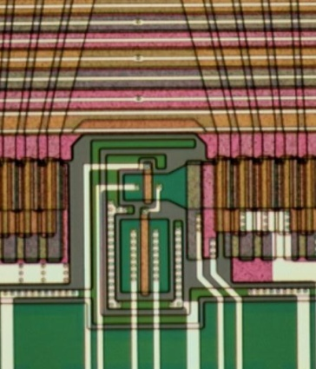
(almost) Column-Parallel Fast CCD (FCCD)
Constant area
taper
Mini-shift reg.
Output stage
~300 µm pitch
bond pads
(wire-bondable)
Metal strapping
Notes:
1 Show the active area
2 Show the taper, leading to the 10 column mini shift register
3 Create space for the output stage without charge loss
4 To guarantee speed we added the metal strapping lower the r of the RC that is generated by the polysilicon and the CCD capacitor
5 Point out the pitch is 300um

Slide 14
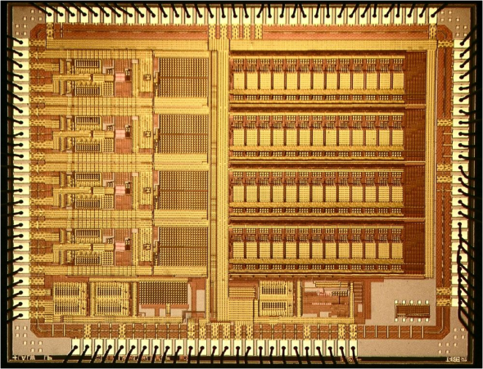
Readout IC – from SNAP to FCCD
SNAP CCD readout (CRIC) requirements
  16 bit dynamic range at 100 kHz
  4 channels per chip
  low power
  space qualified
Fast CCD readout (benefit from SNAP development)
  16 channels per chip
  ADC pitch < 300 µm
  10 x speed
LBNL
CCD
Custom readout IC
Back end electronics
Notes:
1 Move on to the second builiding block
2 there is expertice in house
3 Our needs are fullfilled with a chip that looks like the cric but is 10x faster and had 16

Slide 15
CCD Readout FCRIC
Voltage integrator
Output =
Optimal noise filtering
Switched cap preserves charge
±
Preamp
Multi-gain
integrator
CDS
Pipelined ADC
16 channels
Gain 8, 2, 1
12 + 1 bit ADC
Covers 15-bit dynamic range
Quantization error always < photostatistics
CDS – correlated double sampling
Notes:
Explain the gut of on channel
1 Signal from the CCD goes into the pream
2 a multi-gain and intrator stage expands the dinamic range of the ADC and filters the high frequency noise
3 Correlated double sampling takes caro of some low frequency noise and we digitize signal minus reset not signal than reset and then subtract them
4 the resulting signal is digitized
5 state the characteristics of the

Slide 16
Floating Point Readout
Photostatistics √N
Quantization Error
Notes:
***pd*** photostatistics ~ sqrt(number of incident photons)
want electronics to be well below photostatistics
floating point scheme means that quantization error << photostatistics

Slide 17
13-bit ADC block diagram
Basic 13-bit pipeline
ADC architecture
x13
Clock
Input
stage
bit cell
bit cell
D12
D0
Digital output
Notes:
***pd***N-bit pipeline ADC has N stages, each operating at the sampling rate.
As stage 1 deals with sample at time T1, stage 2 deals with T0, stage 3 with T-1, etc.

Slide 18
The 1.5-bit cell architecture
Input
+
Output
x2
-
ADC
DAC
Digital output
Notes:
***pd*** each pipeline stage – conceptually – has a 1 bit ADC: the input is > or < REF/2
each stage also has a 1-bit DAC, so that the analog output is (IN +/- REF/2) x 2
This doesn’t work in practice, so a slightly more complicated scheme is used, but it’s the idea

Slide 19
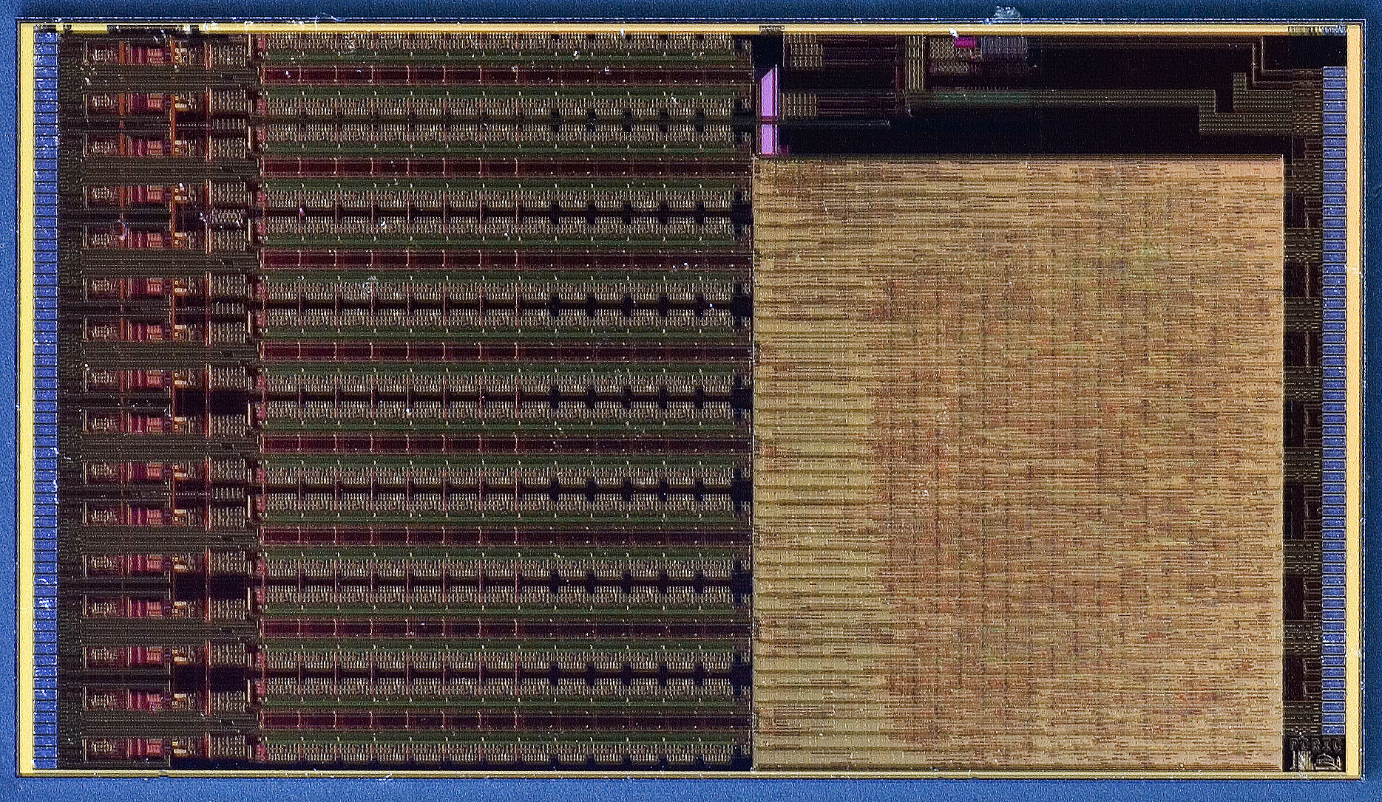
fCRIC
4.8 mm
Digital section
Timing generation
Readout
Control
Preamp
Integrator
CDS
Pipelined ADC
Custom CCD readout and ADC chip

Slide 20
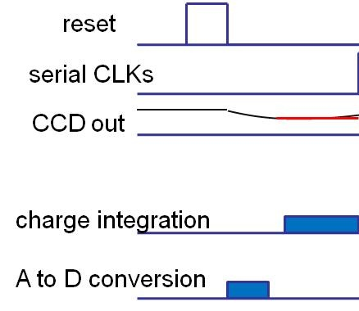
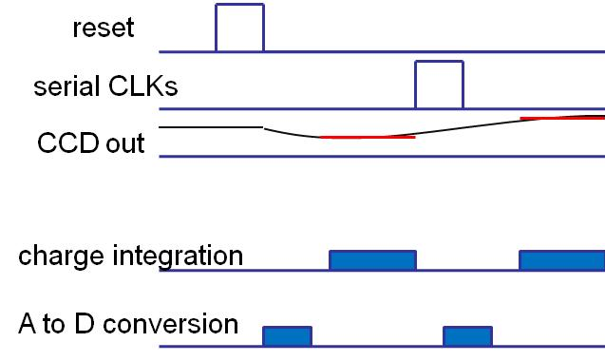
FCCD readout sequence
reset
Sum. Well
serial CLKs
CCD out
charge integration
A to D conversion
LBNL
CCD
Custom readout IC
Back end electronics
Notes:
Show one of the beutys of the FCRIC, digitization happens when the charge is not being averaged,
reduces noise pickup
Better noise performance
FCRIC has 8 electrons of noise

Slide 21
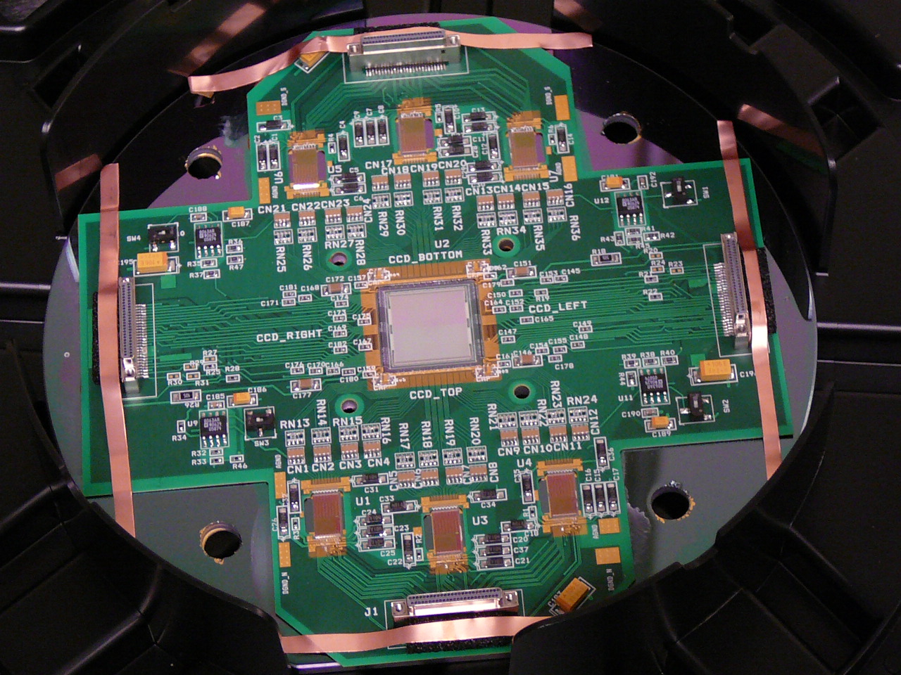
2007
LBNL
CCD
Custom readout IC
Back end electronics
Notes:
Point the different part of this board
CCD
CLOCKS
Readout chips,
Lots of space good for debugging

Slide 22
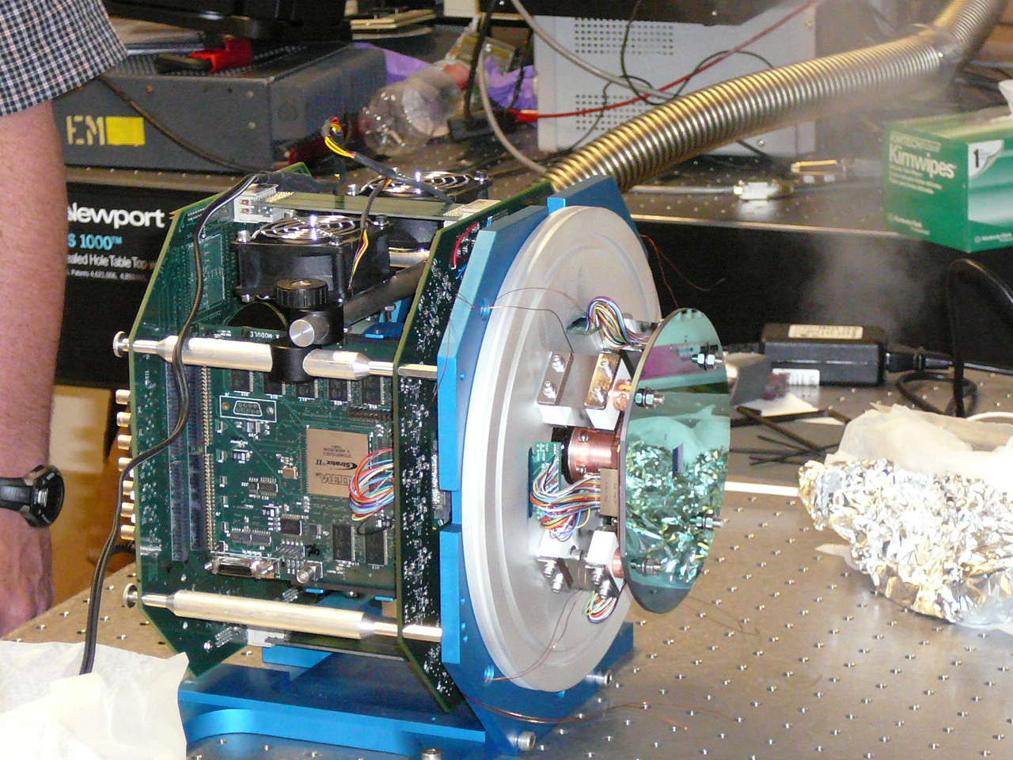
FCCD Readout – ANL/LBNL partnership
2008
LBNL
CCD
LBNL
CCD
Custom readout IC
Custom readout IC
Back end electronics
Back end electronics
Notes:
We need all three blocks to be implemented to have a working camera
Partnership with ANL
How it looks after completed

Slide 23
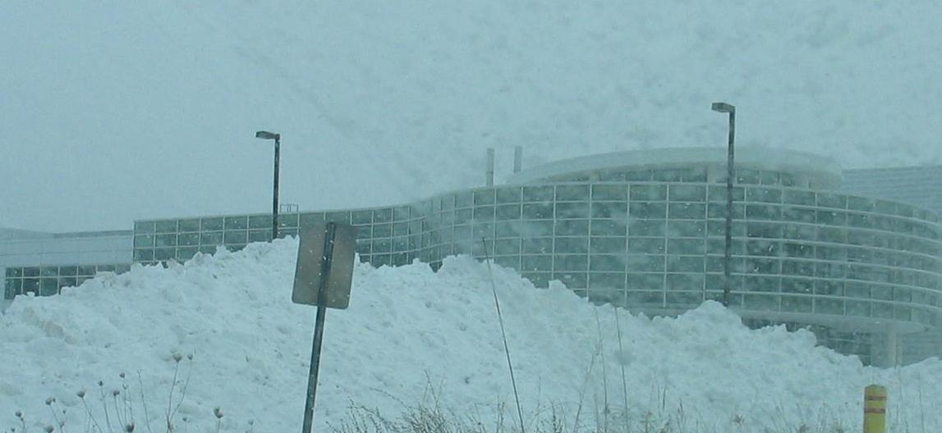
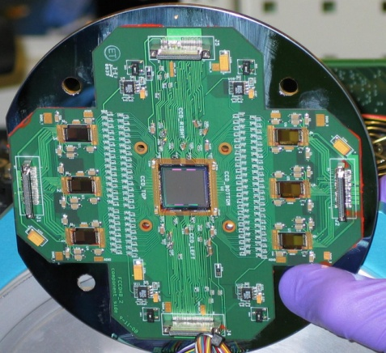
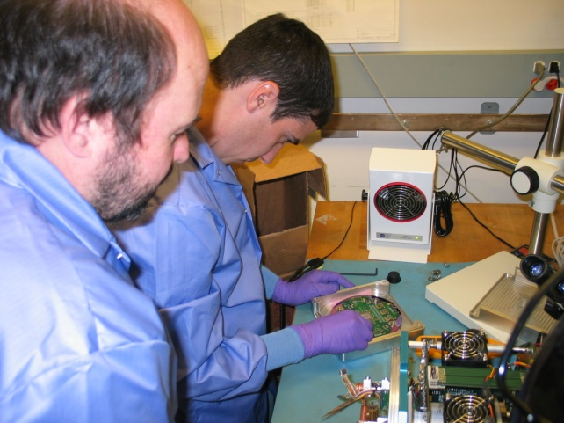
APS and FCCD
January 2009
January 11, 2009 – Peter and Dionisio arrived to install subassembly
January 12 - First light with old substrate
January 13 - First light with new substrate
January 14 - First x-ray with x-ray tube
January to July
  Make Improvements
  Characterize detector
July 15, 2009 First beam at 8id
:
Notes:
Break on the technical to show a fun slide

Slide 24
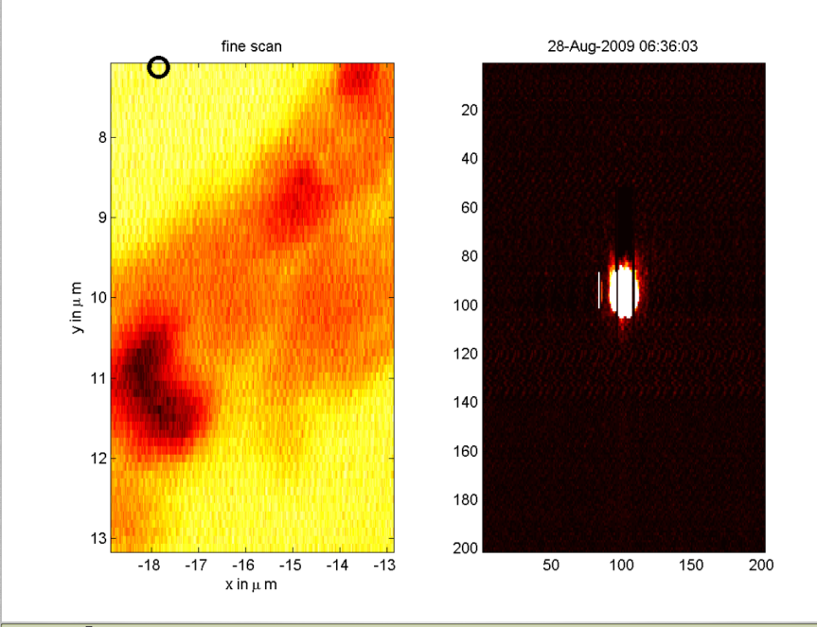
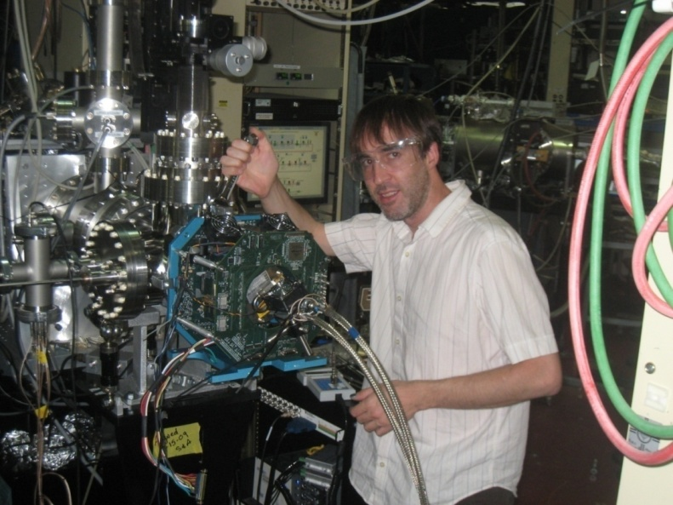
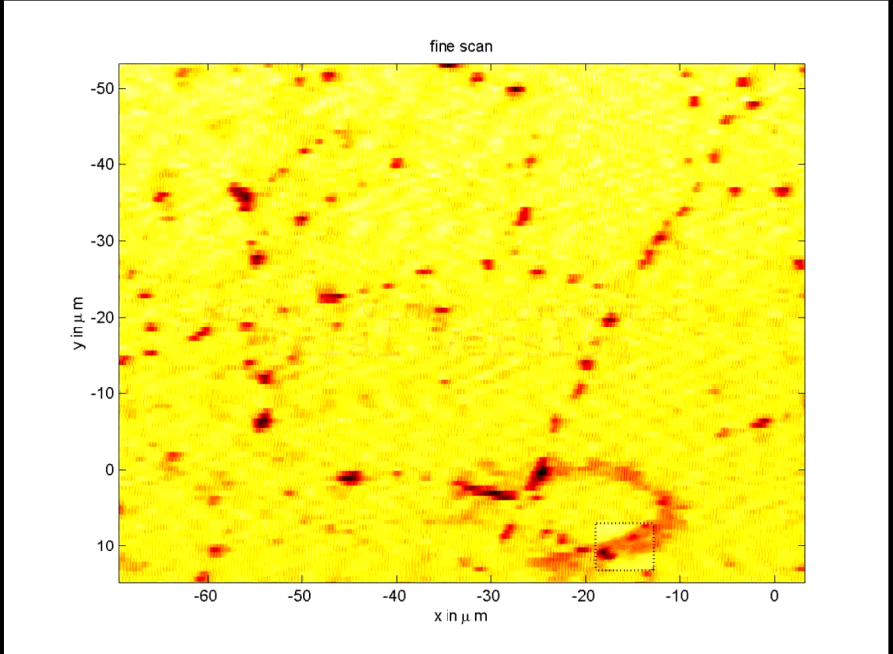
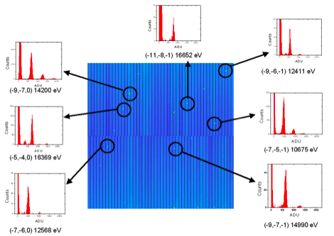
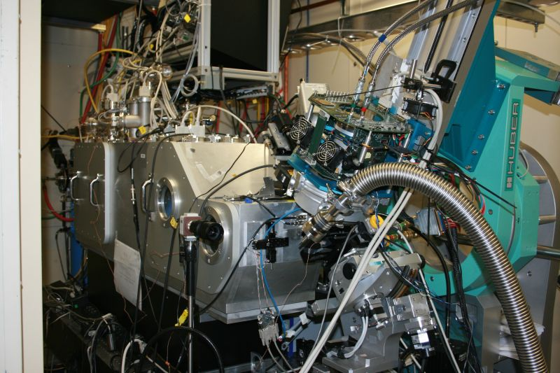
At the ALS
Ptycography / Scanning uDiffraction
ALS
BL 9.0.3
ALS
BL 12.3.2
2.7 min. with FastCCD (at 20 Hz - disk write limited for this test) 6.2 hrs. with MAR133
Notes:
Goal: Show that the camera has been used at LBNL
Show a fun movie
Show that fast is good for dynamics
but it is also good for improve the beam lines efficiency by usign more time taking data than wasting photons on readout...
First explain we are imageing one of the Tin grains. We had it set in a stage that allow us to heat it. And the objective is to see what happens when it melts. As we didn’t know how long this would take we had to set the camera to 20fps because of disk speed limitations.
Second, show the movie. Also show that this method of saving data to disk is not very smart because we ended with thousands of images but only a few ones are really interesting. This creates the question about smarter cameras/sensors.

Slide 25
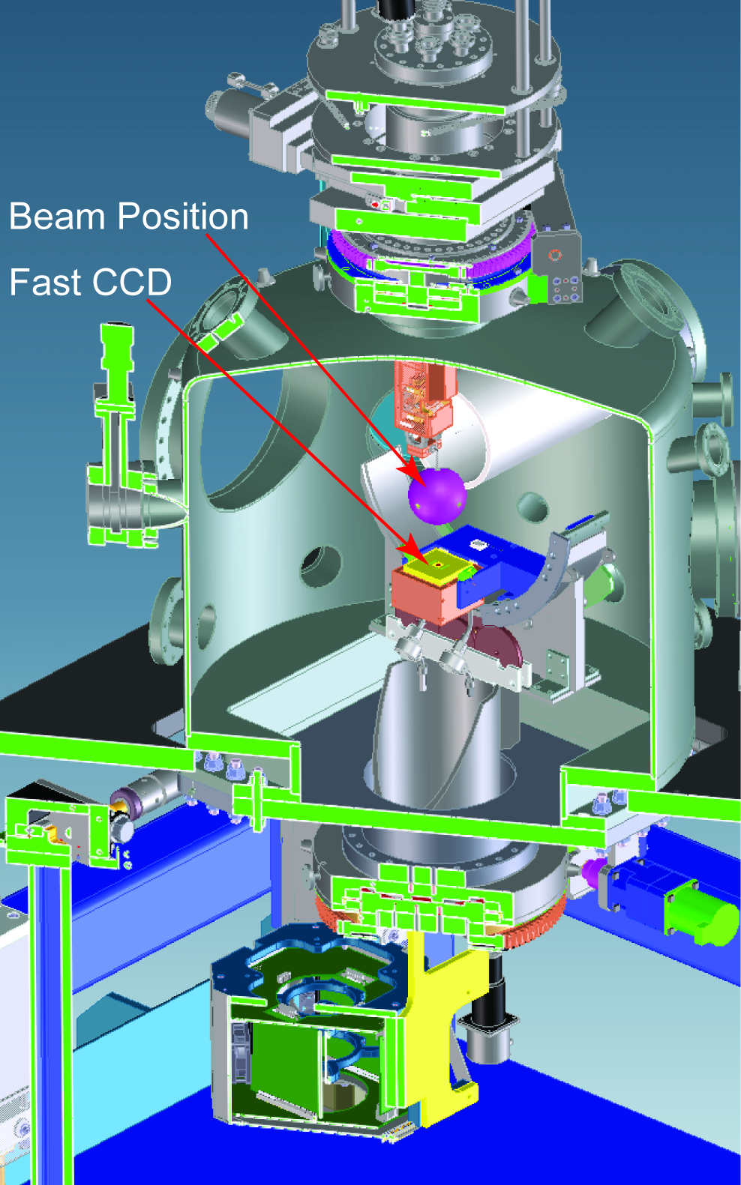
Need for compact, movable detector
Need compact FCCD (cFCCD)
Detector and sample are movable
Two Rotations:
  360º in the horizontal plane.
  100º in the vertical plane.
Notes:
Need for compact to get closer to the sample, better solid angle
Need to move the sample
Need to move the detector

Slide 26
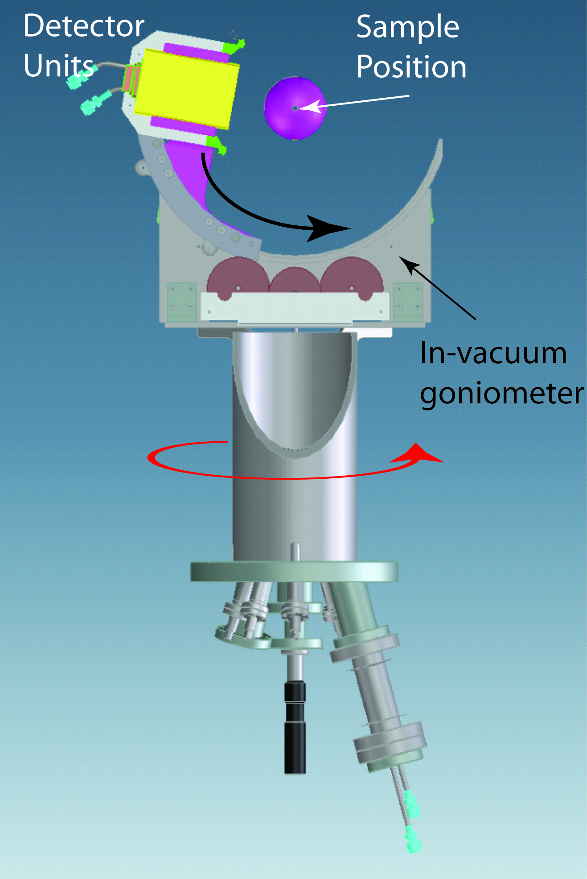
Need for compact, movable detector
Need compact FCCD (cFCCD)
Detector and sample are movable
Two Rotations:
  360º in the horizontal plane.
  100º in the vertical plane.
Notes:
Need for compact to get closer to the sample, better solid angle
Need to move the sample
Need to move the detector

Slide 27

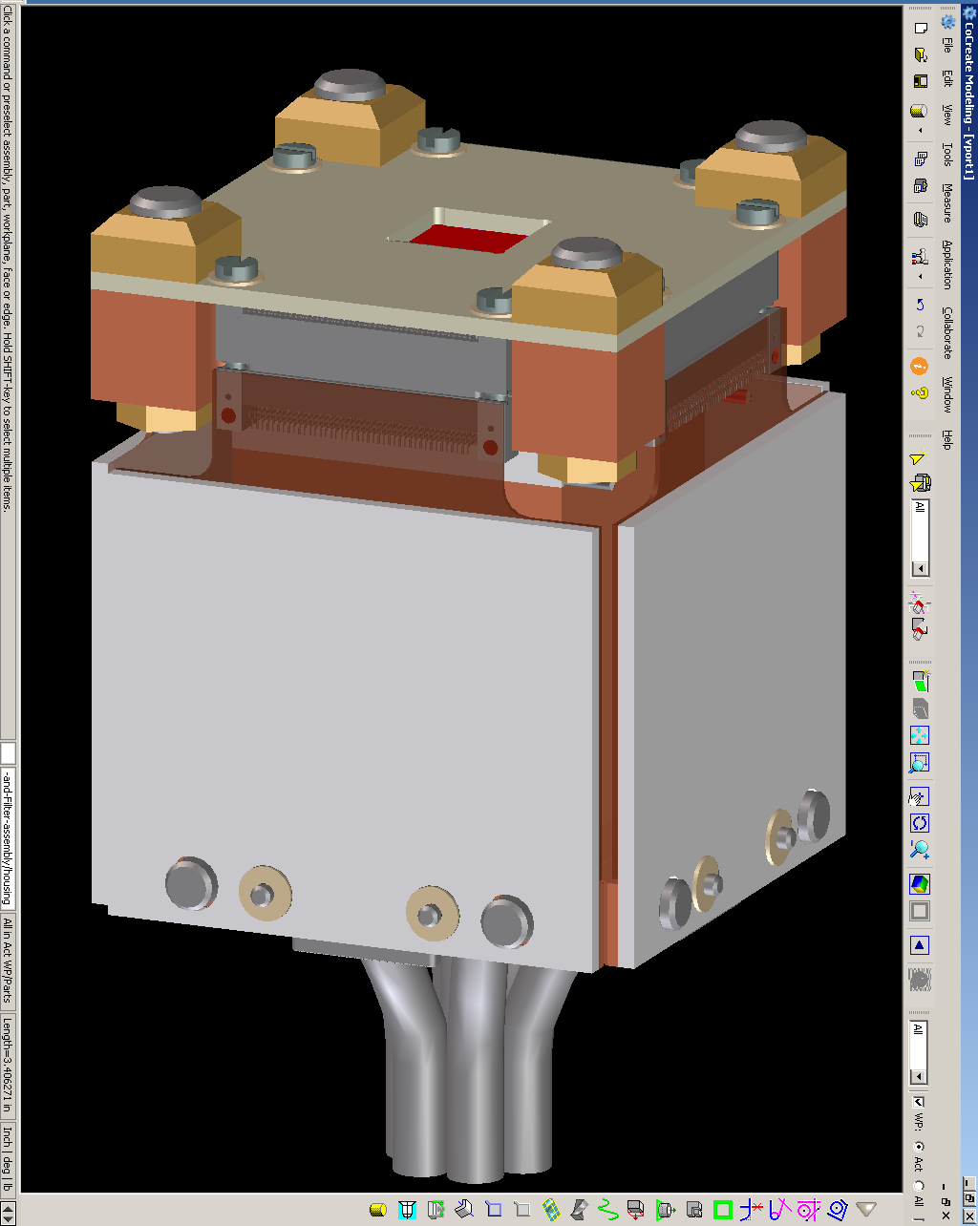
From FCCD to Compact FCCD
FCCD 6” wafer holder
cFCCD 2.5” cubic
Notes:
What we have
What we want to have

Slide 28
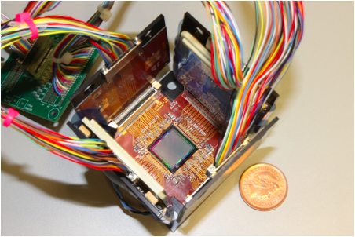
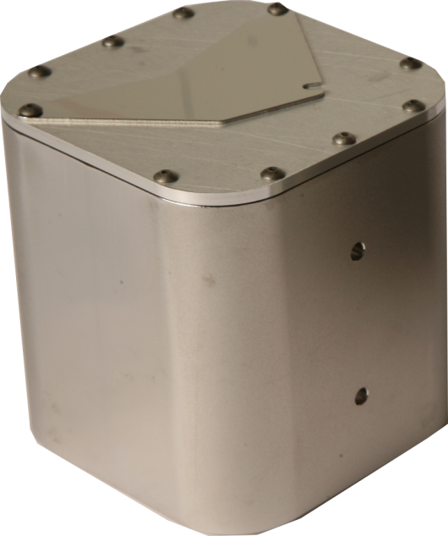
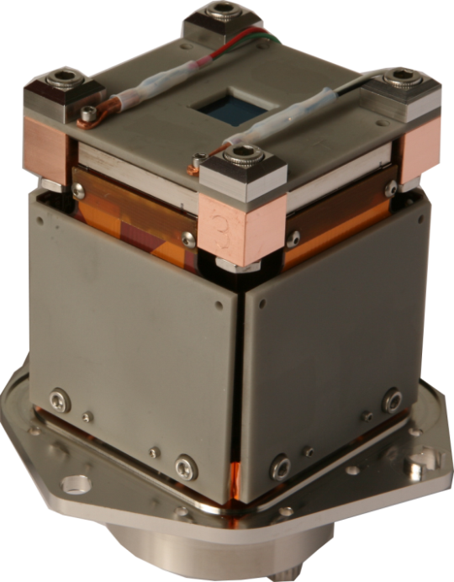
Compact Fast CCD (cFCCD)
2.5”
12.2009
2.5”
Prototype (front-illuminated)
Final mechanical / thermal verification
03.2010
Notes:
Show the camera board looks after we compacted them
Show final camera

Slide 29
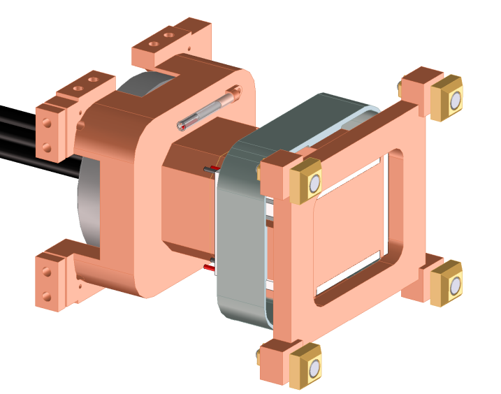
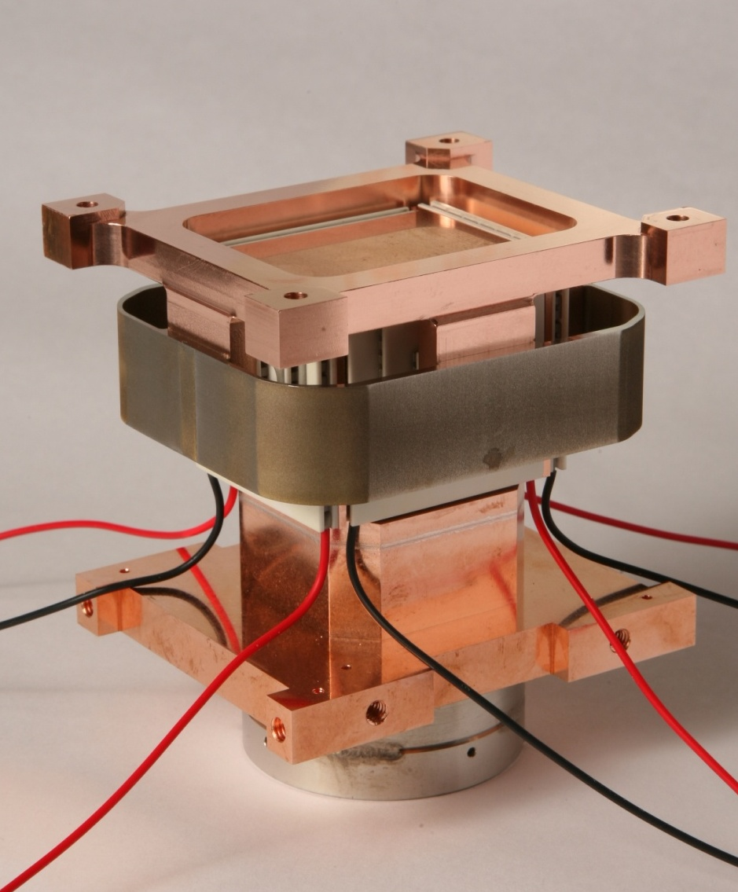
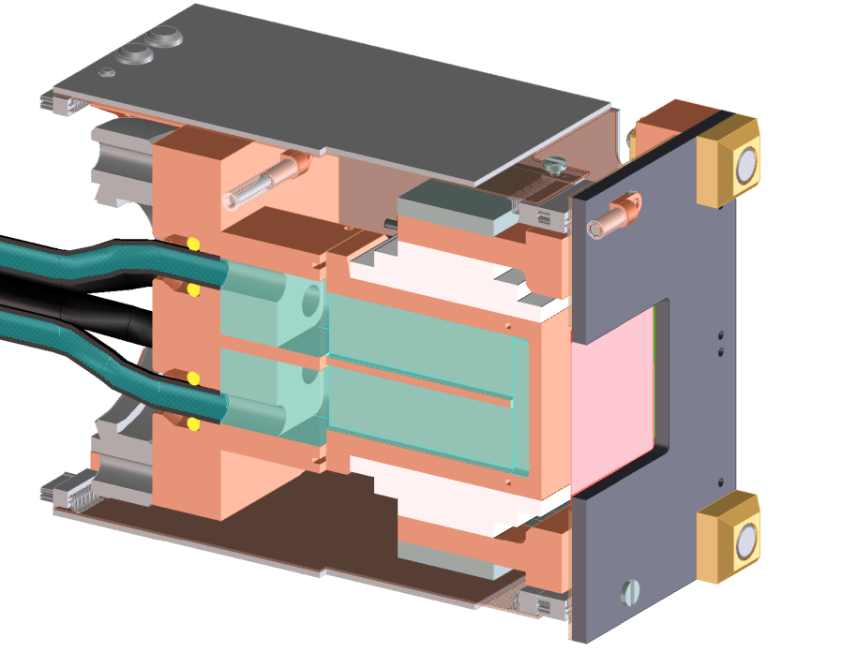
Cooling for cFCCDs

Slide 30
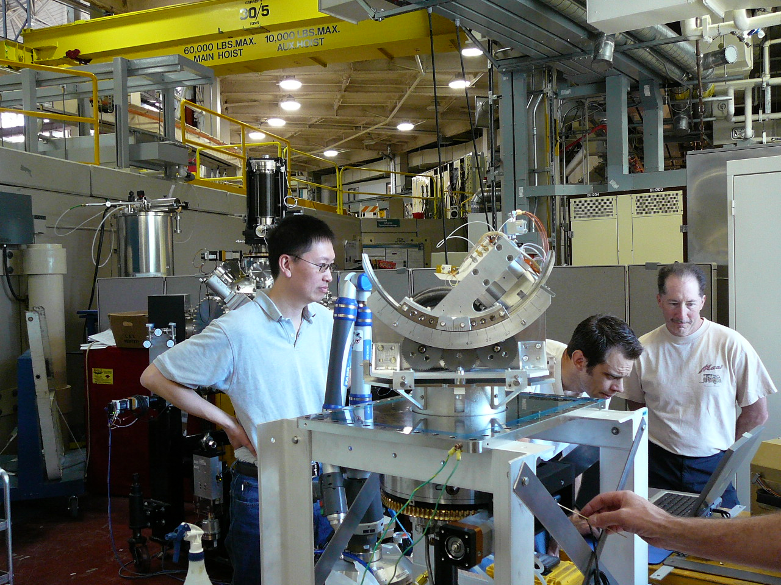
Soft x-ray scattering chamber for ALS / LCLS

Slide 31
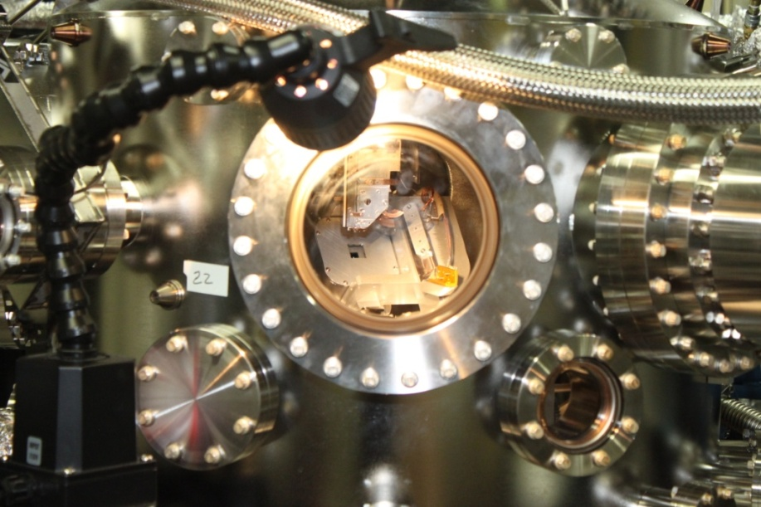
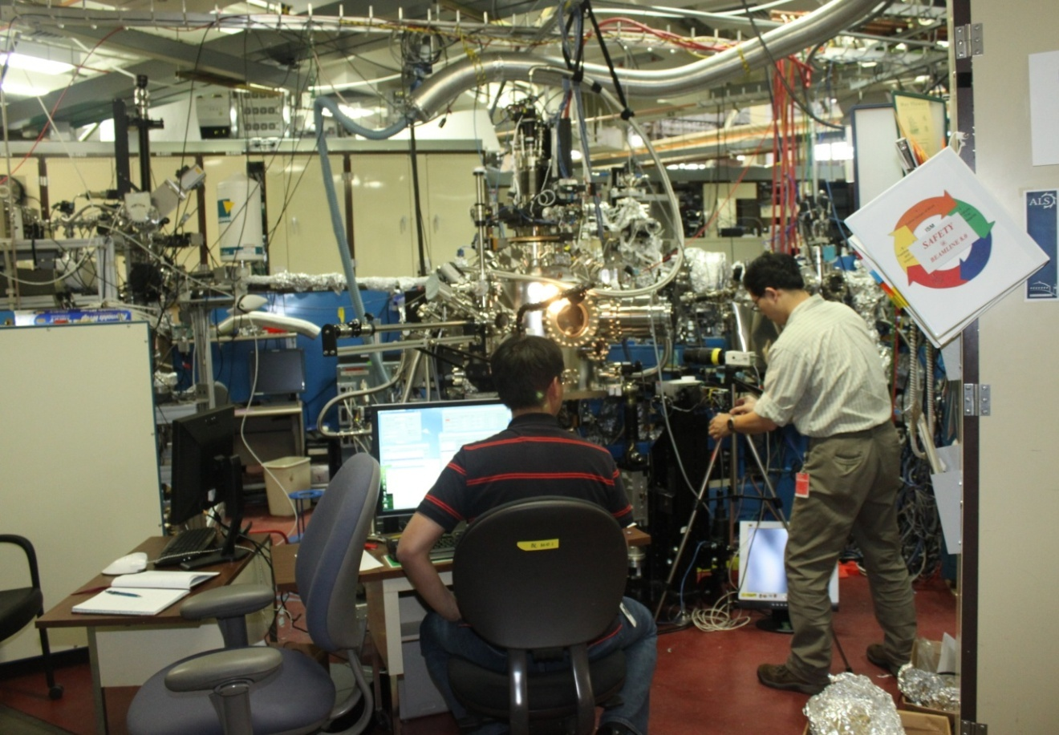
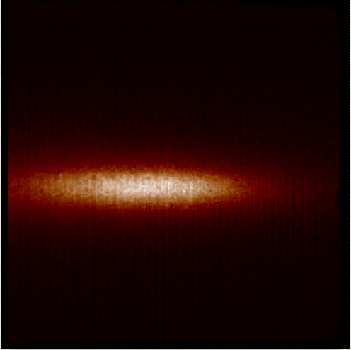
cFCCD at beam line 8 at ALS
Data taken at 854 eV, Ni L-edge.
Notes:
We started usign the compact at ALS

Slide 32
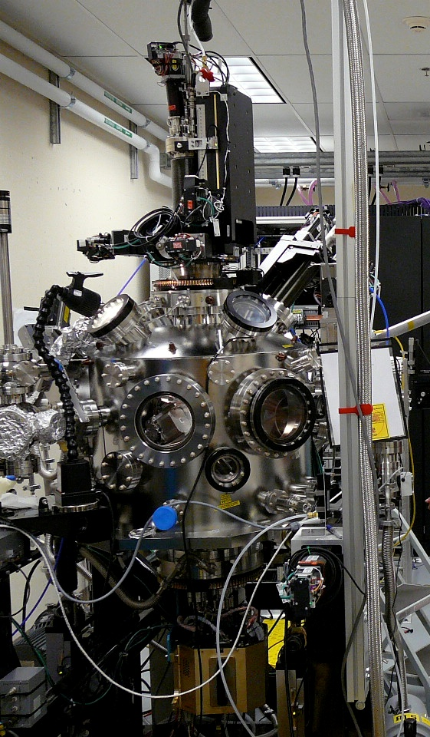
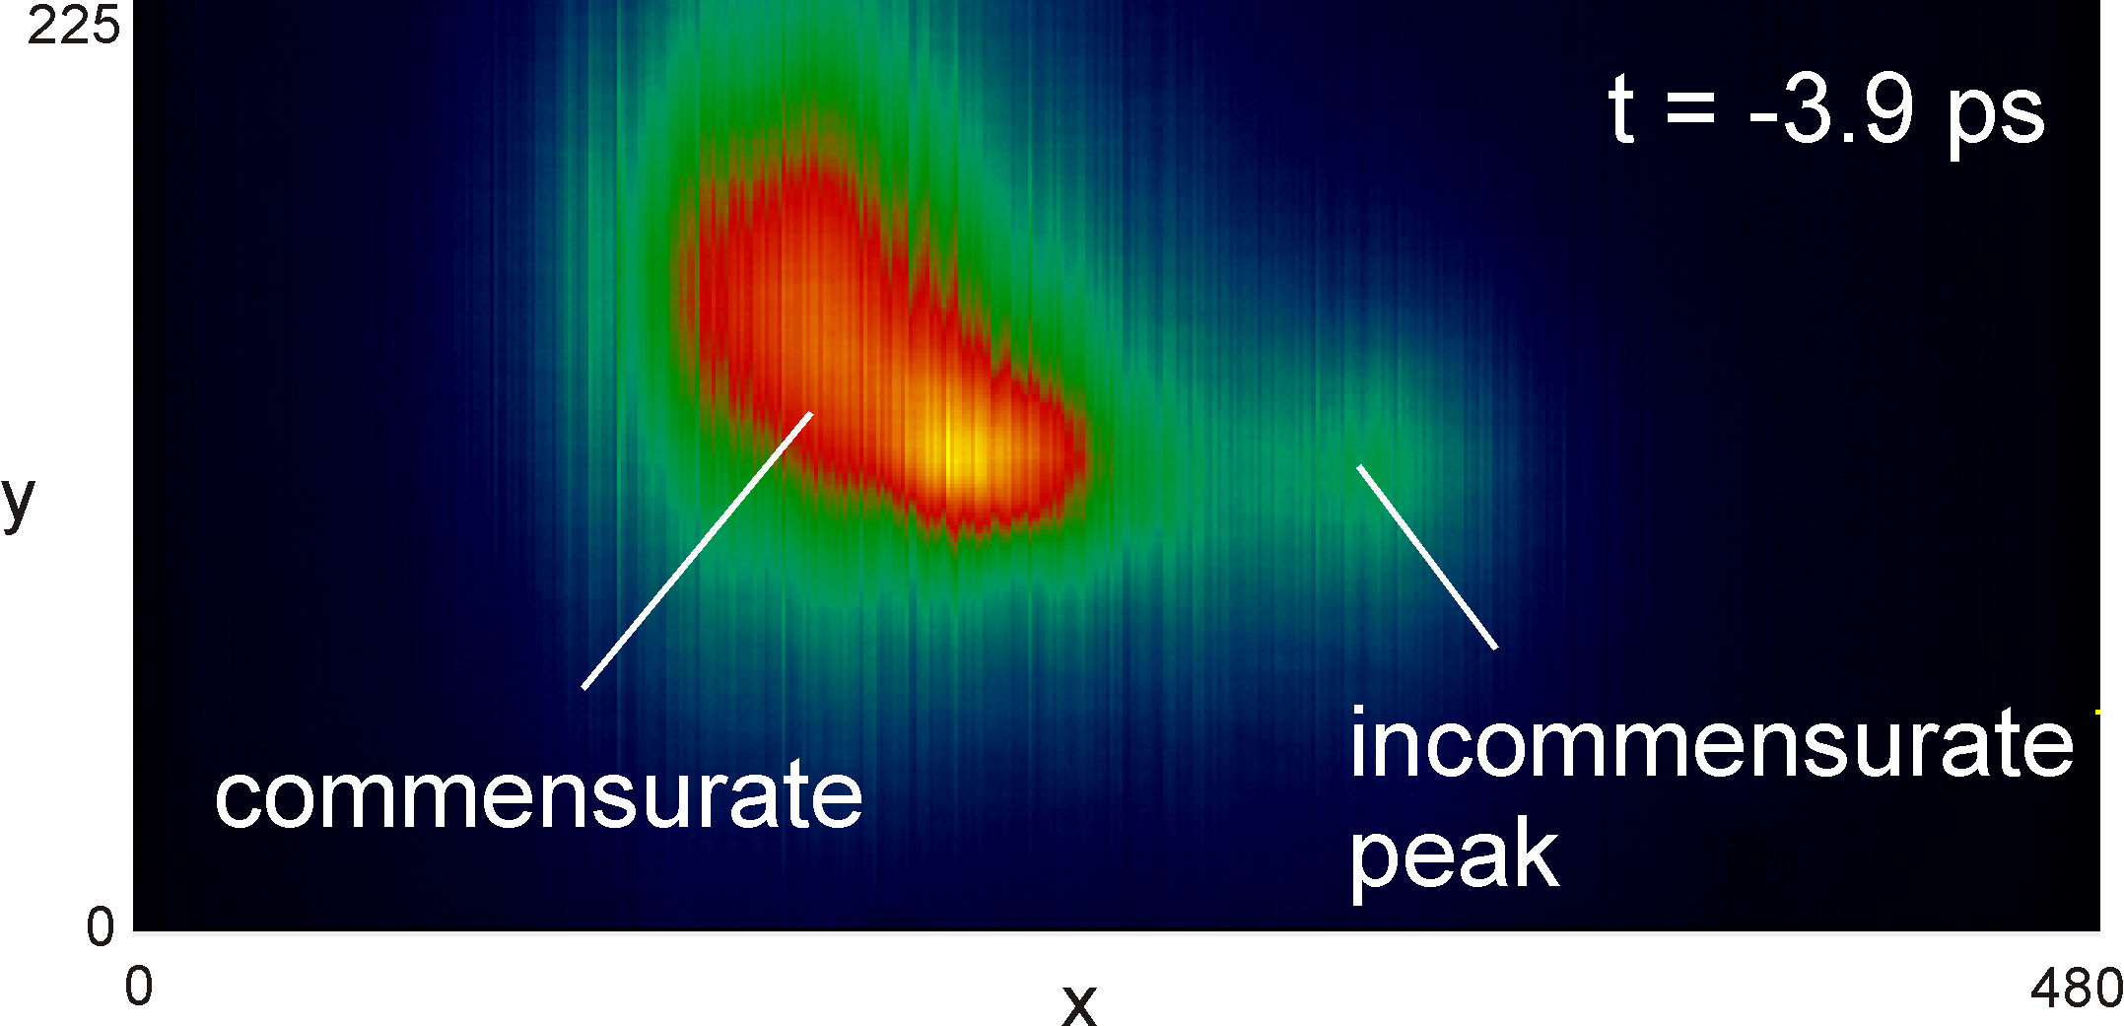
Experiment at hutch 2 at LCLS
Example data from
Steve Johnson
steve.johnson@psi.ch
Paul Beaud
paul.beaud@psi.ch
1st SXR run July / August
Used by all 3 groups
cFCCD is in operation!
Notes:
And we also used it at LCLS
Done with compact

Slide 33
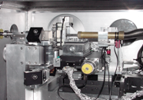
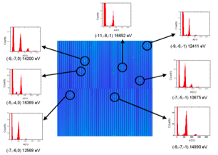
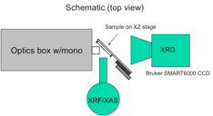
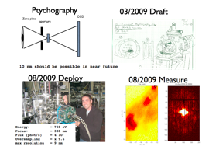
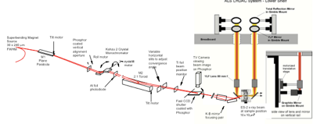
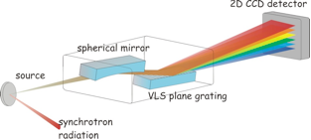



Needs at ALS & 1k Frame Store CCD
STXM
Scanning μDiffraction
μXRF,μXRD,μXAS
High Pressure Melting
Photon in / photon out
Ptychography
Photoemission (phosphor)
Tomography
XPCS
2009 ALS User’s Meeting
Notes:
***pd*** 2009 ALS UM – identify that almost all outstanding detector needs can be addressed with a 1k FS CCD
Received ARRA funds, sufficient to deliver 8 systems

Slide 34




What is Frame store?
Frame store ->Electronic shutter
Notes:
What frame store is
Why we like it, electronic shutter

Slide 35





(New) R&D CCD – 1k Frame Store
  30 x 30 um pixel
  1920x960 pixels (8 times the area of cFCCD)
  Thick 200-650um
  200fps
  Data volume ~ 400MB/s (HD 250GB -> ~10 min)
FY09 LDRD Wafer
First wafers received in 9/2010
Notes:
In our current R&D wafer we have one 1k FS CCD
Its characteristics
Point that this camera generates a lot of data
We got silicon
We like compact cameras

Slide 36

New ATCA based system
ATCA Chassis Network Connections
Camera Interface
Node
User
Client
Processor Node
Data Capture
Module
Fabric
Switch
Hub
GUI Interface
Module
Camera
Head
Timing
Module
Sys. Config.
Module
Digital
PSU
RAID Array Node
10 GbE Network
1 GbE Network
Custom Interface
Custom
Shelf
Manager
Image processing
  Dark image subtraction
  Gain correction
  Zero suppression
  Digital integration
  Binning
  ...
Notes:
Explain how we will deal with all the data
New readout system base on the Advance Telecomunication computing architecture

Slide 37
Conclusions & Outlook
Synchotron radiation detector developement benefited from knowledge and infrastructure existing at LBNL.
CCD sensor and readout IC were succesfuly used to create a fast camera for X-rays detection.
Prototype FCCDs (480 x 480) have been used in experiments at ALS, APS and LCLS
  Along with a new, compact mechanical design
A 1k frame store version (1920 x 960) is being developed, and several systems will be delivered to ALS and APS

Slide 38
Thanks!
LBNL
  P.I.: Peter Denes
  Nord Andresen
  Jacque Bell
  Jean-Marie Bussat
  George Chao
  Dionisio Doering
  John Emes
  Dario Gnani
  Bryan Holmes
  John Joseph
  Jimmie Johnson
  Brad Krieger
  Patrick McVittie
  Howard Padmore
  John Peper
  Jean-Pierre Walder
  Rhonda Witharm
  Sergio Zimmerman
  George Zizka
ANL
  P.I. : Patricia Fernandes
  John Weizeorick
  Brian Tieman
  Tim Madden
  Lisa Gades
  Todd Hayden
  John Lee
  Steve Ross
  Suresh Narayanan
  Alec Sandy
  Chris Piatak
  Jonathan Baldwin
Users
  Prof. Larry Lurio, Northern Illinois University, IL
  Prof. Robert Leheny, John Hopkins University, MD.
  Prof. James Harden, University of Ottawa, Canada.
  Prof. Hyunjung Kim, Sogang University, Seoul, Korea.
  Prof. Sunil Sinha, University of San Diego, CA.
  Prof. George Thurston, Rochester Institute of Technology, NY.
  Dr. Yi-De Chuang, LBNL, USA
  Dr. Stefano Marchesini, LBNL, USA
  Dr. Nobumichi Tanamura
  Dr. Steve Johnson
  Dr. Paul Beaud
  ...

