Slide 1
12.3.2
Tin sample
Nobumichi Tamura, Martin Kunz, Kai Chen, Rich S. Celestre, Dionisio Doering, Tae Sung Kim, Peter Denes, Patric Gruber, Andy Minor, Daniel Kiener

Slide 2
FCCD proff of principle experiment
Objective
  Visualize some difraction lines of a Tin sample as they melt.
  The sample will be heated using an external reater with a termocouple to monitore the temperature.
  The difraction line was chosen at random.
  The observation will be done at 40 fps on x2 adc gain and 30V bias voltage.

Slide 3
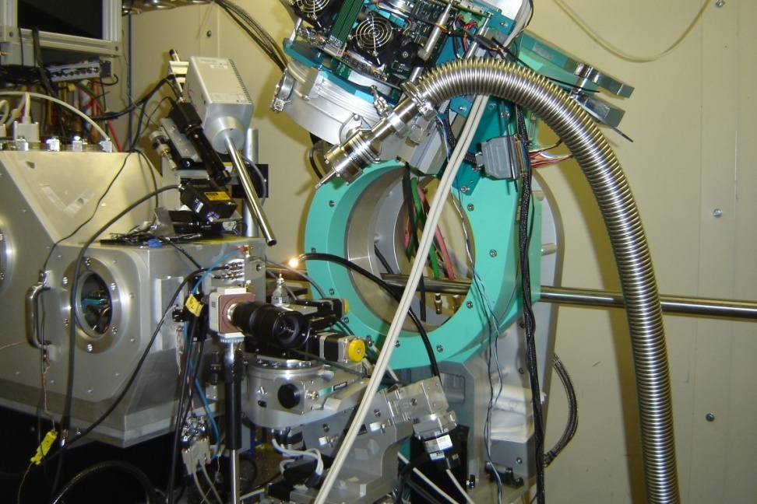
Installing the FCCD
FCCD
Sample
Xray output

Slide 4
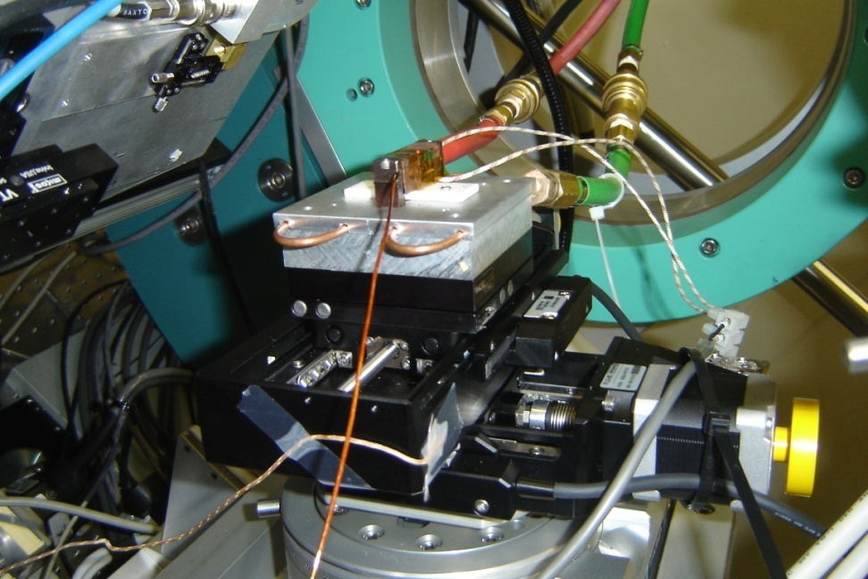
Setup
Solder joints of tin were place on to of a heater.

Slide 5
Movie Area Scan
The Xystage was used to perform an inspection of the sample. The X axis was moved form minus to plus its limits and then a stem on the y direction was done

Slide 6
Movie line scan
In this case the sample was positioned in such way that the beam crossed one very active area (several difraction lines) and was scanned once.

Slide 7
Melting
The heater controller was installed in side the hutch. This means that every step to increase the temperature had to be done with the beam line off and someone needed to go inside the hutch.
The temperature was monitored using a termocouple which means that the reading temperatures was +/- a few degrees different from the sample.
At about 2XX C we observed the lines starting to move and sudenly desapear.
Afer examining the sample it showed clear evidence of melting.

