Slide 1
FCCD @ ALS
ALS Users meeting
10/2009
Dionisio Doering
John Joseph
Nord Andresen
Peter Denes

Slide 2
ALS Workshop
System description
Experiments done at beam line 12.3.2
Experiments done at beam line 9.0.1
Next camera
  cFCCD

Slide 3
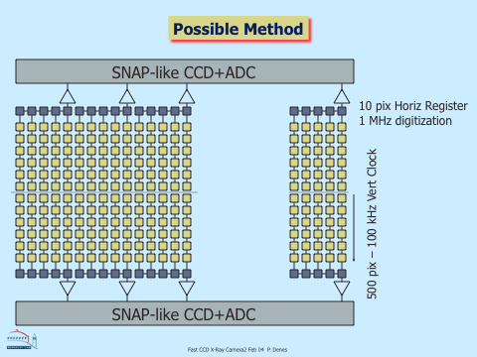
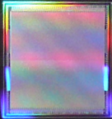
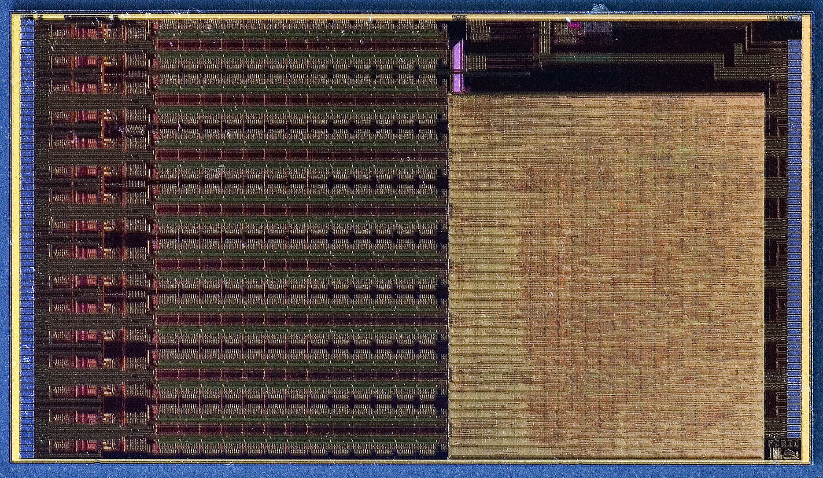
Concept
CCD
ADC
Custom multi-port CCD
480x480 pixel matrix
30μm pixels
Direct detection
Back side illumination
Custom readout chip FCRIC

Slide 4
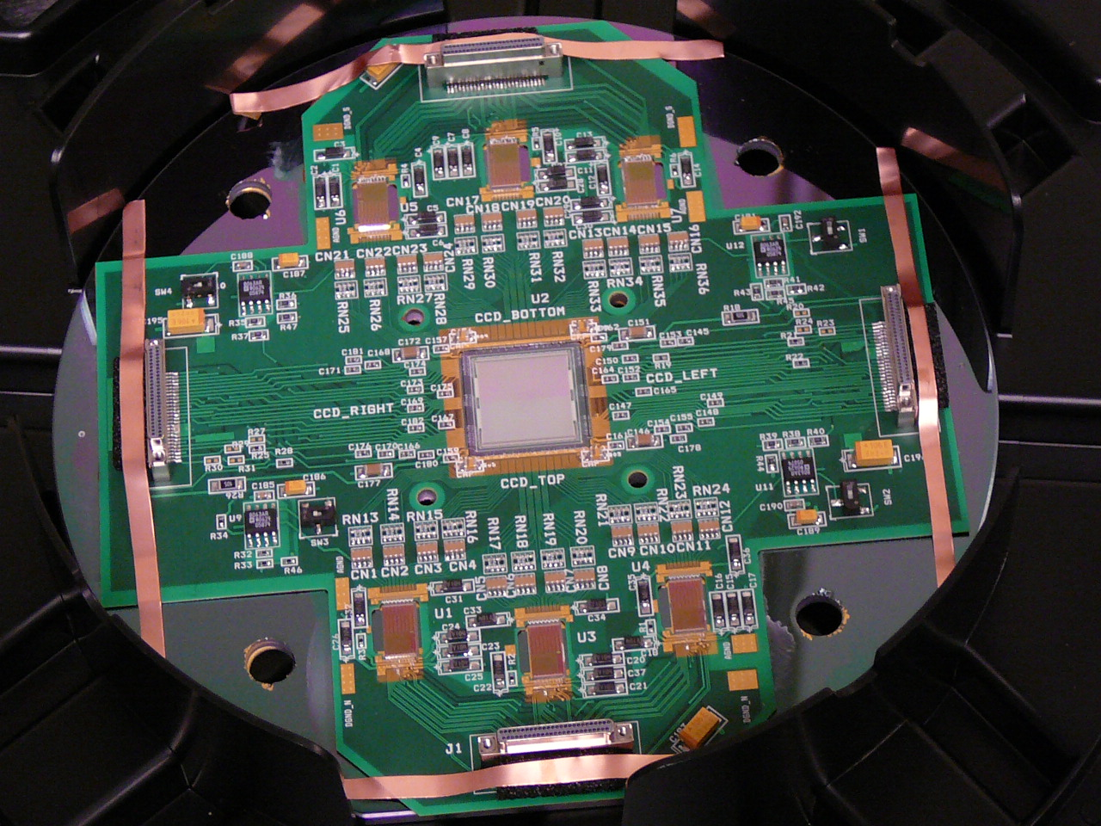
2nd Pass Substrate
(Thin) PCB – CCD + fCRIC on Si, rest on PCB
  1st version completed Q4 ‘07
  Cross-talk in array components
  Difficult to wire bond
2nd version to fix those problems Q3 ‘08

Slide 5
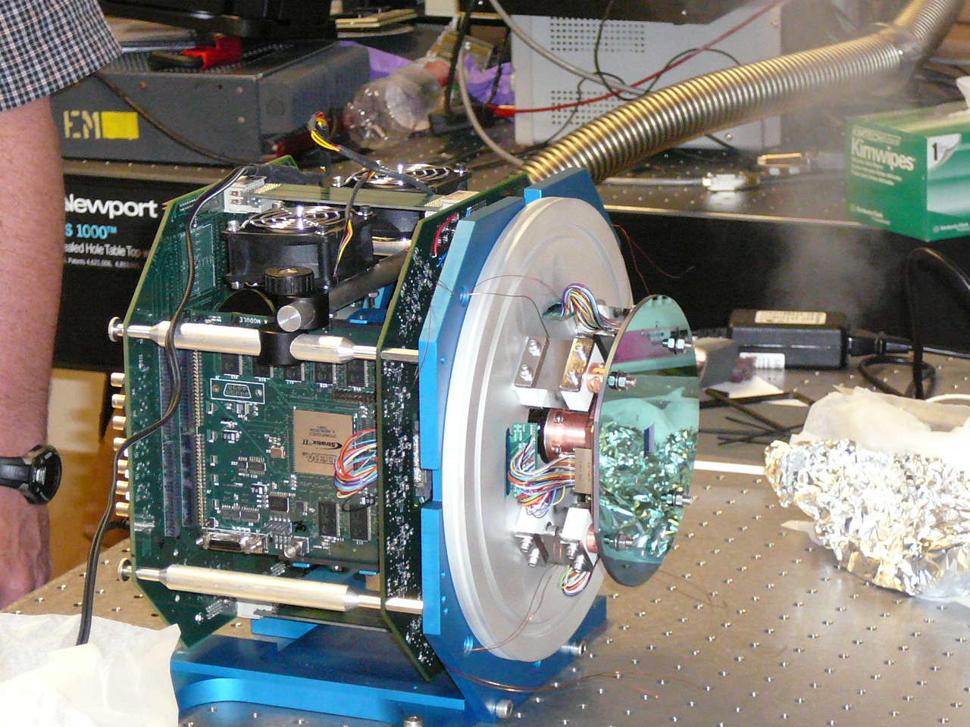
Put it all together – Jun. ‘08
Substrate
hν
Readout / DAQ

Slide 6
Fast Direct detection X-Ray CCD testing on beamline 12.3.2
Nobumichi Tamura, Martin Kunz, Kai Chen, Rich S. Celestre
Dionisio Doering, Tae Sung Kim, Peter Denes
Patric Gruber, Andy Minor, Daniel Kiener

Slide 7
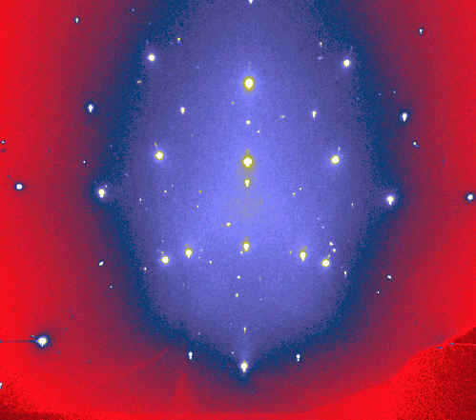
X-Ray microdiffraction at the ALS: principle
Sample is raster-scanned under a submicron-sized white (polychromatic) X-ray beam focused by Kirkpatrick-Baez mirrors. At each step a diffraction pattern is recorded.
Analysis of the diffraction pattern scans provides with phase distribution, crystal orientation maps, strain/stress maps, dislocation structure and distribution
The technique helps understanding the complexity of materials micromechanics (strength, resistance to failure, …) at granular and subgranular level
X-Ray CCD Detector
Focusing optics (KB mirrors)
White or Monochromatic X-ray beam
X
Sample on a XY scanning stage
Y
No sample rotation required !
Aluminum on Silicon
Laue pattern captured by a X-Ray CCD detector

Slide 8
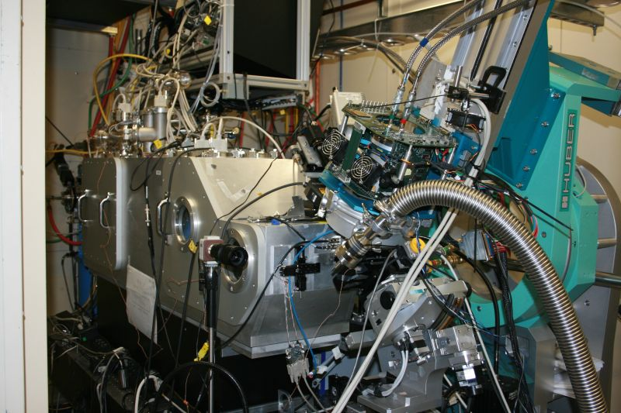
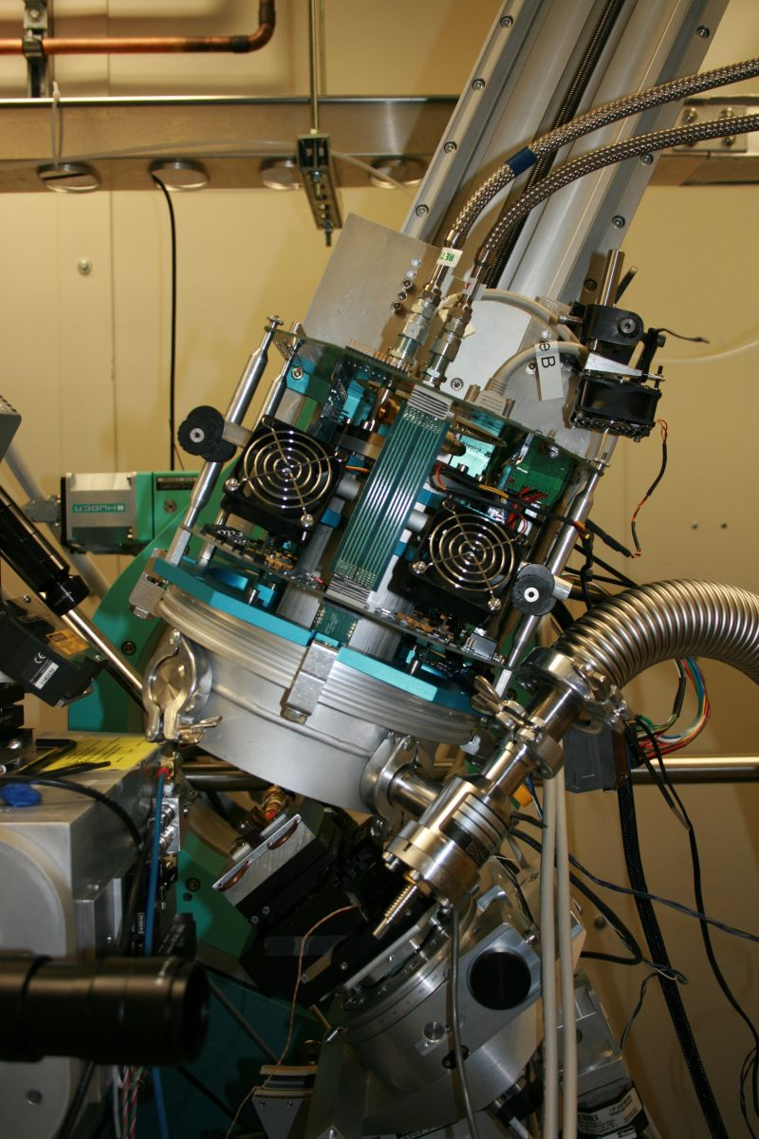
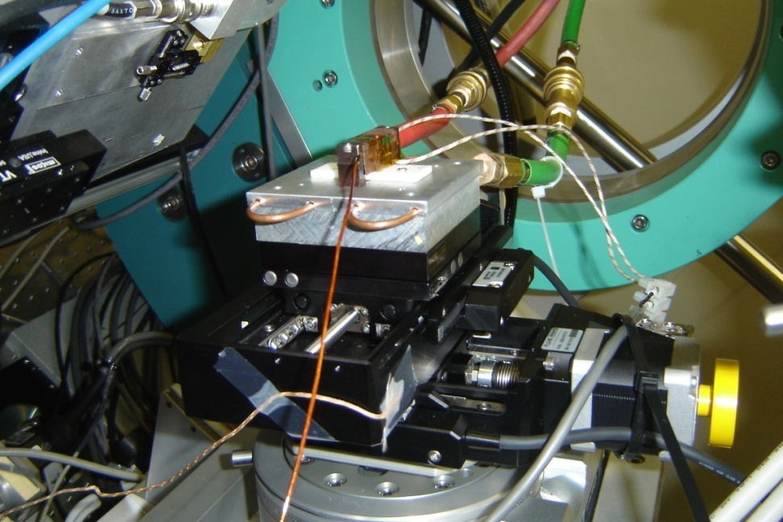
The Beast:

Slide 9
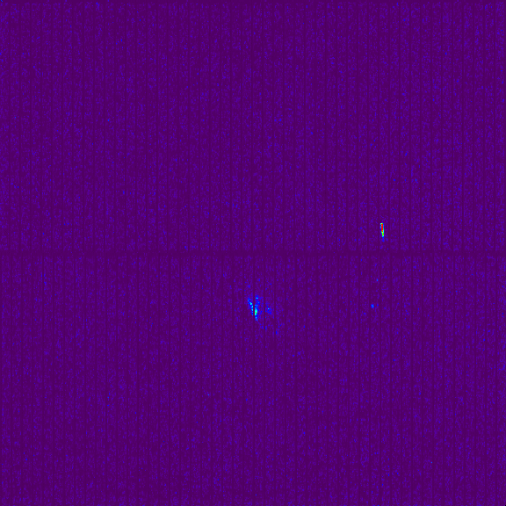
Current limitations (Not to have too many expectations for the tests!):
> Sensor is too small and can’t be moved close enough => pattern indexation, phase identification, strain refinement are not possible at this time
Maximum frame read rate is currently ~50 Hz (software issue)
Saved frames are uncorrected
Vibrations due to vacuum pump
Si
Sn
Tin/silicon
Solid angle: ~6 degrees

Slide 10
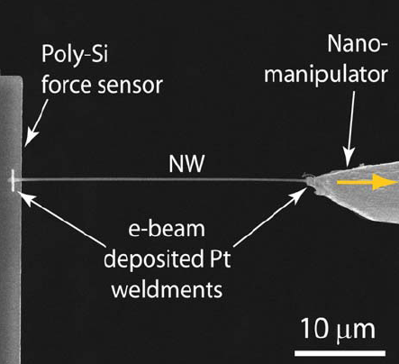
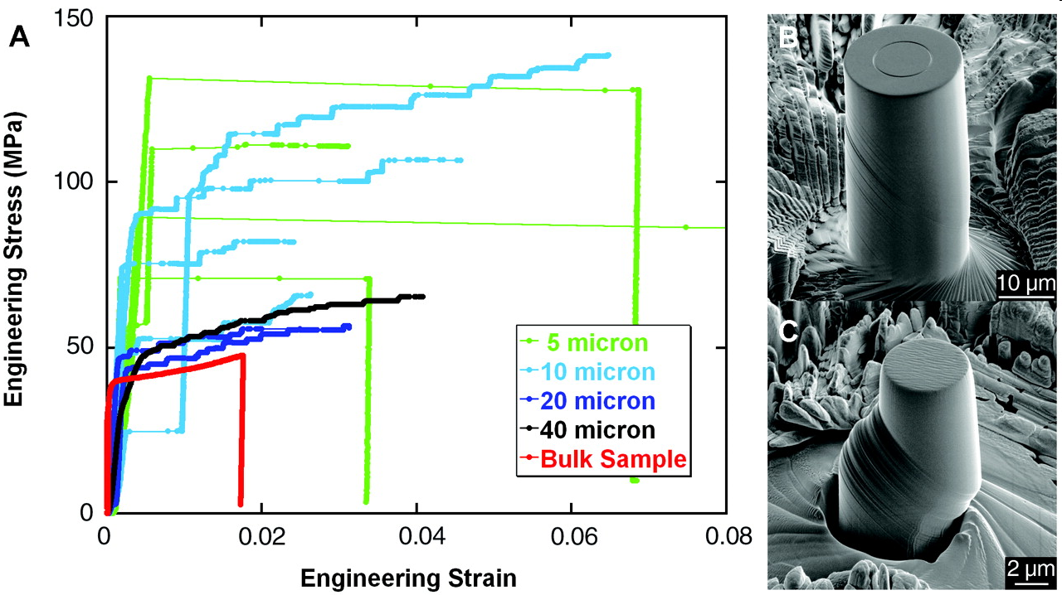
Time-resolved proof of principle experiment
in situ tensile loading of a 200 nm diameter single crystal nanowire (Karlsruhe)
Understanding of the “smaller is stronger” effect in terms of dislocation activities by X-ray diffraction
Follow one spot while loading the sample

Slide 11
Time-resolved proof of principle experiment
in situ tensile loading of a 200 nm diameter single crystal nanowire (Karlsruhe)
Understanding of the “smaller is stronger” effect in terms of dislocation activities by X-ray diffraction
Follow one spot while loading the sample

Slide 12
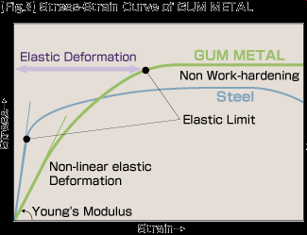
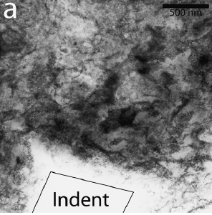
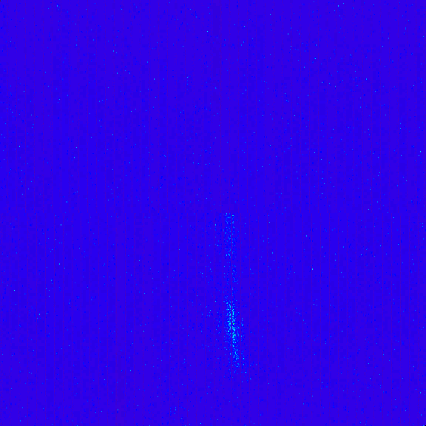
Time-resolved proof of principle experiment: backup plan
Gum Metal (Ti–24(Nb+V+Ta)–(Zr,Hf)–O) deformation: exceptional elastic deformation, high strength, no work hardening
New non-dislocation deformation mechanism (Nobody knows how it works!)
Polycrystalline
Large residual deformation
Splitting of the peak: phase transformation?
Time resolved reciprocal space mapping is required

Slide 13

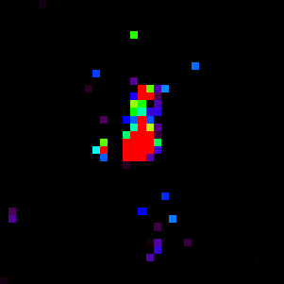
Time-resolved proof of principle experiment: backup plan
Tin melting (T ~ 232 C)
Sudden grain rotation and splitting before melt?

Slide 14
Fast Diffraction scan
- 3200 data points
- 2. 7 min (@ 20 Hz) with Fast CCD (continuous scan)
- 6 hours 13 minutes with a MAR133 (stop and go)
Solder “grain structure” (just following where the strongest peak in the diffraction pattern is ! )

Slide 15
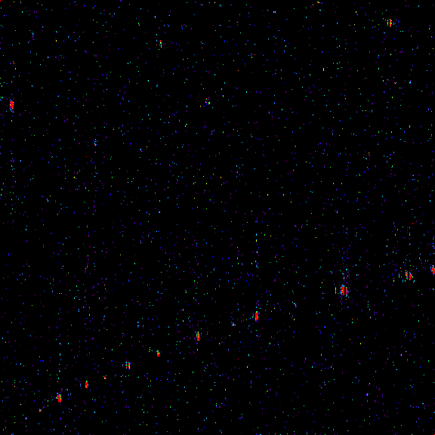
Energy resolving capabilities: toward fast energy-resolved Laue
A fast alternative to monochromator energy scan
Potassium Titanyl Phosphate KTiOPO4 (or KTP)
Orthorhombic:
a= 1.28193 nm
b= 0.63991 nm
c= 1.05842 nm

Slide 16

Energy resolving capabilities: toward fast energy-resolved Laue
Slits closed to maximum
Single photon counts (each pixel is an energy dispersive detector)
Pixel intensity proportional to photon energy
20 Hz frame rate

Slide 17
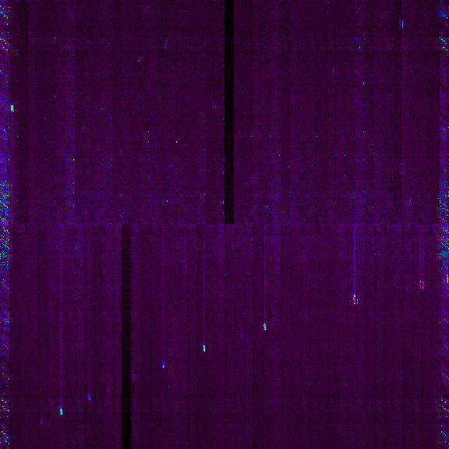
Energy resolving capabilities: toward fast energy-resolved Laue
Added up contribution of 2500 frames taken at 20 Hz (~ 2minutes exposure).
The original Laue frame is reconstructed but with statistics on single photon counts

Slide 18
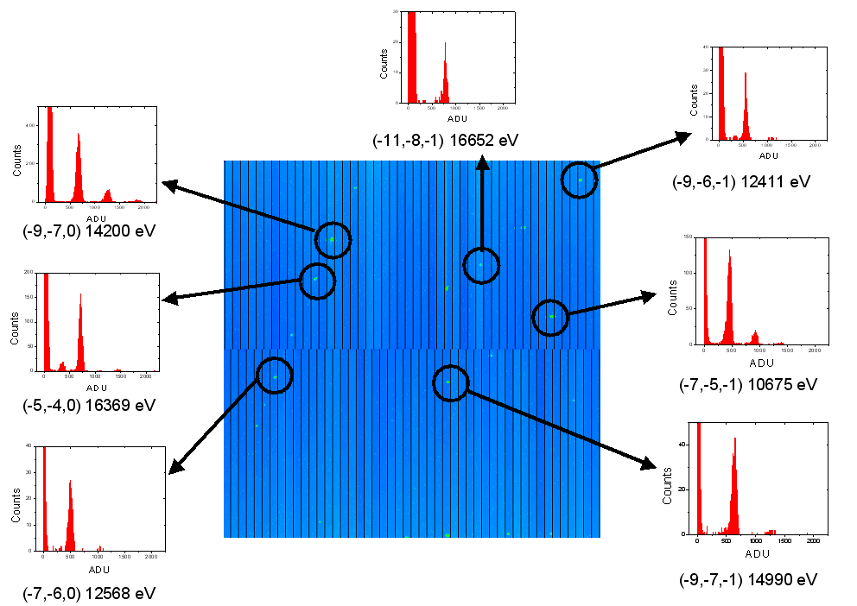
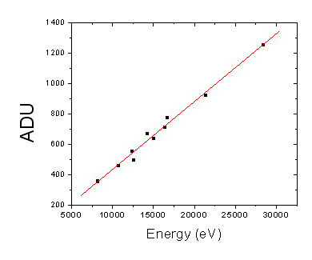
ALS/APS Fast Direct detection CCD (Prototype) …
And energy sensitivity in photon counting mode …
KTP crystal indexed. The energy of each reflection can be measured …
Energy-resolved Laue diffraction

Slide 19
Concluding Remarks …
Promising .. but we need a bigger detector …
Data storage and processing will become an issue (~90 000 frames, 58 GB in 2 days)
Experiments were conducted with slits at minimum size, frame rate was set to 20 Hz (~50 ms exposure time)

Slide 20
BL 9.0.1
Thanks to Stefano Marchesini et. al.

Slide 21
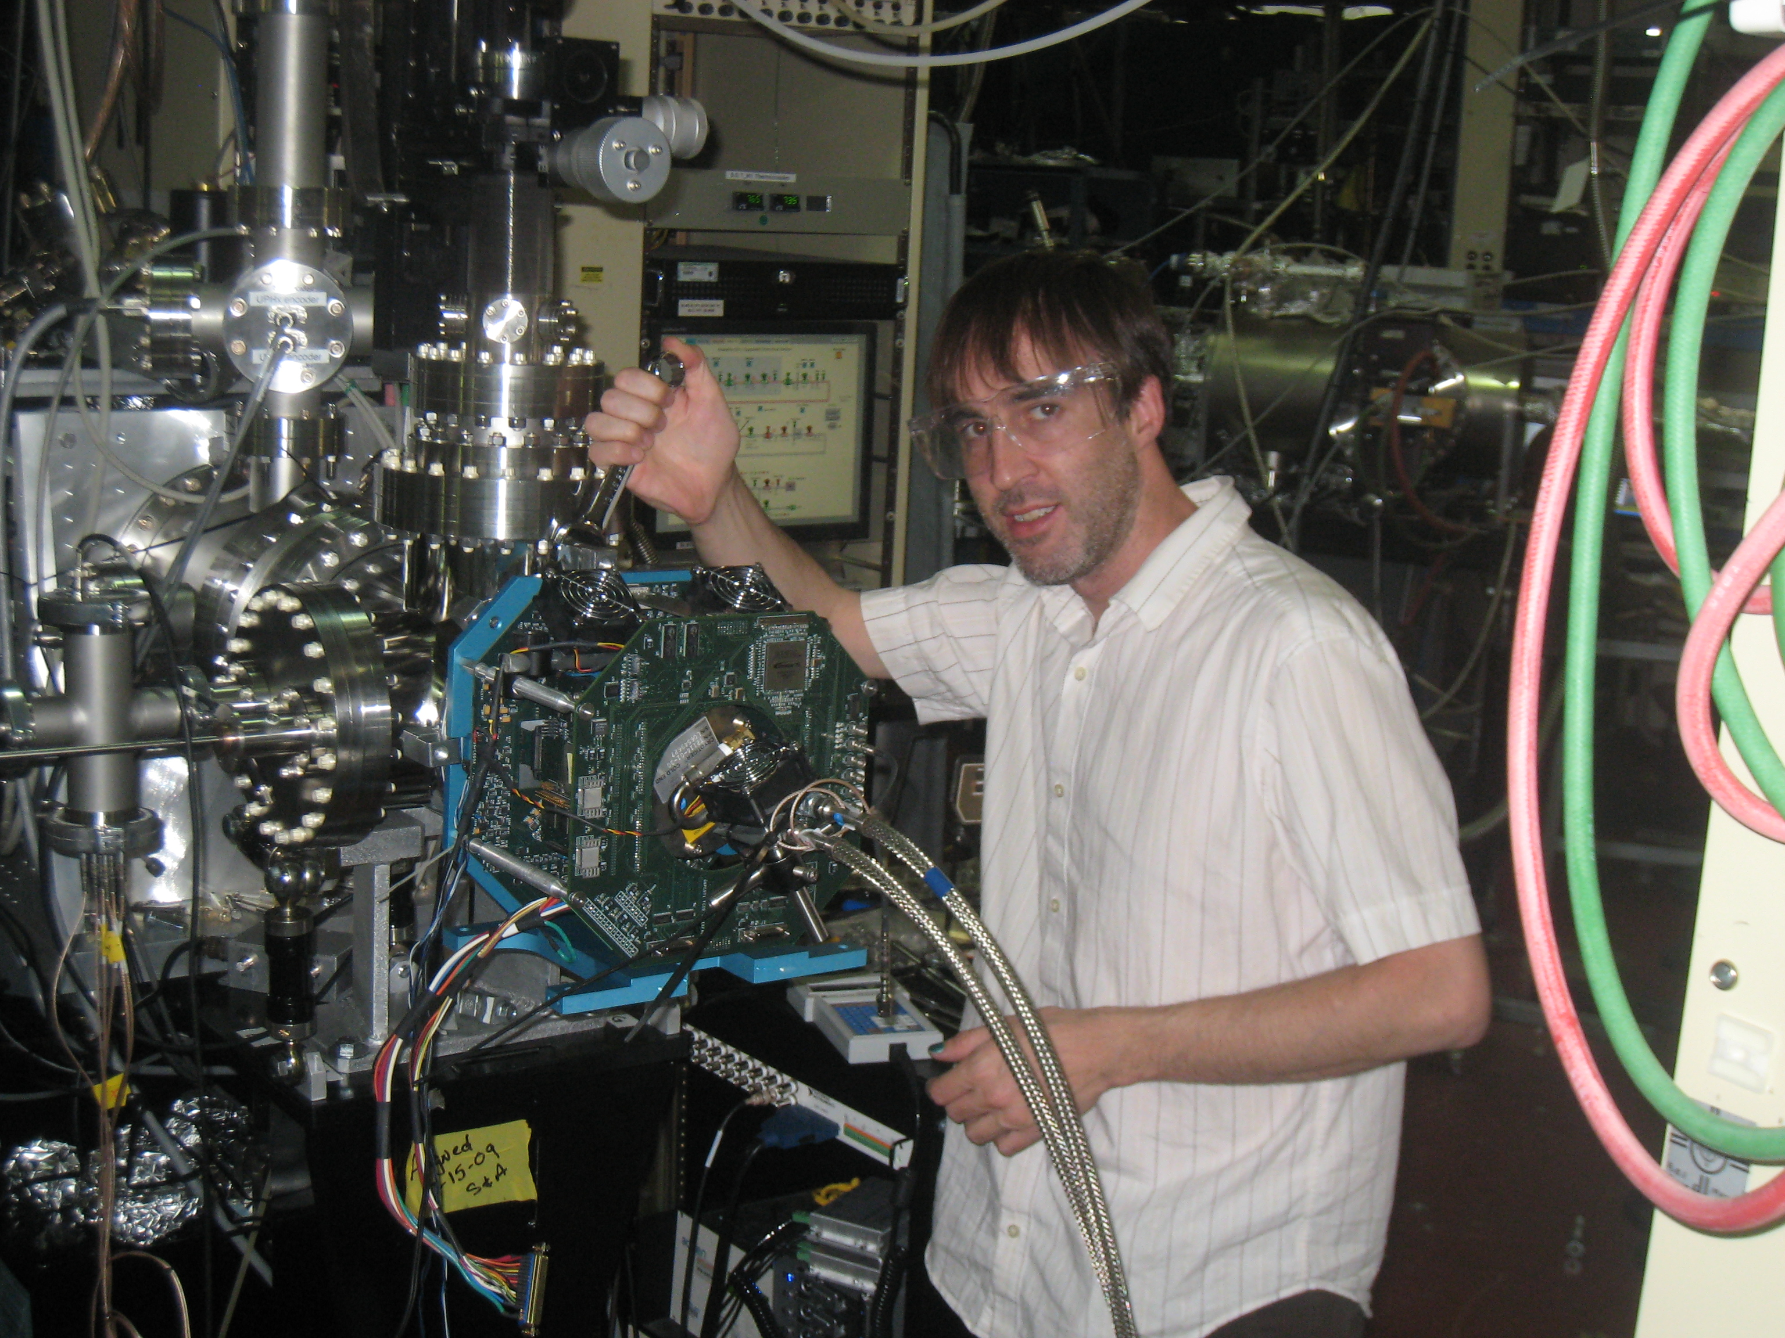
BL 9.0.3: chamber for fCCD

Slide 22
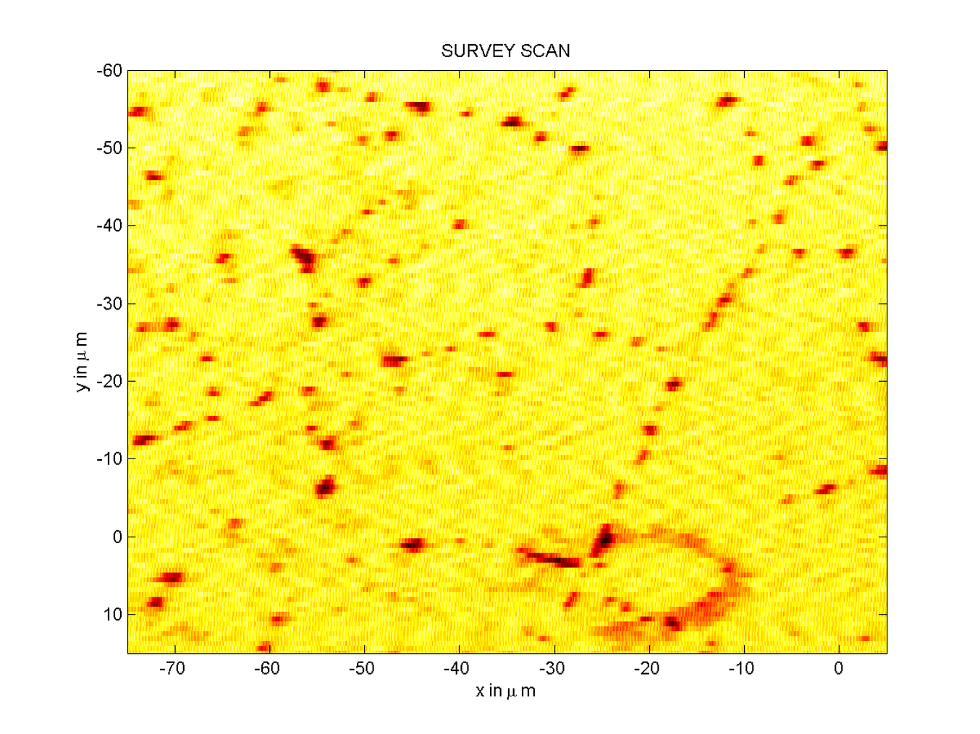
BL 9.0.3 : Movie

Slide 23
Next canera @ ALS : cFCCD
Same sensor: 480 x 480
Same readout: fcric + back end electronics + camera link + PC
New
  mechanics
  cooling system
This camera will also be used at the LCLS (120 fps)

Slide 24
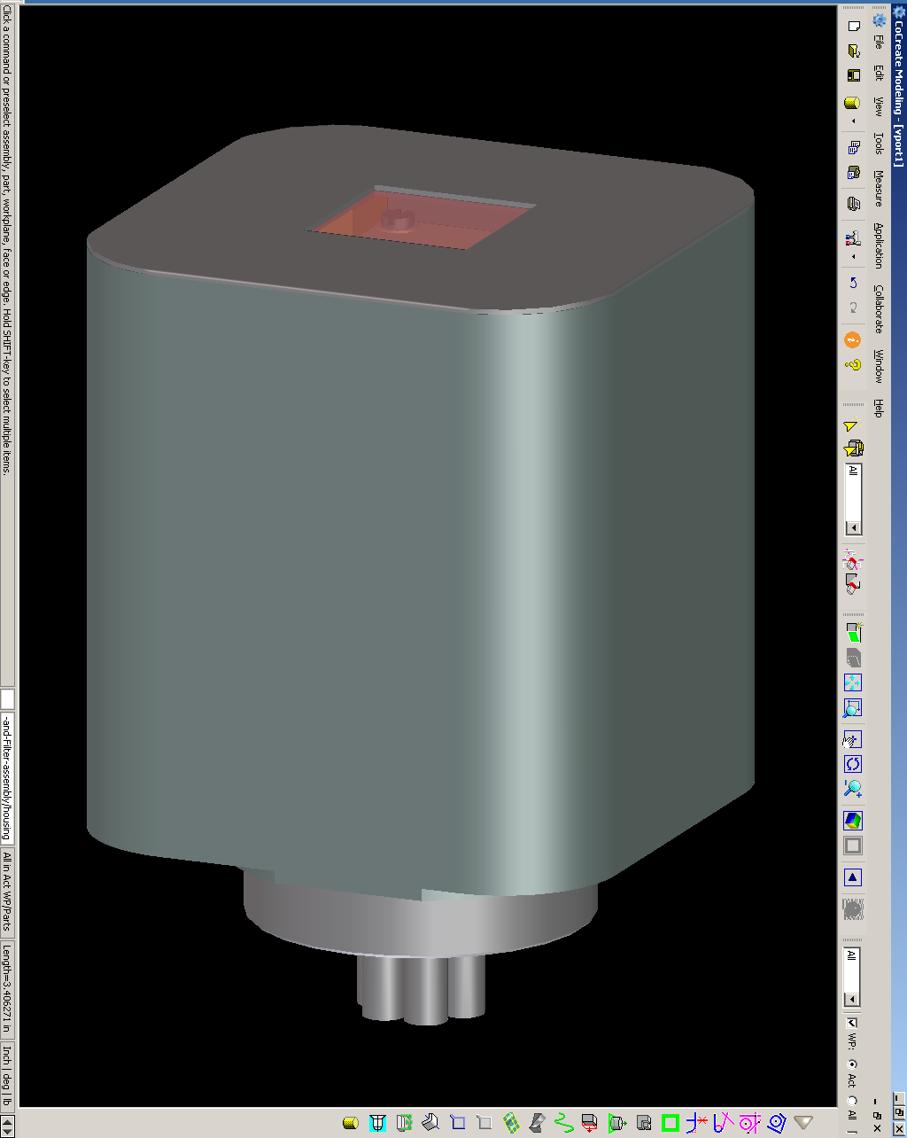
c(ompact)FCCD
FCCD 6” wafer holder
cFCCD 2.5” cubic
Mechanics is being designed to hold also a 1k frame store sensor

Slide 25
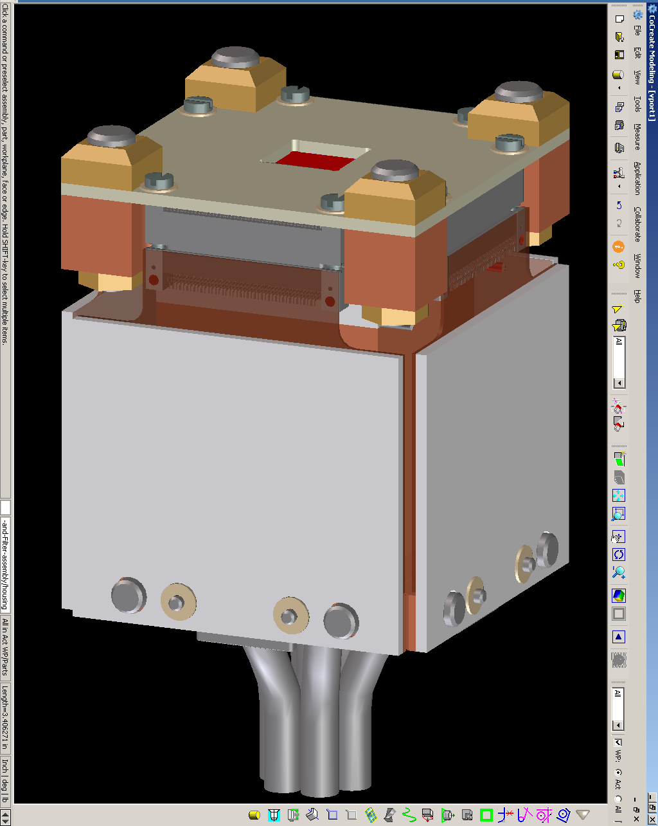
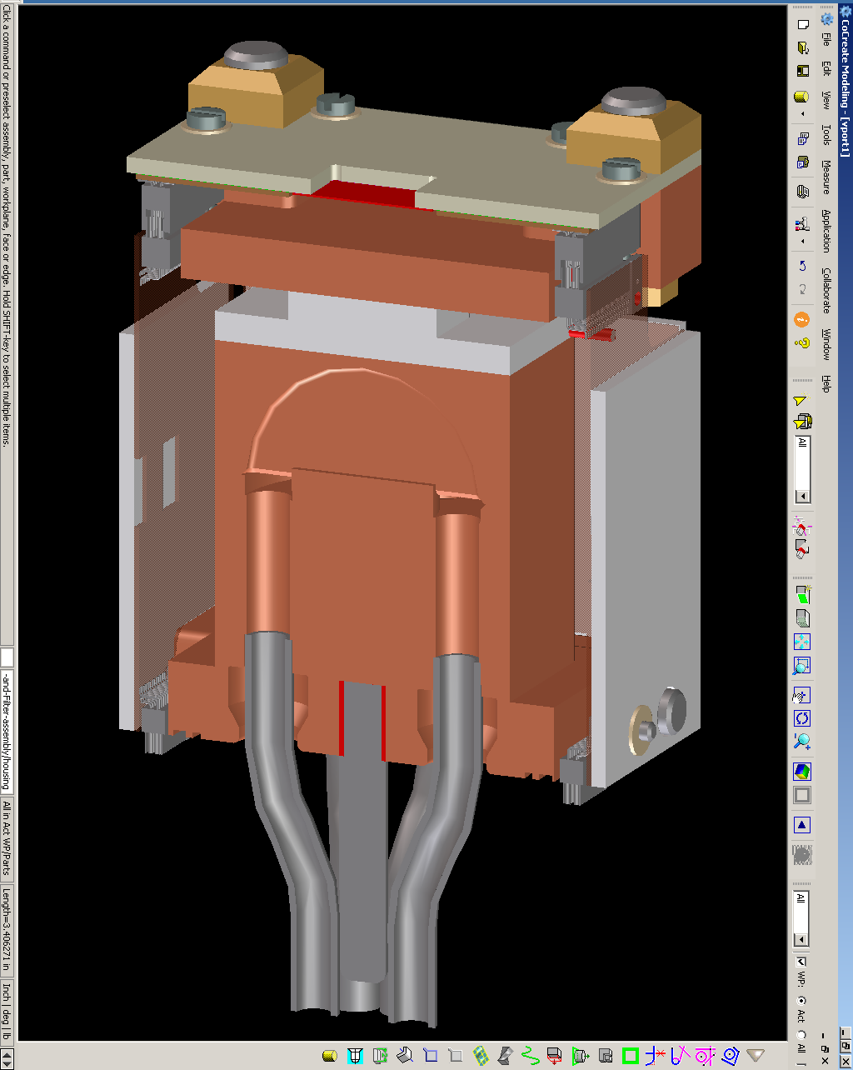
cFCCD mechanical model

Slide 26
Conclusions
Prototype: done
Test on beam line 12.3.2: done
Test on beam line 9.0.1: done
cFCCD: in progress (Jan 2010)

Slide 27
Backup

Slide 28
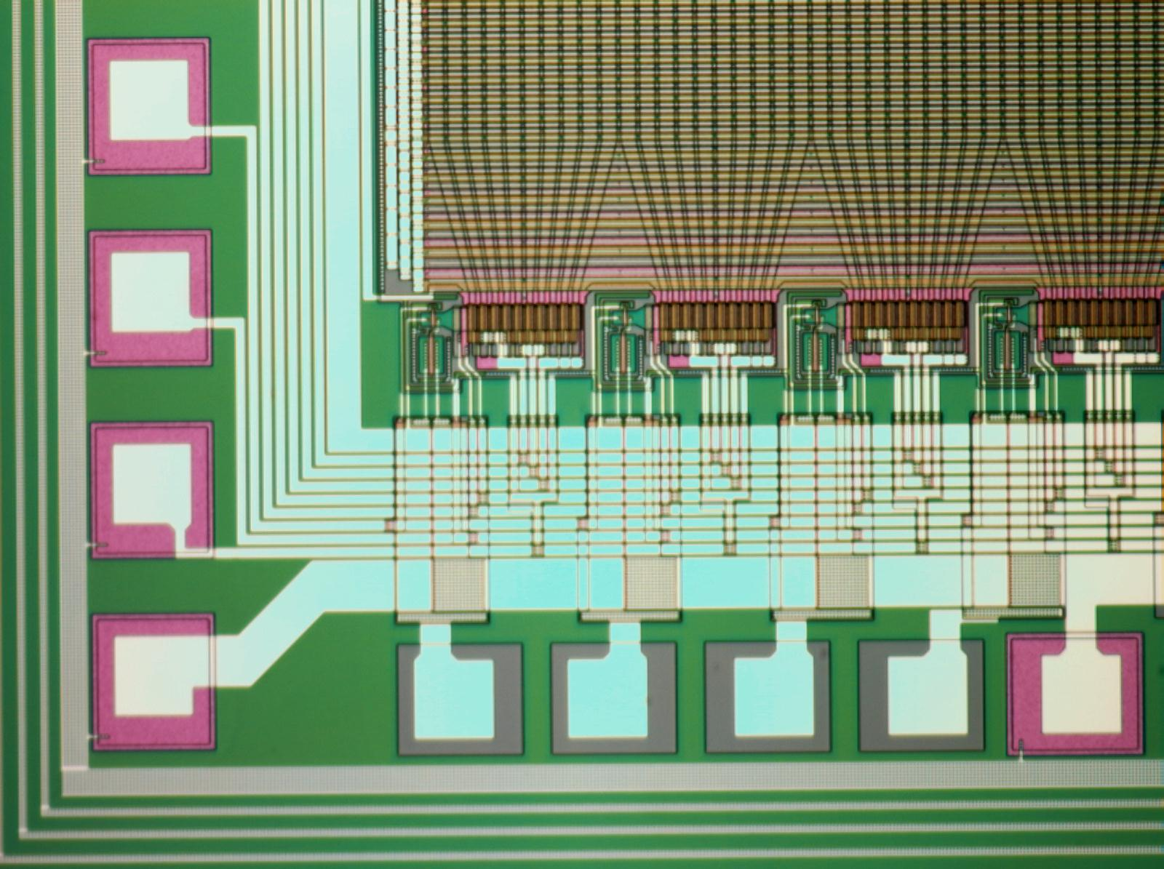
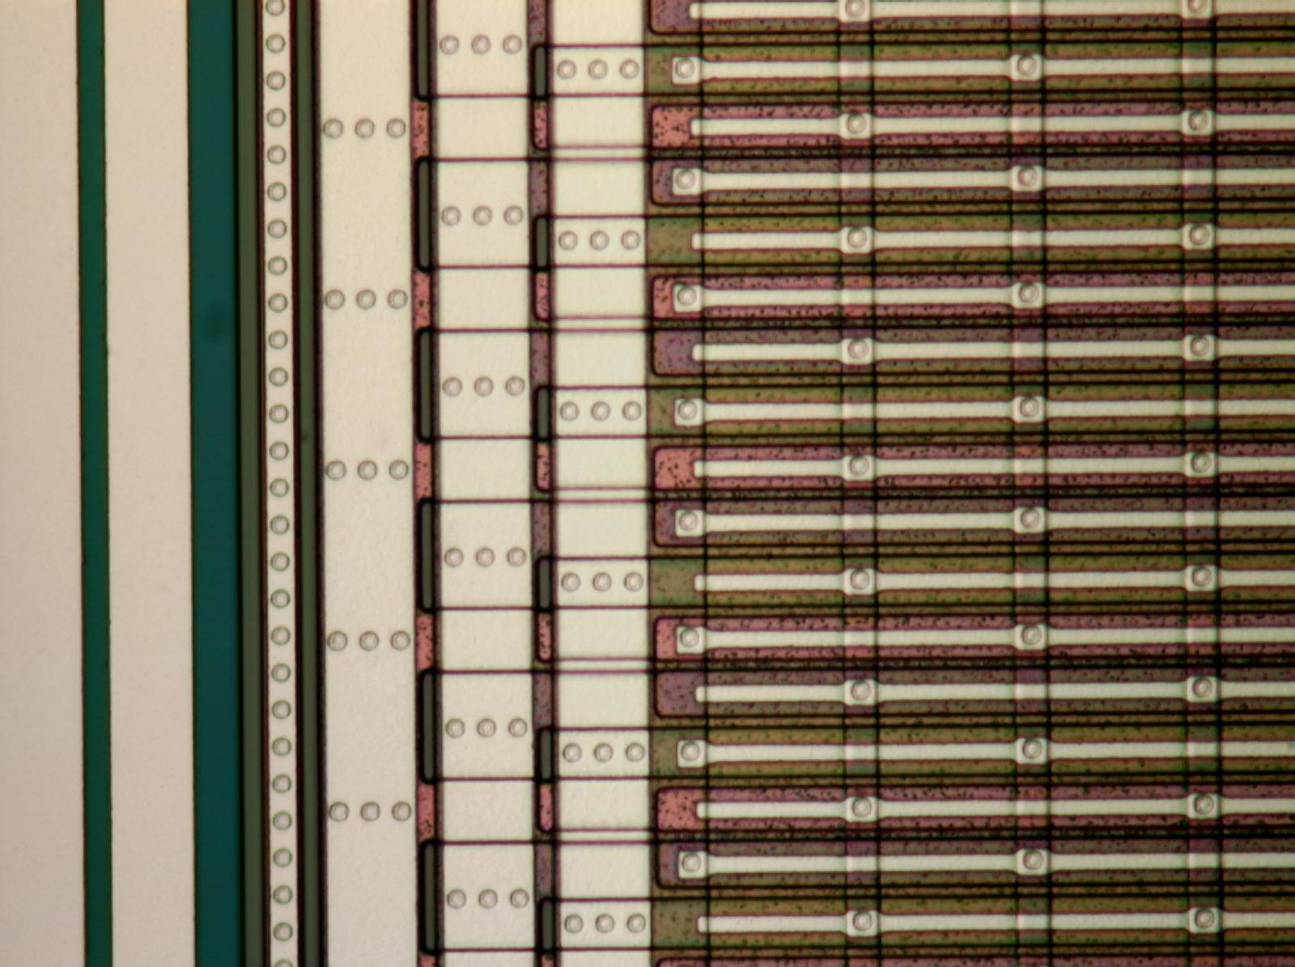
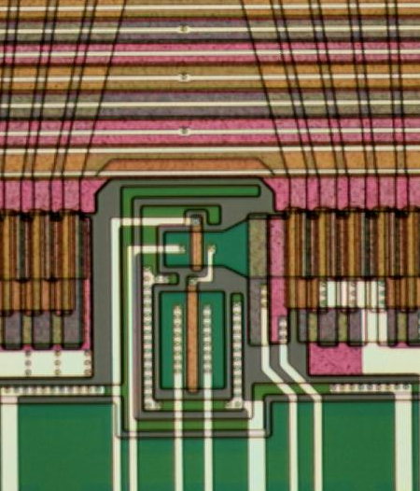
(almost) Column-Parallel CCD
Constant
Area
Taper
Mini-shift reg.
Output stage
Mini-SR with taper
Metal strapping
~300 µm pitch
bond pads
(wire-bondable)

Slide 29
CCD Readout Based on CRIC
Voltage integrator
Output =
Optimal noise filtering
Switched cap preserves charge
±
Preamp
Multi-gain
integrator
CDS
Pipelined ADC
Gain 8, 2, 1
12 + 1 bit ADC
Covers 15-bit dynamic range
Quantization error always < photostatistics
CDS – correlated double sampling

Slide 30
fCRIC
16 channels on 300 μm pitch, 15 bit range
Chip submitted Q3 ’06 (TSMC 0.25 μm CMOS)
Chips received Q4 ‘06
4.8 mm
Digital section
Timing generation
Readout
Control
Preamp
Integrator
CDS
Pipelined ADC
Custom CCD readout and ADC chip

Slide 31
FCCD Readout – J. Weizeorick

Slide 32
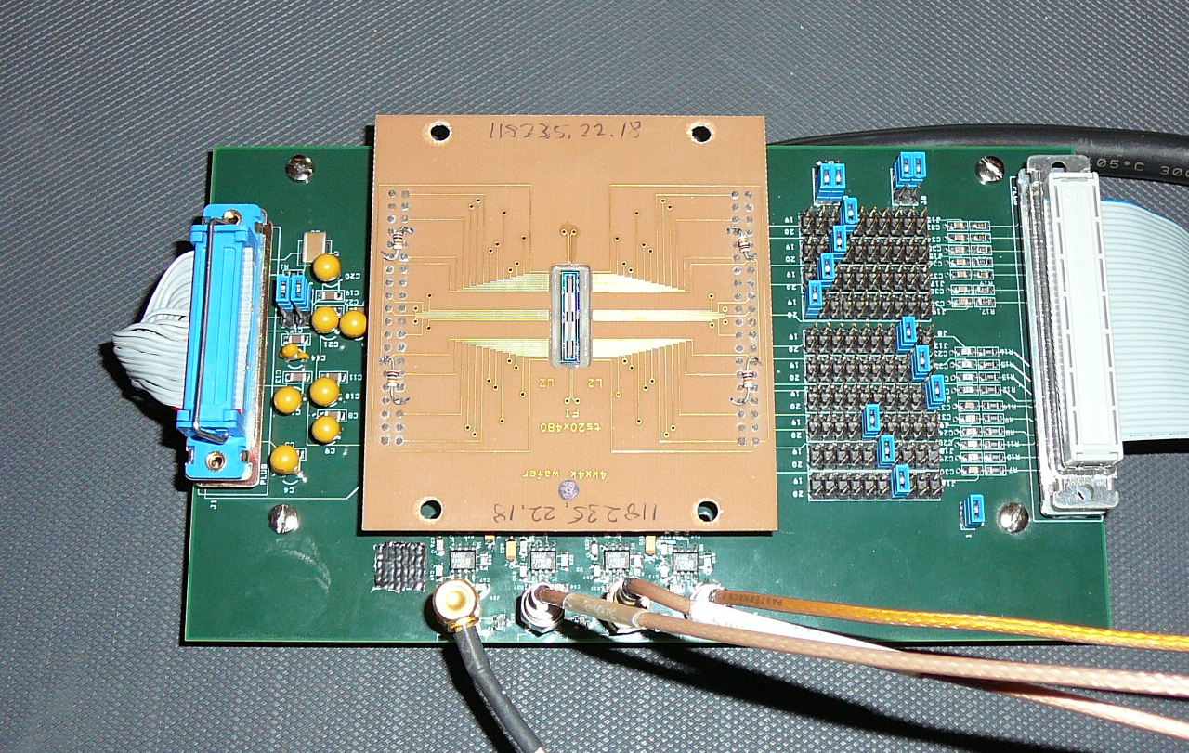
Initial Tests at Low Speed with 4-port 20 x 480 CCD
“Picture frame” board
Clock de-scrambling
Clocks
Analog (DC) voltages
CCD
Interface board

Slide 33

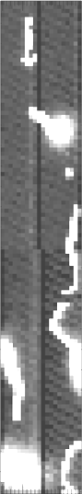
Lab Test – 20 x 480 – 30 Minute Exposure Apr. ‘07
Bill Kolbe (SNAP CCD test group)
T = -135 C
Slow readout (“Leach Controller” – astronomical CCD controller [http://www.astro-cam.com/], with some modifications for these high voltage, n-type CCDs)
Cosmic rays … visible
Dark current 5 e−/pixel/hour
  30 μm pixel
Calibrate with ⁵⁵Fe
  3.5 μV/e⁻ (as expected)

Slide 34
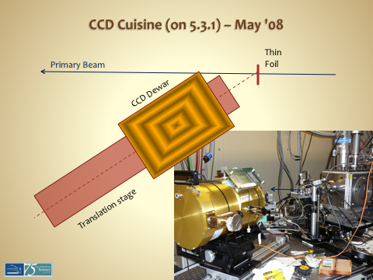
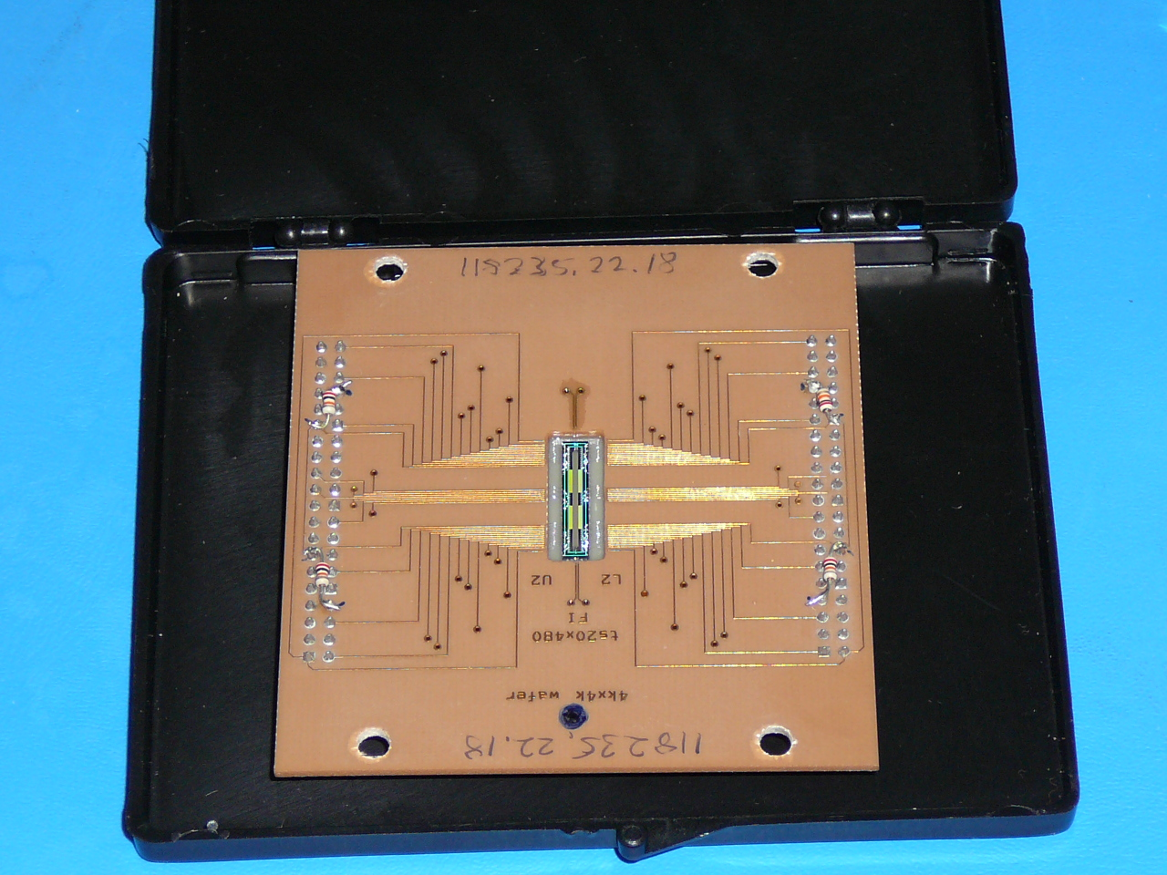
1st Beam Test on 5.3.1
20 x 480 CCD
Slow readout
Fluorescence x-rays

Slide 35
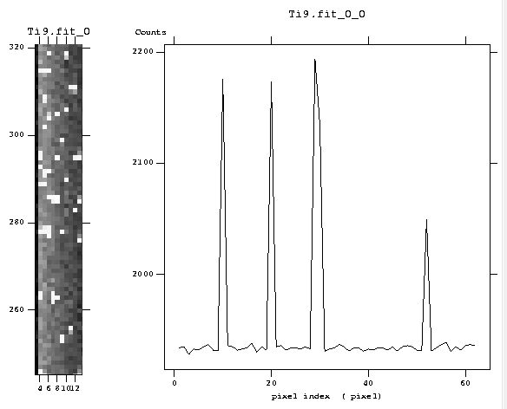
See x-rays, Cluster Size ≥ 1

Slide 36
Direct Detection in Thick Si → Spectroscopic
Foil | E (xray) | <ADC> | RMS
Ti | 4.5 | 116.1 | 15
V | 4.94 | 129.8 | 12
Fe | 6.4 | 167 | 13
Co | 6.92 | 182.1 | 18.8
Ni | 7.46 | 200.1 | 20.7
Cu | 8.03 | 209.275 | 17.37
Au | 8.49 | 226.6 | 17.2
Noise a bit higher than desired (recurring
theme) but (a)CP-CCD structure OK and useful (also) for spectroscopy

Slide 37
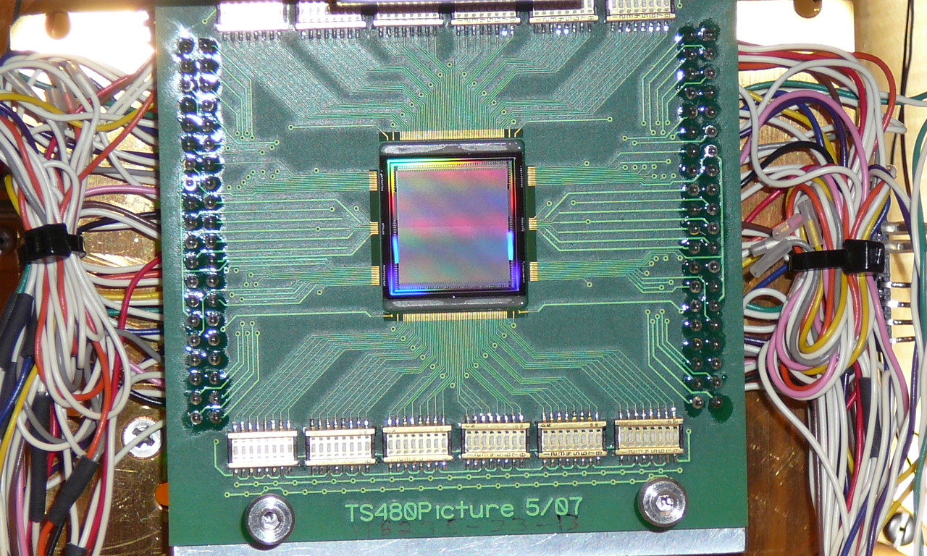
Test Board with 480 x 480 CCD
PCB
CCD
2 x 48 switches

Slide 38
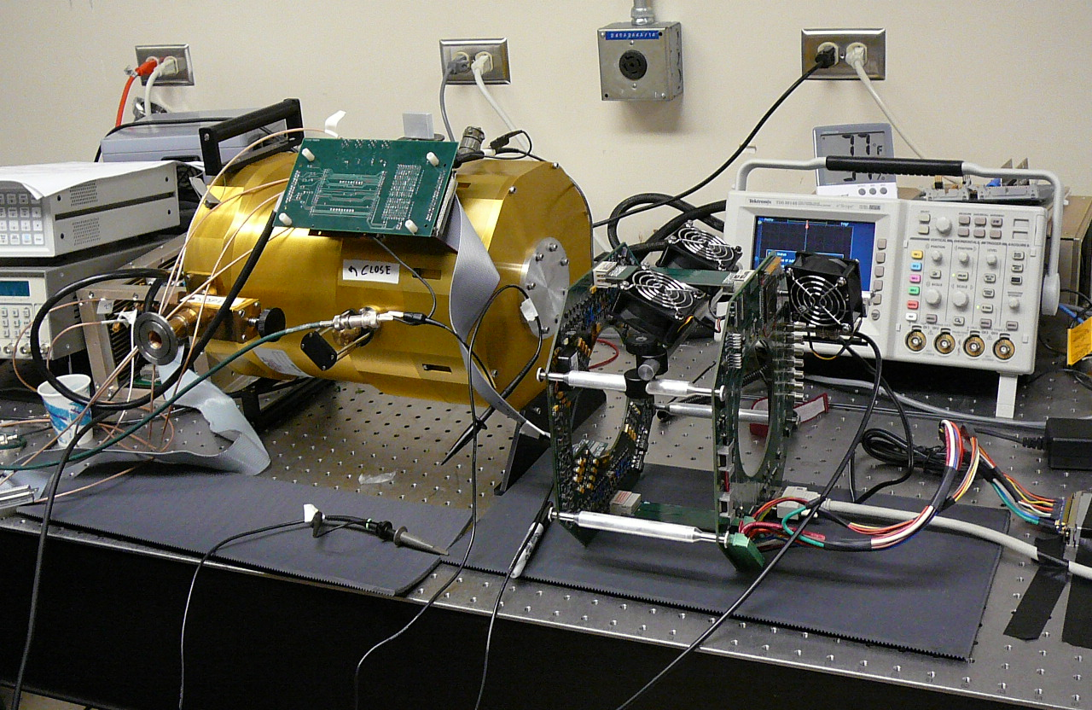
Mate ANL Clock Driver to 480 x 480 Feb. ‘08
I/F Board
Dewar
ANL Clock Driver

Slide 39
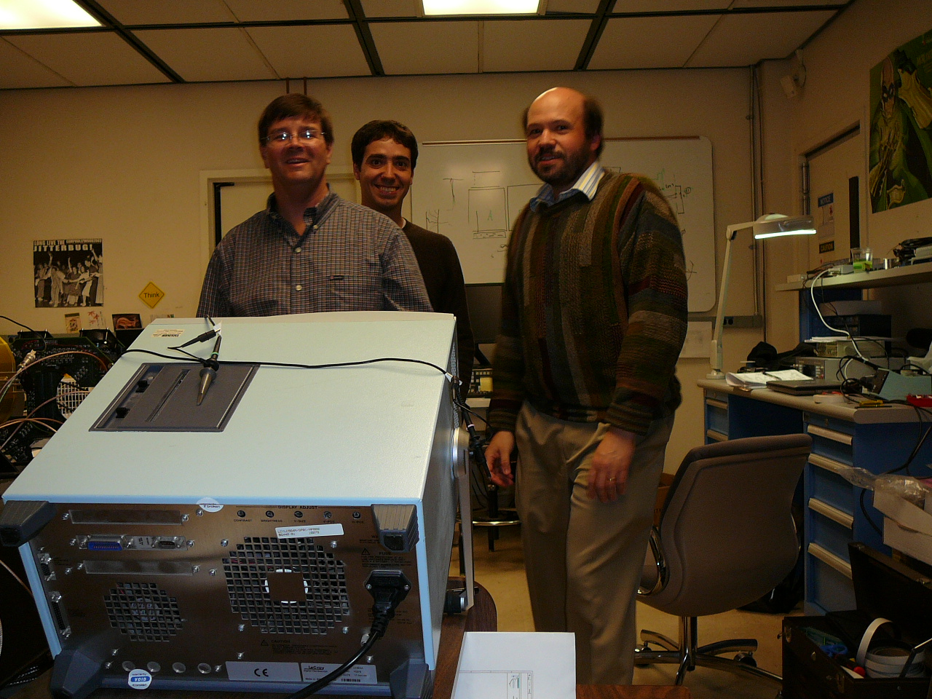
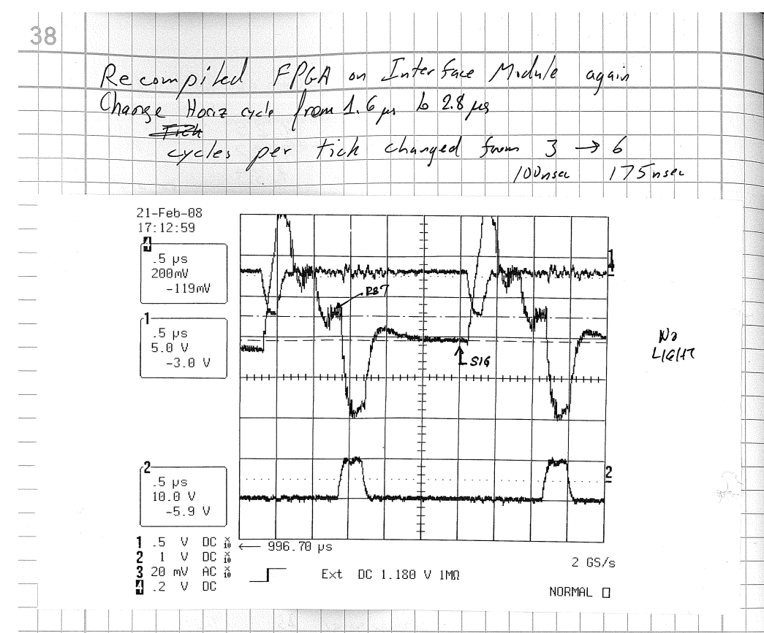
Guilty Parties
Test clock drivers on 480 x 480 CCD in dewar

Slide 40
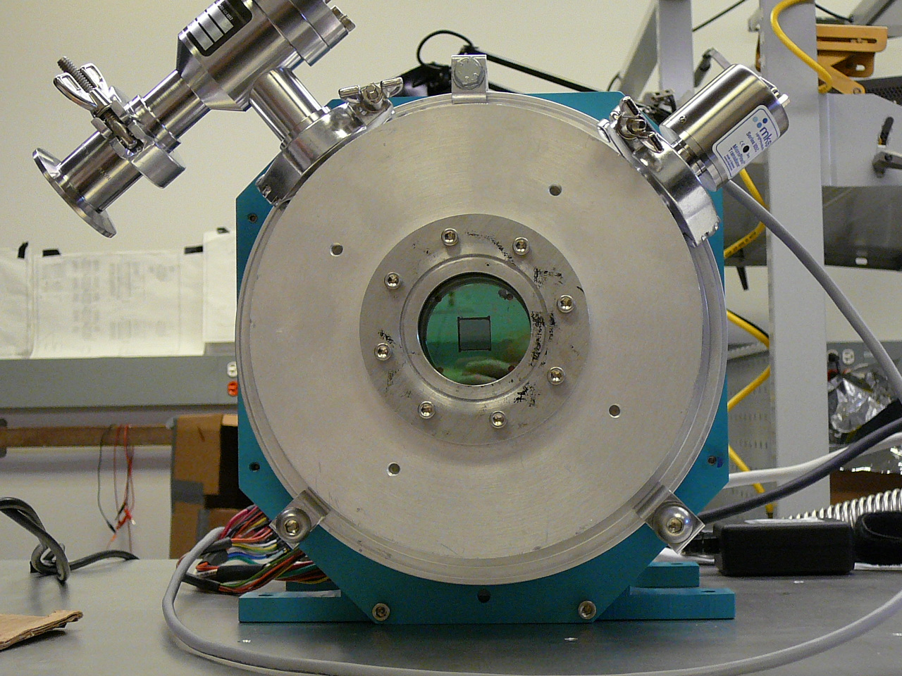
480 x 480 → APS Jan. ‘09

Slide 41
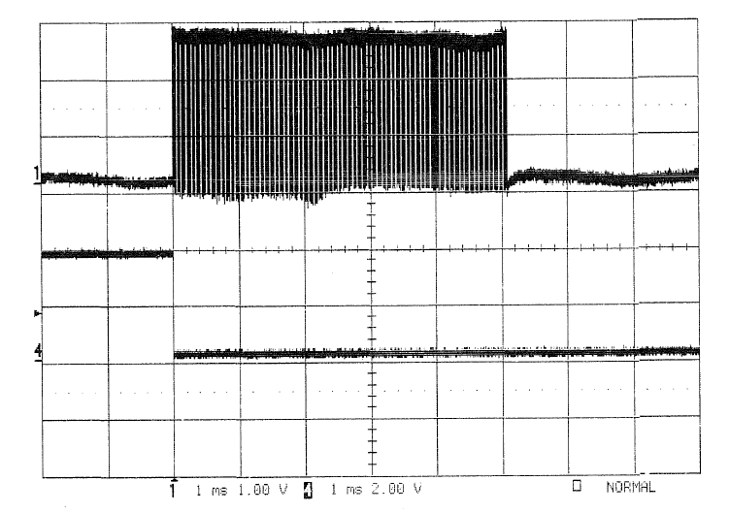
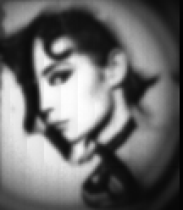
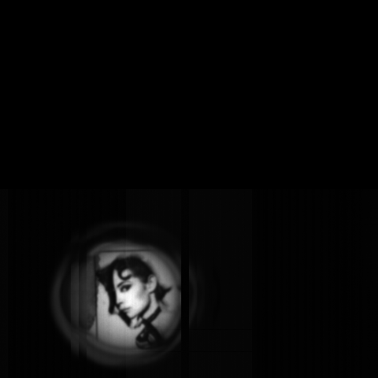
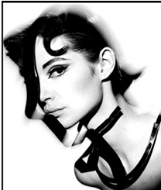
First Images with Fast Readout
Synchronize fCRIC clock with CCD clock
Verify 5 ms readout
Start to optically characterize CCD
5.1 ms
Trigger

Slide 42
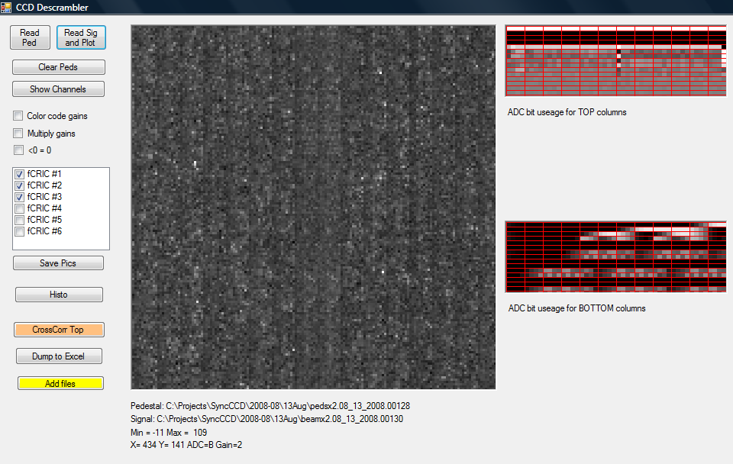
FCCD on 5.3.1 Aug. ‘08
1st look at xrays with
“the real thing”
Bright dots = xrays

Slide 43
Resolution vs. E
Fit to a⊕bE
a = 350 eV
b = 0.019
Noise ~ 175 eV/pixel (factor 3 too high)
b should be zero. Could power supply noise cause gain fluctuations?
(e.g. if V_{RESET} moves up and down, current through output transistor
changes, so g_{m} changes, …)
New substrate, Forced x8

