Slide 1
Beam Transport Modules Preliminary Design Review (WP12)
Dr Paul Aden
Project Manager
ESS PDR, Lund, 10th November 2015

Slide 2
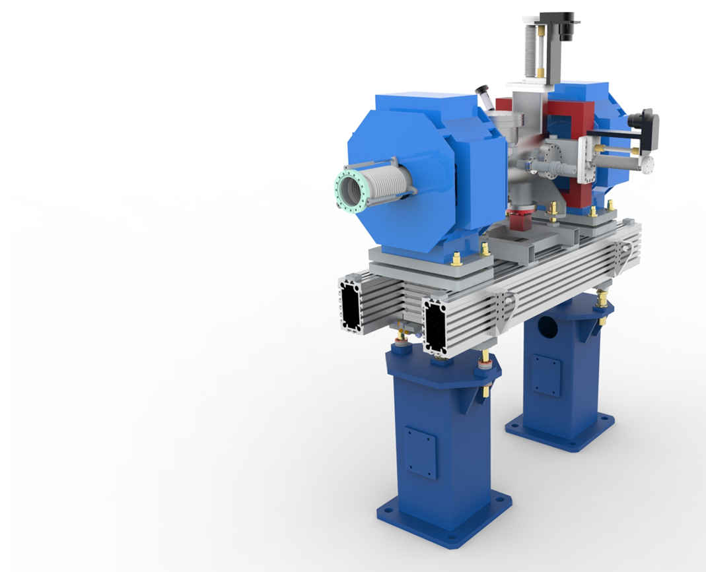
BTM WP Scope
To design, procurement and assemble;
2 Prototypes
3 Test Chambers
75 LWUs
52 Beam pipe modules
2 Differential pumping systems
2 mobile installation cleanrooms
Notes:
Over the next four years we have been asked to delivery …

Slide 3
Scope of work update
Particle control only on 52/75 LWUs
Upto HEBT
BPM work package
Only electrical centre measurement, not on prototype
BPMs Pickups are to be supplied on contract loan from DESY
Final decision on BPM design expected March 2016
Magnet designs still now finalised.
Unknown completion date (Dec 15?)
Working with space envelopes until then (not ideal)
Notes:
Upto hebt

Slide 4
Overview In/Out
In
Girder design & procurement
Chamber design (within given parameters) & procurement
Vacuum design & procurement
Survey & Alignment
Particulate Control
Out
BPM Procurement & Design
BCM Design
Bolt in diagnostics
Magnet Design & Procurement
Installation & Onsite testing

Slide 5
Scope of Work
Technical Annex currently being complied.
Full Scope now available
Full excluded / included list in STFC document tdl-1224-meng-spec-0005

Slide 6
Schedule
2015 | 2016 | 2017 | 2018 | 2019 | 2020
BTM Design
Elliptical Prototype
Spoke Prototype
Magnet Deliveries
BPM Deliveries
BTM Assembly
BP Assembly
20/08/19
LWU Assembly
Installation Cleanrooms
Differential Pumping System 1
Differential Pumping System 2

Slide 7
Final Design Reviews
Milestone | Date
Elliptical | June 2016
Spoke | June 2016
HEDP | July 2016
LEDP | July 2016
Cleanrooms | August 2016
Beam Pipe | August 2016

Slide 8
Schedule Detail
Last LWU 20/08/19
First useful magnet delivery 5/5/17
Final Magnet Design not until December 15
Therefore, no magnets on prototypes
Q7 magnets arriving first, these magnets however these LWUs do not require particle control.

Slide 9
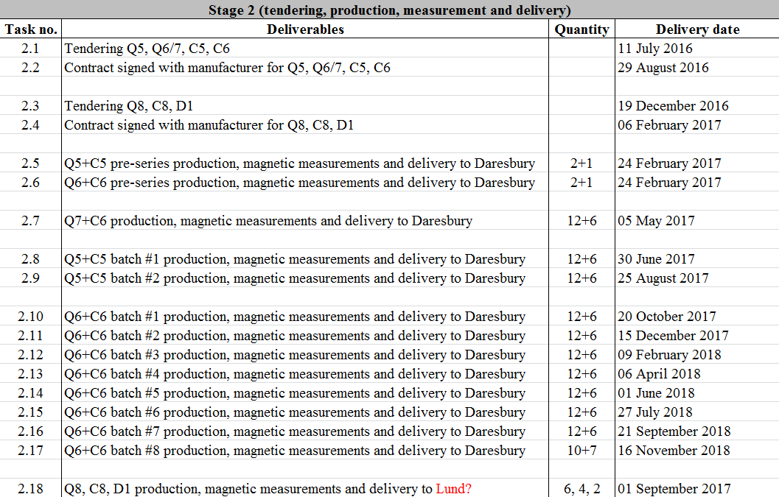
Elettra Delivery Plan
Current schedule suites magnet deliveries, do magnet deliveries suite ESS?

Slide 10
BPMs
Last date for BPM design to be given to STFC, March 2016.
For strip line full detailed design should be given
Will allow re-design of chambers
Will give time for manufacture of chambers
BPM Delivery
BPMs should start arriving at STFC in August 2016
Should be continuous supplied to STFC at a rate of 4 BPM pickups per week.
No Delivery Schedule has been seen

Slide 11
Summary
Prototype
Build to start 10/2/16
Production Units
PDR 10/11/15
Beam pipe build to start 8/8/16
LWU Build to Start 13/2/17 – dictated by magnet shipments
BPMs must have finalised design by March 16
Magnet Delivery schedule could be changed to improve LWU deliveries
Notes:
Prototype 2 - FDR 14/7/16

Slide 12
Mechanical Design

Slide 13
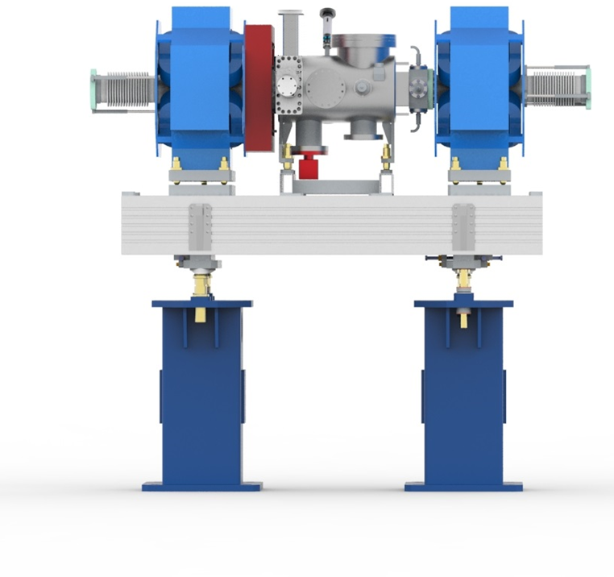
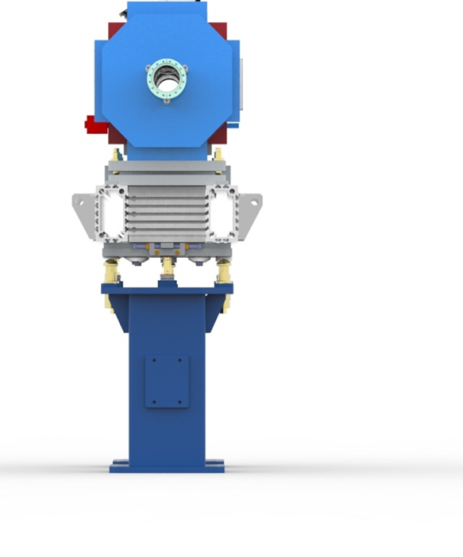
Warm Linac Units

Slide 14
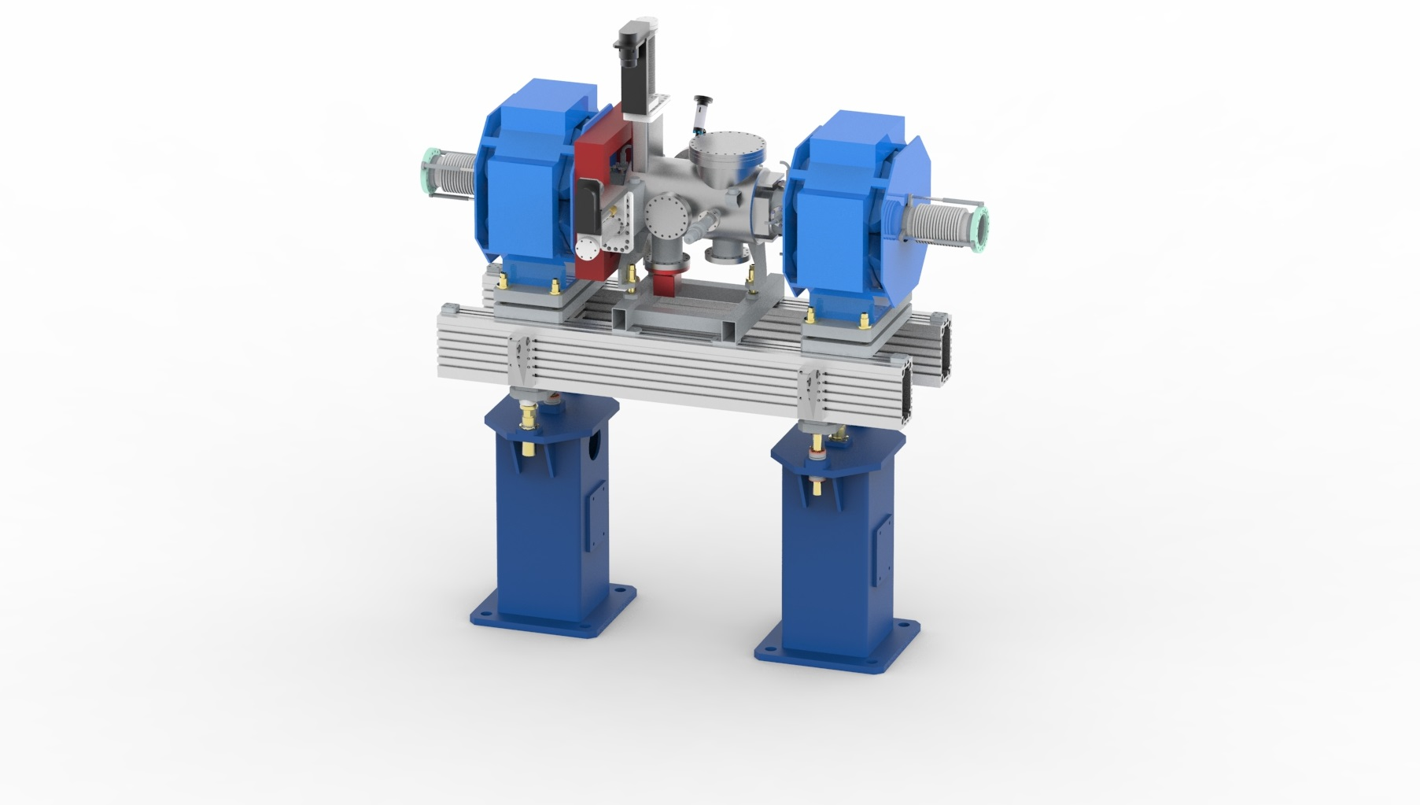
Warm Linac Units
Quadrupole Magnets
One BPM per LWU
‘Particle Free’ Chamber
- ISO 5 or better
Aluminium slotted girder
Fiducials, laser tracker alignment
Semi–kinematic
girder adjustment
Built in lifting points
Pedestals

Slide 15
Design Overview
Based on many years experience developing accelerator modules
Slotted girders allows for versatility
Optimised for ground vibrations
Fiducial mounts for survey and alignment
±50µm alignment to local girder network
Girder adjustment ±55mm
Magnet/Chamber adjustment ±15mm
Large space between pedestals for access/egress

Slide 16
Chamber Design

Slide 17
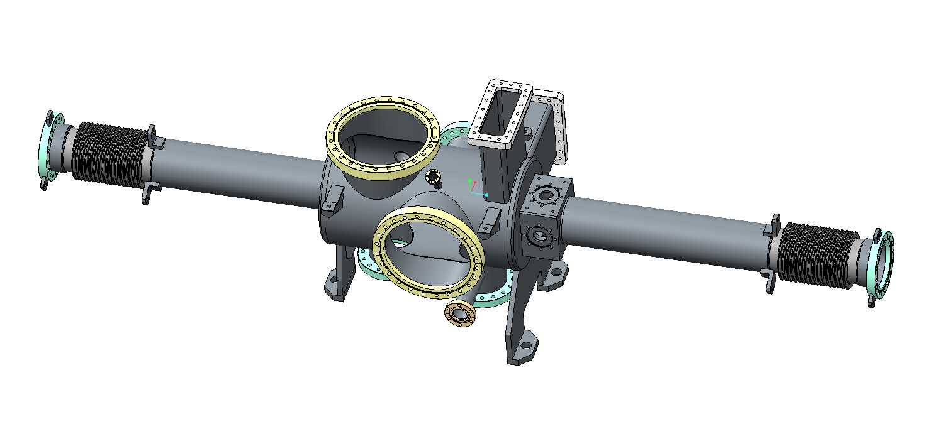
Material Selection
Tube & main chamber body; 316L
Tube to be seamless.
Tubes 3.2mm thickness, Magnetic permeability to be less than 1.005
Bellows TBC
Either 316L or 321
Flanges 316LN

Slide 18
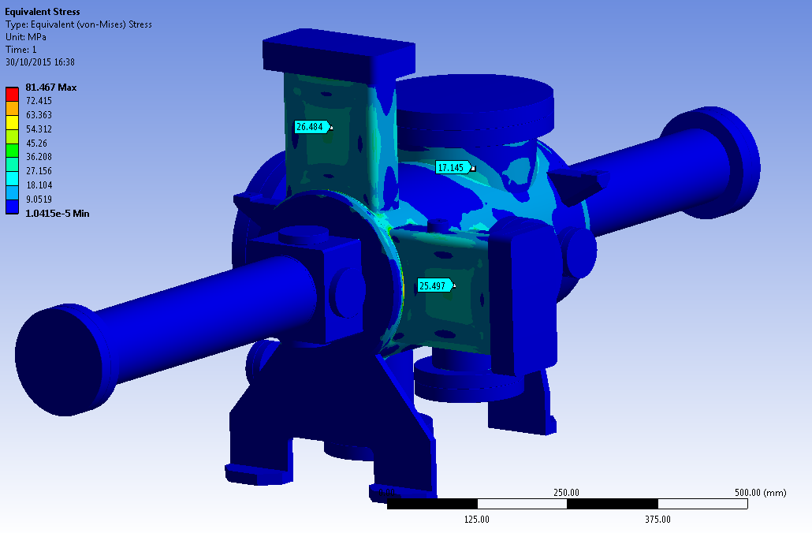
Chamber Stress
Current design does not exceed 80MPa.
Therefore if required the wall thickness on the tubes potentially could be reduced

Slide 19
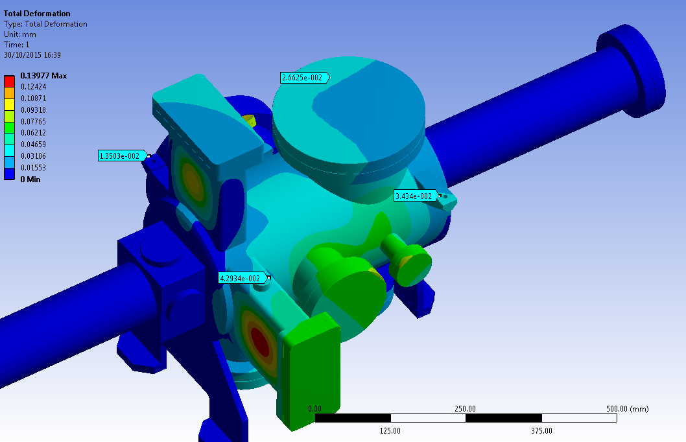
Chamber Deflection
Maximum chamber deflection is 0.14mm on box flanges.
Maximum of 50µm on fiducials – fiducial position to be re-assed

Slide 20
Add New Schematic Here

Slide 21
BPM
BPM design
Current estimates based upon;
Button BPMs
Welded into the chamber
Prototype must have flanged design
Both types will fit in the space envelope
(now that there is one BPM per LWU)

Slide 22
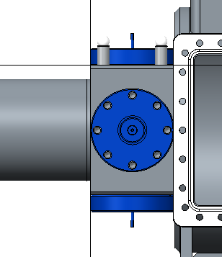
BPM
Welded BPM | Flanged BPM
Pros: | Pros:
High reliability of the welded (STFC) | Flanged BPMs easier to clean/PC
Welded BPMs do not create additional leak point | Flanges easier to replace in-situ
Higher installation accuracy
Cons: | Cons:
Welded BPMs more difficult to particle count | Create many possible leak points
Can not be swapped out | Processing is more time consuming

Slide 23
BPM
Prototype design uses DN 25
To match existing BPM Pickups
DESY Proposed block to use DN 50
STFC Proposed block to use DN40
European standard
Needs discussion with DESY but may give smaller block.
Space available for stripline units is 175mm to still allow magnet / Chamber adjustment
This needs to includes space for mounting & feedthroughs
Notes:
(210 with zero adjustment)

Slide 24
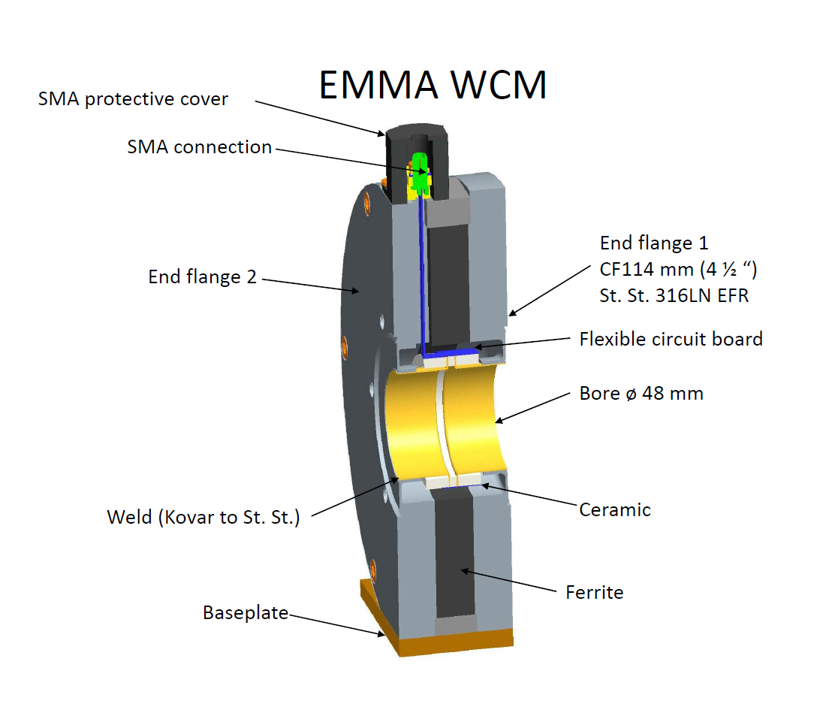
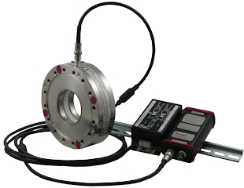
BCM Design
4 x BCMs. Flanged solutions are preferable.
Preferred Solution
Similar EMMA Design

Slide 25
Design
Current design uses Knife Edge flanges.
Are ESS bound to this?
Can we look at other options?
Prototype to use knife Edge
Bellows Design…

Slide 26
Bellows

Slide 27
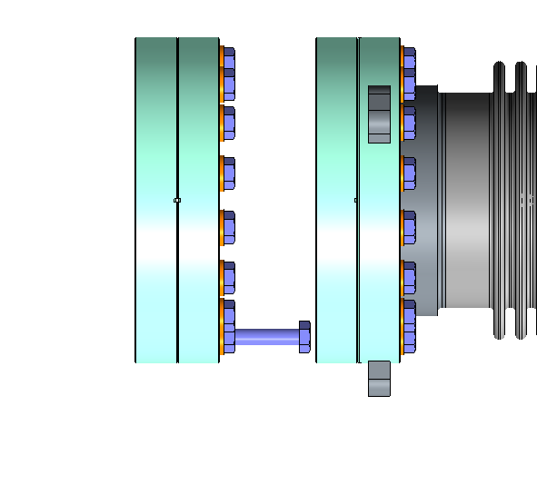
Bellows Travel Requirements
Tapped Blanking Flange
Gate valve
VAT 48
LWU Side
35mm M8
Bellows Travel Required 85mm

Slide 28
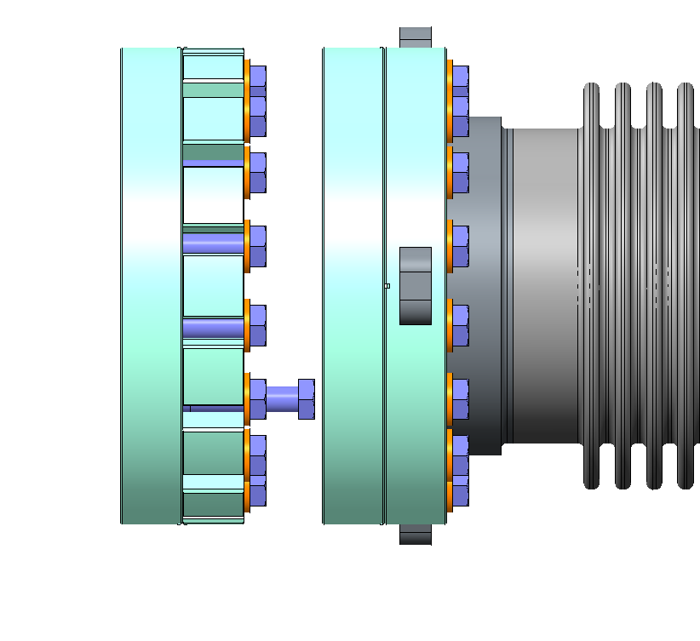
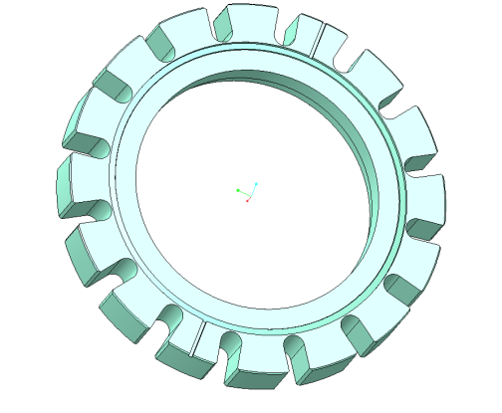
Bellows Travel Requirements
Bolt Extraction Direction
Gate valve
VAT 48
Slotted CF Flange
Tapped CF Flange
Bellows Travel Required 65mm

Slide 29
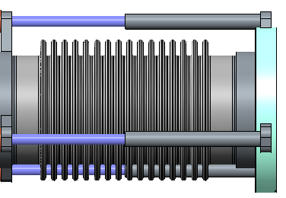
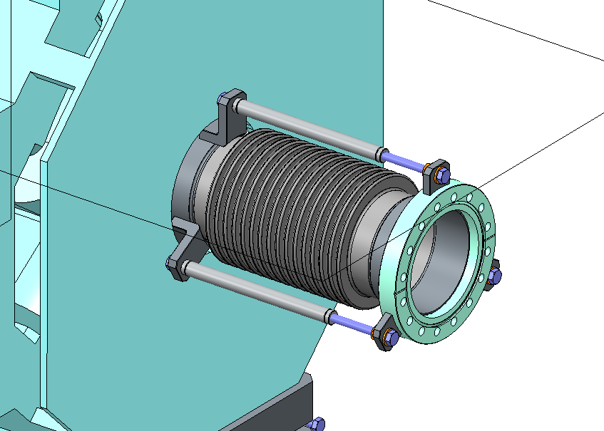
Bellows constraints
Can be ‘bagged’ during installation
Currently in discussions with DESY to investigate possible use of KEK film on mobile cleanrooms.

Slide 30
Bellows Design
Still in discussions with suppliers
Specifications maybe difficult to achieve
Slotted flanges would reduce the travel required by the bellows
Could non-standard width flanges be used?
Can the internal bellows ID be reduced?
To say 85mm?
What could the minimum be?
Are rotatable flanges required.
Do they need mechanical fixings?
How to prevent particle generation?

Slide 31
Bellows Design
Any other methods to reduce bellows travel
Capped LWUs rather than flanged.
Capped gate valves?

Slide 32
Survey and Alignment

Slide 33
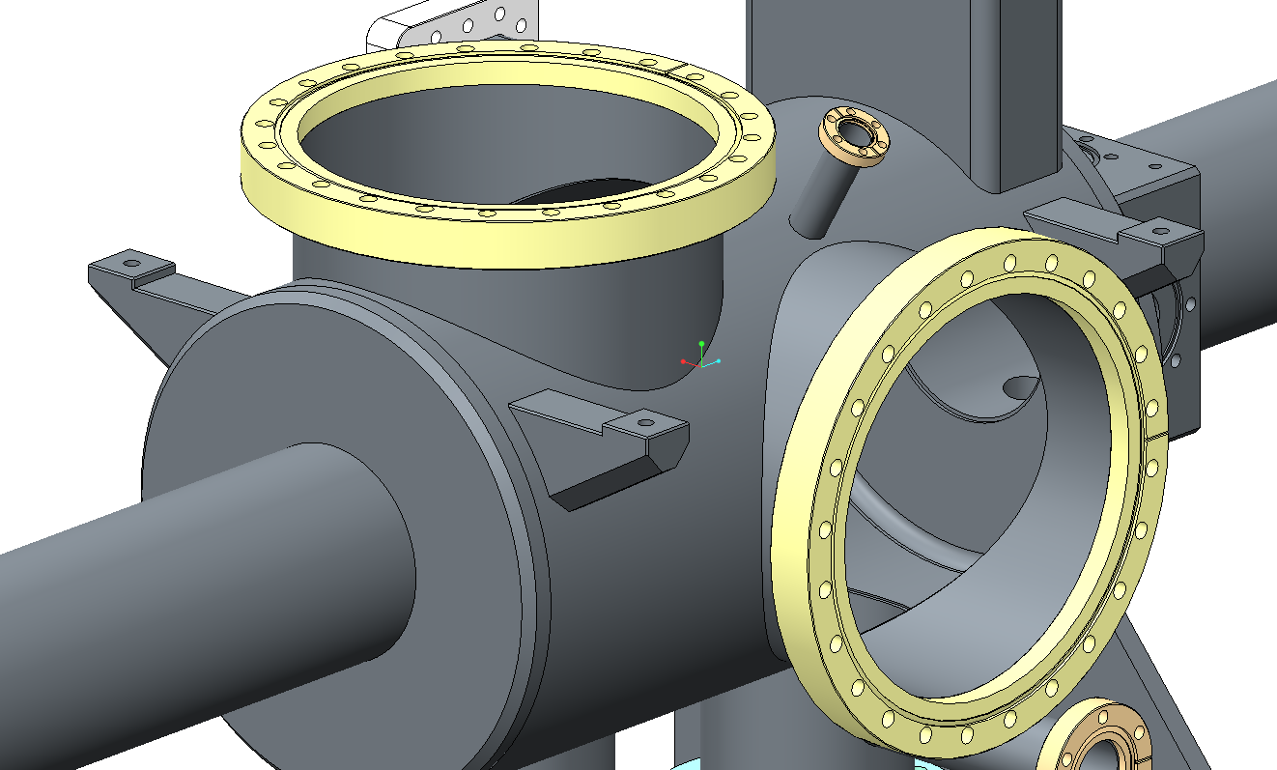
Survey & Alignment
4 x 6H7 Fiducial Mounts,
Will be machine post chamber assembly to ensure accuracy

Slide 34
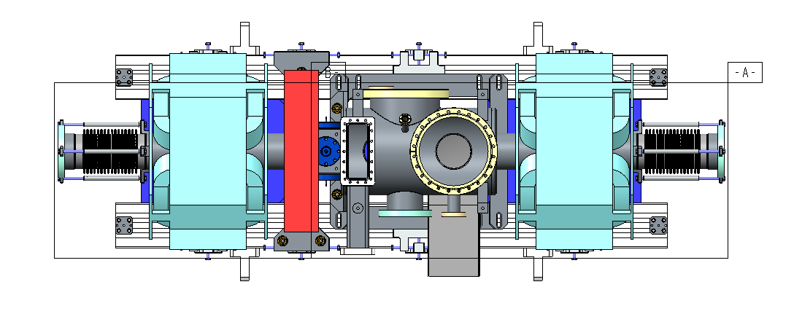
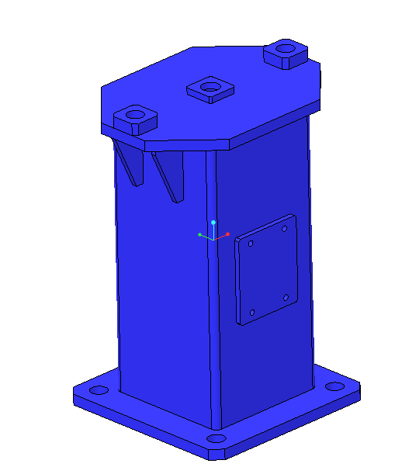
Survey & Alignment
4 x 6H7 Fiducial Mounting points at each corner of the girder.
4 x 6H7 Fiducial mounting points at each corner of the pedestal.

Slide 35
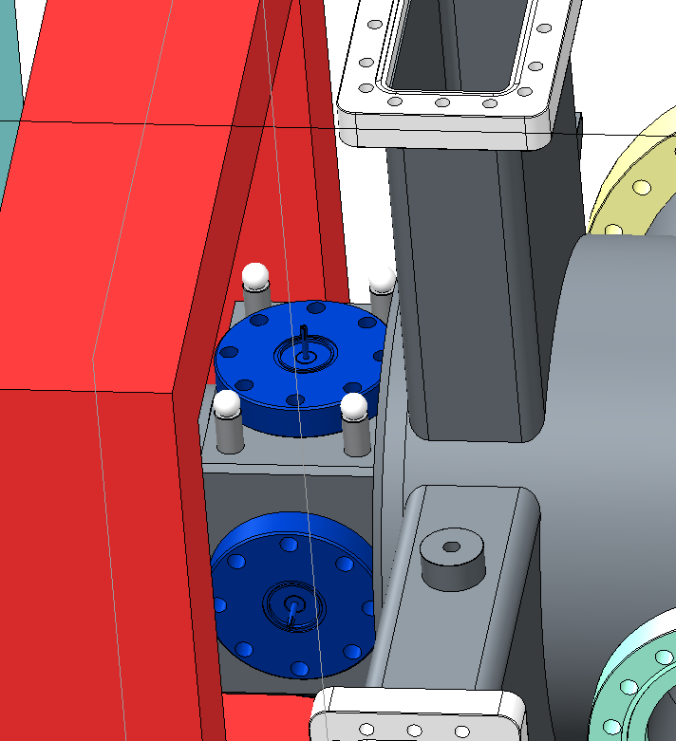
Survey & Alignment
BPM Survey fiducials for reference to local girder network

Slide 36
Prototype

Slide 37
Prototype
Prototype to be one welded assembly
Three other dummy chambers to be three flanged units in different configurations, to improve particulate control

Slide 38
Prototype
Reduce production series risk
Determine particle control procedure to be agreed
Producing three dummy chamber will allow for variation in design to be tested to determine best design to achieve
Low particulate requirement
Most efficient Particle control procedures
Most fit for purpose design

Slide 39
Schematic LWU Layouts

Slide 40
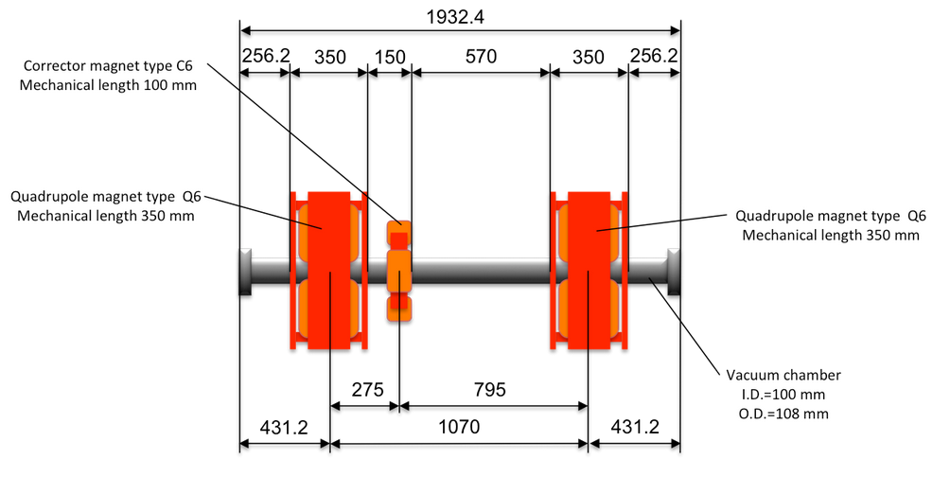
Elliptical Requirements

Slide 41
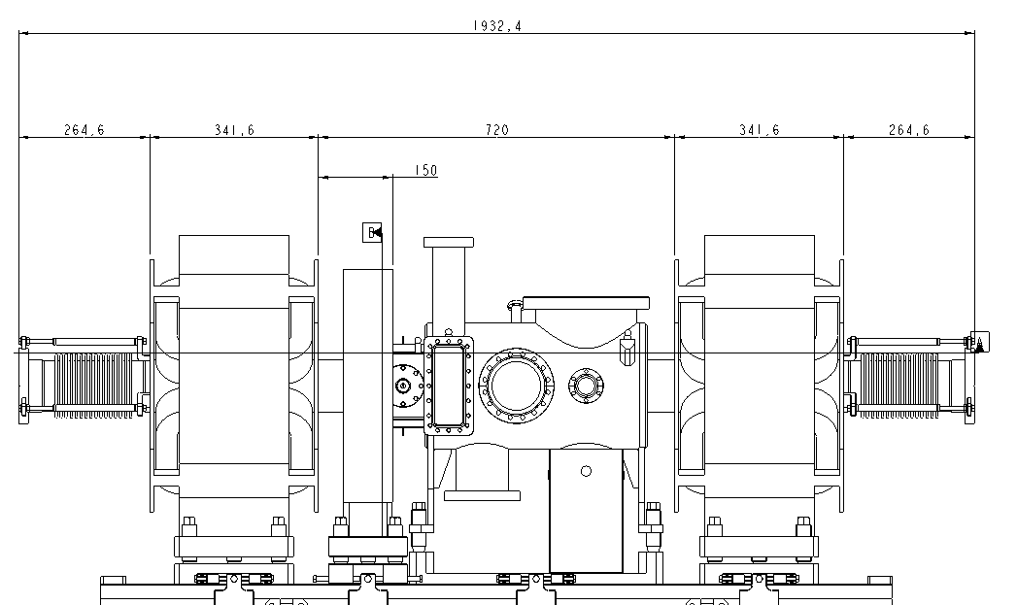
Elliptical Design
1932.4mm
256.2mm
350mm
720mm
350mm
256.2mm
150mm

Slide 42
Elliptical

Slide 43
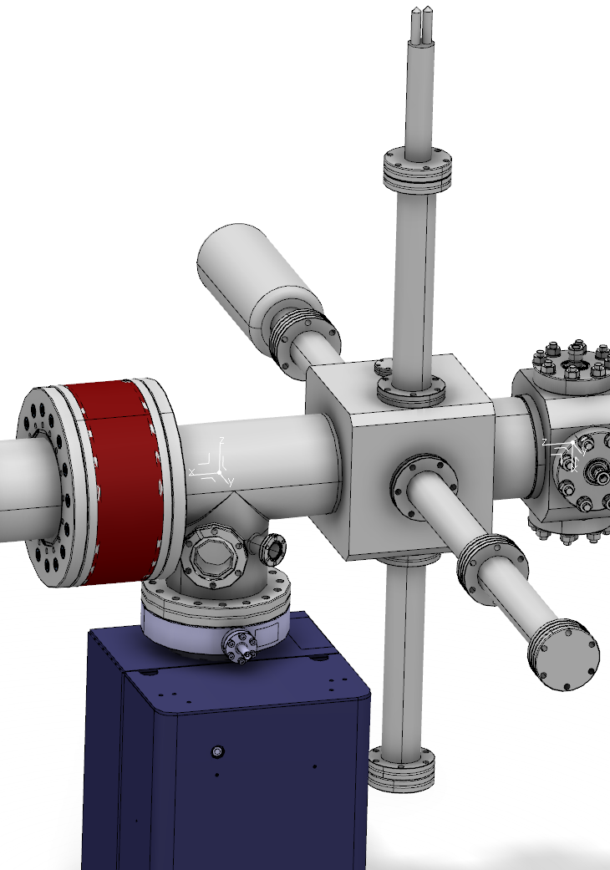
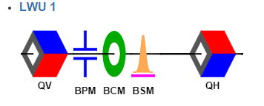
Elliptical
5 Types to cover the 7 variations
Chamber Type 1

Slide 44
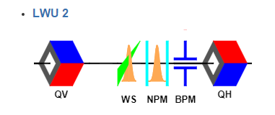
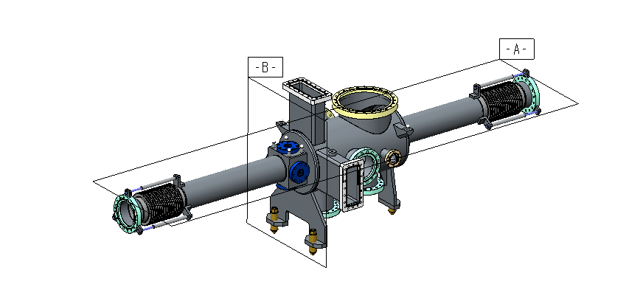
Elliptical
Chamber Type 2 Covers:
Notes:
Non-invasive Profile Monitor – such as ionization profile monitor

Slide 45
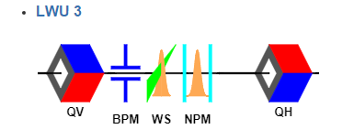
Elliptical
Chamber Type 3 Covers:
Same basic Chamber design but with BPM at rear
Could be the same chamber if is made of three parts

Slide 46
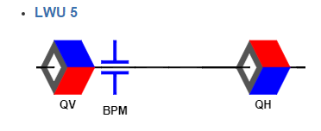
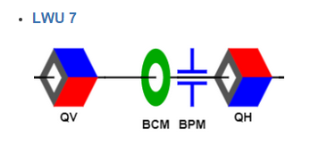
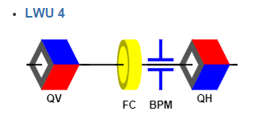
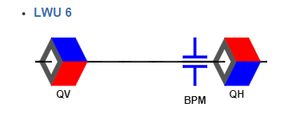
Elliptical
Chamber Type 4
Chamber Type 5

Slide 47
Spoke LWUs

Slide 48
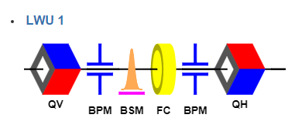
Spoke Chambers
3 Types to cover the 8 variations
Chamber Type 1
FC Flange unknown

Slide 49
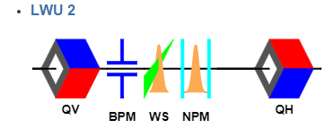
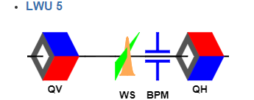
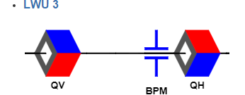
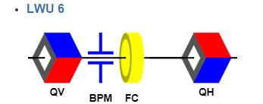
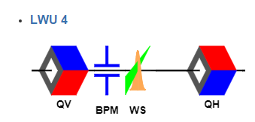
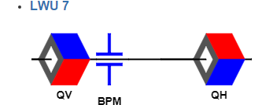
Spoke
Chamber Type 2
?

Slide 50
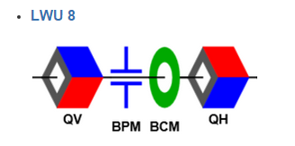
Spoke
Chamber Type 3

Slide 51
LEDP
Elliptical Chamber Type 2

Slide 52
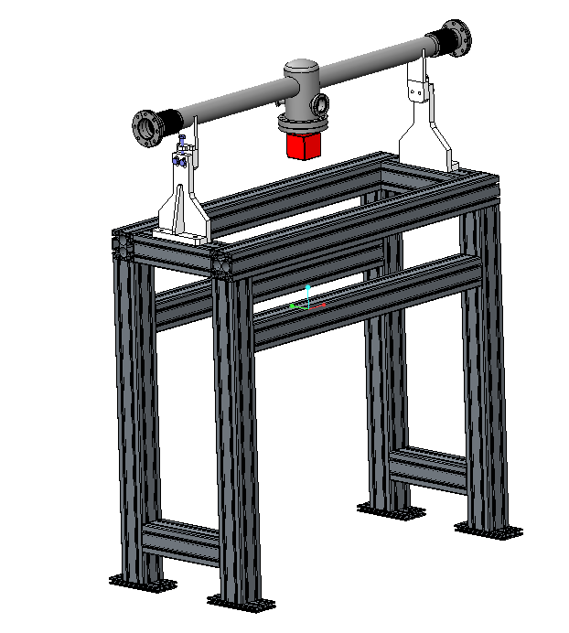
Beam Pipe units
No Survey or alignment requirements
Fiducials will be included.
No fine adjustment
Basic no adjustable framework
Central Pumping section with spare ports

Slide 53
Girder Design

Slide 54
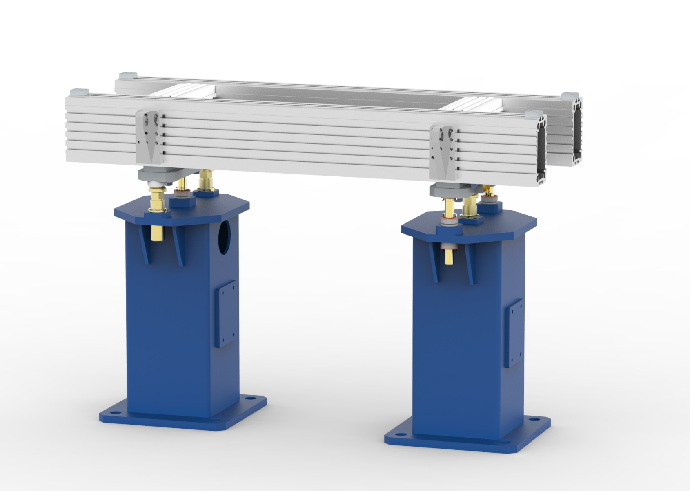
LWU Girder

Slide 55
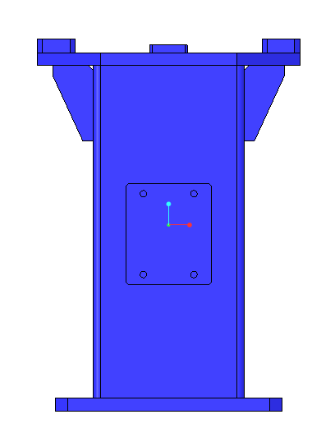
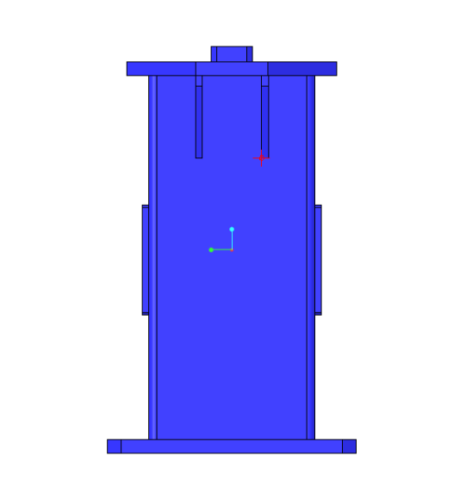
Pedestals
Steel Box Section- hollow to allow for damping sand if needed
Mount for central support and wheels
No Grout. Kinematic can cope with floor unevenness Holes on floor etc…
710mm
450 mm
450 mm

Slide 56
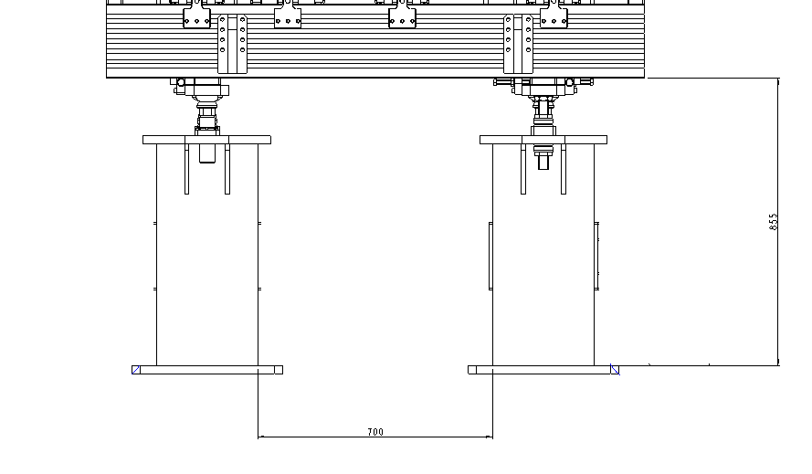
Ingress / Egress
850mm
700mm

Slide 57
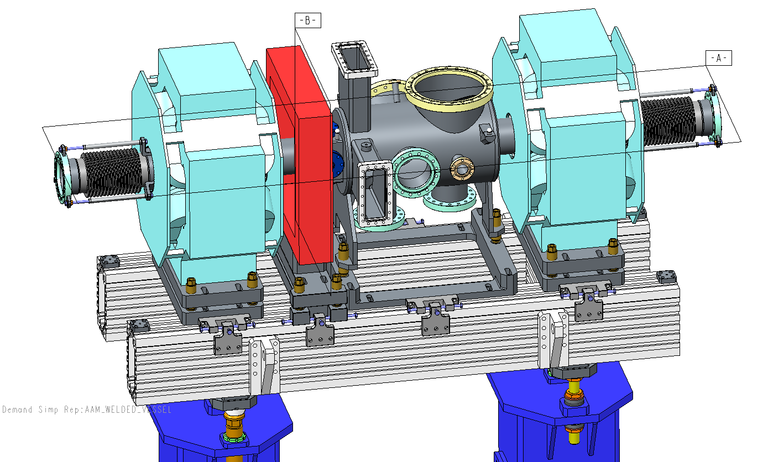
Adjustment
Individual item adjustment on three point kinematic mounts

Slide 58
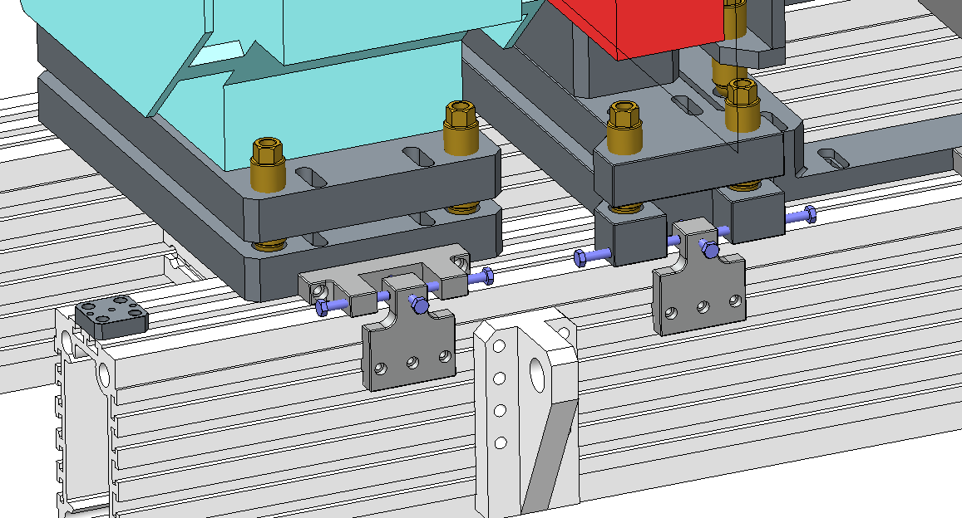
Adjustment
=/ 15mm – check later

Slide 59
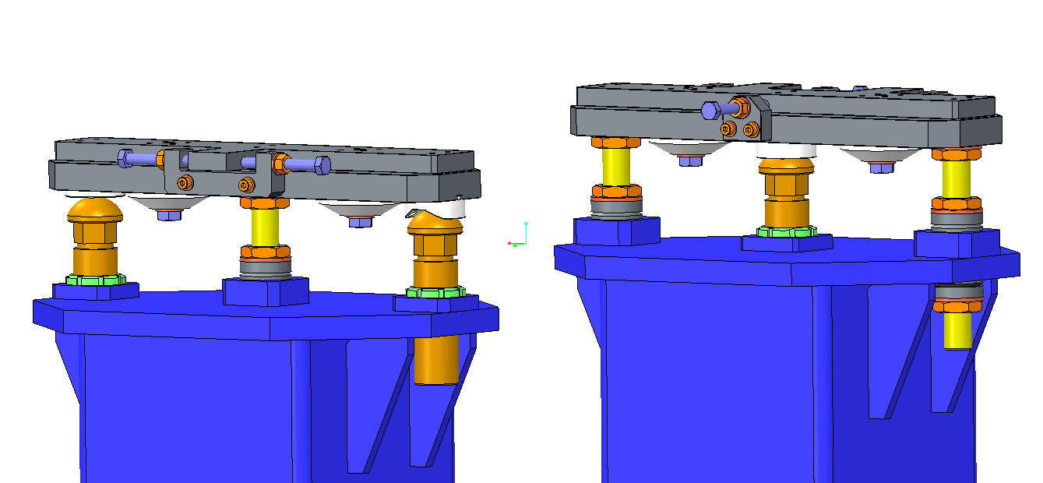
Vertical Adjustment
Vertical Adjustment on Semi-Kinematic mounts ± 50mm

Slide 60
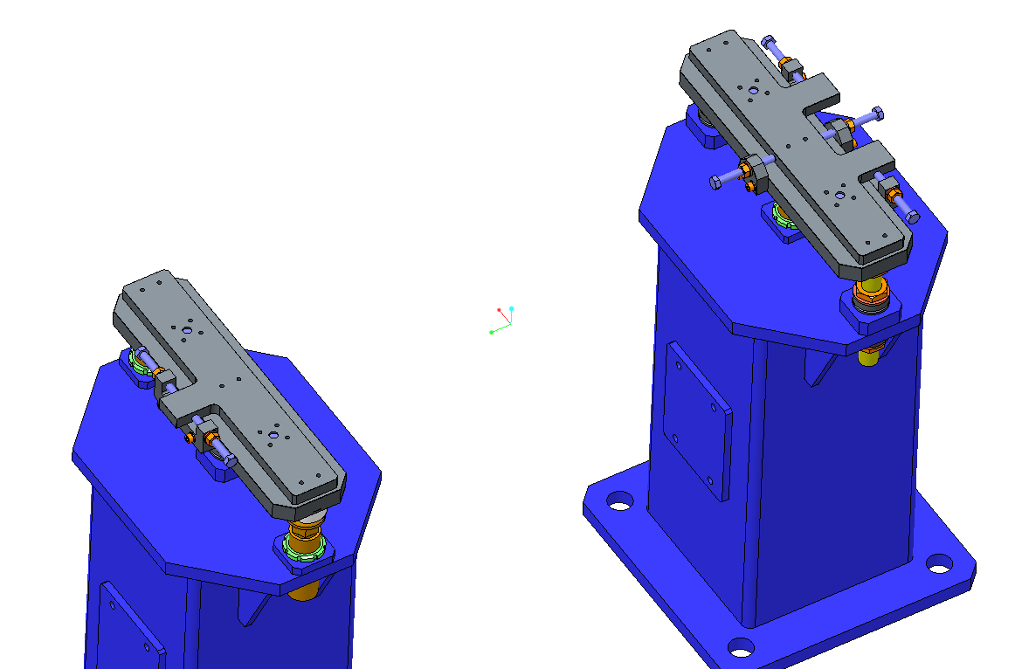
Adjustment
Slider Plate, Girder directly mounted to these steel plates

Slide 61
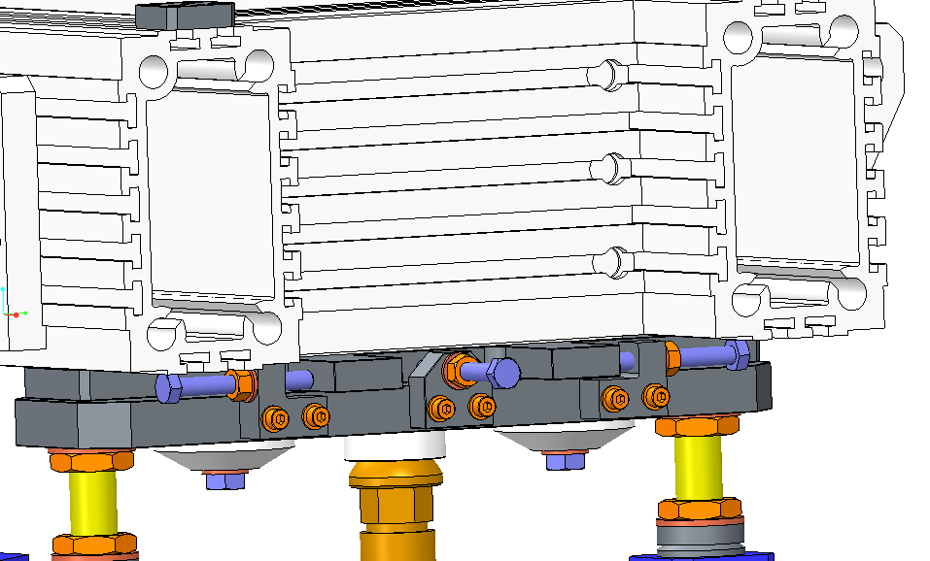
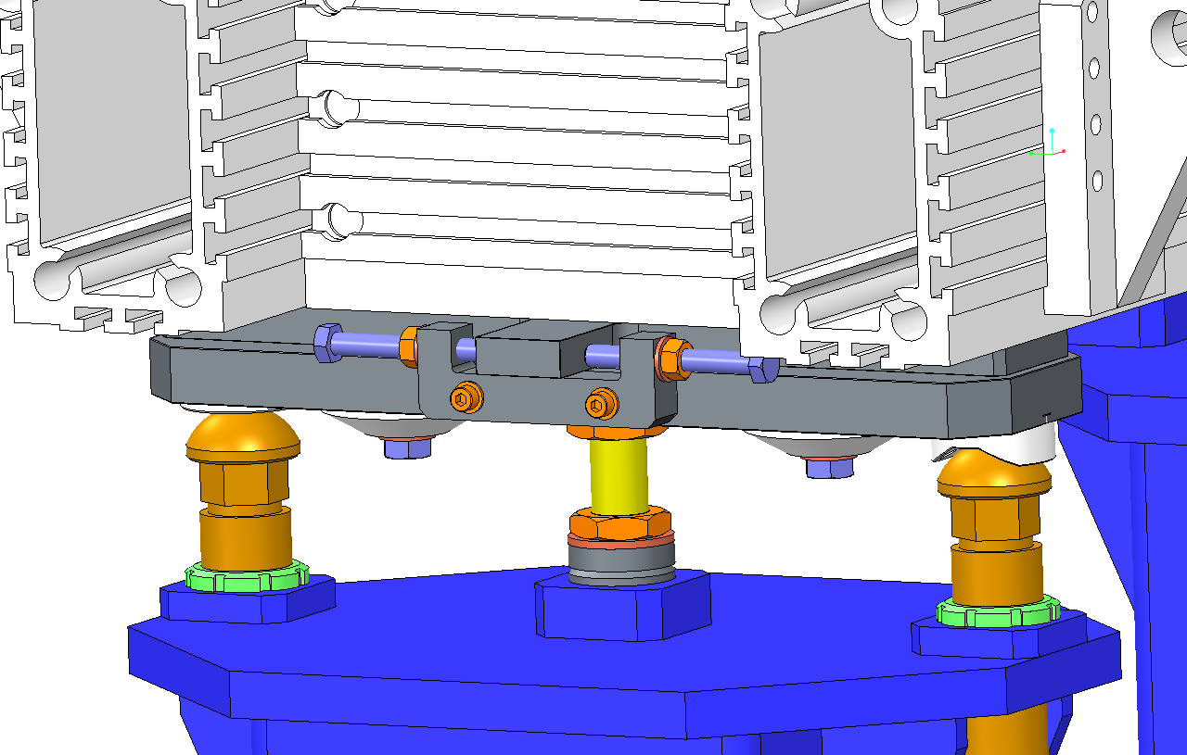
Y & Z Adjustment
Adjusting Screws

Slide 62
Semi Kinematic Adjustment
Lifting Points
Y,Z Plate
Girder
Cone Adjusting Screw
Horizontal Movement Clamps
Vee Adjusting Screw
Flat Adjusting Screw
Notes:
At the request of ESS Survey and alignment group horizontal girder adjustment is above vertical adjustment

Slide 63
Semi Kinematic Mounts
Flat
Cone
M30 Tie Downs
‘V’

Slide 64
Adjustment
Slotted Girder allows for ‘unlimited’ ‘coarse’ on z Adjustment.
Mounting adjustment allows for ±15mm fine adjustment
Kinematic mounts allow for vertical adjustment ±25mm on a fine M24 nut.
Plus girder adjustment
At the request of ESS Survey and alignment group horizontal girder adjustment is above vertical adjustment

Slide 65
Installation support/wheels

Slide 66
Installation Supports
Lifting Points for Girder, Adjusted for CoG
Removable wheels
Fixes pedestals together to easy removal and replacement of girder whilst pedestals are not fixed to the floor

Slide 67
ELI-NP Lifting Frame

Slide 68
Shipment

Slide 69
Delivery
From Scope Document:
All beam transport modules will be shipped DDP (Delivered, Duty Paid) from Daresbury Laboratory. STFC is responsible for loading the all the Beam Transport Modules onto a vehicle, for all export procedures and for onward transport to ESS. ESS will accept responsibility for BTMs after a visual inspection and pressure check, i.e. that the pressure still reads 1100mbar.

Slide 70
Transport Method Option
Airide trailer for low road vibration transmission
Springs between girder and box base for shock loads
Quantity will depend on girder length & weight
1
Plywood lid
2
Open plywood box with corner supports
Spring dampers
3
Module
Lifting Points required on 3.
Plywood bottom with timber base for reinforcement
Anti-Vibration Springs
between module and box base

Slide 71
Crates
Crates will be capable of being stacked two units high.
All crates will have tilt & shock watch detectors mounted on the sides.

Slide 72
Production Management
All Beam Transport Modules will have serial numbers
All Items in the module will be similarly numbered
All Modules will have Quality Control documents which will follow the module through the build process
All BPMs should have serial numbers etched into them, the BPMs used on each module will be reordered in the modules Quality Control Log
Each Module will ship with it’s unique quality control log

Slide 73
Outstanding Design Items
Bellows – availability / compromise
Rectangular flange design
BPM Decisions
BPM Style – full detailed design required by March 16
Flanged vs Welded
Flange Size
BPM Delivery Schedule
Stripline everywhere?
H&V Corrector Design
Q5 Magnet Design
Dipole Magnet Design
Particulate Process agreement

Slide 74
Other Options
Delivery without magnets?
Staff welcome to come to STFC to spend time building LWUs
Notes:
BI to be installed in the tunnel.
Cleanroom times & delivery times.

Slide 75
Thank You
ESS PDR, Paul Aden, 10-11-15

