Slide 1
Molecular Flow
Mean Free Path $≫$ Vessel Dimensions
Mean free path = distance between particle-particle collisions
Vessel dimension = distance between particle-wall collisions
Typicall accelerator dimensions:
Molecular flow regime occurs at pressures less than $\sim {10}^{−3} Torr$
In molecular flow, geometry plays a critical role
Viscous flow: particles are “carried by the flow”
$⇒$ geometry of the vessel unimportant
Molecular flow: particles move independently, interact with walls only
$⇒$ geometry of the vessel important

Slide 2
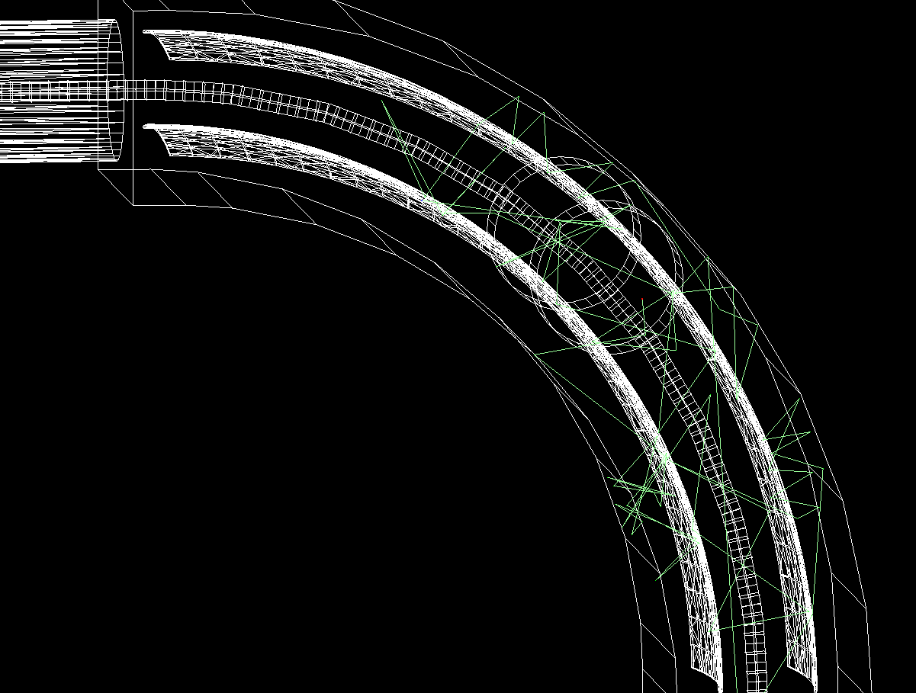
Molecular Flow Simulations
Particles bounce off walls
Random direction
No memory of momentum before the interaction
Outgoing probability distribution governed by Lambert’s Cosine Law
Pressure obtained from particle hit counts over a given surface
Particles bouncing off the dipole electrodes and chamber walls in the vertical drop dipole in FRIB Front End

Slide 3
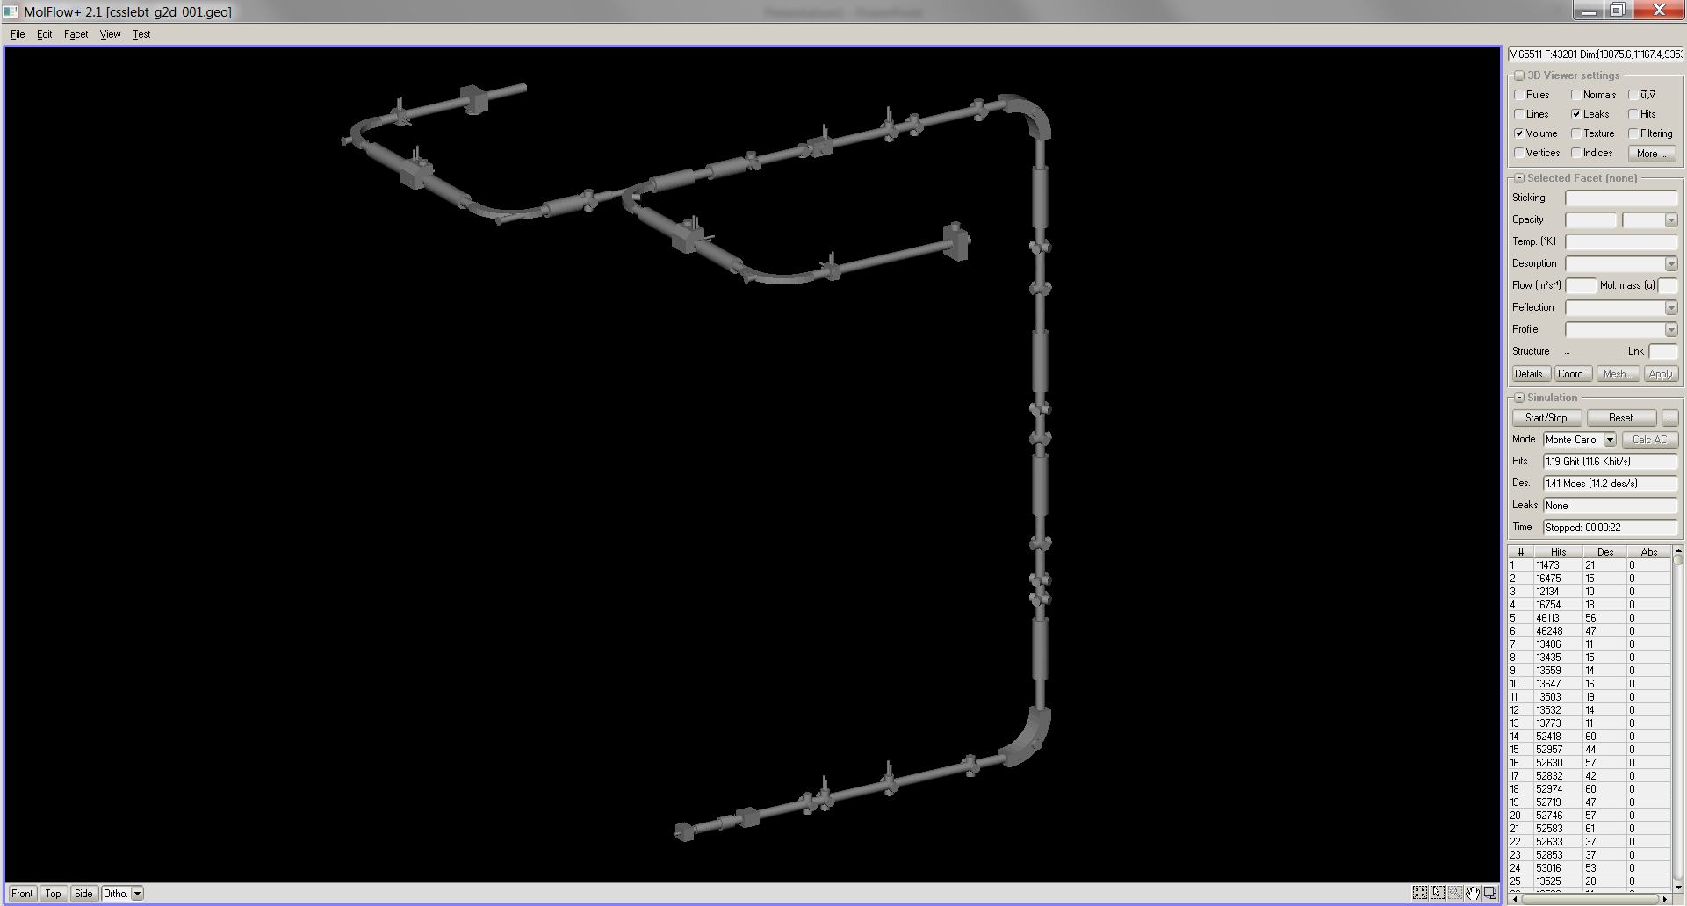
MolFlow+
Windows application written in C++
Developped and maintained by Roberto Kersevan (CERN)
http://test-molflow.web.cern.ch/
Provides stationary-state pressure profiles
Molflow+ interface with a model of the FRIB Front End (from the two ECR sources to the RFQ entrance down in the tunnel)

Slide 4
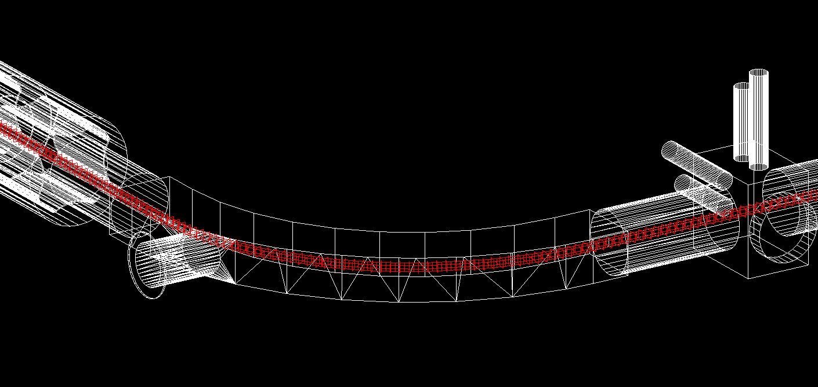
Setting up a model in MolFlow+
Geometry
Vacuum chamber CAD model exported to STL; ensuring it is a leak-tight enclosed volume
Test-facets
Create area over which pressure is measured (i.e. particle hits are counted)
Outgassing
Thermal outgassing coefficient
Any additional sources, e.g. diffusion from ECR source, support gas ions dumped on the analyzing magnet
Pumps
Pumping speeds for the gas considered
Each gas considered separately, simulations for different gases superposed to yield final result
In each model:
The final pressure profile scales linearly with the outgassing coefficient
A single simulation provides pressure profile for various outgassing results
Dependence on pumping speeds is more complex (geometry-dependent)
Each pumping scheme requires a new simulation run
Analyzing magnet in the model of the FRIB Front End with highlighted test-facets along the beam axis

Slide 5
FRIB Front End Simulations in MolFlow+
Simulations were used to validate vacuum system design against requirements
Two beam scenarios considered:
Uranium beam with oxygen support gas (nominal beam)
Argon beam with oxygen support gas (shown here)
Pressure requirements
Average pressure over FE sections:
Extraction Region: 1E-7 Torr
Charge Selection Section: 3E-8 Torr
Low Energy Beam Transport: 5E-9 Torr
Requirements established based on the uranium beam scenario
Based on beam transmission requirement of $≥90\%$ transmission
Argon needed to be examined when NEG pumps were introduced
NEGs do not pump noble gases

Slide 6
Scenario: Argon Beam with Oxygen Support
Outgassing sources:
Uniform thermal outgassing from vacuum chamber walls
Diffusion from ECR source (upstream end of model):
Argon atoms
Oxygen molecules
Diffusion from analyzing magnet
Argon atoms (dumped charges)
Oxygen molecules (recombined from oxygen ions in the beam)
Diffusion from RFQ (downstream end of model)
Simulating an open boundary condition to a higher pressure region

Slide 7
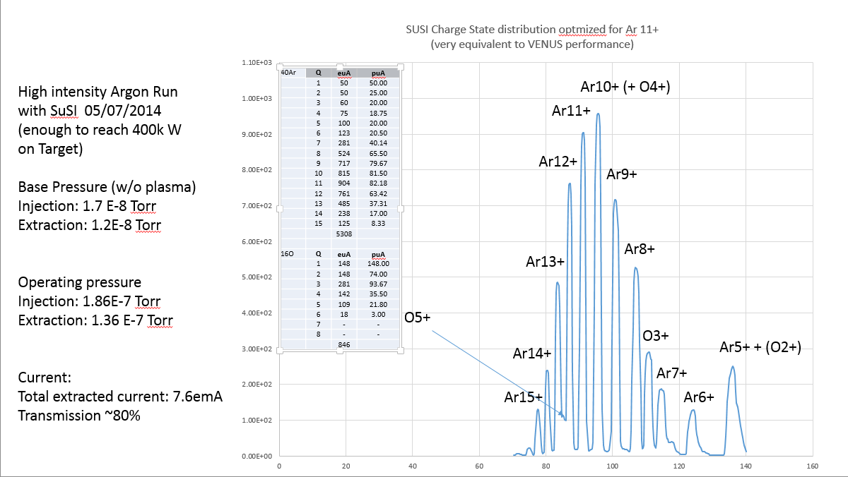
Argon & Oxygen Parameters Given by Measurements from the SuSI Source

Slide 8
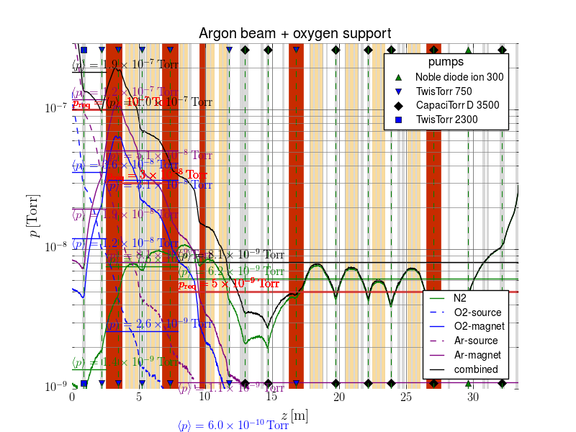
Scenario: Argon Beam with Oxygen Support
SuSI data, case with 3 transported charges (Ar10+, Ar11+, Ar12+)
Thermal outgassing: N2 only
Average pressure:
 | ER [Torr] | CSS [Torr] | LEBT [Torr]
Req. | 1E-7 | 3E-8 | 5E-9
N2 | 1.4E-9 | 7.6E-9 | 6.2E-9
O2 (ECR) | 3.6E-8 | 2.6E-9 | <5E-10
O2 (magnet) | 1.2E-8 | 3.1E-8 | 6.0E-10
Ar (ECR) | 1.2E-7 | 8.1E-9 | <5E-10
Ar (magnet) | 1.9E-8 | 5.1E-8 | 1.1E-9
Total | 1.9E-7 | 1.0E-7 | 8.1E-9

Slide 9
Scenario: Uranium Beam with Oxygen Support
Same model as for Argon case, except:
No argon, only oxygen
Oxygen pressure/concentration obtained from an alternative source (measurement with a uranium beam)

Slide 10
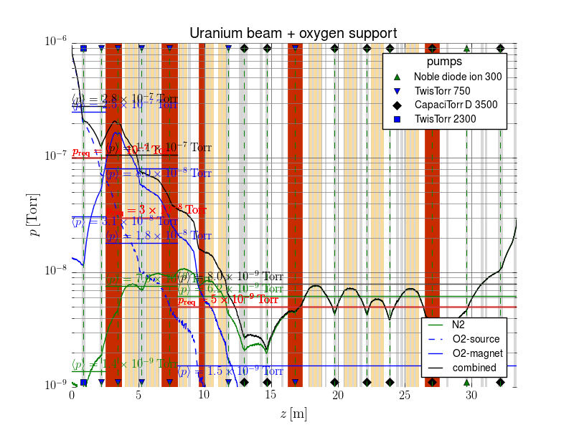
Scenario: Uranium Beam with Oxygen Support
Updates since last model:
Pumping scheme
Magnet temperature = 310 K (was 350 K)
Transmission calculation update: Kimura formula used
Average pressure:
 | ER [Torr] | CSS [Torr] | LEBT [Torr]
Req. | 1E-7 | 3E-8 | 5E-9
N2 | 1.4E-9 | 7.6E-9 | 6.2E-9
O2 (ECR) | 2.5E-7 | 1.8E-8 | <5E-10
O2 (magnet) | 3.1E-8 | 8.0E-8 | 1.5E-9
Total | 2.8E-7 | 1.1E-7 | 8.0E-9

Slide 11
Vacuum Calculation Results
Pressure levels obtained from simulations are higher than required levels in some sections, however…
Consideration of beam transmission has shown that beam losses with simulation results are still acceptable
Upgrade paths (additional pumping ports) were added in critical areas

