Slide 1
High Brilliance Beam Diagnostic
A. Cianchi
University of Rome “Tor Vergata”
and INFN

Slide 2
Outline
Brightness and Brilliance
Fundamental parameters
Transverse and longitudinal measurements
Intercepting and non intercepting diagnostic

Slide 3
Brightness and Brilliance
Several authors give different definitions
Brilliance is sometimes used, especially in Europe, instead of brightness
There is also confusion because the same words apply both to particle beams and photon beams
The best way is to look to units, which should be unambiguous

Slide 4
Some references
C. Lejeune and J. Aubert, “Emittance and Brightness, definitions and measurements”, Adv. Electron. Electron Phys.,Suppl. A 13, 159 (1980).
A. Wu Chao, M. Tigner “Handbook of Accelerator Physics and Engineering” World Scientific, pag 255
C. A. Brau “What Brightness means” in The Physics and Applications of High Brightness Electron Beam”, World Scientific, pag 20
M. Reiser, “Theory and design of charged particle beams”, Wiley-VCH, pag 61
Shyh-Yuan Lee, “Accelerator Physics”, World Scientific, pag 419
J. Clarke “The Science and Technology of Undulators and Wiggles” Oxford Science Publications, pag 73

Slide 5
Definitions of Brightness
For many practical application it is more meaningful to know the total beam current that can be in a 4 dimensional trace space V₄.
For particle distribution whose boundary in 4D trace space is defined by an hyperellipsoid
[A/(m-rad)²]
Normalized Brightness

Slide 6
But
Often the factor 2/π² is left out in literature
Often the RMS emittance is used in place of effective emittance and so there is another factor to take into the account
So it is important to agree on the brightness definition, but the difference can be also in numerical factors

Slide 7
Brilliance
Photons/ (s mm² mrad² 0.1% of bandwidth)
H. Wiedeman uses the name “spectral brightness” for photons
Report of the Working Group on Synchrotron Radiation Nomenclature – brightness, spectral brightness or brilliance?
The conclusion reached is that the term spectral brightness best describes this quantity. Brightness maintains the generally accepted concept of intensity per unit source size and divergence, while the adjective spectral conveys the scientific importance of the number of photons in a given bandwidth, particularly for experiments such as inelastic and/or nuclear resonant scattering.
J. Synchrotron Rad. (2005). 12, 385

Slide 8
Parameters to measure
High brightness can be achieved with small emittance, high current or both
Longitudinal and transverse parameters must be measured
High charge and small emittance -> high power density beam
Low charge, very short bunch length
We focus our attention on linac or transfer line where it is possible to use intercepting diagnostic
For some applications, it is needed to measure also the transverse parameters in different longitudinal positions (correlation)

Slide 9
Transverse parameters
The most important parameter is the transverse emittance
To obtain high brightness beam it is of paramount importance to keep emittance growth under control
Different methods apply for beams with or without space charge contribution
Mainly the space charge is relevant at the exit of the RF GUN (few MeV)

Slide 10
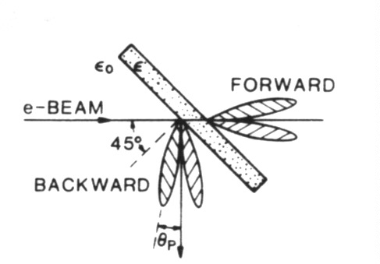

Intercepting devices
OTR monitors
  High energy (>tens of MeV), high charge (>hundreds of pC)
  No saturation
  Resolution limit closed to optical diffraction limit
  Surface effect
Scintillator (like YAG:CE)
  Large number of photons
  Resolution limited to grain dimension (down to few microns)
  Saturation depending of the doping level
  Bulk effect
  Thin crystal to prevent blurring effect
Wire scanner
  Multiple scattering reduced
  Higher beam power
  Multishot measurement
  1 D
  Complex hardware installation

Slide 11
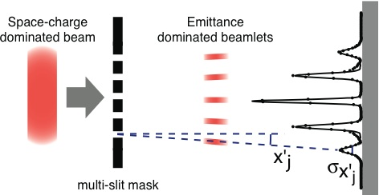
Emittance measurements with space charge
To measure the emittance for a space charge dominated beam the used technique is known 1-D pepper-pot
The emittance can be reconstructed from the second momentum of the distribution
C. Lejeune and J. Aubert, Adv. Electron. Electron Phys. Suppl. A 13, 159 (1980)

Slide 12
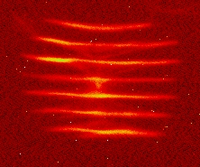
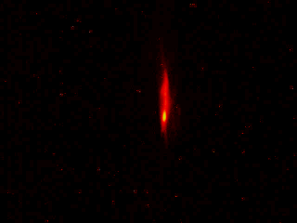
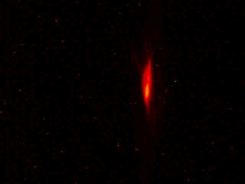
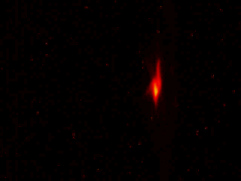
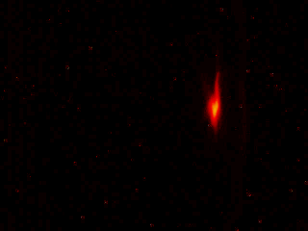
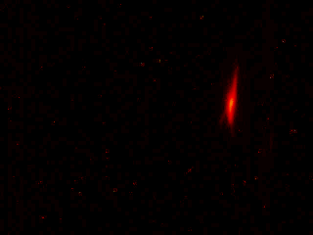
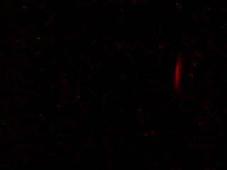
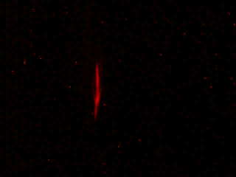
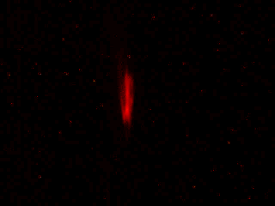
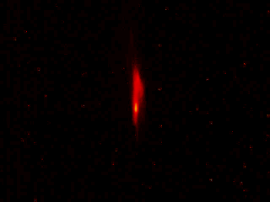
Examples

Slide 13
Design issues
The beamlets must be emittance dominated
Martin Reiser, Theory and Design of Charged Particle
Beams (Wiley, New York, 1994)
Assuming a round beam
d must be chosen to obtain R₀<<1, in order to have a emittance dominated beam

Slide 14
Design issues (2)
The contribution of the slit width to the size of the beamlet profile should be negligible
The material thickness (usually tungsten) must be long enough to stop or heavily scatter beam at large angle
But the angular acceptance of the slit cannot be smaller of the expected angular divergence of the beam

Slide 15
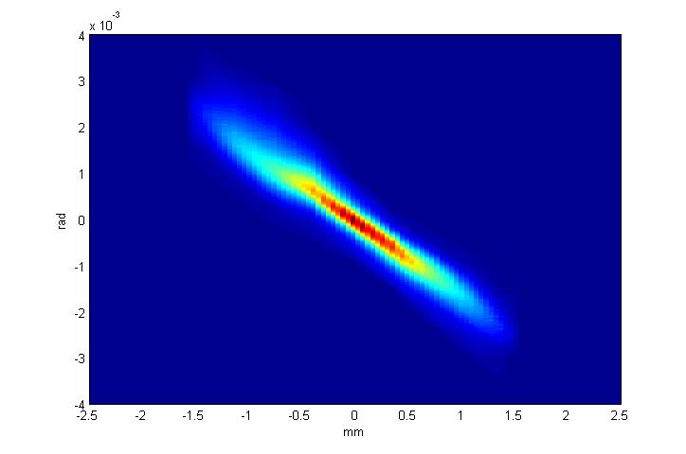
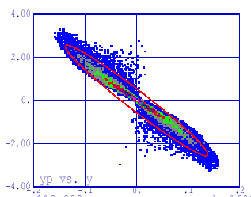
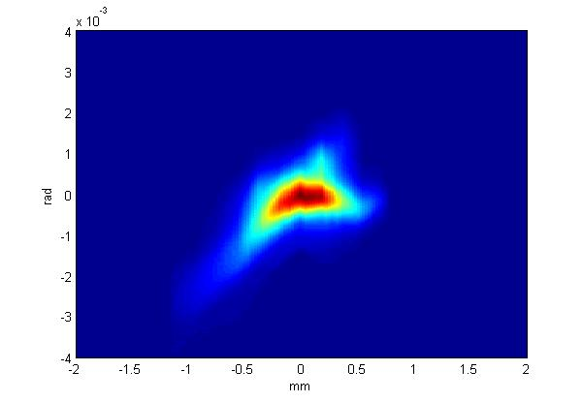
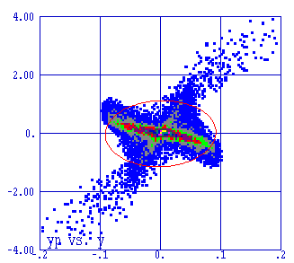
Phase space mapping

Slide 16
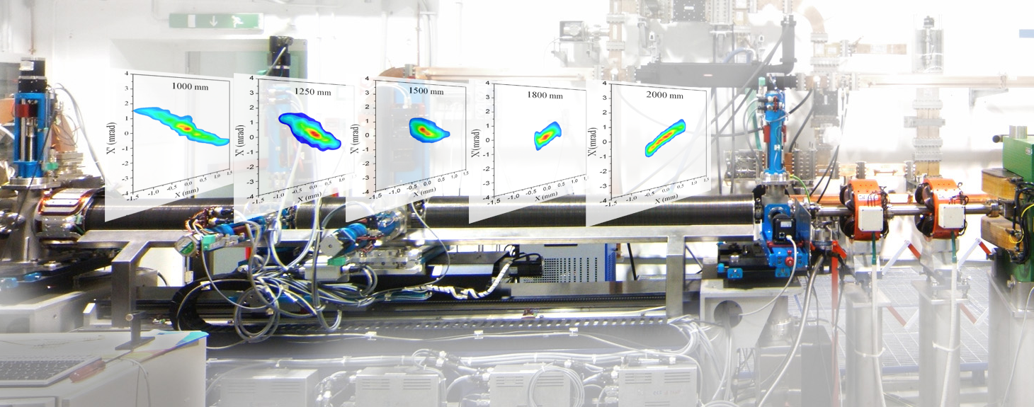
Phase space evolution
A. Cianchi et al., “High brightness electron beam emittance evolution measurements in an rf photoinjector”, Physical Review Special Topics Accelerator and Beams 11, 032801,2008

Slide 17
Emittance measurement without space charge
The most used techniques for emittance measurements are quadrupole scan and multiple monitors

Slide 18
Beam Matrix

Slide 19
Multiple screens
There are 3 unknown quantities
σ_{i,11} is the RMS beam size
C_{i} and S_{i} are the element of the transport matrix
We need 3 measurements in 3 different positions to evaluate the emittance

Slide 20
Example : FLASH @ DESY
M. Minty, F. Zimmermann, “Measurement and control of charged particle beams”, Springer (2003)
DESY-Technical Note 03-03 , 2003 (21 pages) Monte Carlo simulation of emittance measurements at TTF2 P. Castro

Slide 21
Quadrupole scan
k₁
P₁
P₂
k₂
Beam
k₃
Quadrupole
Schermo
It is possible to measure in the same position changing the optical functions
The main difference respect to the multi screen measurements is in the beam trajectory control and in the number of measurements

Slide 22
Source of errors
Usually the largest error is in the determination of the RMS beam size (Mini Workshop on "Characterization of High Brightness Beams“, Desy Zeuthen 2008, https://indico.desy.de/conferenceDisplay.py?confId=806)
Systematic error comes from the determination of the quadrupole strength, mainly for hysteresis. So a cycling procedure is required for accurate measurements
Thin lens model is not adequate
Energy
Large energy spread can gives chromatic effect
Assumption: transverse phase space distribution fills an ellipse

Slide 23
Phase space reconstruction
y
x
ρ
Tomography is related to the Radon theorem: a n-dimensional object can be reconstructed from a sufficient number of projection in (n-1) dimensional space

Slide 24






Tomography
Radon Transform
Fourier transform of the Radon transform
A. C. Kak and Malcolm Slaney, Principles of Computerized Tomographic Imaging, IEEE Press, 1988.
D. Stratakis et al, “Tomography as a diagnostic tool for phase space mapping of intense particle beam”, Physical Review Special Topics – Accelerator and Beams 9, 112801 (2006)

Slide 25


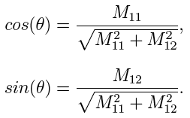

Tomography measurements
Scaling factor
Rotation angle
C can be easily obtained from beam spatial distribution
s can be calculated from the beam line optics
The accuracy of the result depends from the total angle of the rotation and from the number of the projections

Slide 26
Longitudinal parameters
Fundamental parameter for the brightness
Bunch lengths can be on ps (uncompressed) or sub-ps time scale!
Several methods
  Streak Camera
  Coherent radiations
  RFD
  EOS
  Others?
T. Watanabe et al, “Overall comparison of subpicosecond electron beam diagnostics by the polychromator, the interferometer and the femtosecond streak camera”, Nuclear Instruments and Methods in Physics Research A 480 (2002) 315–327

Slide 27
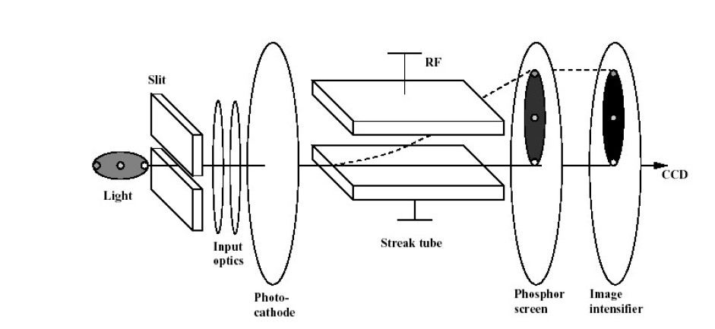
Streak camera
Expensive device
Resolution limited to 200-300 fs FWHM
It is better to place the device outside the beam tunnel so a light collection and transport line is needed
Reflective optics vs lens optics
Intercepting device

Slide 28
RF deflector
RFD OFF
The transverse voltage introduces a linear correlation between the longitudinal and the transverse coordinates of the bunch

Slide 29
RFD
P. Emma, J. Frisch, P. Krejcik ,” A Transverse RF Deflecting Structure for Bunch Length and Phase Space Diagnostics “ ,LCLS-TN-00-12, 2000
D. Alesini, “RF deflector based sub-ps beam diagnostics: application to FEL and Advanced accelerators”, International Journal of Modern Physics A, 22, 3693 (2007)

Slide 30
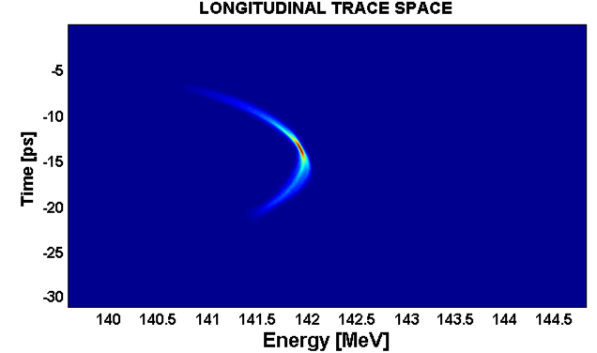
Longitudinal phase space
Using together a RFD with a dispersive element such as a dipole
Fast single shot measurement

Slide 31
Slice parameters
Slice parameters are important for linac driving FEL machines
Emittance can be defined for every slice and measured
Also the slice energy spread can be measured with a dipole and a RFD

Slide 32
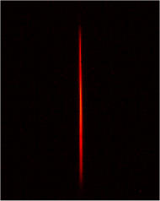
RFD summay
Self calibrating
Easy to implement
Single shot
Resolution down to tens of fs
Intercepting device
As energy increases some parameter must be increased:
  Frequency
  Voltage or length
7 ps FWHM

Slide 33
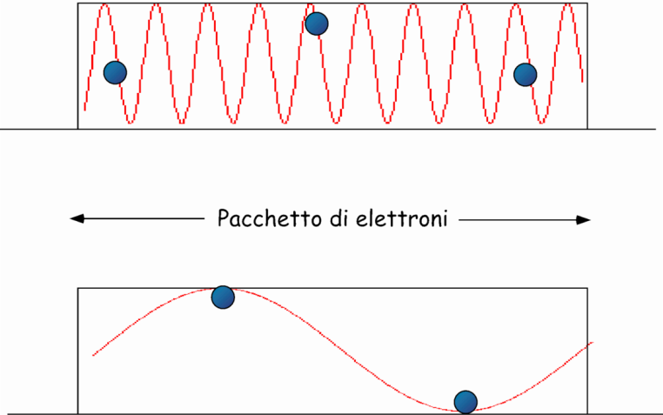
Coherent radiation
Any kind of radiation can be coherent and usable for beam diagnostics
  Transition radiation
  Diffraction radiation
  Synchrotron radiation
  Undulator radiation
  Smith-Purcell radiation
  Cherenkov radiation

Slide 34
Power Spectrum
I_{tot}(ω)=I_{sp}(ω)[N+N*(N-1) F(ω)]
From the knowledge of the power spectrum is possible to retrieve the form factor
The charge distribution is obtained from the form factor via Fourier transform
The phase terms can be reconstructed with Kramers-Kronig analysis (see R. Lai, A.J. Sievers, NIM A 397 (1997) 221-231)

Slide 35
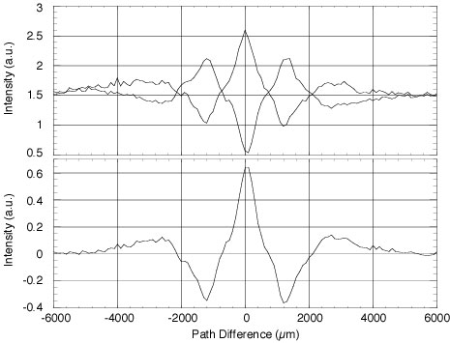
Martin-Puplett Interferometer
Roof mirror
Incident radiation with an arbitrary intensity distribution I(ω)
P
BS
Moveable
roof mirror
A
Golay cells or Pyroelectric detector

Slide 36
Experimental considerations
Spectrum cuts at low and high frequencies can affect the beam reconstruction
  Detectors
  Windows
  Transport line
  Finite target size
For this reason the approach is to test the power spectrum with the Fourier transform of a guess distribution
Coherent synchrotron radiation or diffraction radiation can be generated by totally not intercepting devices and so they are eligible for high brightness beams diagnostic
Multishots measurements. Single shot devices are still under developing

Slide 37
Electro Optical Sample (EOS)
Totally non intercepting device and not disturbing device
It is based on the change of the optical properties of a non linear crystal in the interaction with the Coulomb field of the moving charges
Several schemes has been proposed and tested
Very promising technique
I.Wilke et al., “single-Shot electron beam bunch length measurements” PRL, v.88, 12(2002)
G. Berden et al., “Electo-Optic Technique with improved time resolution for real time, non destructive, single shot measurements of femtosecond electron bunch profiles, PRL v93, 11 (2004)
B. Steffen, “Electro-optic time profile monitors for femtosecond electron bunches at the soft x-ray free-electron laser FLASH“, Phys. Rev. ST Accel. Beams 12, 032802 (2009)

Slide 38
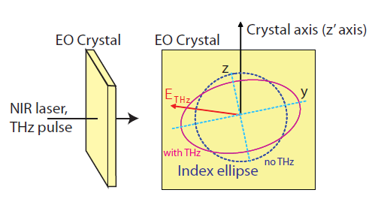
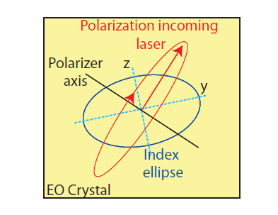




A bit of theory

Slide 39
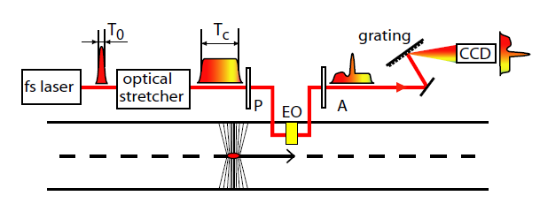

Spectral decoding
Artifacts due to frequency mixing
Minimum resolution in the order
J.R. Fletcher, Opt. Express 10, 1425 (2002)

Slide 40
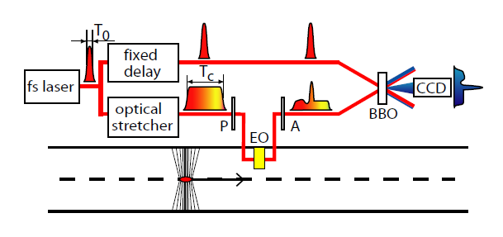
Temporal decoding
Resolution : duration of the gate beam, thickness of the SHG crystal
100 fs or slightly better
low efficiency SHG process, approx. 1mJ laser pulse energy necessary

Slide 41
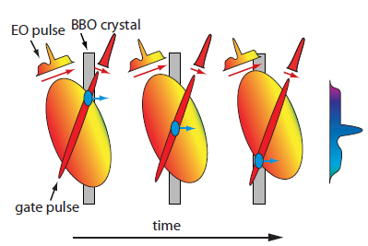
Temporal cont.
The short gate pulse overlaps with different temporal slices of the EO pulse at different spatial positions of the BBO crystal. Thus the temporal modulation of the EO pulse is transferred to spatial distribution of the SHG light.

Slide 42
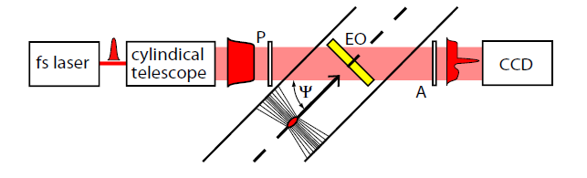
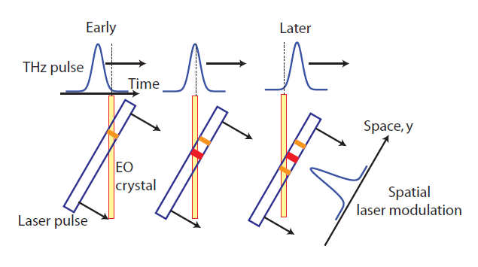
Spatial decoding

Slide 43
The problems of intercepting diagnostic
High charge
Small beam dimension (between 50 μm down to tens of nm)
High repetition rate
All the intercepting devices are damaged or destroyed from these kind of beams
No wire scanners, no OTR screens, no scintillators
There are good candidates for longitudinal diagnostic
It is difficult to replace intercepting devices for transverse dimensions
There are a lot of ideas in testing

Slide 44
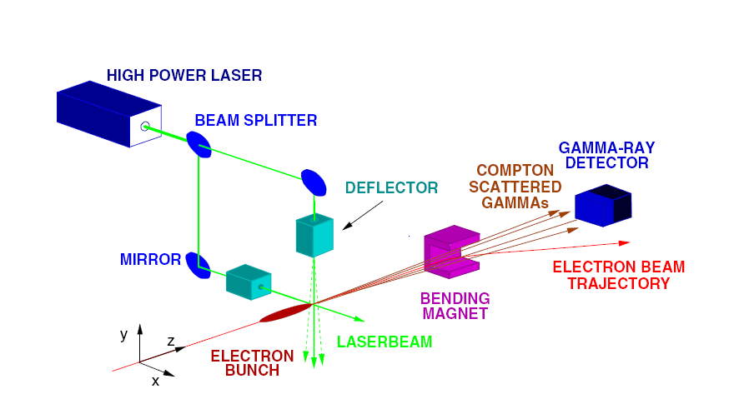
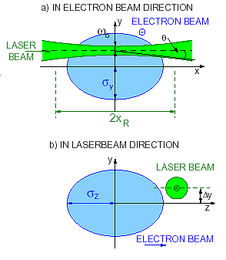
Laser Wire
Rayleigh range of the laser beam : distance between the focus and the point where the laser spot-size has diverged to of its minimum value
Not intercepting device
Multi shot measurement (bunch to bunch position jitter, laser pointing jitter, uncertainty in the laser light distribution at IP)
Setup non easy
Resolution limited from the laser wavelength
Several effects to take into account
I. Agapov, G. A. Blair, M. Woodley, “Beam emittance measurement with laser wire scanners in the International Linear Collider beam delivery system”, Physical review special topics- accelerators and beams 10, 112801 (2007)

Slide 45
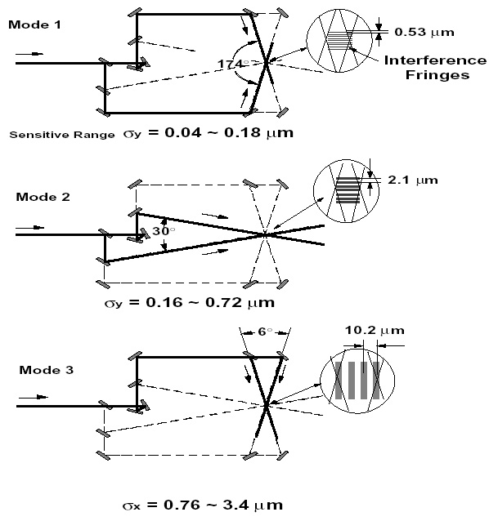
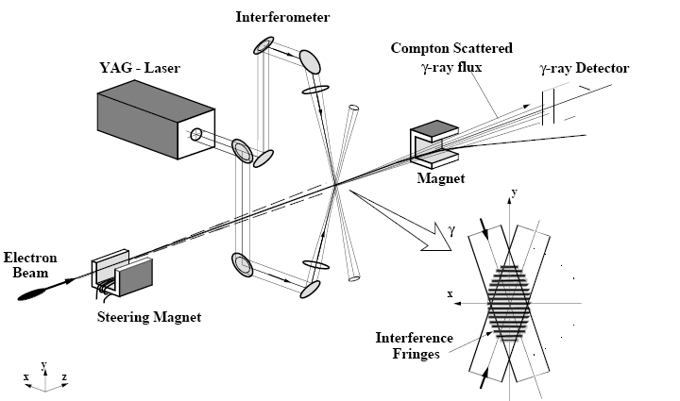
Laser interferometry
Tsumoru Shintake, “ Proposal of a nanometer beam size monitor for e⁺e⁻ linear collider”, Nuclear Instruments and methods in Physics Research A311 (1992) 453

Slide 46
Conclusions
High brightness beam demands particular diagnostic techniques
Especially non intercepting diagnostics are strongly recommended
Some of them are already state of the art
Some others are still developing
New ideas are daily tested, so if you want your part of glory start to think about today!

