Slide 1


USPAS - Fundamentals of Ion Sources
16. Electron Beam Ion Sources/Traps (EBIS/EBIT)
Daniela Leitner (LBNL, MSU),
Damon Todd (LBNL),
Daniel Winklehner (MIT)

Slide 2
Content
EBIT/EBIS Ion sources
EBIT Ion Source Fundamentals
Brief History
Main processes in the EBIT Source
Ionization Potential and Final charge state in an EBIS/EBIT
Trap Capacity
Cathode – E-beam production
  Cathodes – Electron Beam Confinement – Magnetic Fields
Collector
  E-beam dump
Electrodes and trapping
Charge Breeder

Slide 3
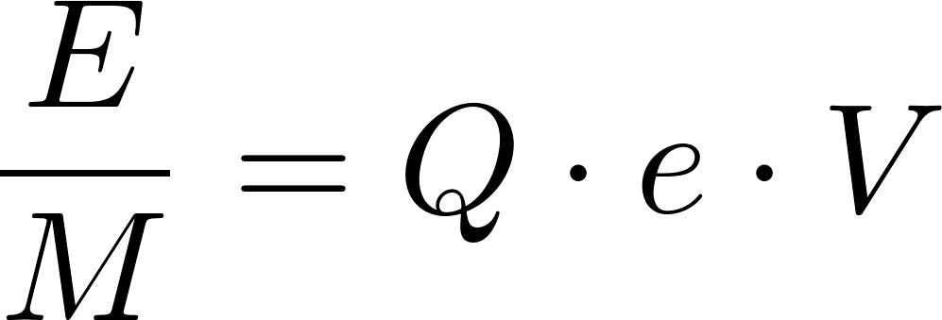
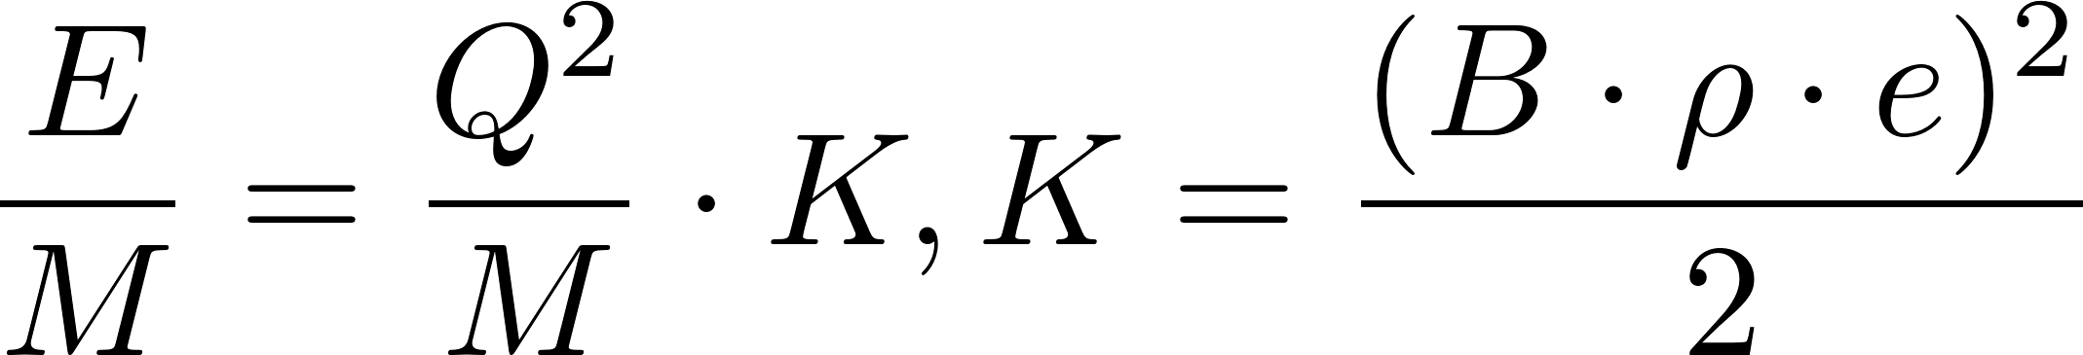
Electron Beam Ion Sources
  1967 first proposed – developed at about the same time as ECR ion sources
  Driven by the need to use high charge states to increase the final energy for the accelerator
    Linac
    Cyclotrons
Notes:
Classic possibility: charge stripping after preaccleration- higher losses, reliability of charge stripper, beam quality losses

Slide 4
Key Concepts – physical basis of operations
Production of an extended electron beam of a given energy (Ionization Energy!, High electron density!)
Creation of an electrostatic trap for the ions while they get ionized by step-by-step ionization (Confinement Time!)
Injection of a defined number of low charge state ions or injection of neutrals into the trap (vapor/gas)
Extraction of the ions when desired charge state is reached (inherently pulsed operation)
EBIS do not operate with a plasma discharge!
Notes:
Draw main concepts of EBIT on board
First order: Electron Beam Ion Sources are not plasma sources! – major advantage in terms of control of charge state

Slide 5
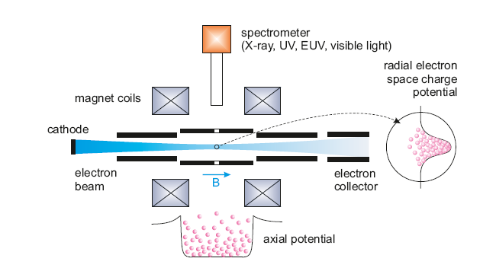
EBIT Ion sources – main concept
Electron beam | radial confinement and breeding – successive electron impact ionization
Magnetic field | compression of electron beam
Trap electrodes | axial confinement
arXiv:1411.2445 ; CERN-2013-007
G.Zschornacka,b, M.Schmidtb and A.Thornb

Slide 6
EBIT Ion sources – main concept
arXiv:1411.2445 ; CERN-2013-007
G.Zschornacka,b, M.Schmidtb and A.Thornb
Notes:
Electron beam energy is determined by the

Slide 7
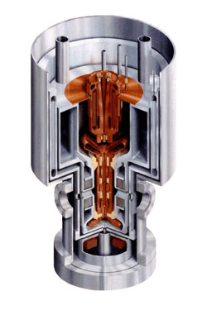
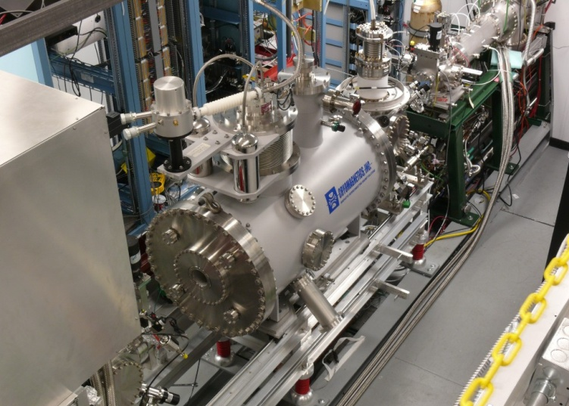
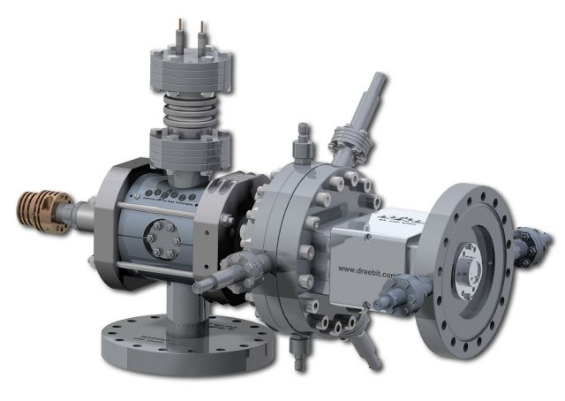
EBIT overview
  Development today: family of ion sources, warm magnets, permanent magnets, superconducting
  atomic physics groups, x-ray generator, calibration
  Injector for synchrotrons: RHIC
  Charge Breeder for post –accelerators (Rex-Isolde (CERN), CARIBU (ATLAS, ANL), ReA (FRIB/NSCL, MSU))
LLNL EBIT
Permanent magnet
ReA EBIT
Superconducting magnets

Slide 8
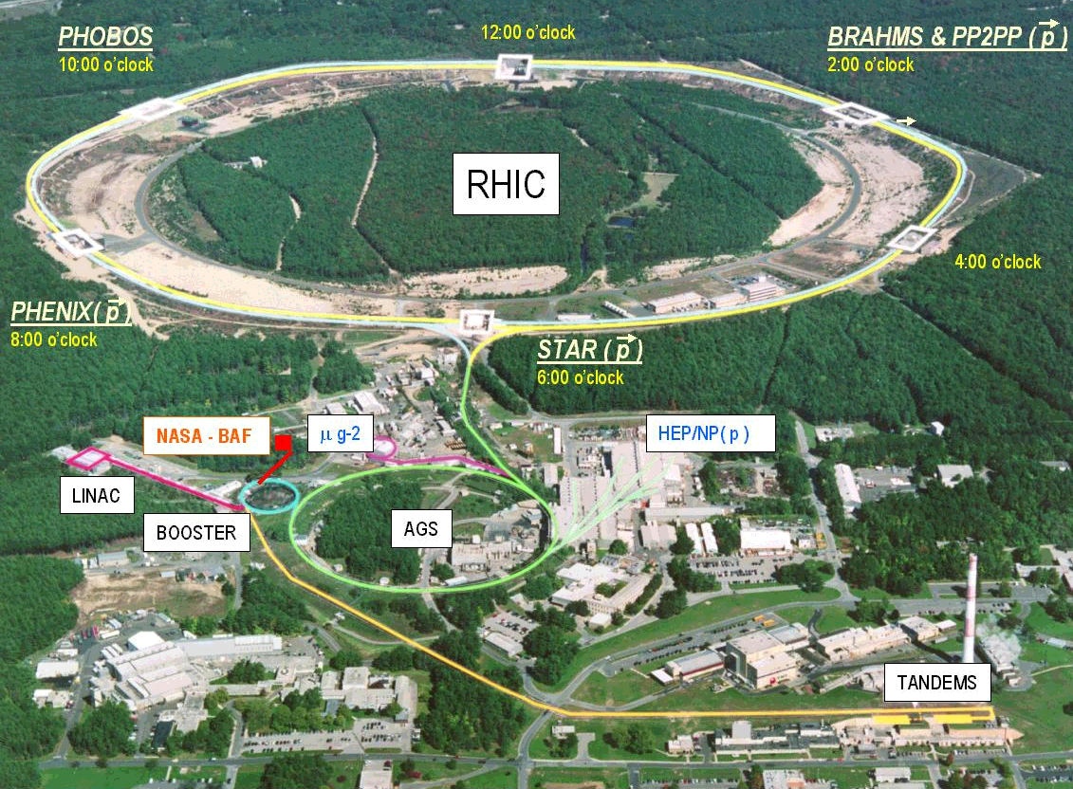
RHIC: Relativistic Heavy Ion Accelerator
(collider)
  2 independent intersecting storage rings with 6 interaction points
  Can circulate heavy ions or protons
Chain of accelerators
  3 injectors (High charge state injector (EBIS source+linac), Tandem injector, proton linac)
  Booster Synchrotron
  Alternating Gradient Synchrotron
  2.4 miles circumference storage ring

Slide 9
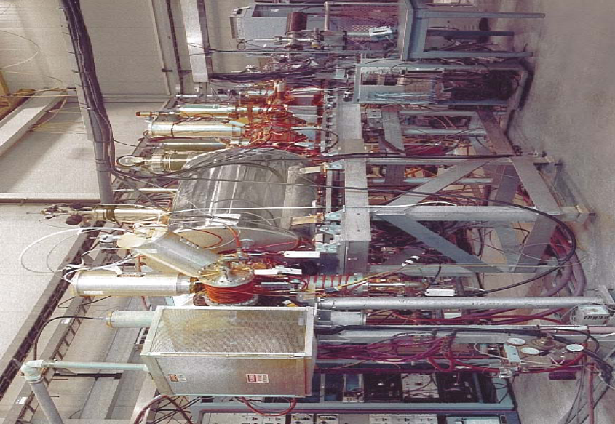
EBIS test stand facility at RHIC

Slide 10
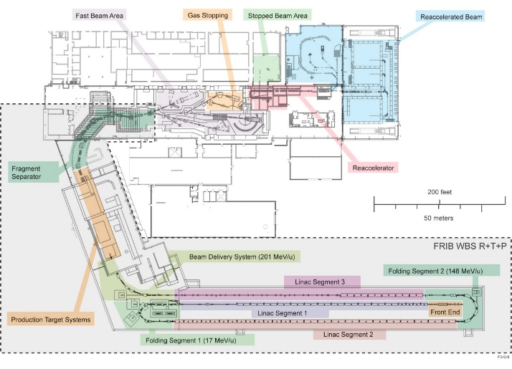
ReA Post-Accelator at MSU
EBIT CB
RFQ
CM1
CM2
CM3
ReA3 Low Energy Experimental Hall
D-Line
N4 Stopped beams
A1900
ReA3
L-Line
ReA High Energy Experimental Hall
MHB
Cryomodules : SC LINAC
RFQ
EBIT CB
1+ ‒› n+
CCF
A1900
> 50 MeV/u
Gas
Stopper
Experiments
Mass
separation

Slide 11
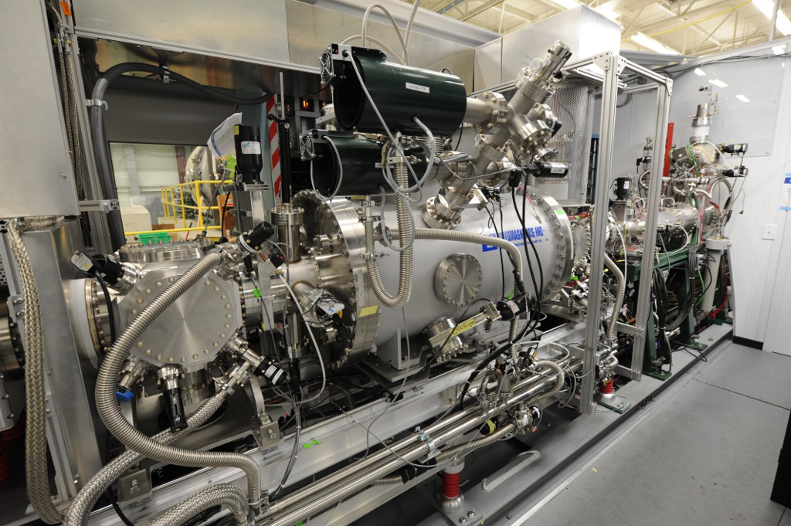
ReA EBIT Charge Breeder
Beam Line
Magnet + Trap
E-gun
Collector
Ion extraction
Key parameters:
Magnetic field: B=6T,
Electron current: I_{e}=0.5 … 5 A,
Electron energy: E_{e} < 30 keV
Current density: j ~ 10⁴ A / cm²
Trap Length: 635 mm

Slide 12
Ionization Balance in the EBIT Trap
  Ionization through electron impact (step-by-step) until charge state balance is reached
    Charge generation processes x Charge destructive processes
    Main Atomic processes are
      1. Electron Impact Ionization
      2. Charge Exchange
      3. Radiative Recombination
  Multiple collisions are required – ionization time must be long enough to reach desired charge state
  Key Concept
  Ionization Factor: Product of the electron flux and the time of bombardment

Slide 13
Ionization Factor

Slide 14
Maximum Capacity of the trap
Key Concepts
  Residual gas pressure
  Compensation
  Pulsed operations
How many particles can be stored?

Slide 15
Extraction of Ions from the EBIT

Slide 16
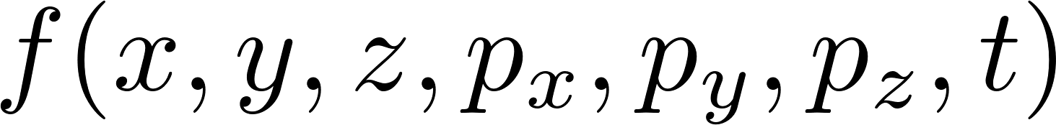
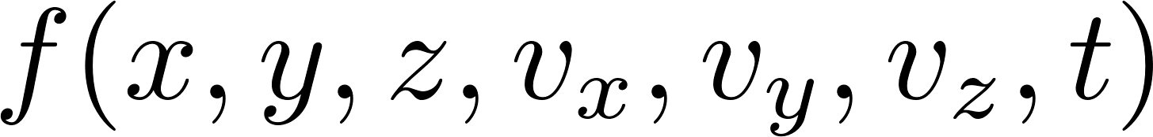
Particle Distributions
Ensemble of particles can be described in 6D + time:
or

