Slide 1
USPAS - Fundamentals of Ion Sources 16. Electron Beam Ion Sources/Traps (EBIS/EBIT)
Daniela Leitner (LBNL, MSU), Damon Todd (LBNL), Daniel Winklehner (MIT)

Slide 2
Content
EBIT/EBIS Ion sources
EBIT Ion Source Fundamentals
Brief History
Main processes in the EBIT Source
Ionization Potential and Final charge state in an EBIS/EBIT
Trap Capacity
Cathode – E-beam production
Cathodes – Electron Beam Confinement – Magnetic Fields
Collector
E-beam dump
Electrodes and trapping
Charge Breeder

Slide 3
Electron Beam Ion Sources
1967 first proposed – developed at about the same time as ECR ion sources
Driven by the need to use high charge states to increase the final energy for the accelerator
Linac
Cyclotrons
Notes:
Classic possibility: charge stripping after preaccleration- higher losses, reliability of charge stripper, beam quality losses

Slide 4
Key Concepts – physical basis of operations
Production of an extended electron beam of a given energy (Ionization Energy!, High electron density!)
Creation of an electrostatic trap for the ions while they get ionized by step-by-step ionization (Confinement Time!)
Injection of a defined number of low charge state ions or injection of neutrals into the trap (vapor/gas)
Extraction of the ions when desired charge state is reached (inherently pulsed operation)
EBIS do not operate with a plasma discharge!
Notes:
Draw main concepts of EBIT on board
First order: Electron Beam Ion Sources are not plasma sources! – major advantage in terms of control of charge state

Slide 5
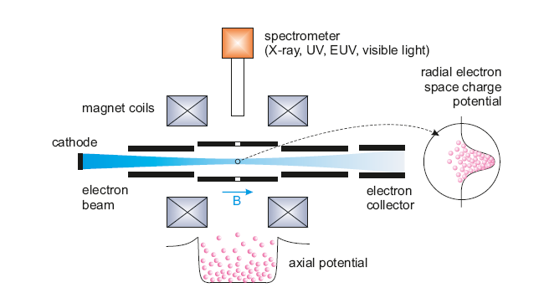
EBIT Ion sources – main concept
Electron beam | radial confinement and breeding – successive electron impact ionization
Magnetic field | compression of electron beam
Trap electrodes | axial confinement
arXiv:1411.2445 ; CERN-2013-007
G.Zschornacka,b, M.Schmidtb and A.Thornb

Slide 6
EBIT Ion sources – main concept
arXiv:1411.2445 ; CERN-2013-007
G.Zschornacka,b, M.Schmidtb and A.Thornb

Slide 7
EBIT overview
Development today: family of ion sources, warm magnets, permanent magnets, superconducting
Sources are commercial available
Injector for synchrotrons: RHIC
Charge Breeder for post -accelerators
Other usage: atomic physics groups, x-ray generator, calibration

Slide 8
ReA EBIT Charge Breeder
Magnet + Trap
Beam Line
E-gun
Collector
Ion extraction

Slide 10
Particle Distributions
Ensemble of particles can be described in 6D + time:
or

