Slide 1
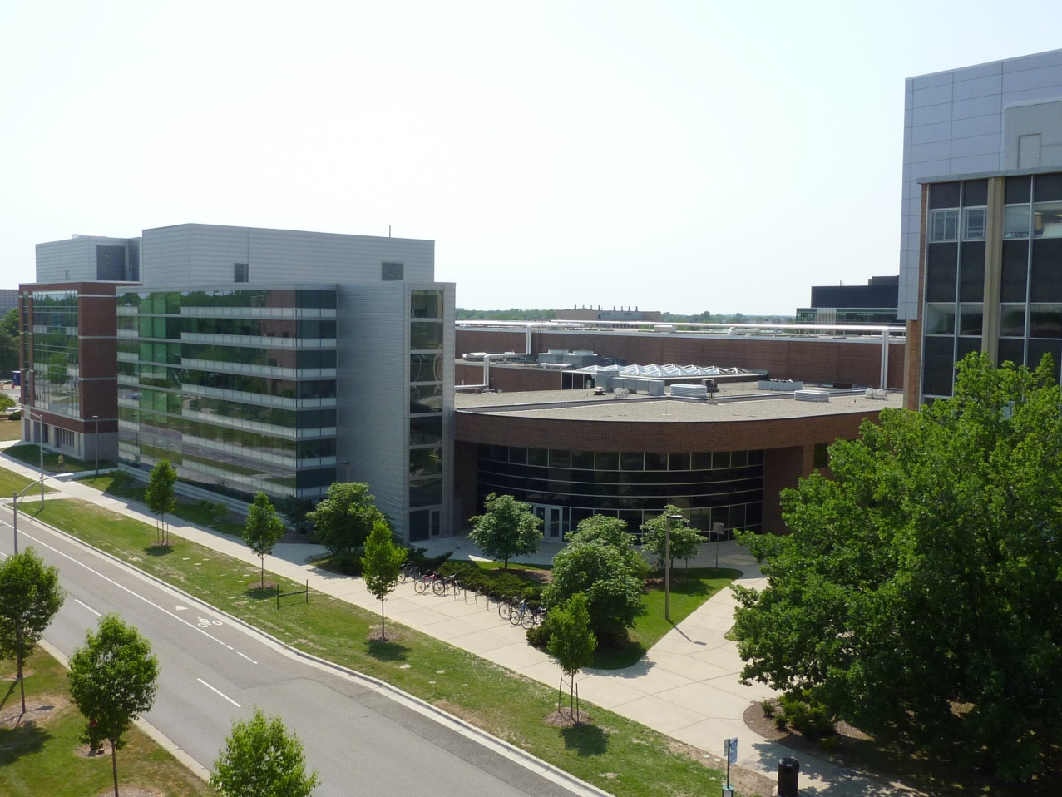
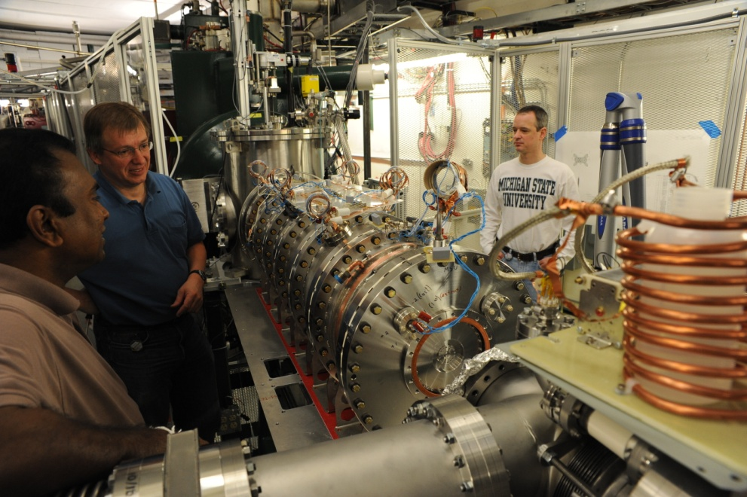
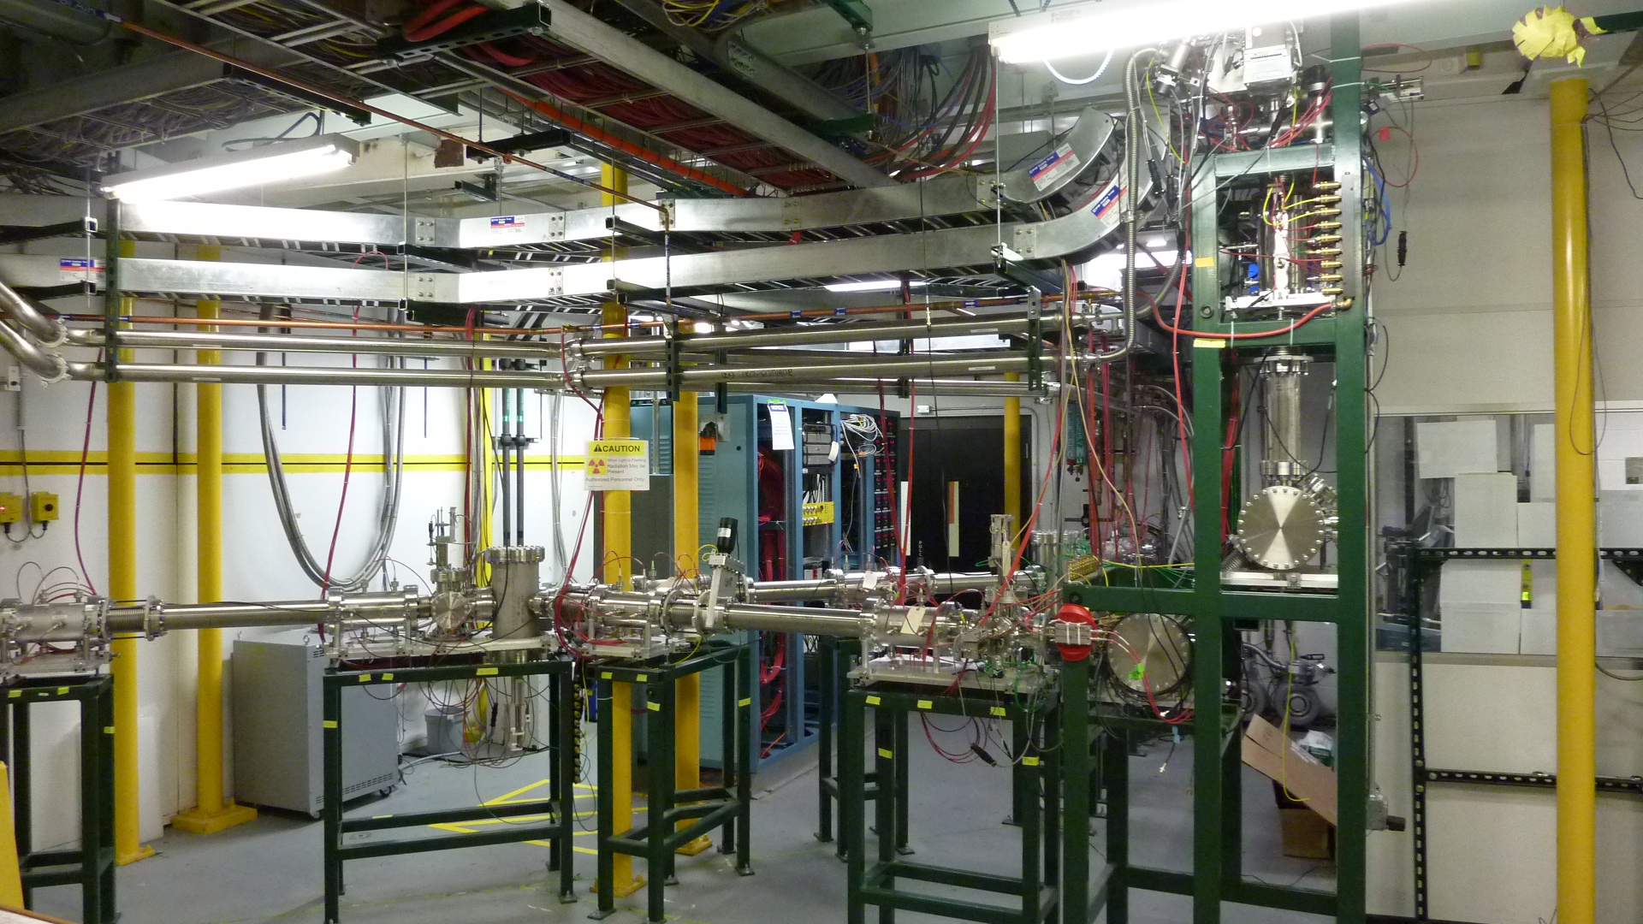
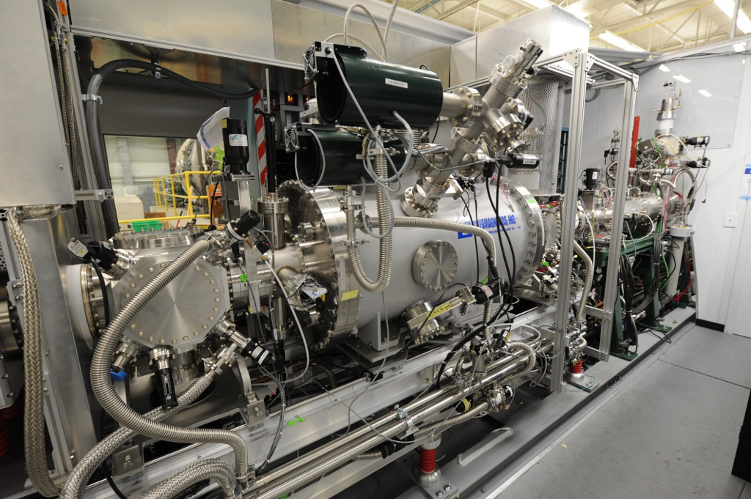
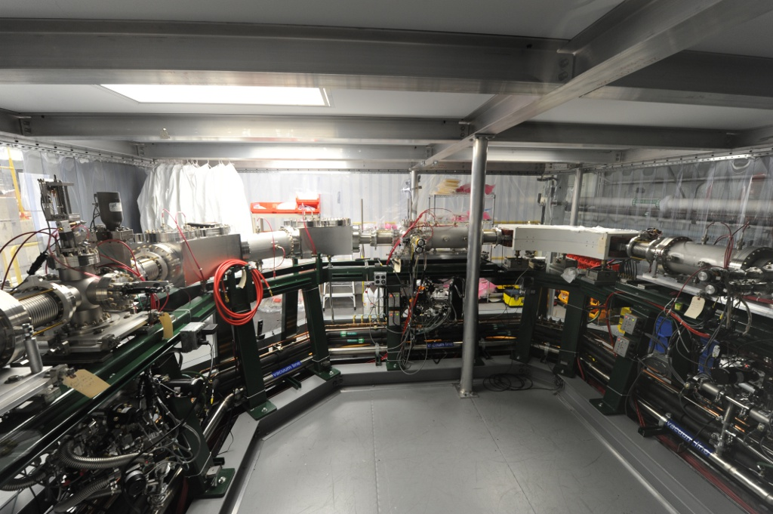
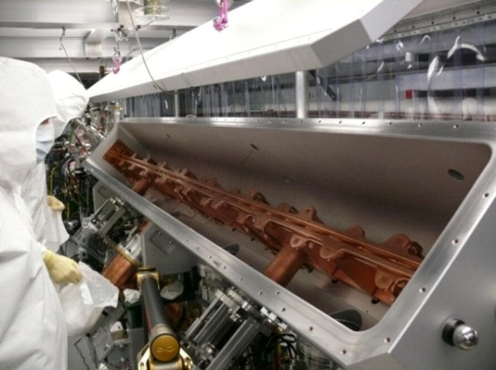

The Electron-Beam Ion Trap (EBIT) of the ReA post-accelerator
A. Lapierre, S. Schwarz, T. M Baumann, K. Kittimanapun, W. Wittmer, C. Sumithrarachchi, A. J. Rodriguez, S. J. Williams, A. Villari, G. Bollen and D. Leitner
National Superconducting Cyclotron Laboratory, Michigan State University, East Lansing, USA

Slide 2
Outline
  PART I
  Motivation for a post-accelerator: ReA
  A few words on the future Facility for Rare Isotope Beams (FRIB)
  Reacceleration concept
  ReA EBIT charge breeder (key parameters, main charactersitics)
  PART II (some real physics…)
  “Charge breeding” physics
  Physics of (continuous) beam injection
  PART III
  Commissioning results:
    Efficiency, e-beam current density, time structure, contaminations….
  Summary & Outlook

Slide 3
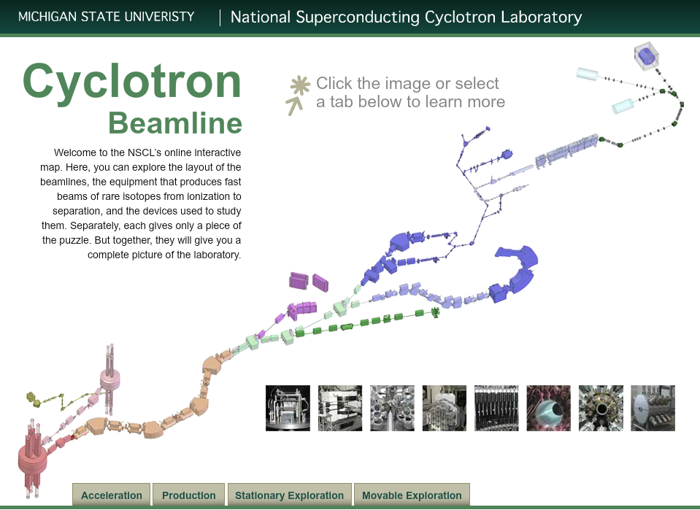

ReA: Reaccelerator of rare isotopes
NSCL: National Superconducting Cyclotron Laboratory
  User facility producing rare-isotope beams by projectile fragmentation.
ReA@NSCL
  Post-accelerator for reacceleration of rare-isotope beams to several MeV/u.
  Why do we need to reach this energy regime ?
  Key reactions in nuclear astrophysics.
  Nuclear structure studies
  e.g., nuclear physics…
“Low” Energy Beam Area
To produce beams of a few MeV/u, rare isotopes are first thermalized in a gas cell…
How does this entire system work?
High-energy stable-isotope beams from 2 coupled cyclotrons transported to a target where rare-isotope beams are produced at high energies
ReA, post-accelerator
Beam “stopping”
He gas cells
EBIT charge breeder
High Energy Beam Area
Acceleration (>80 MeV/u):
Electron Cyclotron Ion Sources + coupled cyclotrons
Production (>80 MeV/u):
Projectile fragmentation & separation
In short…
Accel. → Production → Stopping → Reaccel.
Target, e.g., beryllium
NSCL rates ≤ 10⁹ pps
(Thermalization)

Slide 4
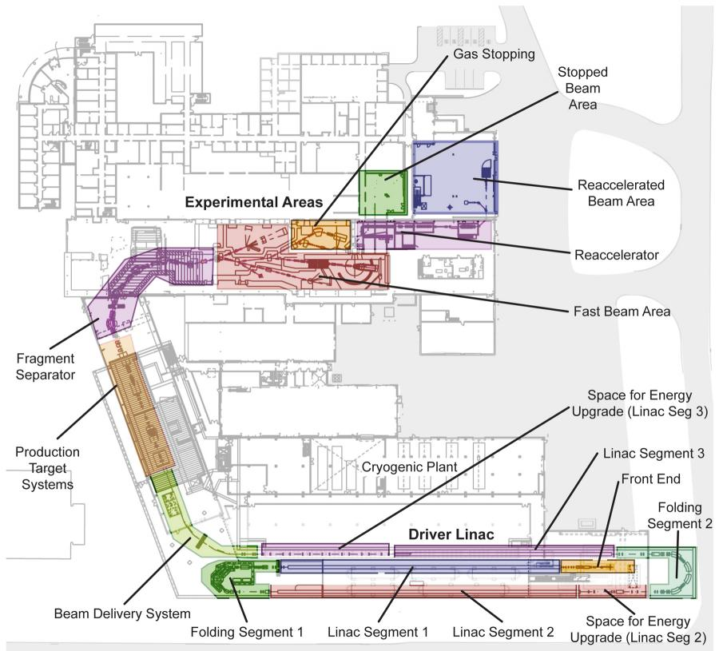
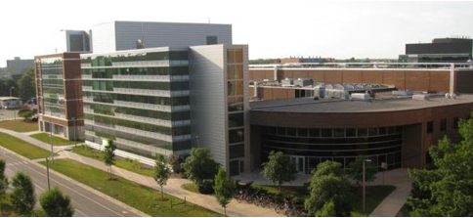
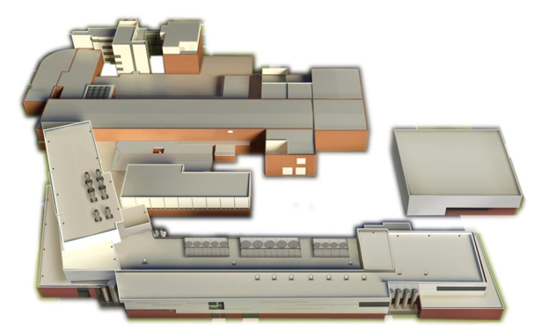
Facility for Rare Isotope Beams (FRIB)
In 2008, NSCL & MSU selected to establish the US facility (FRIB) for science with rare-isotope beams → Early completion ~2020
Coupled cyclotrons
The two NSCL coupled cyclotrons will be later replaced by a 400-kW superconducting heavy-ion “driver” linac.

Slide 5
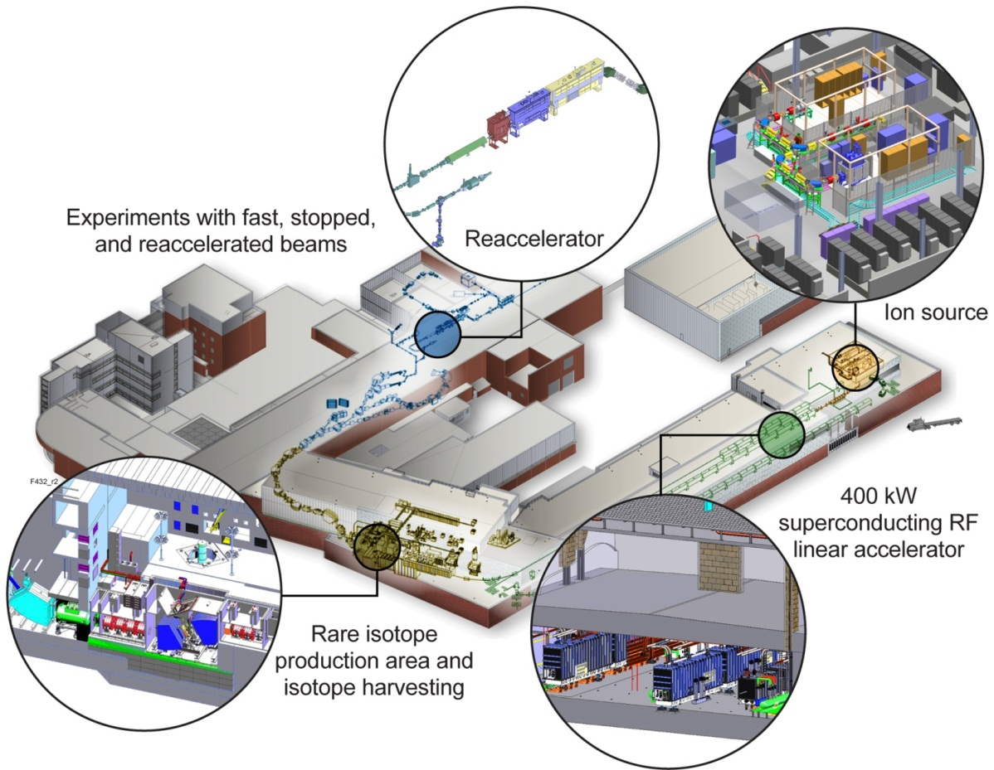
Facility for Rare Isotope Beams (FRIB)
Different perspective…
EBIT charge breeder
FRIB will increase the current production rates of rare isotopes by up to 2 orders of magnitude < 10¹² pps

Slide 6
The ReAcceleration concept
ReA post-accelerator
12 keV/u
600 keV/u
A few MeV/u,
E_{final} (F, A, Q)
MHB
80 MHz
RB
β=4.1%
β=8.5%
Magnetic
sector
Room-temperature RFQ
Superconducting RF linac
Achromatic
Q/A separator
2≤ A/Q ≤ 5
Quasi-continuous injection
Pulsed extrac. rates: 5 – 50 Hz
Charge breeding times: 200 – 20 ms
Electrostatic
sector
12 keV/u x A
EBIT charge breeder
1+ → Q+
Trapped ions
< 500 eV
*Production & In-flight separation
<1 eV
After production and separation, the beam is sent to the beam stopping area, decelerated, thermalized, and transported to the EBIT.
Thin foil
target
≤ 60 keV
First configuration, ReA3
Continuous stable heavy ion beam >80 MeV/u
He gas-cell
⁴⁸Ca 0.3 - 6 MeV/u
²³⁸U 0.3 - 3 MeV/u
“Stopping” area
Final configuration, ReA (x4)
NSCL rare-isotope beam rates, < 10⁹ pps
⁴⁸Ca 0.3 - 20 MeV/u
²³⁸U 0.3 - 12 MeV/u
  After production, rare isotopes are “stopped” in a He gas cell
  Injection into an electron beam ion source/trap for charge breeding (1+ → Q+)
  Extraction to Q/A separator and injection into a RFQ, and SRF cavities for reacceleration

Slide 7
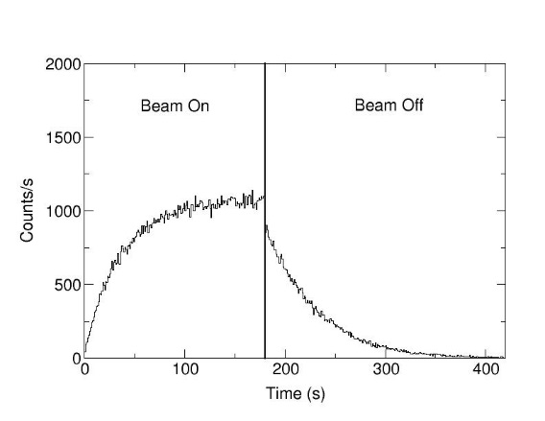
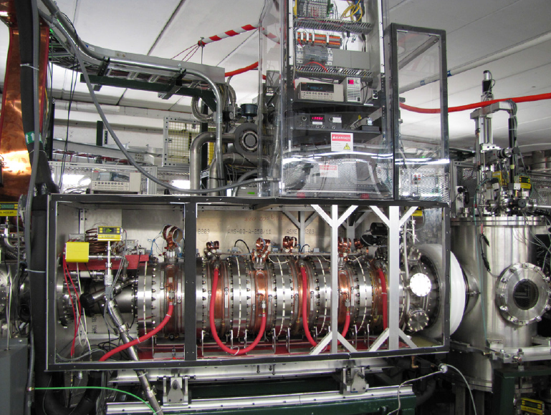
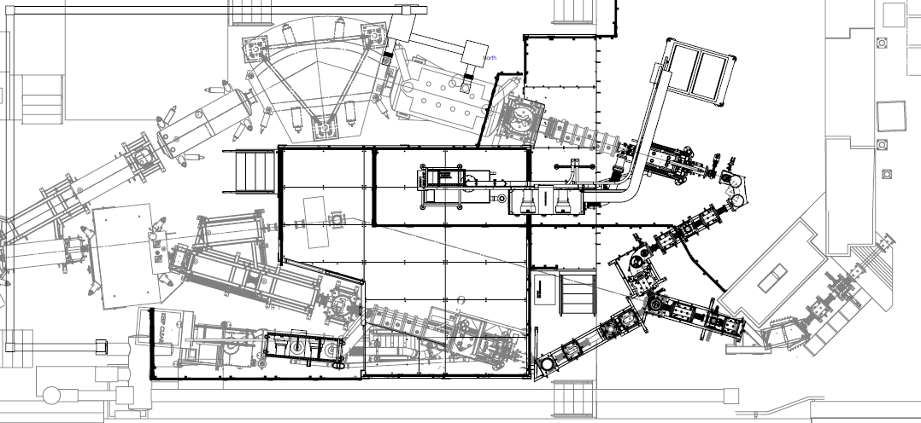
The beam “stopping” area
Beam thermalization:
Decelerate rare-isotope beams
Reduce emittance to 2π mm mrad (95%, 30 keV) before reacceleration
For efficient beam transport and EBIT injections
Si det. measure β activity for particle ID & beam transport optimization
He gas cell (Argonne lab)
The purpose of beam thermalization…
Rare-isotope beams
from the production area
After thermalization, the beam is transported thru a low-energy beam line to a analyzing dipole for mass selection.
DC beams > 80 MeV/u
We have Si det. To measure the activity of the beam and optimization the beam transport and ID the type of beam we are dealing with.
Analyzing dipole magnet
DC beams < 60 keV

Slide 8
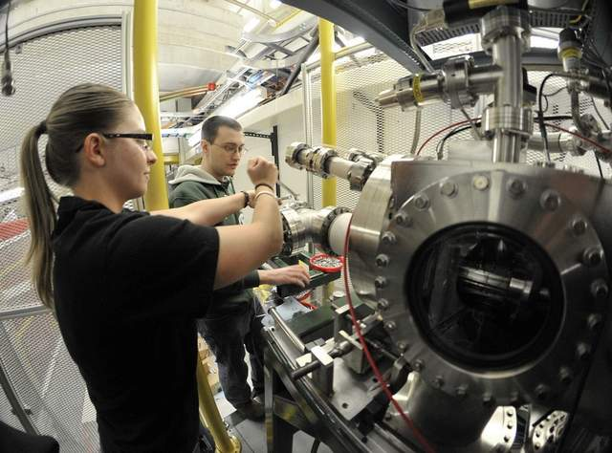
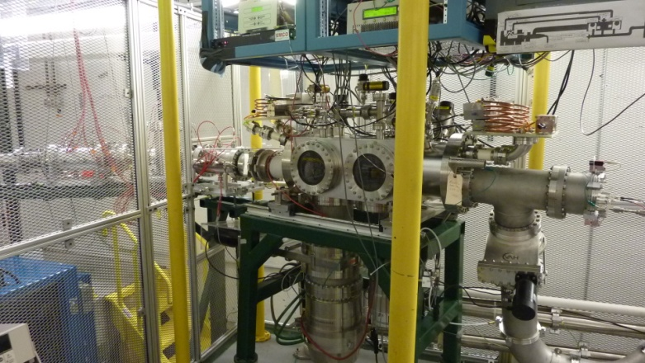
The beam “stopping” area
Second beam line:
Equipped with offline (surface) ion source (e.g., K, Rb…)
For commissioning purposes
On the other side of the beam lines…
Analyzing dipole magnet
DC beams < 60 keV

Slide 9
From the stopping area to ReA
To post-accelerator
built on an elevated platform
Analyzing
magnet
DC beams < 60 keV

Slide 10
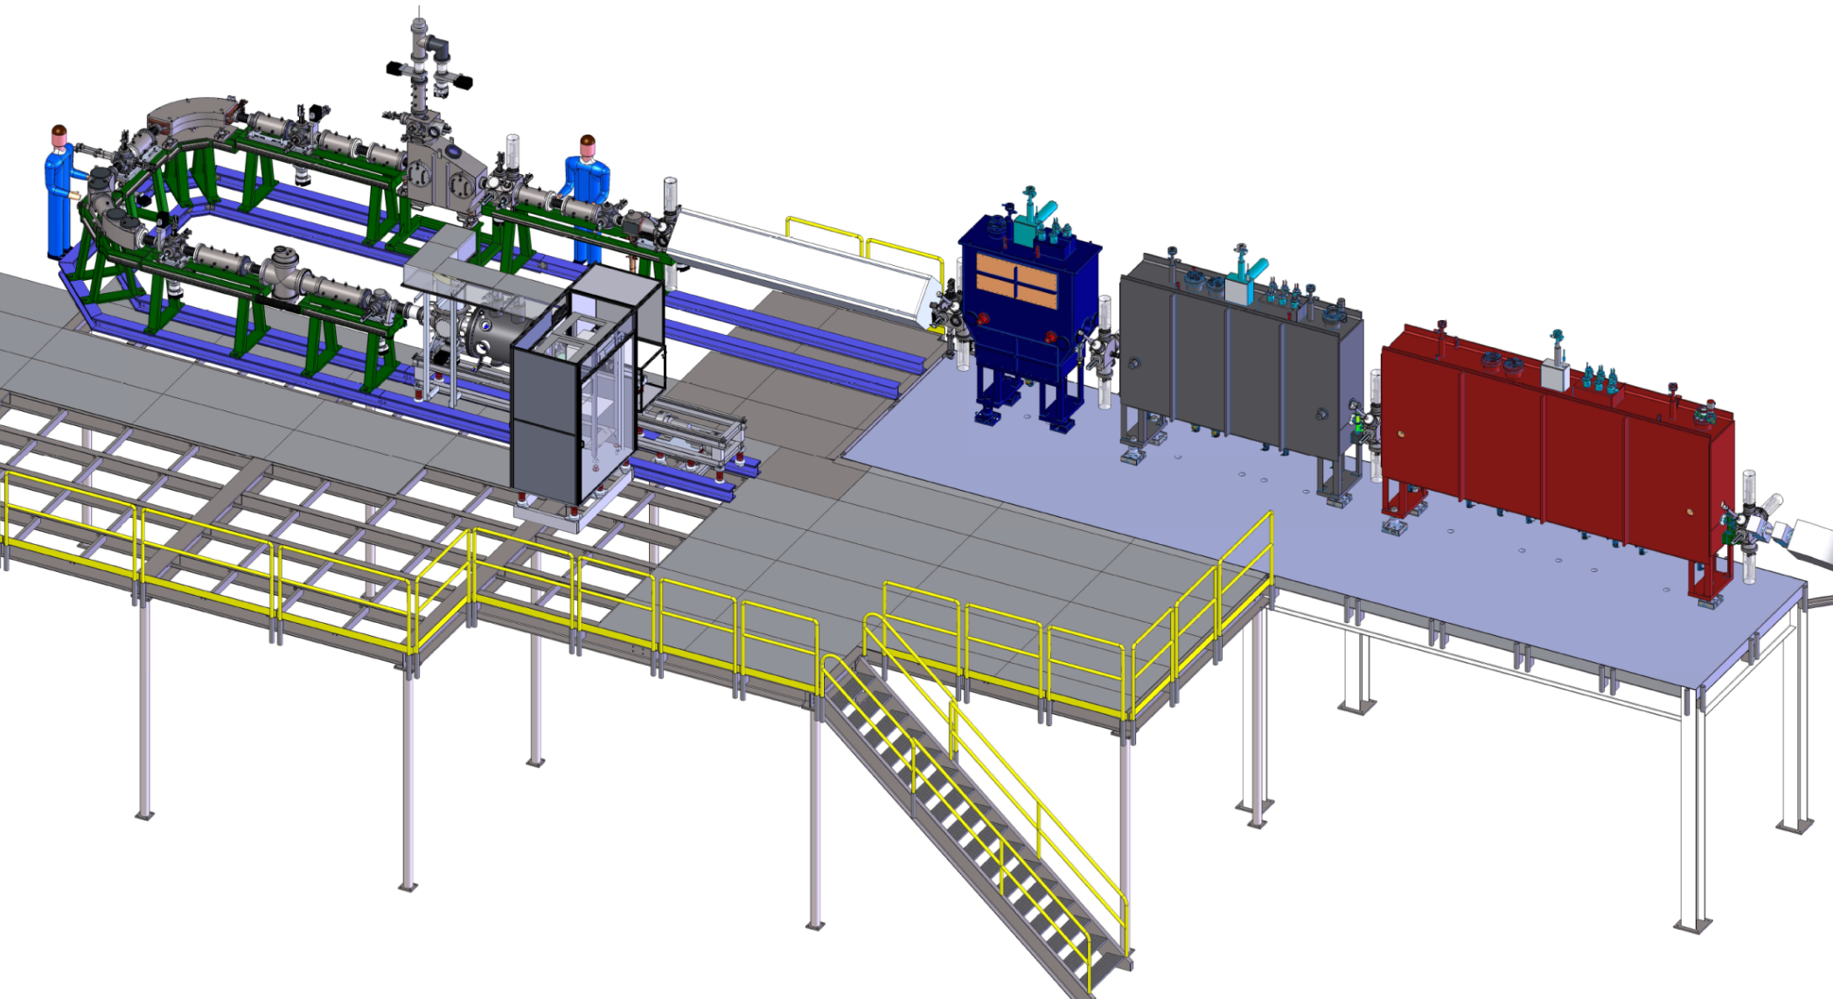
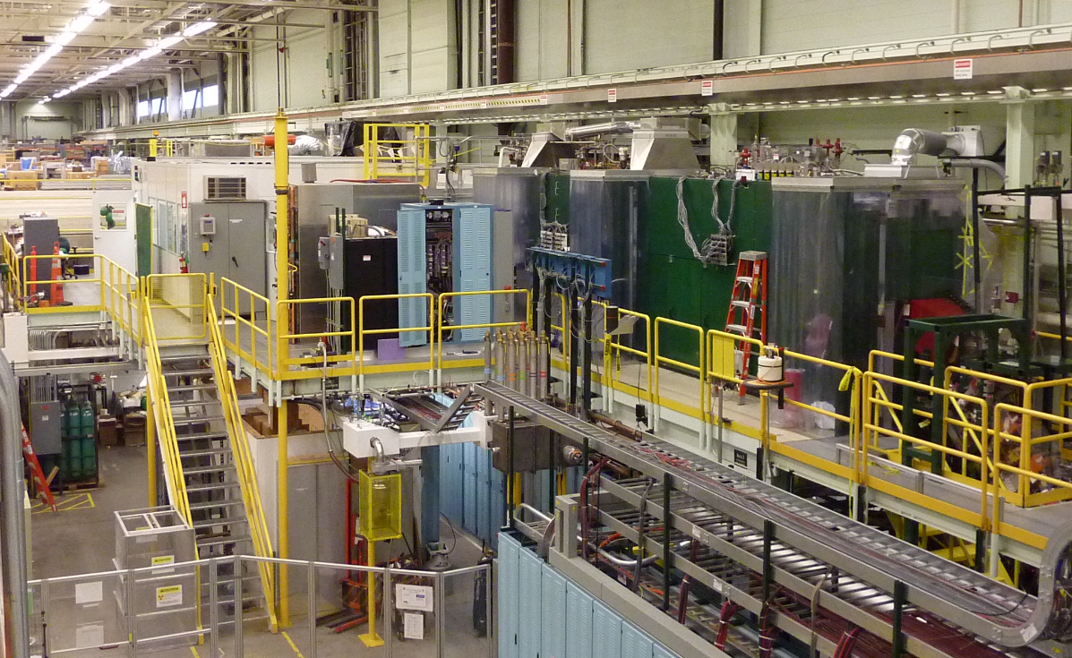

EBIT charge breeder in the ReA facility
Q/A separator
Room-temperature RFQ accelerator
SRF linear accelerator (LINAC)
Installed a few weeks ago!
EBIT charge breeder
Gas-cell stopper
Why do we use a charge breeder & why an EBIT (& not an Electron Cyclotron Resonance Ion Source (ECRIS) ) ?
  CB: Makes compact & cost-efficient compared with accelerator with stripper-foil stages.
  EBIT: High efficiency → Narrow charge state distribution (less ions lost in many charge states)
  EBIT: Fast → Breeding times < 50 ms (adjustable)
  EBIT: High beam purity / Low contamination level → e.g., cryogenic trap (4K)

Slide 11
EBIT working principle
  What is an Electron-Beam Ion Trap and how does it work?
  Produces & traps highly charged ions with a high-current density electron beam
  3 Parts: e-gun, trap + magnet , e-collector
  Strong magnetic field: Electron-beam compression & Ionization by electron impact
  Trap electrodes →Axial ion confinement
  Electron beam → Radial ion confinement
Magnetic field,
up to several Tesla
Quasi-continuous injection & accumulation (~100 ms)
A⁺
Electron
collector
Electron
beam
Trap electrodes
Electron
gun cathode
Φ~6 mm
Pulsed extraction
A^{Q+}
Highly charged ions
Hair-like electron beam
Φ~100 μm
Radial space-charge potential from the electron beam
Axial potential well from the trap electrodes

Slide 12
How do we inject & extract ions ?
Over-the-potential barrier injection
“Quasi-continuous”
Lower-the-barrier extraction
“Pulsed extraction”
U
U
1+
1+
1+
Ions axially trapped with potential well created by 2 barriers
1+
2+
q+
q+
2+
Time sequence
  Extract (< 1 ms)
Injec./Accu
Extract
Injec./Accu
Extract
Injec./Accu
Extract
Inj. & accu. (~100 ms)
Open the trap…
Time
  Typical width of an extracted ion pulse
  Typical pulse width (~10 μs) defined by the time taken by the trapped ions to freely exit the trap
  Instantaneous rate of each pulse is too high for many nuclear-physics experiments
  New extraction schemes being developed to spread in time pulses up to several ms.
~ 10 μs

Slide 13
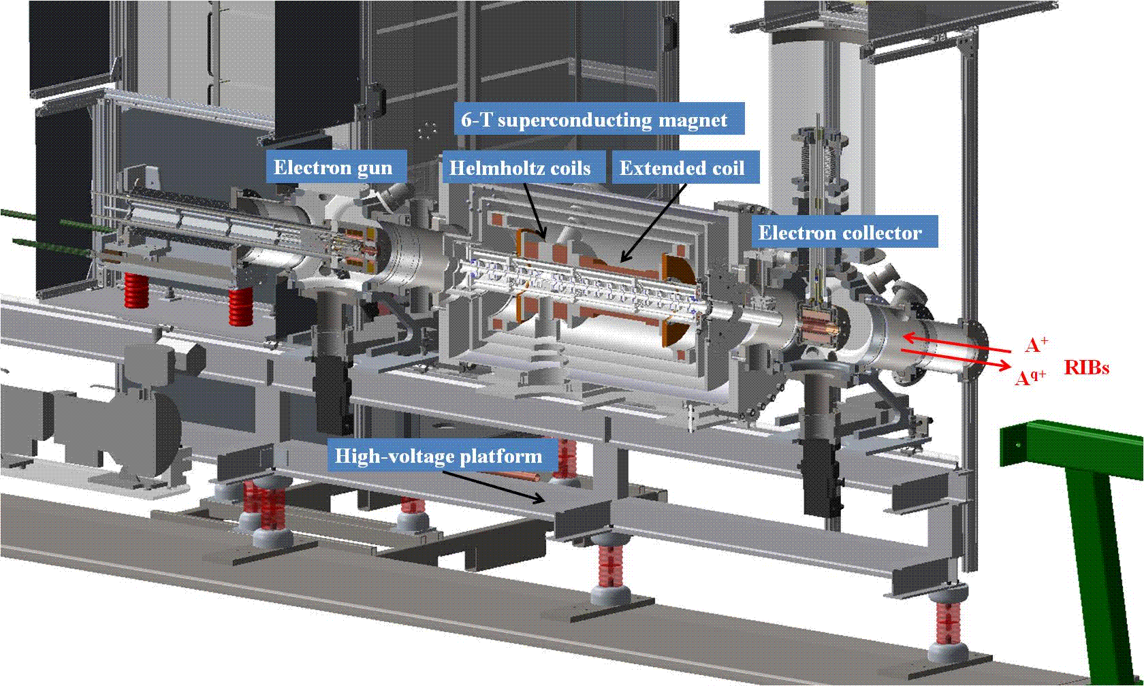
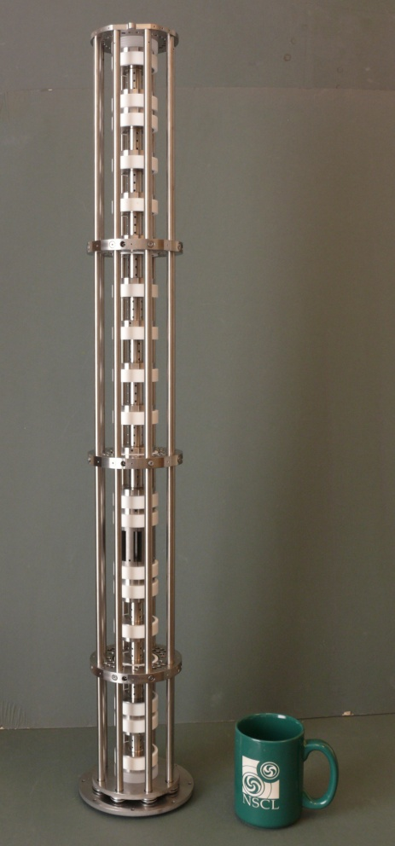
The ReA EBIT
Trap structure
* 1.2 m long
* 23 Ti electrodes
Unique feature for charge breeders: Viewports for visible, X-ray or gamma spectro. of highly charged radioactive ions.
Main requirements of a CB for ReA:
Breeding time < 50 ms (for short-lived isotopes)
Efficiency in single charge states: 20% - 50 %
Charge capacity: up to 10¹⁰ positive charges
Low contamination level.
ReA EBIT key parameters:
High electron current: 1.4 A thru a 4T
E-beam energy < 30 keV (e.g., Ne-like U⁸²⁺)
Current density (750mA/4T): ~500 A/cm²
Reduced contamination: 4-K trap structure

Slide 14
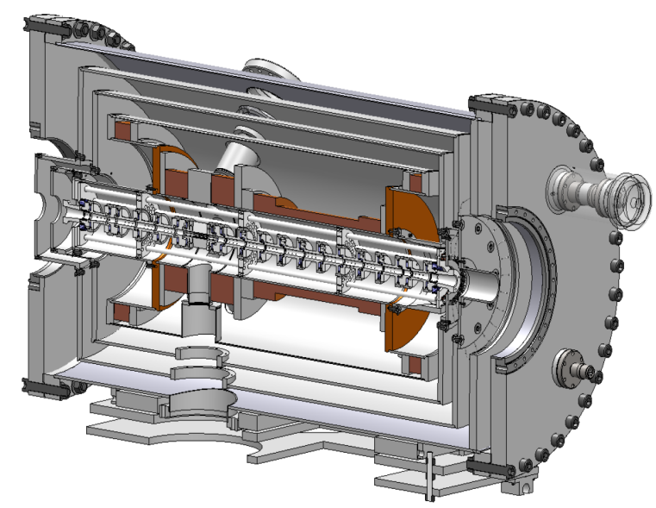
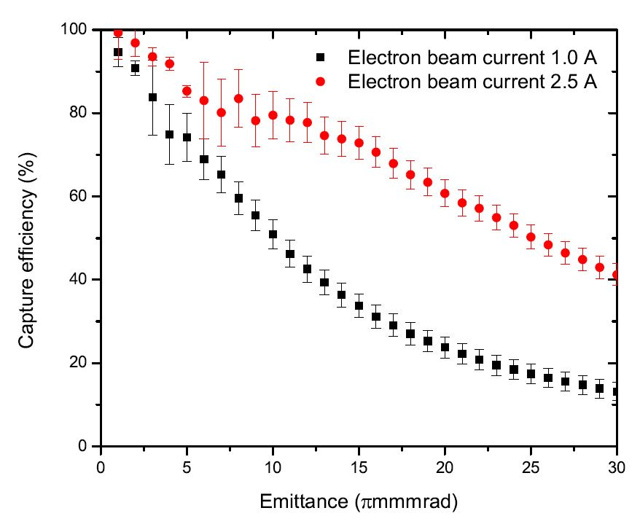
ReA EBIT: Double-magnet configuration
Over-the-potential barrier injection
Solenoid: Long low-field region
  To maximize ionization of 1+ ions within a roundtrip:
  Keep e-beam diameter for high electron-ion beam overlap upon injection → High capture probability
“Quasi-continuous”
U
U
1+
1+
1+
1+
2+
2+
Helmholtz coils: Short high-field region
  Reduce e-beam diameter for high current density → High charge states and fast charge breeding
Location of the two field regions
Capture efficiency
from Monte-Carlo simulations
Preferred B-field distribution
e-beam
i-beam
High field
Low field
Current density~1000 A/cm²
Monte-Carlo simulations of capture eff.:
E. Gavartin – M.Sc. Thesis, MSU,
K. Kittimanapun – PhD, MSU.
@1A: >80% for <3 π mm mrad
Notes:
NSCL unique manget configuration
We inject ion over a trapping barrier, so to ionize them before a round trip, we an an extended low-field region.

Slide 15
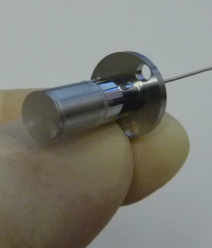
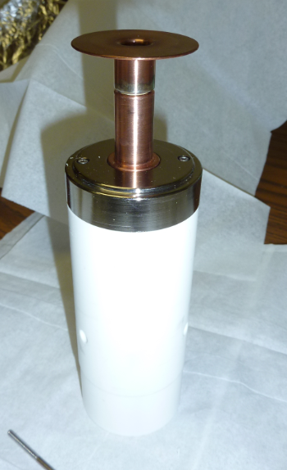
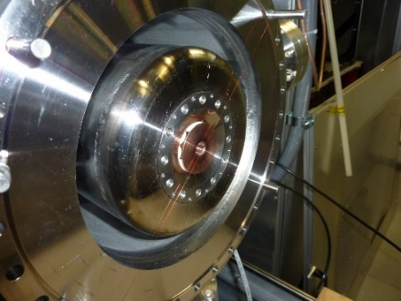
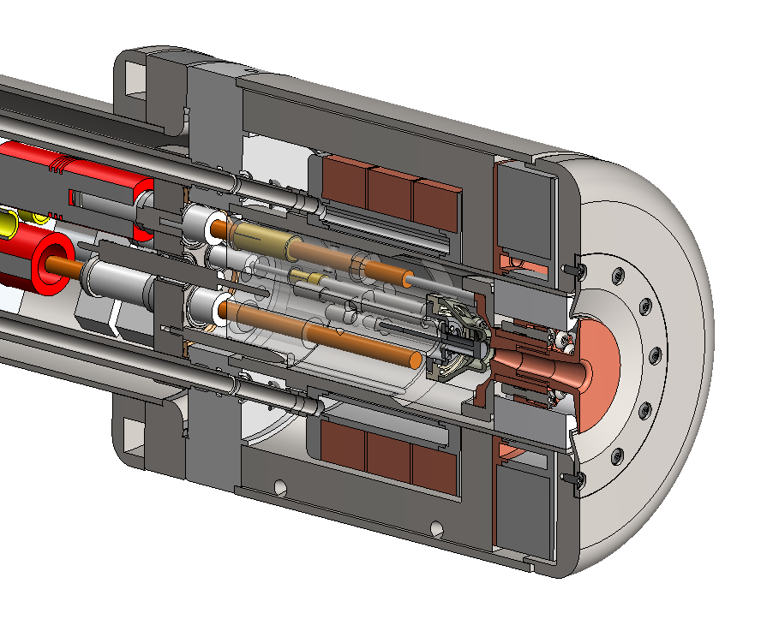
High-current electron gun to maximize the capture efficiency of injection ions
  Thermionic electron gun
  Ba-dispenser cathodes
  6-mm in diameter
  Modular cathode assembly
Modular ass’y includes:
  Anode
  Focus elec.
  Cathode
E-beam current vs. extraction voltage
Demonstrated stable operation
up to ~ 1.4 A (4 T)
Can go away!
Perveance ~ 1.7 A/V^{3/2}

Slide 16

Injection modes
Three modes of injection to produce stable-isotope and rare-isotope beams
  Gas injection producing an atomic beam
  Inject singly charged stable-isotope ions from two offline ion sources
  Inject rare-isotope beams from the beam stopping area
  Simultaneous injection of multiple beams from different sources…
Gas inlet
Offline ion source
Offline source in the stopping area
Rare-isotope beams
Magnet cryostat
Electron gun
Notes:
E-beam character, Helmholtz coil compress e-beam, radially trap by neg space chage from e beam and radially by trap electrodes
High j rapidly increase charge states for short-lived isotopes <10ms, radial trap axial trap
MSU EBIT is different from mag field config and improved e-gun design. E-gun is mount on a plug-type connect, convenient for future upgrade
For fast charge breeding, long trap, mixing the idea of EBI s and t

Slide 17
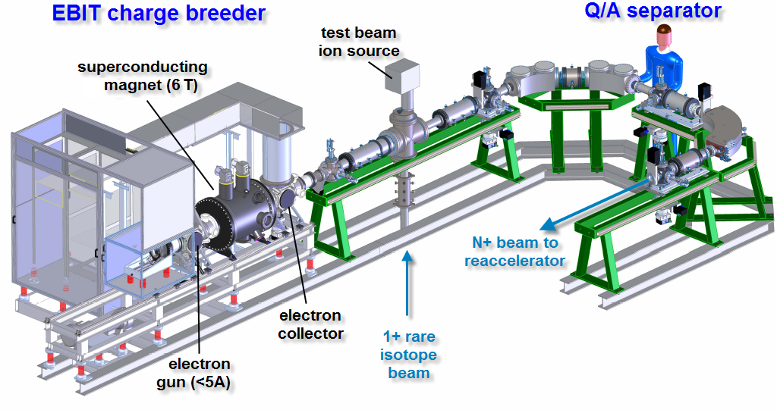
Charge-over-mass (Q/A) separator
Double-focusing (achromatic) spectrometer
Design parameters
  Measured resolving power, (A/Q)/Δ(A/Q)~500
  Achromatic within ΔE/E~3%
  Large energy acceptance to accept EBIT beams
  EBIT beam energy spread (~ion temperature), ΔE<500 eV → ΔE/E~0.3%
45º electrostatic bends
90º dipole magnet
Δm
Δm

Slide 18
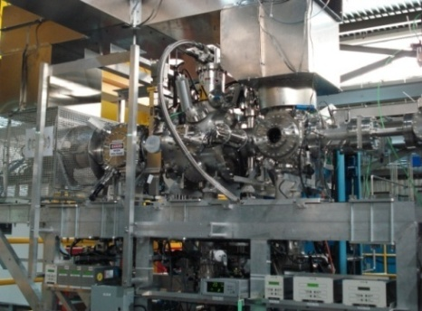
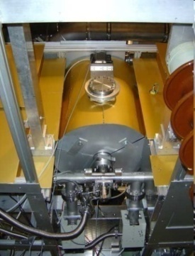
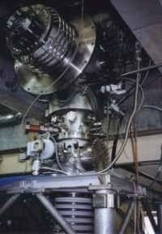
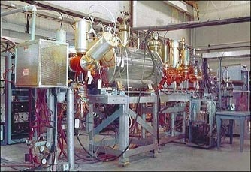
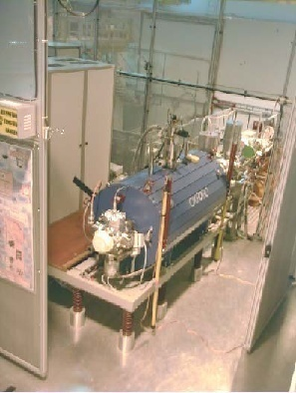
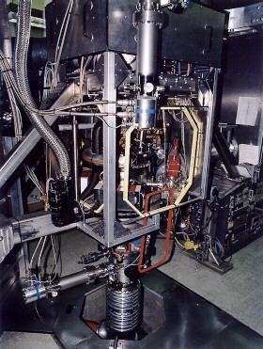
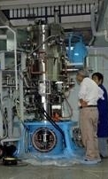
Many other EBIS/T around the world…
TITAN-EBIT
TRIUMF’s CANREB (2nd)
HD-EBIT
Heidelberg
Kielce
Dubna
Dresden
TRIUMF/
Vancouver
GSI/Jena
Frankfurt
NSCL/FRIB
Geneva
LBL
ANL
Brookhaven
Tokyo
Flash-EBIT/SLAC
NIST
Shanghai
LLNL
Clemson
RHIC-EBIS
Livermore-EBIT
REX-EBIS @ CERN
E-beam energy ~ 200 keV
Spectroscopic measurements in Bare Uranium
Only 5 breeders of RIB for post-acceleration:
Applications
Atomic spectroscopy / Surface interaction studies
Charge breeder (source of stable & rare isotopes)
Charge breeder
(post-acceleration of rare-isotope beams)
To mention: REX-EBIS@CERN: First EBIS breeder (Op. ~2000)
REA EBIT: Commissioning/entering operation
CARIBU, Argonne Nat. Lab.: Being commissioned
TRIUMF/ARIEL/CANREB (Planning)
KoRIA (Construction)
Notes:
EBIT/S are widely used around the word. Many of them are used in AMS. A few of them are used to study surface interaction and some are used as a charge breeder. More specifically, there are only 3 facilities around the world which are cern, our lab, and argonne using these device as a charge breeder for post accelerator for rare isotope beam. REXEBIS at cern successfully demonstrated EBIS CB for rib as a first group.

Slide 19
“Charge Breeding” Physics
Quick overview of what happens during charge breeding

Slide 20
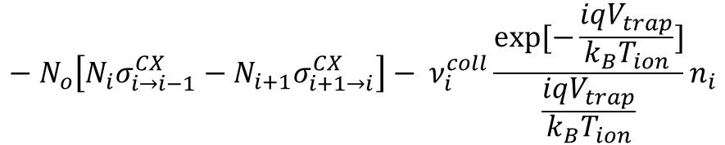
Charge breeding physics
Charge breeding in the EBIT is mainly governed by 4 processes
  Electron-impact ionization
  Radiative recombination with beam electrons
  Charge exchange (elec. capture) with residual gas (neutral)
  4. Ion escape (evaporation) from the trap
Ionization
A^{Q+}
Ionization
A^{Q+1}
Ionization
A^{Q-1}
Ionization
Recombination
Recombination
“Evaporation”
“Evaporation”
“Evaporation”
Charge state evolution described by coupled differential rate equations
Each species has its own rate equation
e-impact ionization
radiative recombination
Each ion species has a its own rate equation
In this equation that describe time variation of the population of an ion species
E-impact and rr depends on the density
$$\frac{dN_{i}}{dt}= \frac{j_{e}}{e}\left[N_{i−1}σ_{i−1→i}^{ion}−N_{i}σ_{i→i+1}^{ion}\right] + \frac{j_{e}}{e}\left[{−N}_{i}σ_{i→i−1}^{RR}+N_{i+1}σ_{i+1→i}^{RR}\right]$$
Ion “evaporation”
E-beam current density
charge ex. recombination
$${−{ N}_{o}\left[N_{i}σ_{i→i−1}^{CX}−N_{i+1}σ_{i+1→i}^{CX}\right]− ν}_{i}^{coll}\frac{exp⁡[−\frac{iqV_{trap}}{k_{B}T_{ion}}]}{\frac{iqV_{trap}}{k_{B}T_{ion}}}n_{i}$$
Trapping potential: Can bee minimized for high V _{trap}
Residual gas pressure
To a good approximation this contribution can be neglected!

Slide 21

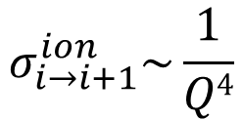

How crucial is each atomic-physics process?
Depends on the cross sections, which control the production rates of every charge state
Krypton
$$σ_{i→i−1}^{CX}\sim Q$$
Charge exchange with residual gas:
High CS but Loss rates small for low pressure
(contribution can be neglected for simplicity)
Electron-impact ionization
(E_{e}=30 keV ~ 1.7 IP)
$$σ_{i→i+1}^{ion}\sim \frac{1}{Q4}$$
Radiative recombination:
CS small for low charge states
(contribution can be neglected for simplicity)
$$σ_{i→i−1}^{RR}\sim Q^{2}$$
  To a good approximation: charge breeding dominated by e-impact ionization for high vacuum & low charge states

Slide 22



Why is the e-impact ionization cross section decreasing for high charge states ?
*E-impact cross section is function of the ionization potential, increasing for high charge states*
Electron-impact ionization cross-section:
$$σ_{EI} ∝\frac{Log[E_{e}/IP]}{E_{e} IP}$$
E_{e}: E-beam energy
IP: Ionization potential
2.7x
Another way to seen it:
Ionization threshold
The cross section depends on the ion radius:
Krypton
n=1
$$∝\frac{1}{Q^{2}}$$
$${π r}_{ion}^{2}$$
He-like Kr³⁴⁺
n=2
Ne-like Kr²⁶⁺
n=3
Ni-like Kr⁸⁺
Need lots of energy to ionize highly charged ions
~20 keV is needed to break the n=1 elec. shell
n=4

Slide 23
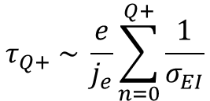

Charge breeding times
Charge breeding times are inversely proportional to the e-beam current density (j_{e}), and e-impact ionization cross sections (σ_{ΕΙ}) (neglect all other processes)
$$τ_{Q+} \sim \frac{e}{j_{e}}\sum_{n=0}^{Q+}{\frac{1}{σ_{EI}}}$$
Time for full conversion ($N_{1}$= $N_{0}\text{)}\text{,}$ assuming $j_{e}στ≪1$
1
$$\frac{dN_{1}}{dt}=N_{0} σ_{0→1} \frac{j_{e}}{e}$$
~40 s
0
Charge breeding for reacceleation mostly limited to moderate charge states: e.g, Kr²⁶⁺ , K¹⁷⁺ , etc…
~2 s
How can we reduce the CB times ?
~100 ms
Ionization cross sections are fixed atomic parameters…
The current density is a device parameter that can be optimized…
R&D program to develop e-guns of high-current & high-current density (~10⁴ A/cm²)
ReA EBIT, Average ~500 A/cm²

Slide 24
Physics of Continuous Beam Injection

Slide 25


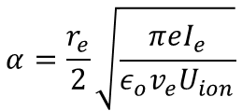



A geometrical model for the capture efficiency of continuous beam injection
Total capture efficiency:
$$P_{capture}=P_{geo}×P_{1→2}$$
(5% instead of 10% in efficiency, make a difference between one or two days of data taking of the users)
v_{x}
$$α$$
$$ε$$
Beam emittance: Area in phase-space of the ensemble of beam particles
Acceptance: Phase-space area of an ensemble of particles a device can accept
Capture
x
Geometrical eff.:
$$P_{geo}=\left\{\begin{aligned}1 , ε≤α \\ α/ε, ε>α\end{aligned}\right.$$
← Describes e-beam & injected ion beam overlap
$$α=\frac{r_{e}}{2}\sqrt{\frac{πeI_{e}}{ε_{o}v_{e}U_{ion}}}$$
EBIT acceptance:
Need high current, I_{e} & large e-beam radius, r_{e}
U
1+
Ionization probability:
$$P_{1→2}=1−exp⁡\left(−\frac{j_{e}σ_{EI}t_{rt}}{e}\right)$$
Need high density, j_{e}
(imply a small e-radius)
t_{roundtrip} ~ 50 μm
The acceptance and the ionization probability have opposite requirements!
To reach high capture efficiencies, need both: high e-beam current AND high-current density!
EBIT beam acceptance: F. Wenander et al. , REX-EBIS, Design & Simulations, CERN 1999

Slide 26



Simplified model…
  Typical ion beam emittance < 3 π mm mrad (95%, 30 keV)
  Assuming a perfect overlap between the ion and electron beams
  Acceptance > Emittance → Geometrical Eff. ~1
v_{x}
$$α$$
$$ε$$
x
  Total efficiency vs. e-beam current density
Total Eff. ~ Ionization probability
$$\sim 1−exp⁡\left(−\frac{j_{e}σ_{EI}t_{rt}}{e}\right)$$
Where is the ReA EBIT ???
… in the next slides…

Slide 27
Commissioning results

Slide 28

Three research areas we focus on to improve performance…
Charge Breeding Efficiency (Capture & Breeding Time)
Optimize the Width of the Extracted Ion Pulses
Beam Purity
(No Contamination !)

Slide 29
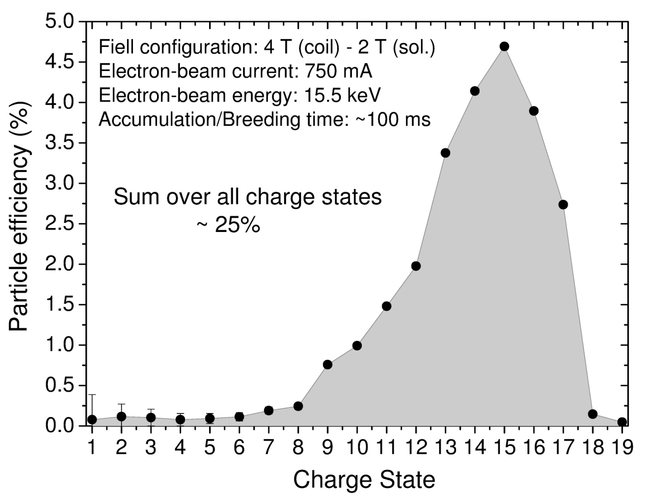
Measured charge breeding efficiency
Efficiency in single charge states of injected ³⁹K stable-isotope beams
  → Measured with a Faraday cup after Q/A separator
Field config.: 4T (H-coils)–2T (sol.)
Electron-beam current: 750 mA
Electron-beam energy: 15.5 keV
Accumulation/Breeding time ~100 ms
With careful optimization:
Up to 6% for K¹⁵⁺
Capture eff.: ~30%
Capture efficiency:
K¹⁵⁺
Does it make sense ?

Slide 30
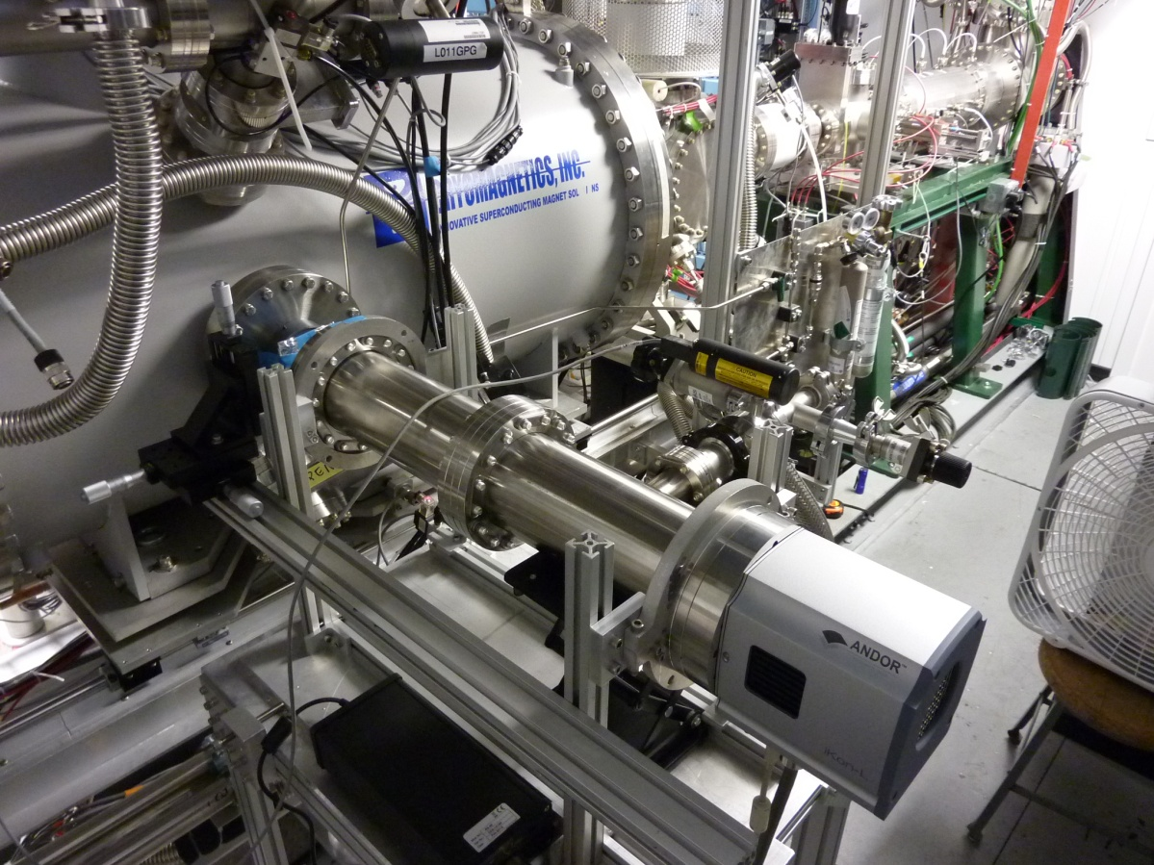
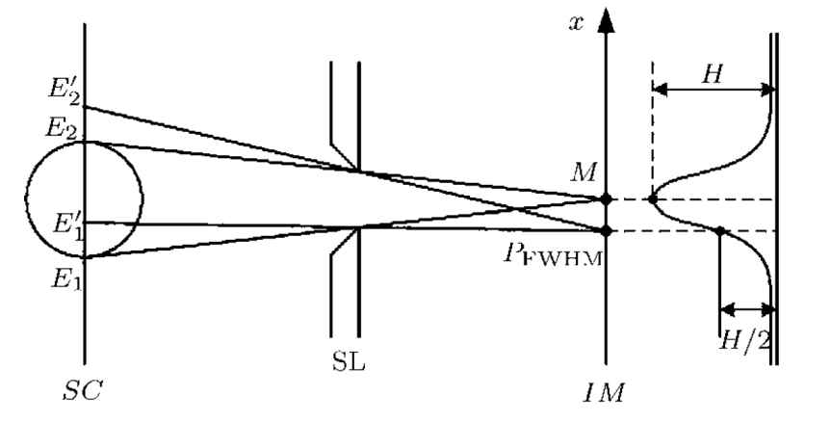
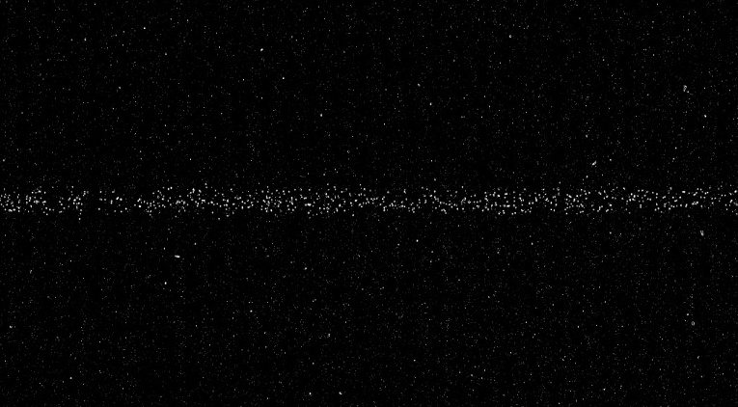

Electron-beam radius measurement and current density
  The capture efficiency of injected beams varies with the e-beam current density
  The density determined from the known current & e-beam radius →
  The e-beam radius measured by imaging x-rays emitted by trapped highly charged ions.
$$j_{e}=I_{e}/{πr}_{e}^{2}$$
X-ray pinhole camera set-up on the ReA EBIT
Projected x-ray
intensity profile
Electron beam
Slit
(Spatial filter)
EBIT
X-ray image of the electron beam
CCD chip on
the image plane
X-ray image of the electron beam
X-ray camera
  r_{e} (80%) ~ 212(19) μm for 800 mA, 4-T field (Helmholtz)
  j_{e} ~ 454(83) A/cm² (4 T)
  T. Baumann, A. Lapierre, S. Schwarz, K. Kittimanapun, D. Leitner, G. Bollen, RSI 85, 073302 (2014)

Slide 31

Calculated capture efficiency of continuously injected beams
  Av. j_{e} ~ 320 A/cm² for 2T (sol.) - 4 T(Helmholtz) field config.
  r_{e}~212 μm → Acceptance ~15 π mm mrad
  Acceptance > Emittance, Geometrical Eff. ~1
U
1+
t_{roundtrip} ~ 41 μm (K+)
Total Eff. ~ Capture Eff. by ionization
$$\sim 1−exp⁡\left(−\frac{j_{e}σ_{EI}t_{rt}}{e}\right)$$
For ~320 A/cm², we can expect at most ~30%
Agree with expt’l results!!!

Slide 32
Calculated capture efficiency of continuously injected beams
  Av. j_{e} ~ 320 A/cm² for 2T (sol.) - 4 T(Helmholtz) field config.
  r_{e}~212 μm → Acceptance ~15 π mm mrad
  Acceptance > Emittance, Geometrical Eff. ~1
How can we get to 80% ?
U
1+
t_{roundtrip} ~ 41 μm (K+)
Total Eff. ~ Capture Eff. by ionization
$$\sim 1−exp⁡\left(−\frac{j_{e}σ_{EI}t_{rt}}{e}\right)$$
For ~320 A/cm², we can expect at most ~30%
Agree with expt’l results!!!

Slide 33
Higher capture eff.: Option 1 → Higher current density
3 basic strategies to increase the capture efficiency of beam continuously injected beams
Compress electron-beam radius
Increase electron-beam current
Both: High compression (6T) & current (1.4A) → Will be investigated in the next months.
Calculated capture efficiency vs. e-beam current & radius
Eff. 30%: 330 A/cm²
Eff. 80%: 1545 A/cm²
Acceptance > Emittance
Fixed trap length: ~ 644 mm

Slide 34
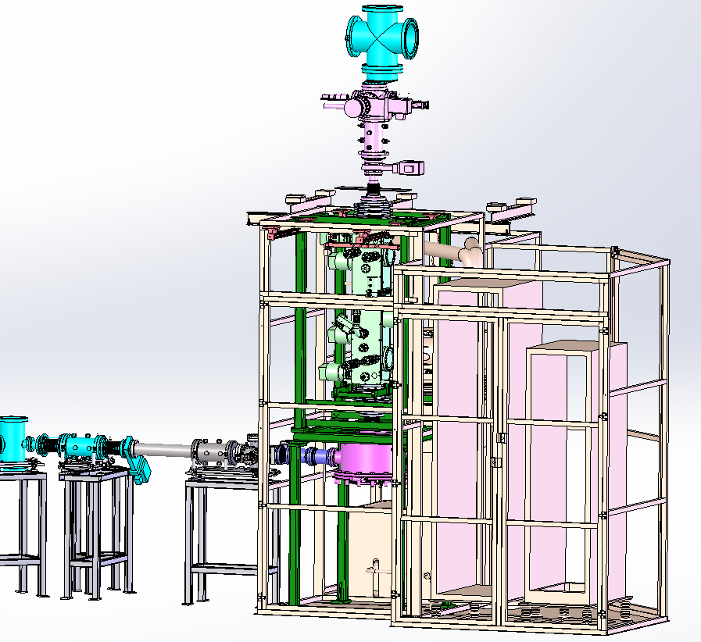
Higher capture eff.: Option 2 → Inject ion pulses
Installing Radio-frequency quadrupole (RFQ) “cooler-buncher” ion trap:
Accumulate injected beams
Produce ion pulses with a cooling gas (e.g., He)
Under installation / Start commissioning ~ Mid-Dec
Beam line for continuous injection
To EBIT
Engineering model
To ReA
Analyzing
magnet
DC beams < 60 keV

Slide 35
Higher capture eff.: Option 2 → Inject ion pulses
Pulsed injection scheme
Pulsed injection
Charge breeding
Pulsed extraction
U
U
1+
1+
1+
1+
2+
Q+
Q+
Q+
Expected capture eff. of injected beams: >90%
Expected breeding eff. in single charge states: up to ~20%
However, the “buncher” ion trap has a space-charge limit…
Max. ~10⁵ - 10⁸ ions/pulse
Max. ~ 10⁷ - 10¹⁰ ions/sec @100 Hz (~max. rate)
Not efficient for high injected beam rates.
***Still need to optimize continuous ion beam injection***
***Continuous beam injection is the best method for high beam rates expected with FRIB***

Slide 36
Time stretching of EBIT extracted pulses
  Developing schemes to spreading in time extracted ion pulses is important for efficiency detection by user’s detection systems:
→Reduce the instantaneous rate (# of ions per pulse (time) width) → Conventional pulse ~10 μs
→DAQ systems can have long dead times (~10 μs) preventing detection of all ions within a pulse.
  Extract (< 1 ms)
  Conventional
Inj. & Accu. (~100 ms)
Trap opened with a square pulse
Time
Slow ion release over ~ ms
  Slow ramp
Ramp-like pulse (AFG)
Time
~ ms
  Train (or Comb)
Time
Train of pulses with a series of successive ~μs square pulses

Slide 37
Time stretching of EBIT extracted pulses
Measured with a microchannel plate after the Q/A separator
Peak intensities normalized to 1
Width ~ 10 μs
Each pulse is ~2-μs long and contains only a few ions
Each pulses spaced by 100 μs (variable)
T. Baumann, A. Lapierre, S. Schwarz, et al. AIP Conf. Proceedings (EBIST2014 International Symposium), to be published (2015)

Slide 38


Contamination maps
Identifying contaminants is essential to eliminate them & provide rare-isotope beams of high purity
Q/A
separator
Measure beam energy after RFQ (E_{RFQ}) with Si detector
RFQ
EBIT
Krypton isotopes from injected gas
Program to map Q/A regions
$$B∝\sqrt{A/Q}$$
Separator measures the Q/A:
63Cu20+
RFQ accel. energy:
$$ERFQ=600 \left[\text{keV}\text{/}\text{u}\right]×A$$
No trace of Co, Ti, Ca here!
40Ar14+
40Ar13+
Contaminants:
Na, Cl → NaCl (fingerprint?)
Si → Aluminized mylar tape adhesive
F → Scroll-pumps: Bearing lubricant & tip seal (Teflon)
S → Dichronite UHV bearing lubricant (WS₂)
Ba, W → Dispenser cathode
All C, N, O, Ar stable isotopes → form residual gas.
38Ar13+
35Cl12+
32S10+
28Si9+
23Na8+
19F6+
16O6+
12C4+
16O5+

Slide 39
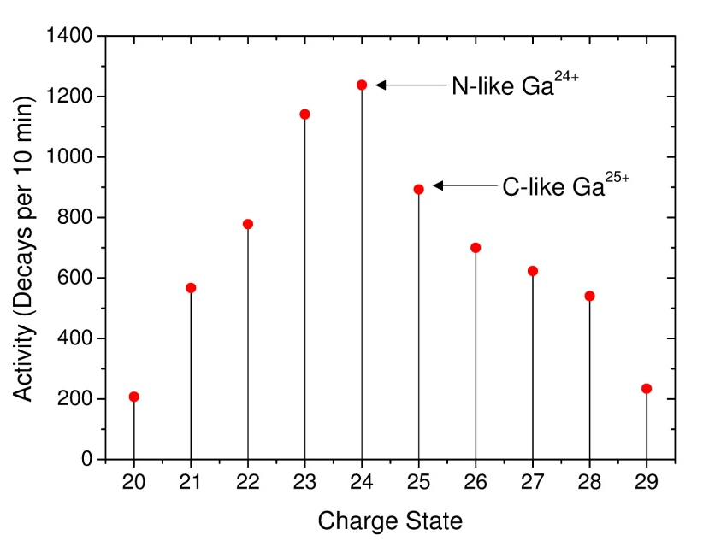
Charge breeding of rare-isotope beams
April 2013: Charge breeding of ⁷⁶Ga [t_{1/2}=33 sec]
β-decay energy spectra
Charge state distribution after Q/A separator
Q/A separator
β-activity measured
with decay counter
RFQ
EBIT
SRF cryomodules
Gas-cell stopper
Notes:
In these two figures we can see
In the right figure we have a CSD distibution …, where we can see the charge state as a function of the beta activity of the beam

Slide 40
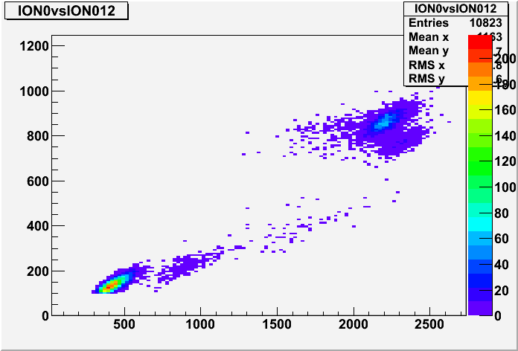
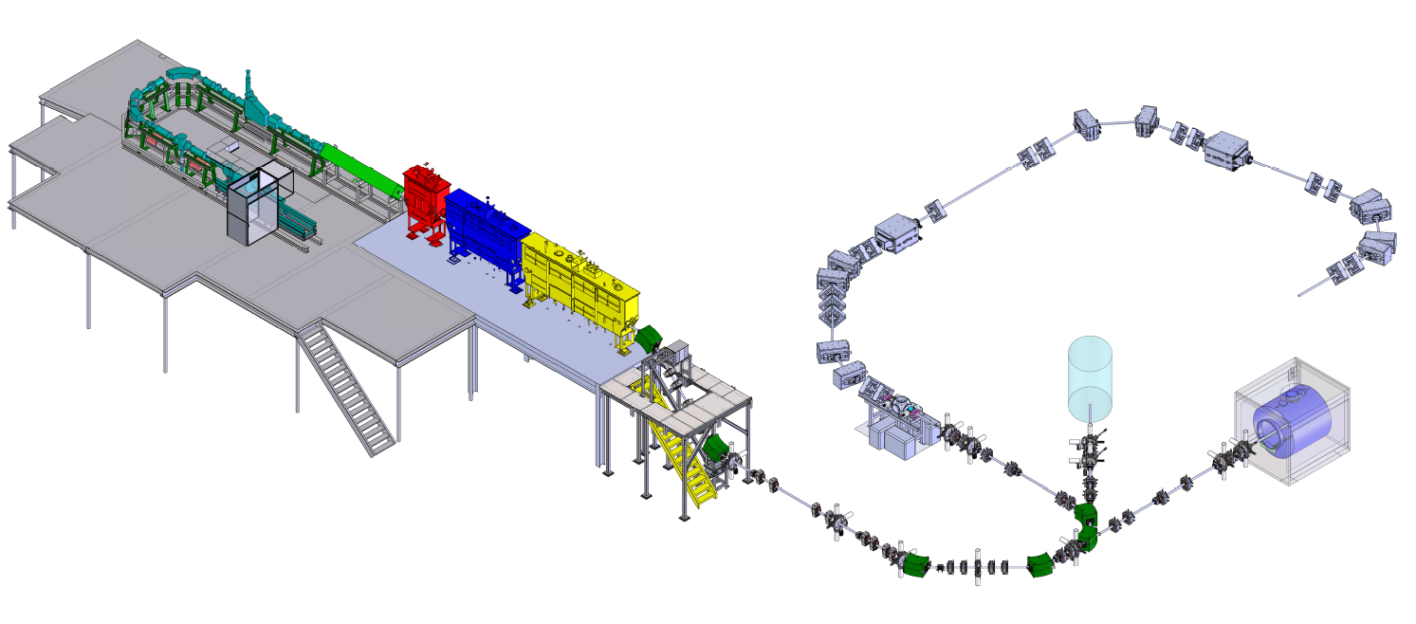
Delivery of rare-isotope beams
August 2013: First beam delivery to users for studies of nuclear reactions
ANASEN: Array for Nuclear Astrophysics Studies with Exotic Nuclei
Charge breeding and reacceleration of ³⁷K¹⁷⁺ [t_{1/2} ~1 s] to 2.3 MeV/u
Charge state distribution after Q/A separator
ANASEN gas chamber (prop. counter)
³⁷K¹⁷⁺
Rate~1000 pps
β-activity measured
with decay counter
ΔE (chan)
¹³C⁶⁺
³⁷Cl¹⁷⁺
Total E (chan)
EBIT
ANASEN

Slide 41
Summary & Outlook
  EBIT being commissioned
  ReA post-accelerator can deliver rare-isotope beams…
  Superconducting magnet failed in Jan. 2014, being repaired, expect return in Feb. 2015
  Next year, EBIT work focus on:
    Improving the charge breeding efficiencies (continuous & pulsed injection)
    Stretching the extracted pulse structure
    Improving the beam purity
    Delivering beams to users
  Early science program with rare-isotope beams next year…
Thank you.

Slide 42
Back-up slides

Slide 43
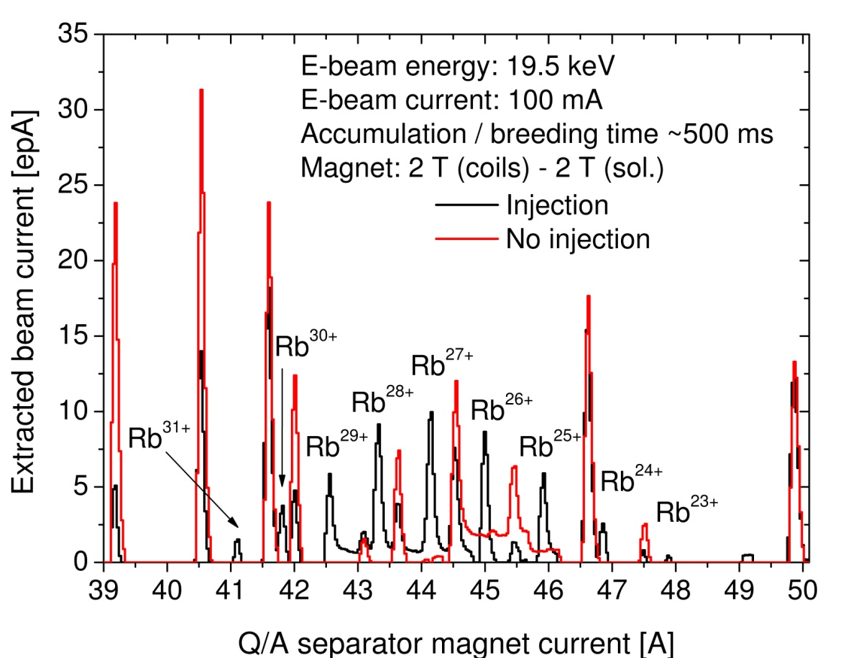
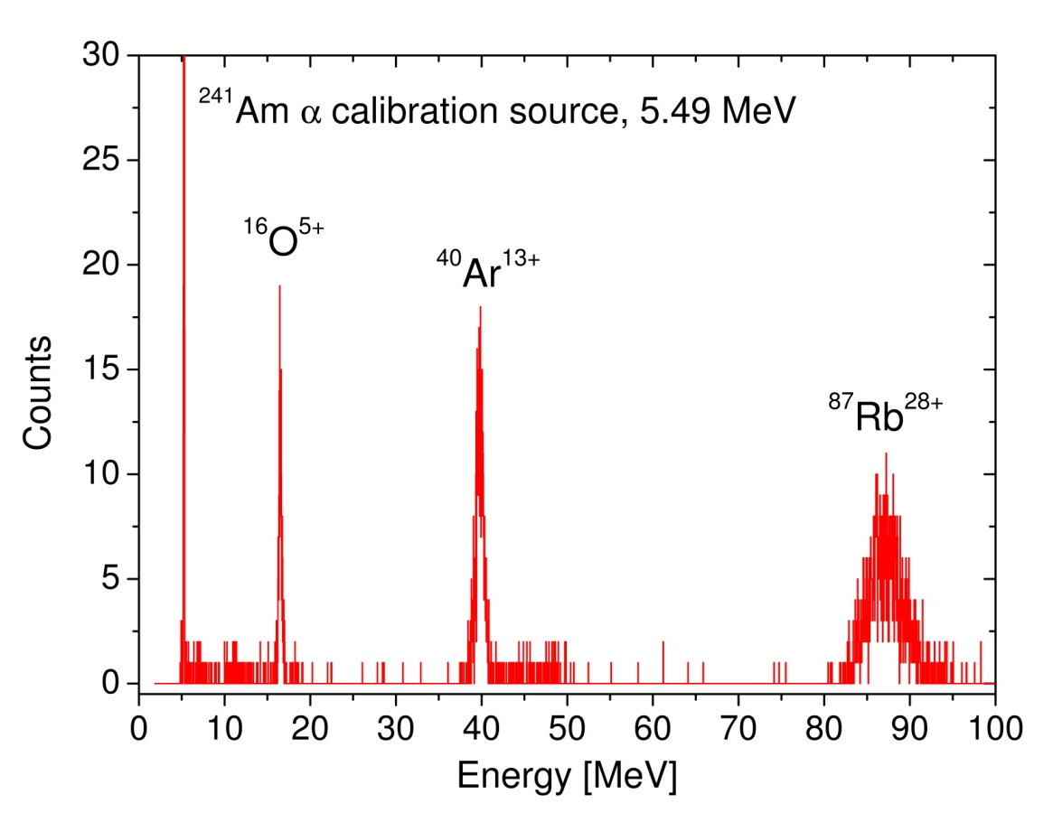
Reacceleration of stable-isotope beams
Dec. 2012: Demonstrated charge breeding of Rb⁺ stable-isotope ions from the offline source in the beam stopping area.
April 2013: Reacceleration of ⁸⁵Rb²⁷⁺ & ⁸⁷Rb²⁸⁺ with the RFQ & SRF cavities.
***First time the beam stopping area was coupled to ReA as a single unit***
Q/A spectrum of charge bred Rb
Energy spectrum of reaccelerated ⁸⁷Rb²⁸⁺ with Si detector after LINAC
Notes:
The left figure shows…
Produced from beams of residual gas in the EBIT: O and Ar
Energy spectrum of reaccelerated ⁸⁷Rb²⁸⁺ taken with a si detector after reacceleration…

Slide 44
Calculated capture efficiency
  From electron-beam size measurements, average current density, J~400 A/cm²
  For beam acceptance > injection beam emittance (ion-electron overlap), Geometrical Eff. ~1
t_{rt}~41 μm (K+)
U
Total Eff. ~ Capture Eff. by ionization = 1 - exp[-σ₁₋₂ t_{rt} J/e]
U
1+
1+
t_{rf}: Interaction time of 1+ ions with e-beam before they can exit the trap.
How can we get to 80%, at least ?
We are here !!!
This curve is telling us that for 400 A/ cm², we can only expect at most ~30%.

Slide 45
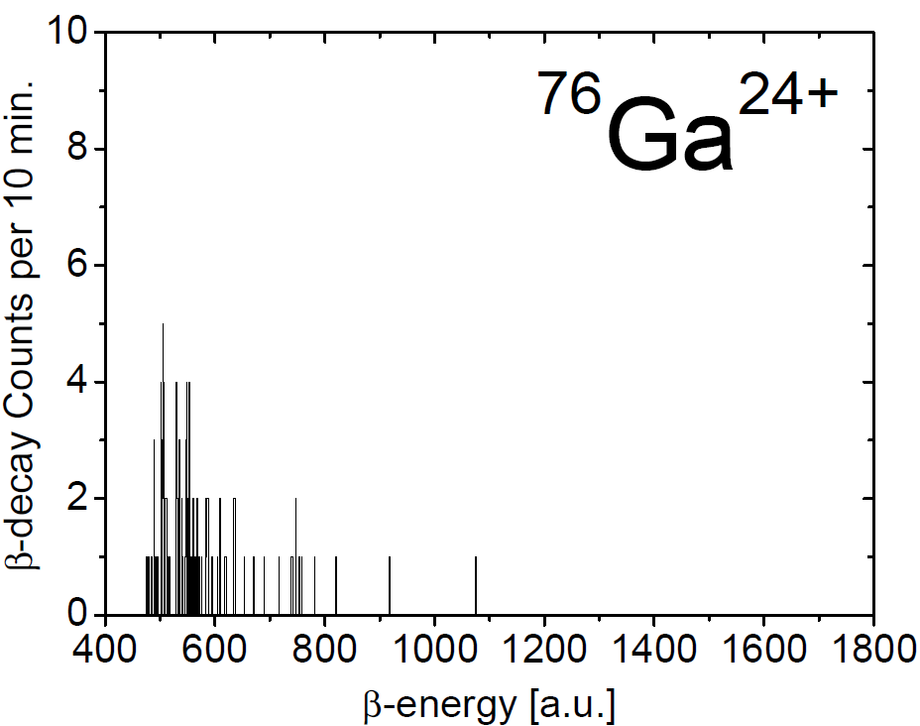
Reacceleration of rare-isotope beams
April 2013: Reacceleration of ⁷⁶Ga²⁴⁺ & ⁷⁶Ga²⁵⁺ to 1 MeV/u
β-decay energy spectrum after reacceleration
Q/A separator
β-decay counter
RFQ
EBIT
SRF cryomodules
Gas-cell stopper

Slide 46
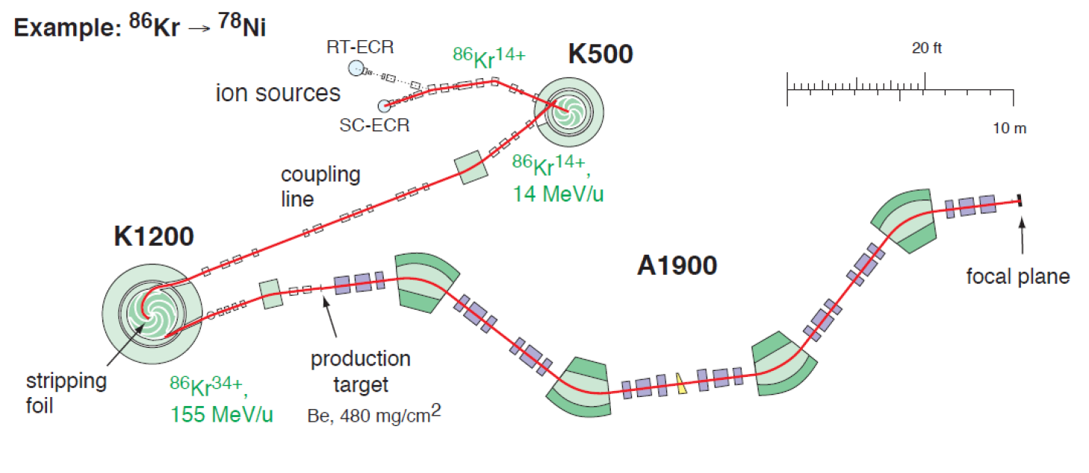
NSCL coupled SC cyclotrons

Slide 47
Capture efficiency (continuous injection) vs length of the high-field region
Full Helmholtz
(High field)
Full Solenoid
(Low field)

Slide 48
CBSIM – Charge Breeding Simulation for Kr

Slide 49

Breeding high charge states by successive ionization
Ionization cross sections depend on beam energy (E_{e}), ionization potential (I_{j}), and number of bound electrons (r_{j}) in each atomic shell j
[cm², eV]
Ionization cross section ∼ 1/q²
→ rapid decrease as
charge state increases
Electron energy (keV) | Ionization potential (keV) | Cross section (cm²) | Rate per ion (s⁻¹) at 5000 A/cm²
10 | 0.02 | ~ 10⁻¹⁷ | ~ 10⁵
200 | 130 | ~ 10⁻²⁴ | ~ 10⁻²
Time for sequential ionization to charge state n
Example: Sn(Z=50) in a 2000 A/cm² beam
∼ 150 ms to reach Ne-like Sn⁴⁰⁺

Slide 50
Contamination measurements
  Rare isotopes injected at low rates (< 10⁶ ions/sec)
  Delivering clean beams to users is important
  Program: Quantify Q/A regions the least contaminated w/ single-ion counting techniques
Q/A scans with a high-sensitivity ammeter
Many Q/A regions with a level of contamination of < 0.1 pA
To give an example how critical it is to deliver clean beam…
³⁷K¹⁷⁺ : 1000 pps.
Request < 1% of ³⁷Cl (not met)
Request < 50% for low-Z ions
Notes:
In this figure we can see peaks of the most abundant (well-known) stable isotopes of the residual gas in the ebit, but also not so adundant isotopes…
What we can say from these figures is that the level of contamination of many region is less than 0.1 pA, but than are many contaminants than can only be meaured with single-ion techniques

Slide 51
CBSIM – Charge Breeding Simulation for Kr
He-like
0
34
1
Ne-like
2
26
3
4
5
6
E_{e}=30 keV
Je =500 A/cm²
Typical charge breeding times:
Ne-like Kr²⁶⁺ ~100 ms
He-like Kr³⁴⁺ ~2s
Bare Kr³⁶⁺ ~40s

Slide 52

Commissioning results
Transverse emittance measurements with Pepperpot-meter
K¹⁸⁺ beam on MCP viewer
Emittance vs charge state
Preliminary
Notes:
E-beam character, Helmholtz coil compress e-beam, radially trap by neg space chage from e beam and radially by trap electrodes
High j rapidly increase charge states for short-lived isotopes <10ms, radial trap axial trap
MSU EBIT is different from mag field config and improved e-gun design. E-gun is mount on a plug-type connect, convenient for future upgrade
For fast charge breeding, long trap, mixing the idea of EBI s and t

Slide 53
The EBIT electron current density is key for optimizing the charge breeder efficiency for ReA
  Breeding times and capture efficiencies are directly related to the current density, which is a function of the electron-beam current and radius.
    The higher the electron-beam current density the shorter the charge breeding times and the higher the capture efficiencies of ions injected into the ReA EBIT charge breeder
where
Simulated charge-breeding time of Krypton
Calculated capture efficiency of injected 1+ ions
A. Lapierre and S. Schwarz (ReA EBIT group), ReA Department

Slide 54
A feel about the breeding time…
Ionization time to reach the population maximum
He-like Kr ~30 ms
M. W. Froese, M Master Thesis, University of Manitoba (based on R. Becker’s CBSIM program)
Note: Recombination with beam electrons and charge exchange with atoms and molecules not included

Slide 55
Capture efficiency vs. Electron-beam energy
R224
4T 0.8 501
1.28 m round trip
3 pi mm mrad

Slide 56

Delivery of rare-isotope beams
Total beam energy vs. energy loss in the ANASEN gas chamber (prop. counter)
No K beam
With K beam
³⁷K¹⁷⁺
ΔE (chan)
¹³C⁶⁺
ΔE (chan)
³⁷Cl¹⁷⁺
Total E (chan)
Total E (chan)
¹⁵N⁷⁺ ???

Slide 57

CBSIM – Charge Breeding Simulation for Kr
Similar graph, but we can see here how the charge state distribution evolves with time…
Log(t/10 [sec])
Ions distributed over a multitude of charge states (not very good…intrinsic efficiency loss)
Injection

Slide 58
Capture efficiency of continuously injected beams
Total efficiency vs. ion beam emittance
Width: Acceptance (P_{geo})
Height: Ionization probability (P_{1→2})
Small r_{e} / High current density:
High eff. for small emittances, only!
(& perfectly aligned beams)
Large r_{e} / Low current density:
Higher eff. for large emittances
(…more alignment forgiving!)
Can go away!
ReA EBIT
All EBIT breeders operating in the low-density regime → Preferred for high acceptance !
Real reason!
→ Injecting high-current e-beams (~ 1 A) into strong magnetic fields is challenging.
Current densities of ~10⁴ A/cm² has never been reached worldwide.
You don’t to remember all the equation, but you have to remember that if the electron beam is large , total = capr by ionzation

Slide 59

Expected FRIB rare-isotope yields
Current NSCL rates ≤ 10⁹ pps
FRIB will allow us to increase the current production rates by up to two orders of magnitude
Slide can go away!
Rates are available at http://groups.nscl.msu.edu/frib/rates/

Slide 60


Courtesy of R. Marrs, co-inventor of the Livermore-EBIT at the Lawrence Livermore National Lab.
What do highly charged ions look like?
Examples of one-electron atoms
Earth
The relative size of the H atoms wrt to H-like U, which has a ratio in radius of 92 and very close to the ratio of sun radius to the earth radius.
This slide also the ratio is ionization cross section which is 10000x less for H-like U91+
r_{H} / r_{U 91+} ~ 92
R_{Sun} / R_{Earth} ~ 109
Highly charged ions:
  Very high electron binding and transition energies
  Very small ionization cross sections
  Much smaller than neutral atoms

Slide 61


CBSIM – Charge Breeding Simulation for Kr
Injection
We can simulate the CB process
He-like Kr³⁴⁺
Bare
Ne-like Kr²⁶⁺
Log(t/10 [sec])
Charge breeding times:
Ne-like Kr²⁶⁺ ~100 ms
He-like Kr³⁴⁺ ~2s
Bare Kr³⁶⁺ ~40s
Ion population maximum of Ne-like Kr: trap contains a narrow charge state distribution → intrinsic loss mechanism

